Slide 1
Where are Minnesota’s Young People Moving?
Sean Williams
HRD Brown Bag January 10, 2018

Slide 2
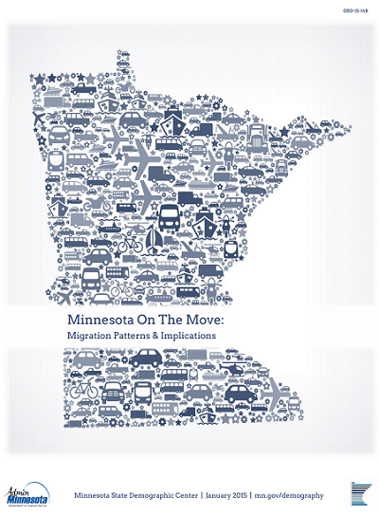
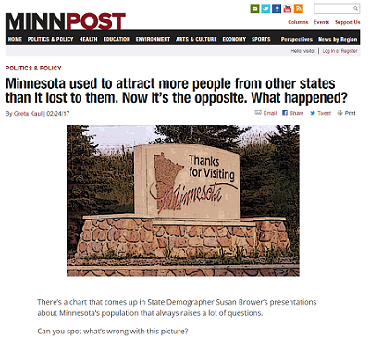
Recent interest in Domestic Migration in Minnesota

Slide 3
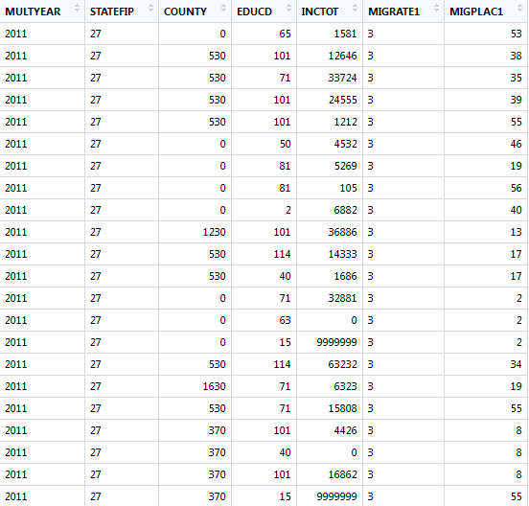
What data is available to answer these questions?
ACS 5-year sample:
273,267 Minnesotans residing in Minnesota surveyed
4,447 who moved to MN from another state
5,610 individuals who moved from MN to another state
Census Bureau Population Estimates
Not a survey—essentially last census + births – deaths + international migration

Slide 4
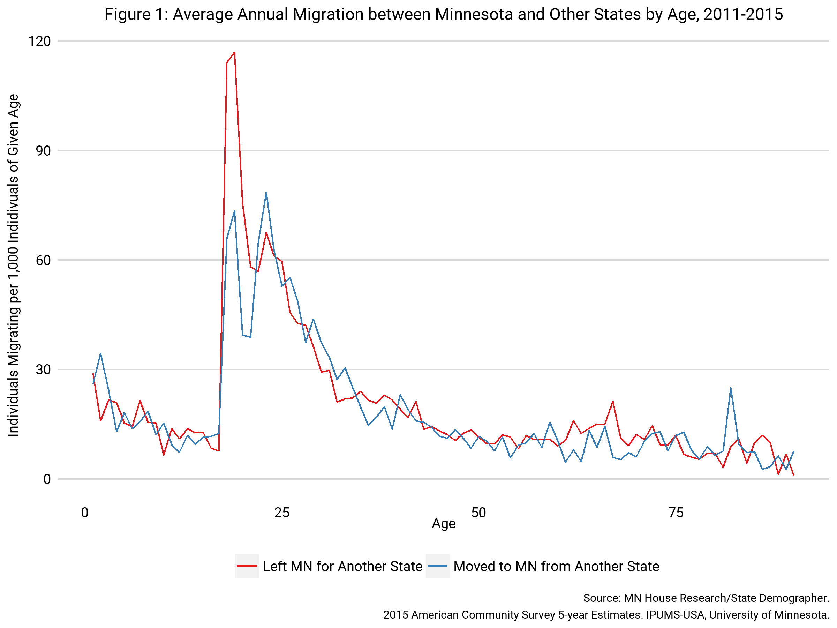
Most people who migrate domestically are in their 20s and 30s

Slide 5
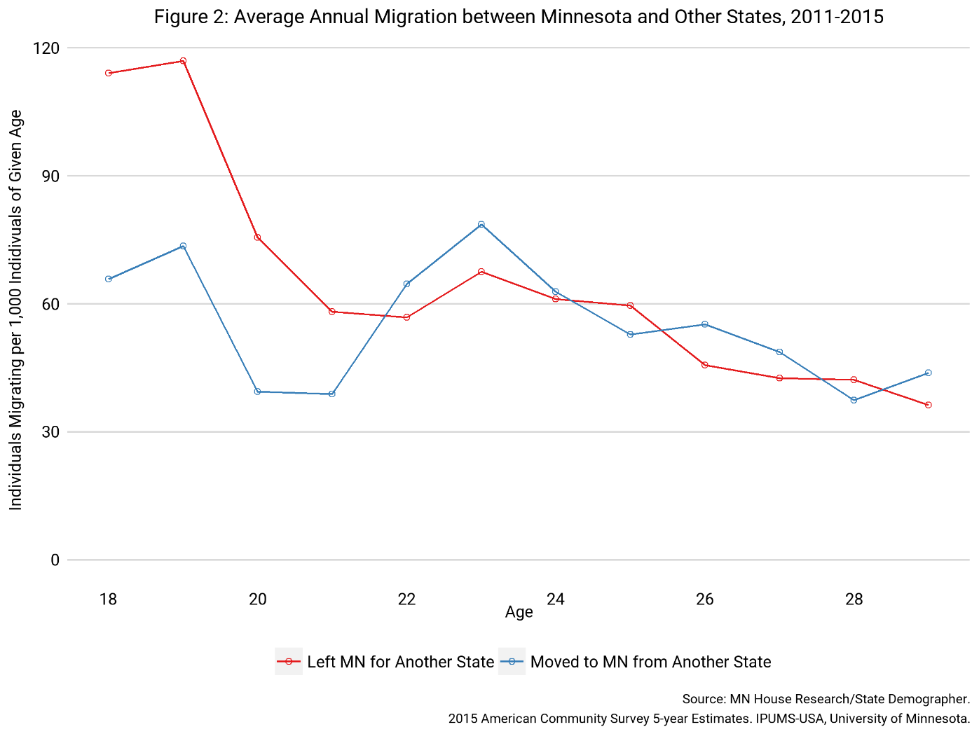
People tend to leave Minnesota in their late teens and early twenties; some return

Slide 6
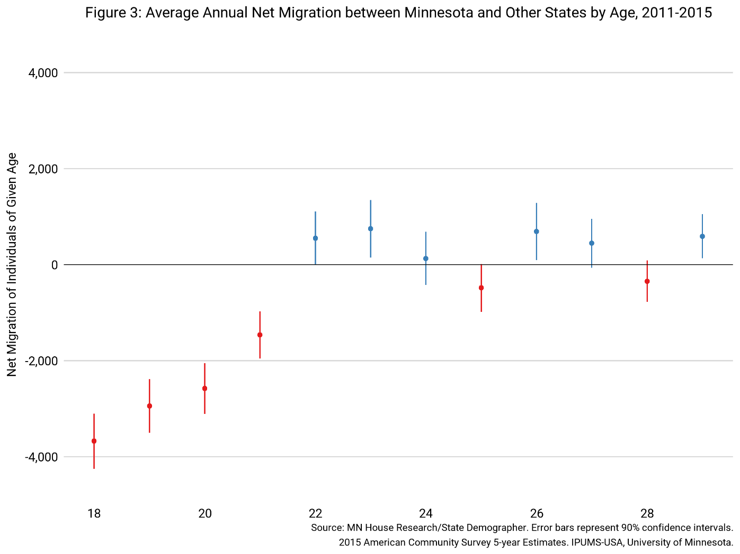
Net domestic Migration is Negative among 18- to 21-year-olds; positive among 22- to 29-year-olds

Slide 7
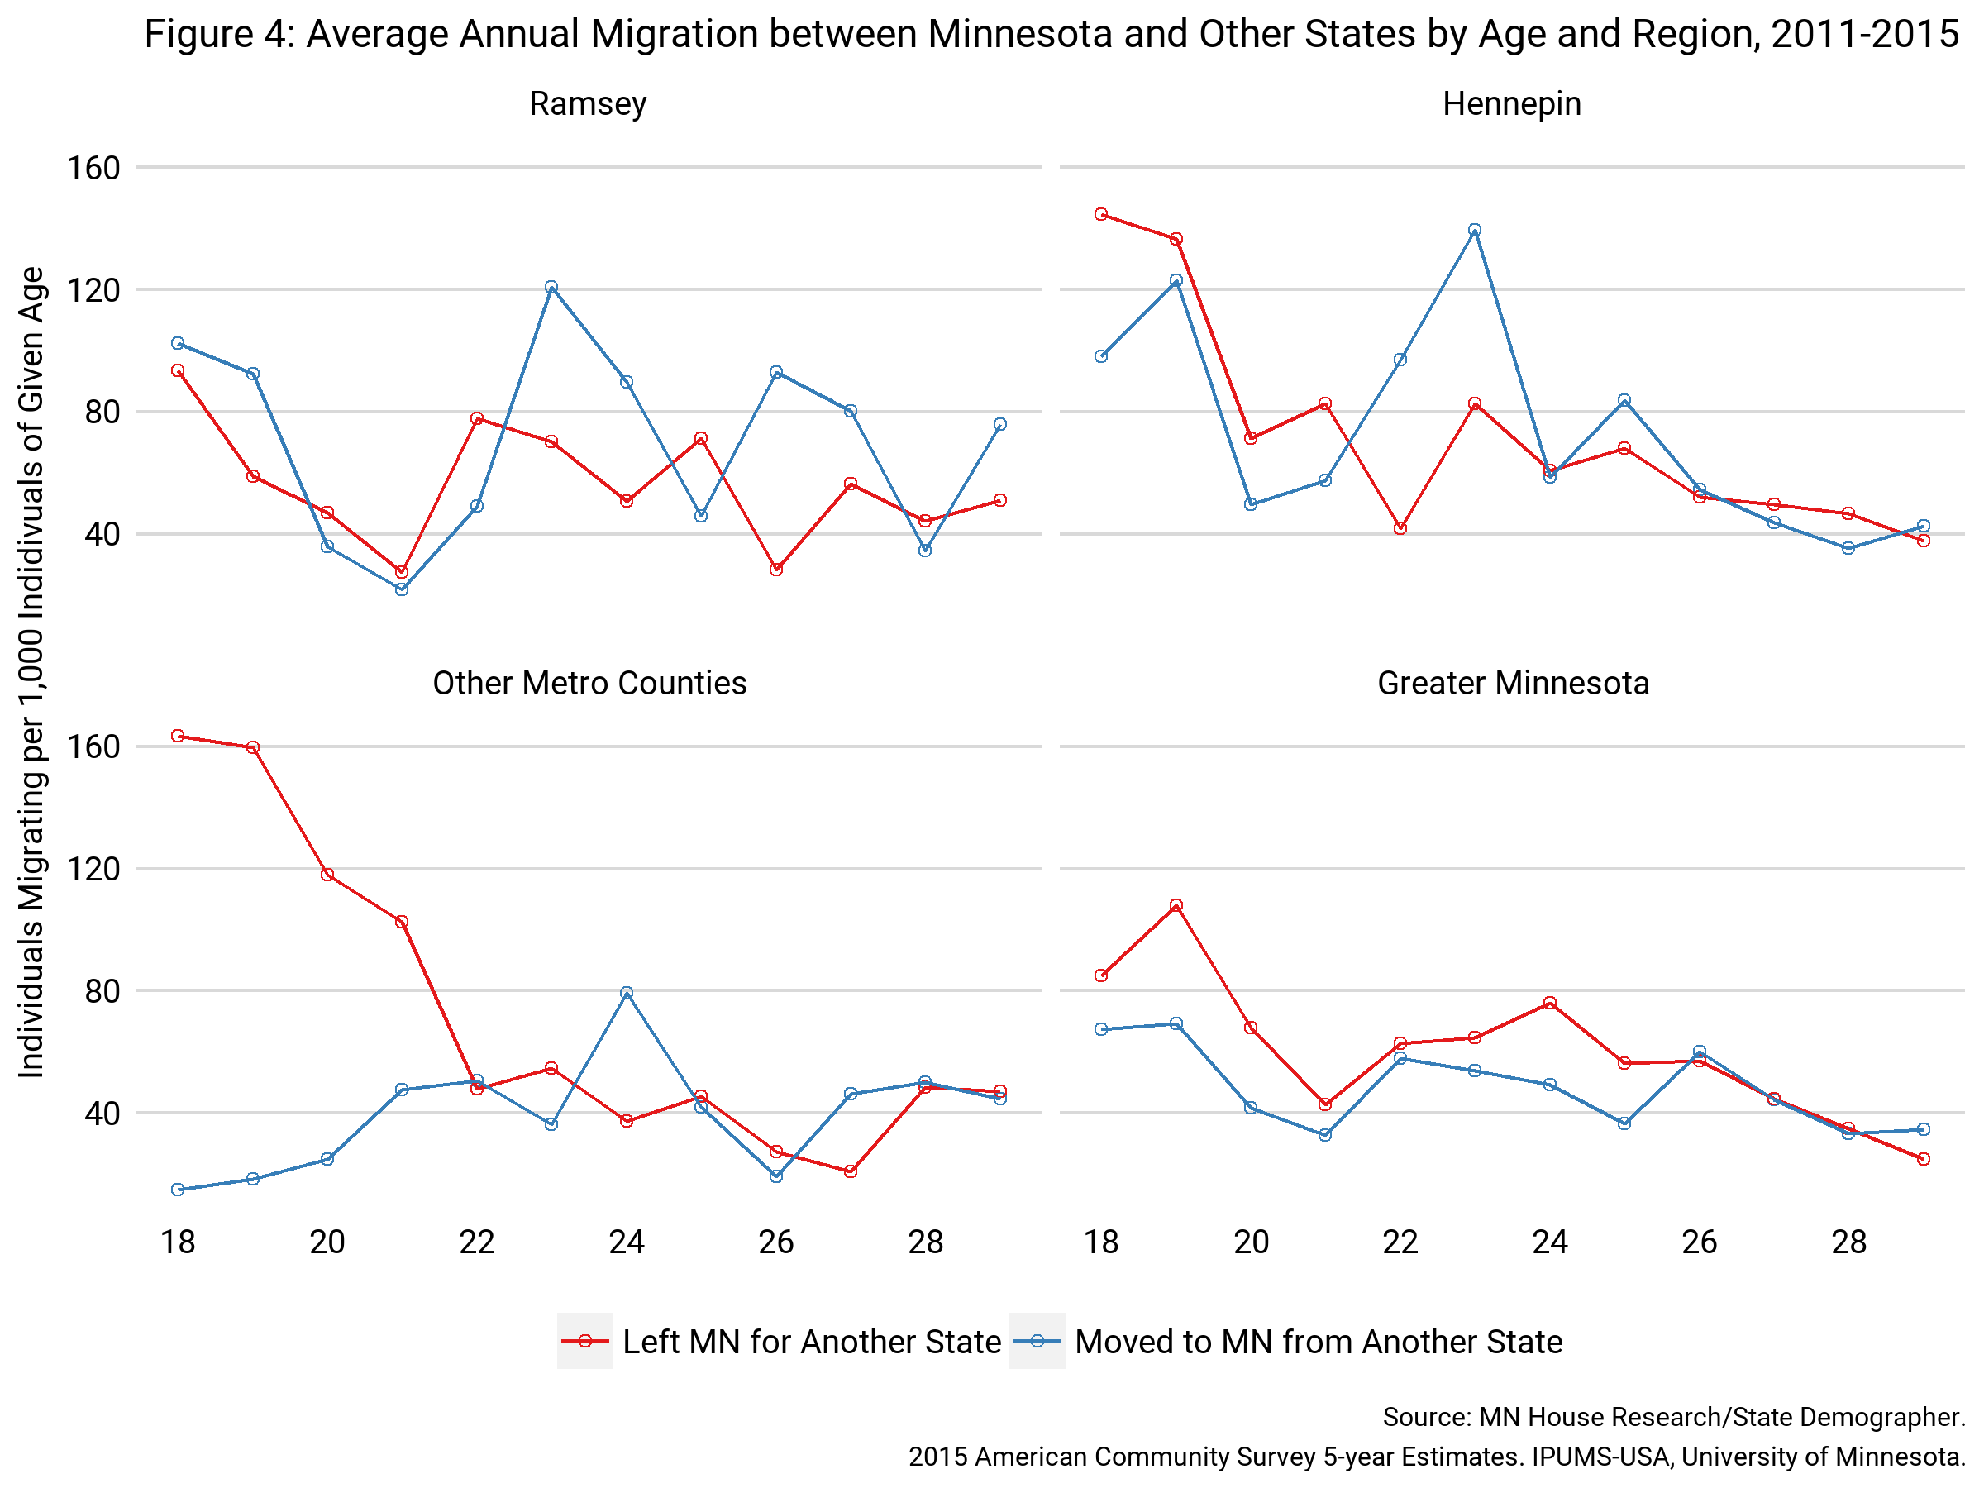
Different Regions of the State Have Different Patterns

Slide 8
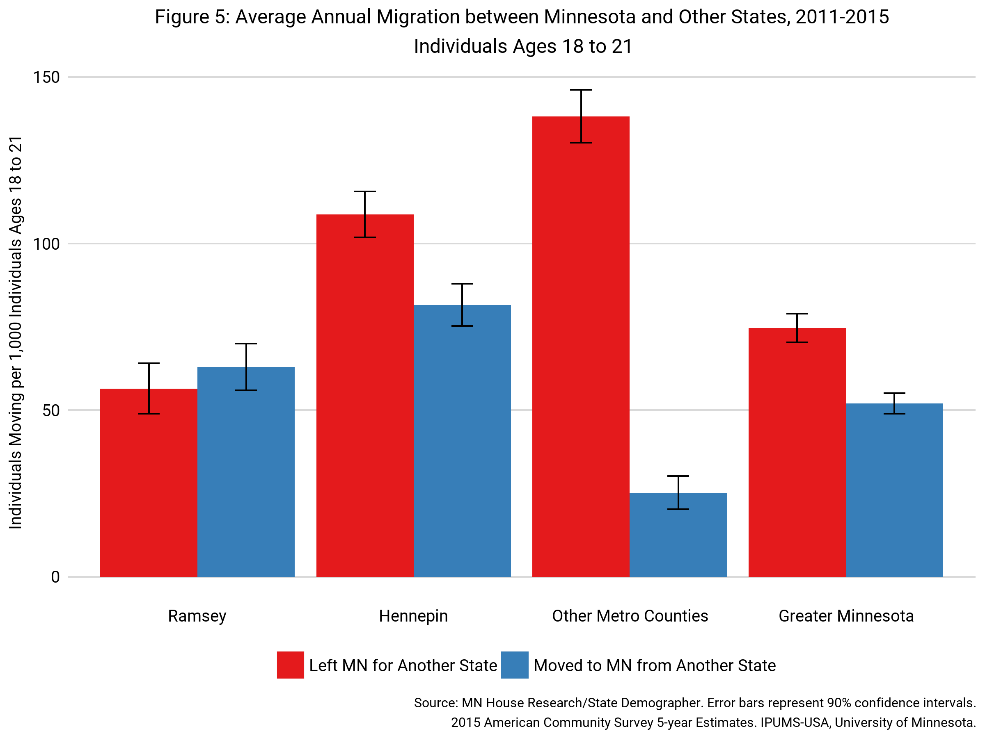
18- to 21-year-olds tend to leave “Other Metro” Counties and Greater Minnesota

Slide 9
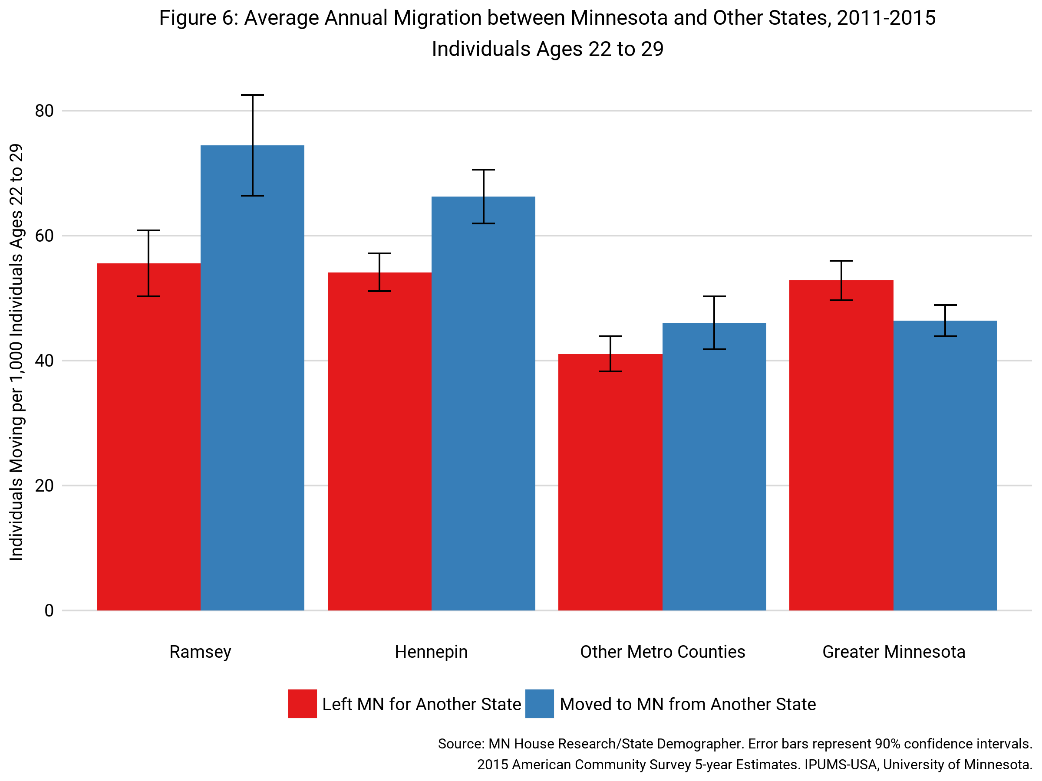
22- to 29-year olds tend to migrate to Hennepin and Ramsey County

Slide 10
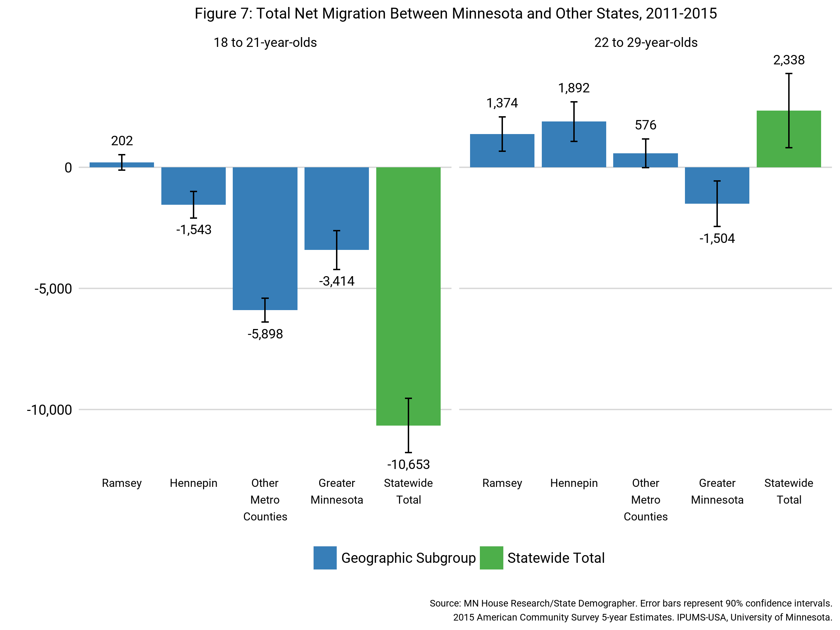
Total Net Domestic Migration by Region

Slide 11
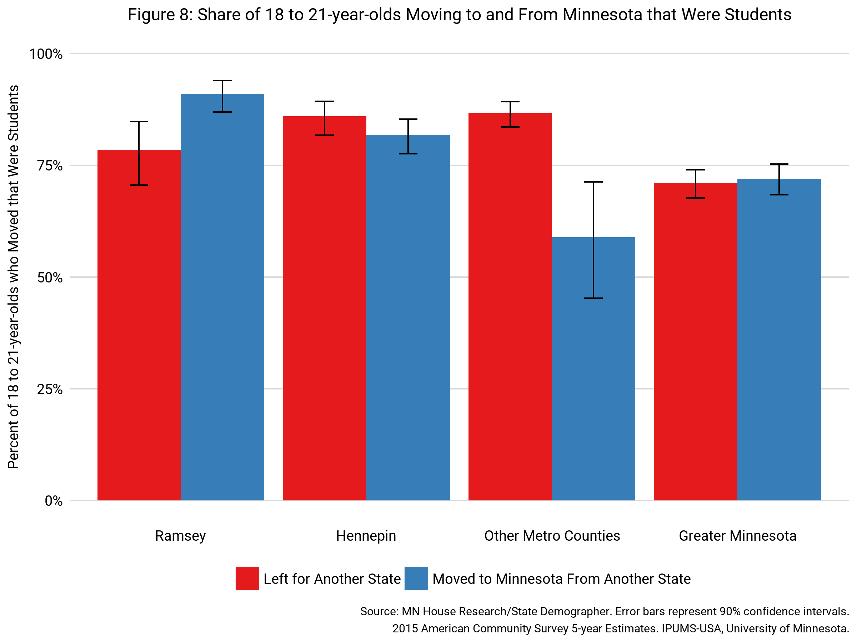
Young people leave (and arrive) in Minnesota for College

Slide 12
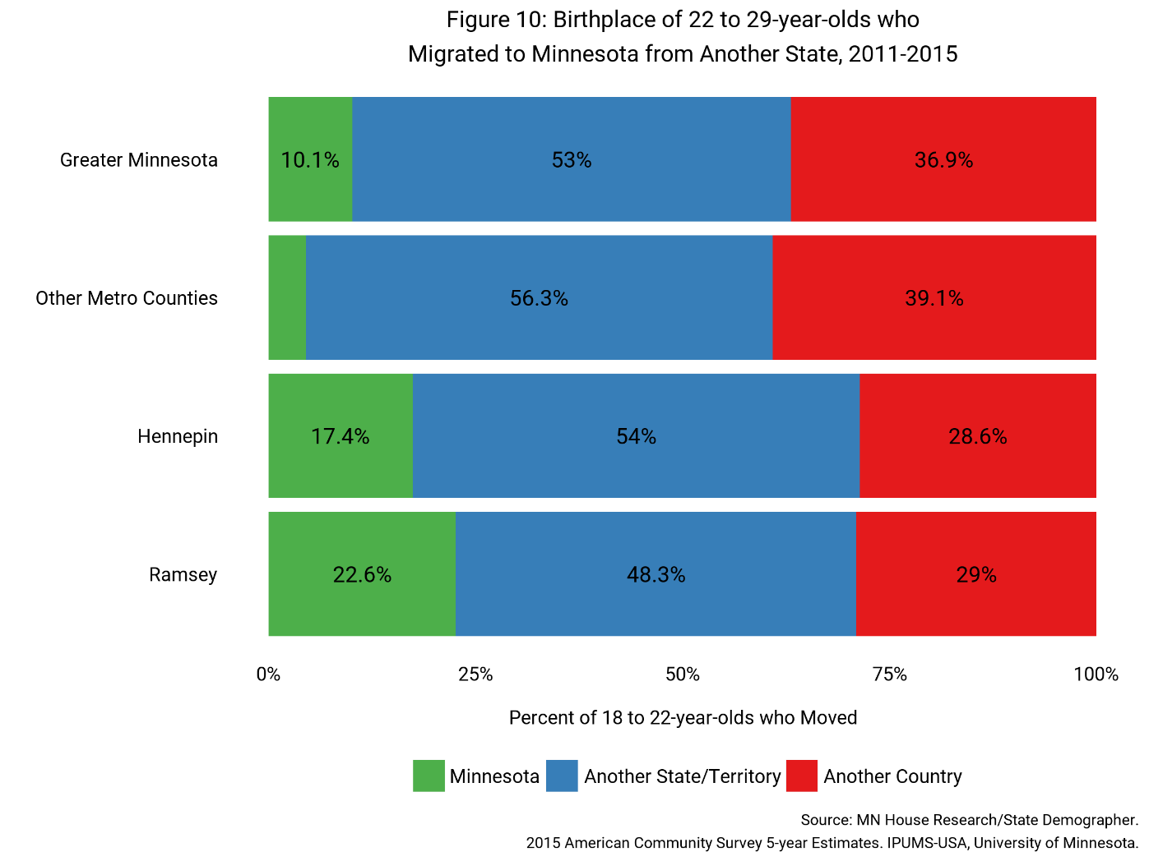
Most domestic migration to Minnesota was not return migration

Slide 13
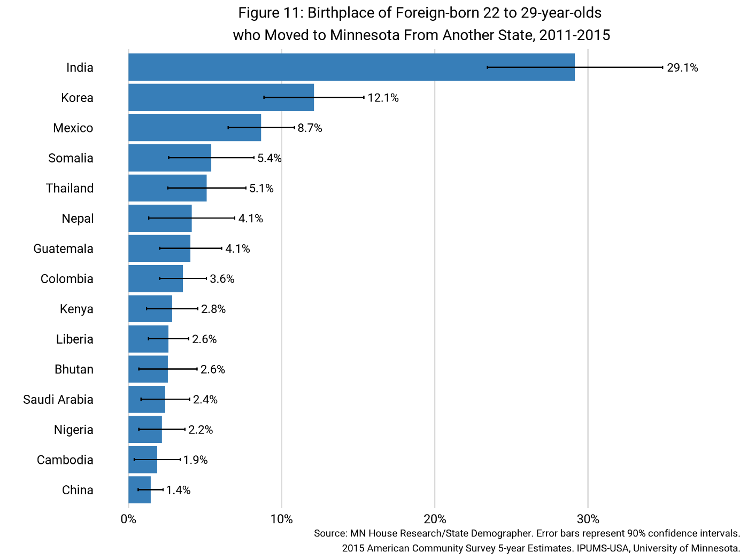
Secondary migration mostly among groups other than resettled refugees

Slide 14
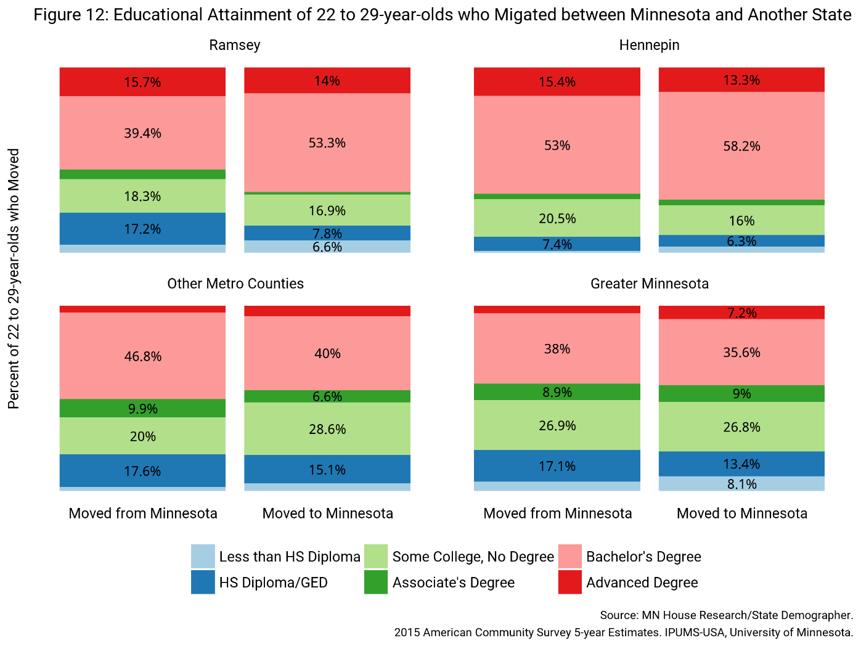
Populations moving to Hennepin and Ramsey County are better educated; other regions not so much

Slide 15
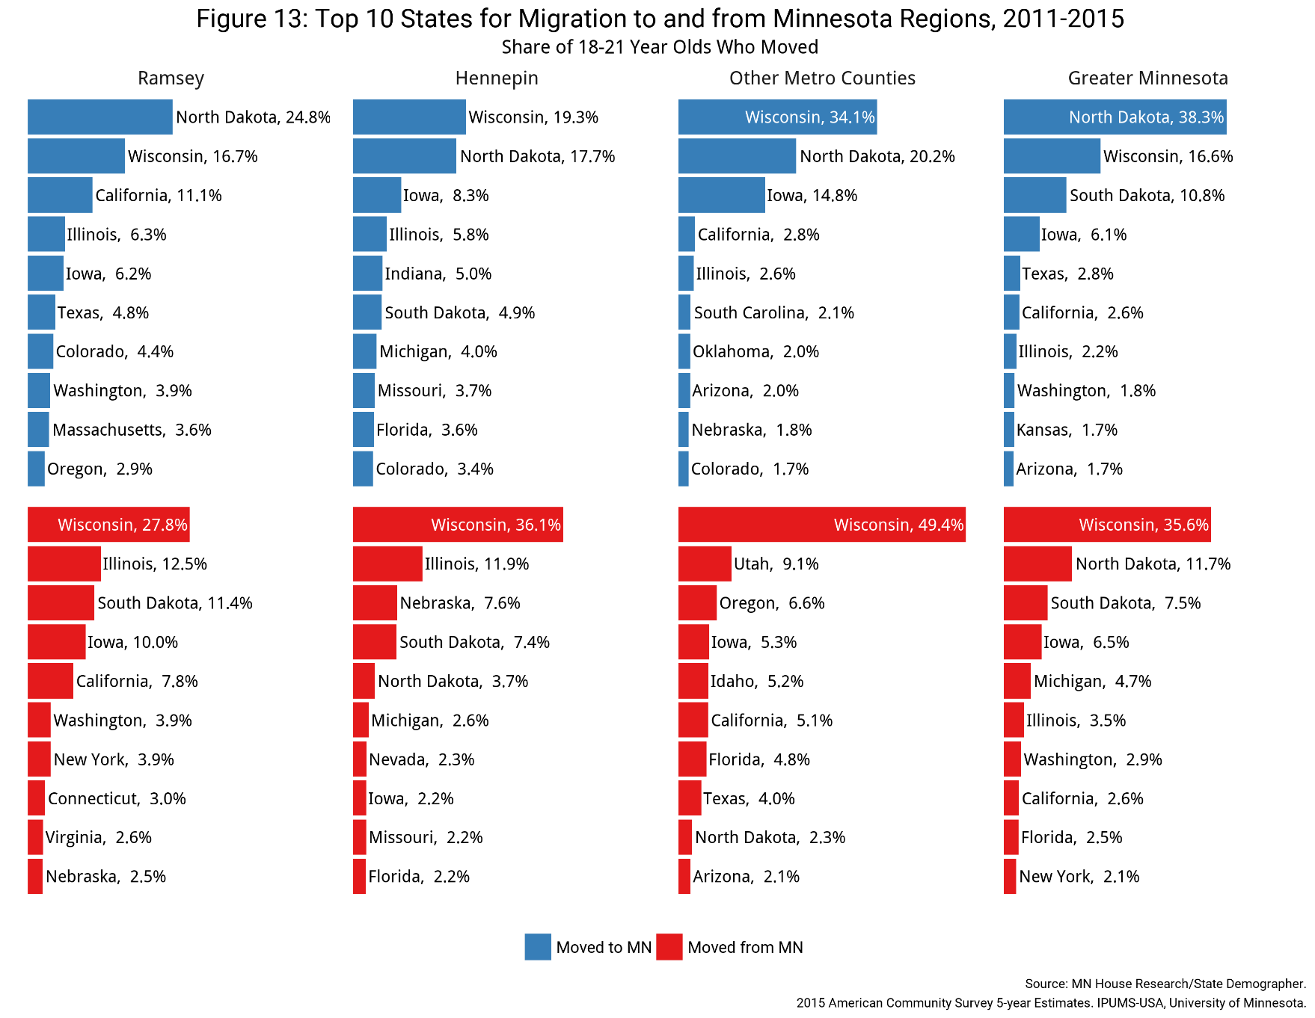
People move to (and from) nearby states

Slide 16
Policy Implications?
Reexamine tuition reciprocity
OHE reports that in fall 2015, on net Minnesota lost:
5,537 reciprocity students to Wisconsin
6,915 reciprocity students to North Dakota
2,208 reciprocity students to South Dakota
Reexamine out-of-state tuition policies
Policymakers should focus on ways to attract recent college graduates; people who move in their late 20s tend to stay. Student loan tax credit was in part inspired by the demographer’s report.

Slide 17

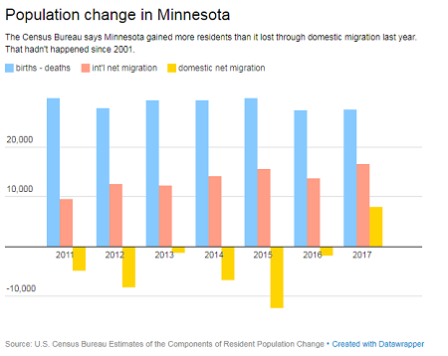
Are young people actually moving back?

