Slide 1

Notes:
[Sources]
- KSLC_Phase_1_Official_Website_Source_v2.0 (user-approved KSLC official content)
- 60b67541-3d3d-47be-8491-07ba957463ee.pptx (user-provided visual reference)

Slide 2

Notes:
[Sources]
- KSLC_Phase_1_Official_Website_Source_v2.0 (user-approved KSLC official content)
- 60b67541-3d3d-47be-8491-07ba957463ee.pptx (user-provided visual reference)

Slide 3
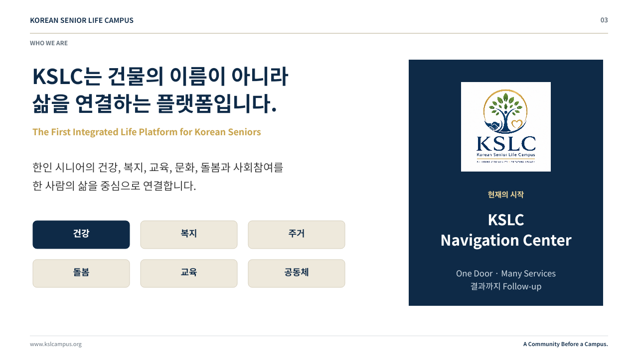
Notes:
[Sources]
- KSLC_Phase_1_Official_Website_Source_v2.0 (user-approved KSLC official content)
- 60b67541-3d3d-47be-8491-07ba957463ee.pptx (user-provided visual reference)

Slide 4
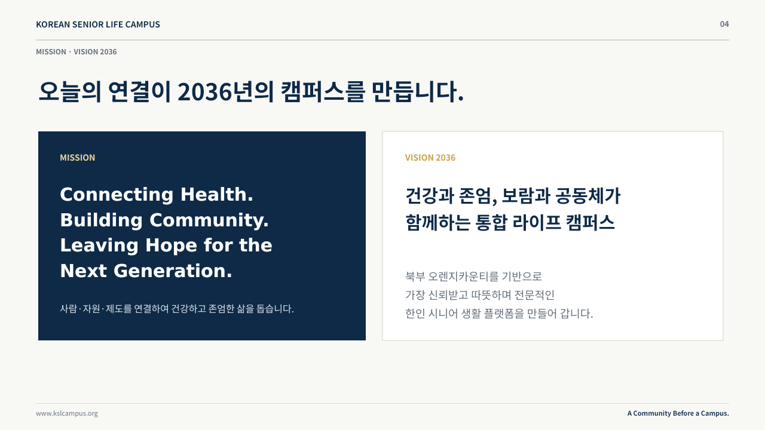
Notes:
[Sources]
- KSLC_Phase_1_Official_Website_Source_v2.0 (user-approved KSLC official content)
- 60b67541-3d3d-47be-8491-07ba957463ee.pptx (user-provided visual reference)

Slide 5
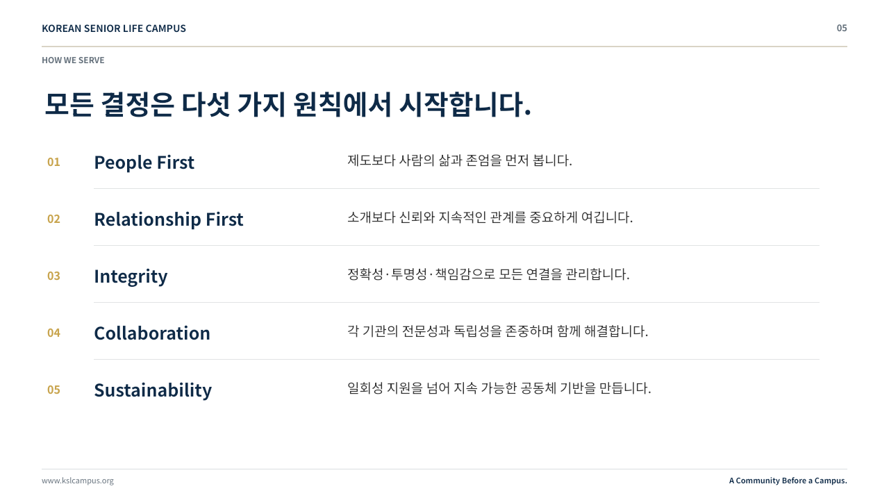
Notes:
[Sources]
- KSLC_Phase_1_Official_Website_Source_v2.0 (user-approved KSLC official content)
- 60b67541-3d3d-47be-8491-07ba957463ee.pptx (user-provided visual reference)

Slide 6
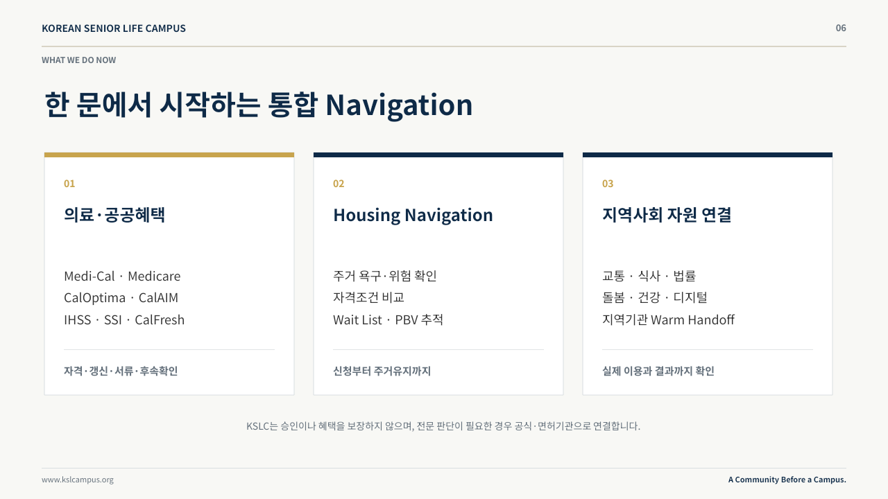
Notes:
[Sources]
- KSLC_Phase_1_Official_Website_Source_v2.0 (user-approved KSLC official content)
- 60b67541-3d3d-47be-8491-07ba957463ee.pptx (user-provided visual reference)

Slide 7
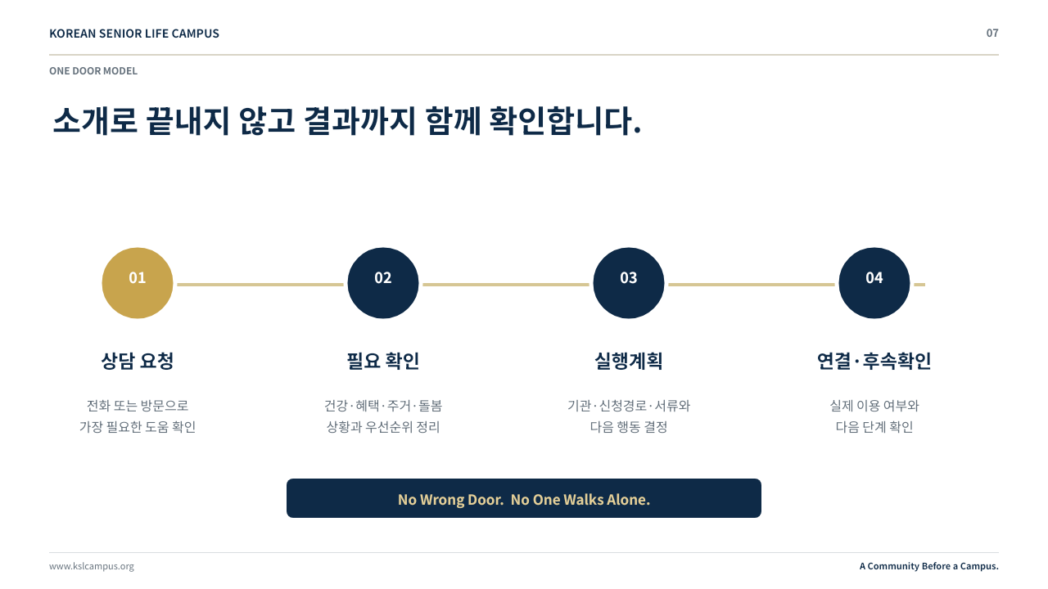
Notes:
[Sources]
- KSLC_Phase_1_Official_Website_Source_v2.0 (user-approved KSLC official content)
- 60b67541-3d3d-47be-8491-07ba957463ee.pptx (user-provided visual reference)

Slide 8
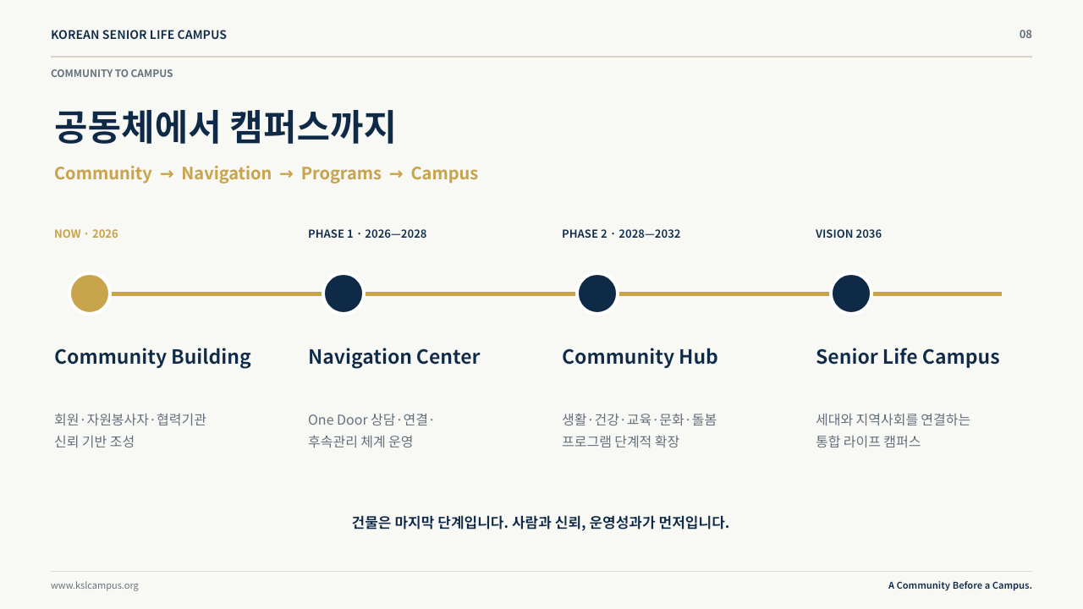
Notes:
[Sources]
- KSLC_Phase_1_Official_Website_Source_v2.0 (user-approved KSLC official content)
- 60b67541-3d3d-47be-8491-07ba957463ee.pptx (user-provided visual reference)

Slide 9

Notes:
[Sources]
- KSLC_Phase_1_Official_Website_Source_v2.0 (user-approved KSLC official content)
- 60b67541-3d3d-47be-8491-07ba957463ee.pptx (user-provided visual reference)

Slide 10

Notes:
[Sources]
- KSLC_Phase_1_Official_Website_Source_v2.0 (user-approved KSLC official content)
- 60b67541-3d3d-47be-8491-07ba957463ee.pptx (user-provided visual reference)

