Slide 1
ISP
Interface Segregation Principle
By
Sean Biefeld

Slide 2
Definition
“Clients should not be
forced to depend upon interfaces (abstractions)
that they do not use.”[1]
-Uncle Bob

Slide 3
Key Ideas
Modularity
Maximize Cohesion
Minimize Coupling
SRP Applied to Abstractions

Slide 4
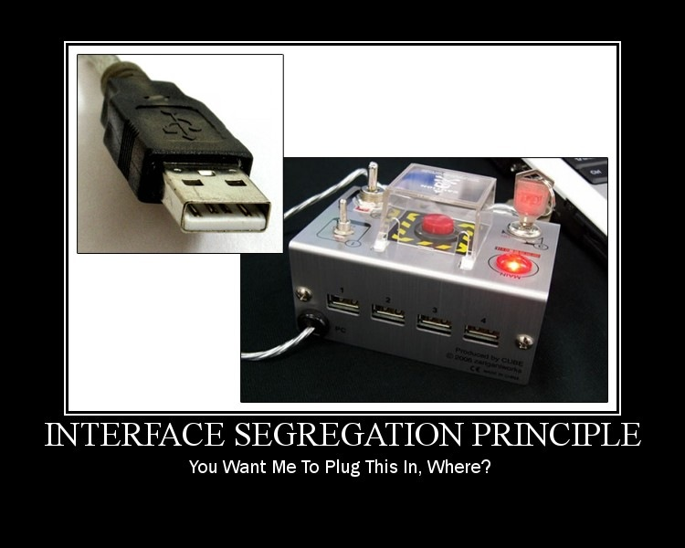
ISP in Picture Form

Slide 5
Where to Look(C#)
Abstract Base Classes
Interfaces

Slide 6
Example
Data Access Abstraction
- Get By Key
- Get All
- Update
- Add
- Delete
Users
Zip Codes

Slide 7
Identify Where to Segregate
Data Access Abstraction
- Get By Key
- Get All
- Update
- Add
- Delete
Users
Zip Codes
Queries
Commands

Slide 8
Segregated Interface
Data Access Commands
- Add
- Update
- Delete
Data Access Queries
- Get By Key
- Get All
Users
Zip Codes

Slide 9
Code

Slide 10
More Information
http://www.objectmentor.com/resources/isp.pdf
http://www.code-magazine.com/article.aspx?quickid=1001061&page=5
http://lostechies.com/wp-content/uploads/2011/03/pablos_solid_ebook.pdf

Slide 11
Bibliography
1.) The Interface Segregation Principle. Robert C. Martin, Object Mentor Inc. 1995
2.) ISP Motivational Poster. Derick Bailey, Los Techies, 2011 Creative Commons Attribution-Share Alike 3.0 United States License.

