Slide 1
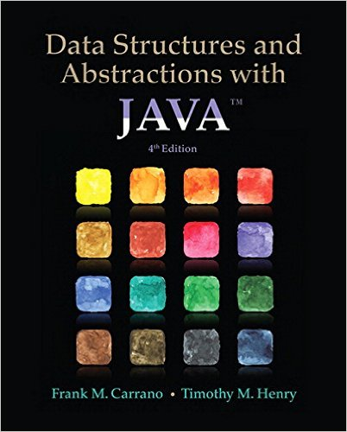
Lecture 1
Chapter 1: Bags

Slide 2
Remember…
Encapsulation?
Abstraction?
Java Interface?

Slide 3
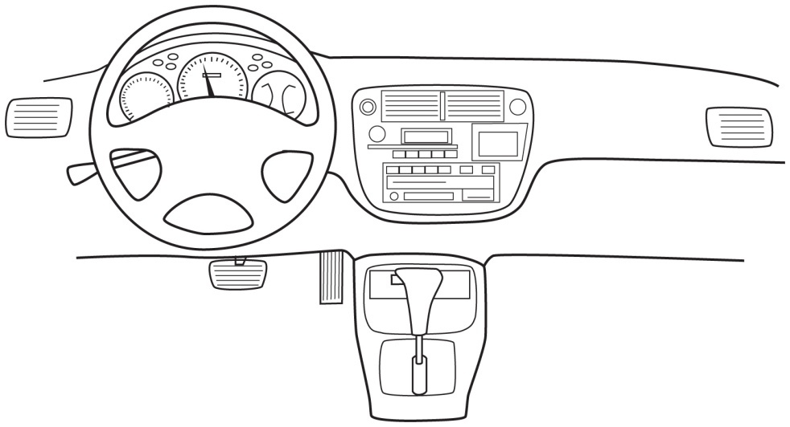
Encapsulation
Hides the fine detail of the inner workings of the class
  The implementation is hidden
  Often called "information hiding"
Part of the class is visible
  The necessary controls for the class are left visible
  The class interface is made visible
  The programmer is given only enough information to use the class
  An automobile's controls are visible to the driver, but its inner workings are hidden.

Slide 4
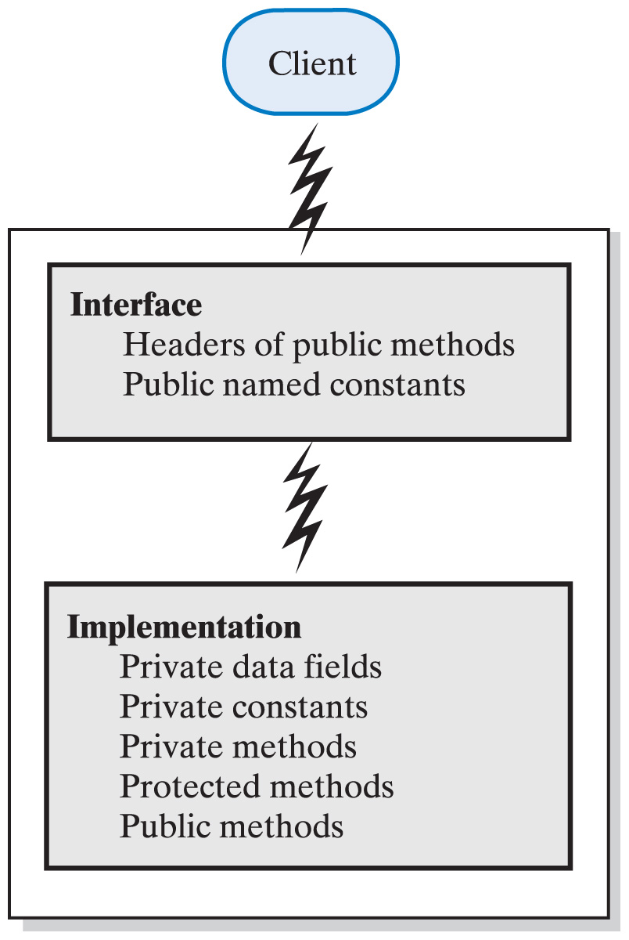
Abstraction
A process that has the designer ask what instead of how
  What is it you want to do with the data
  What will be done to the data
The designer does not consider how the class's methods will accomplish their goals
The interface is the what
The implementation is the how
An interface provides well-regulated communication between a hidden implementation and a client.

Slide 5
Class vs Object
What is the difference between a class and an object?
What is an abstract class?

Slide 6
Java Interface
A program component that contains
  Public constants
  Signatures for public methods
  Comments that describe them
Begins like a class definition
  Use the word interface instead of class
      public interface someInterface
      {
      public int someMethodOne();
      public void someMethodTwo();
      }

Slide 7
Implementing an Interface
A class that implements an interface must state so at start of definition with implements clause
The class must implement every method declared in the interface
Multiple classes can implement the same interface
A class can implement more than one interface
      public class myClass extends someClass
      implements someInterface, anotherInterface

Slide 8
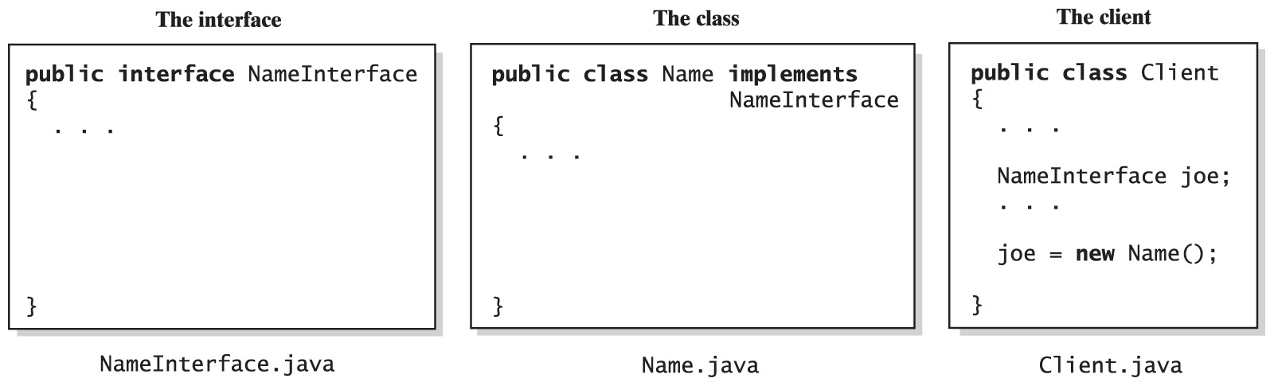
Implementing an Interface
The files for an interface, a class that implements the interface, and the client.
NOTE: an interface can be used as a data type
As a result joe object will not be able to utilize methodC, which makes Client.java independent from implementation
methodA();
methodB();
methodA()
{…}
methodB()
{…}
methodC()
{…}

Slide 9
Java Interface and Generics
See the following example that does not use generics:
    ArrayList myIntList = new ArrayList(); // 1
    myIntList.add(new Integer(0)); // 2
    …
    Integer x = (Integer) myIntList.get (0); // 10
  Typically, the programmer knows what kind of data has been placed into a particular list. However, the cast on line 10 is essential as the compiler can only guarantee that an Object will be returned. To ensure the assignment to a variable of type Integer is type safe, the cast is required.
What if programmers could actually express their intent, and mark a list as being restricted to contain a particular data type? This is the core idea behind generics. Here is a version of the program fragment given above using generics:
    ArrayList<Integer> myIntList = new ArrayList<>(); // 1'
    myIntList.add(new Integer(0)); // 2’
    …
    Integer x = myIntList.get(0); // 10'
  Notice the type declaration for the variable myIntList. It specifies that this is not just an arbitrary ArrayList, but an ArrayList of Integer. We also specify a type parameter when creating the list object.
  Note, that the cast on line 10' is gone as the compiler can now check the type correctness of the program at compile-time. When we say that myIntList is declared with type Integer, this holds true wherever and whenever myIntList is used, and the compiler will guarantee it. In contrast, the cast tells us something the programmer thinks is true at a single point in the code.
No cast needed

Slide 10
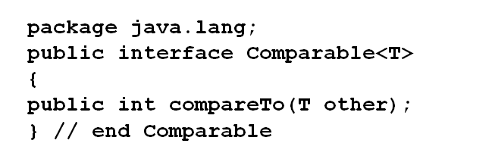
Java Interface and Generics
For example recall that method compareTo compares two objects, say obj1 and obj2
  Returns signed integer:
    Returns negative if obj1 is smaller than obj2
    Returns zero if obj1 is the same as obj2
    Returns positive if obj1 is greater than obj2
  Defined in interface Comparable:
  Any class that has compareTo method implemented must indicate so with implements keyword for the compiler to “see” it:
      public class myClass implements Comparable
What is <T> ?

Slide 11
Extending an Interface
Use inheritance to derive an interface from another interface
When an interface extends another
  It has all the methods of the inherited interface
  Also include some new methods
A Java interface can be derived from several interfaces, even though you cannot derive a class from several classes

Slide 12
Interfaces versus Abstract Classes
Purpose of interface similar to purpose of abstract class
But … an interface is not a base class
  It is not a class of any kind
Use an abstract base class when
  You need a method or private data field that classes will have in common
Otherwise use an interface

Slide 13
Named Constants Within an Interface
An interface can contain named constants
  Public data fields initialized and declared as final
Consider an interface with a collection of named constants
  Then derive variety of interfaces that can make use of these constants

Slide 14
Choosing Classes - Example
Imagine that we are designing a registration system for our school. Where should we begin?
Look at a prospective system from a functional point of view
Ask
  What or who will use the system
    A human user or a software component that interacts with the system is called an actor
  What can each actor do with the system
  Which scenarios involve common goals
    A collection of such related scenarios is called a use case
Design a use case diagram

Slide 15
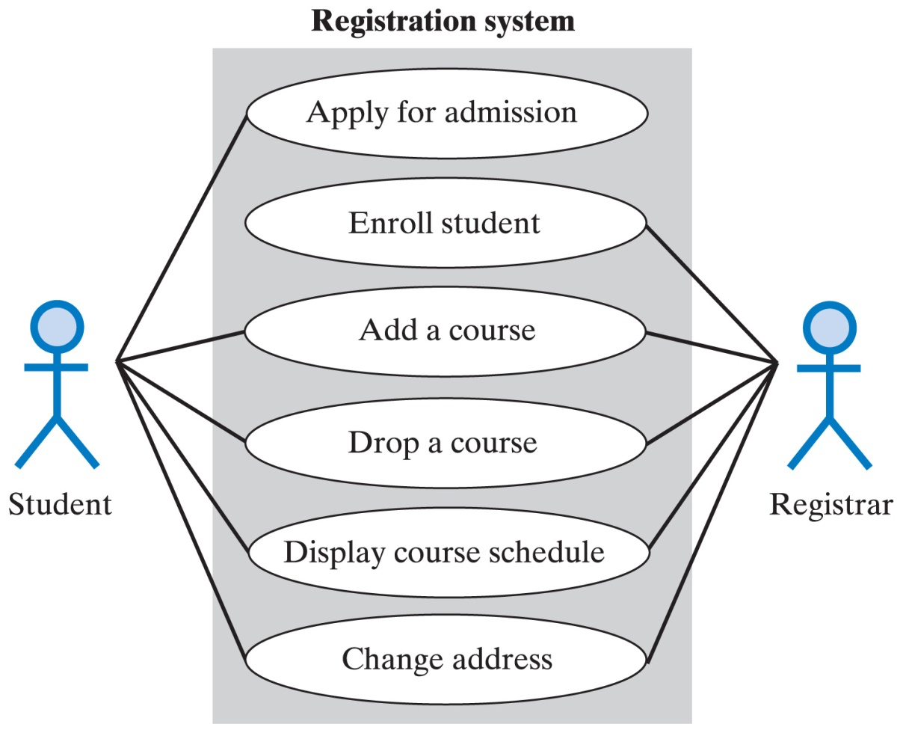
Choosing Classes
A use case diagram for a registration system:

Slide 16
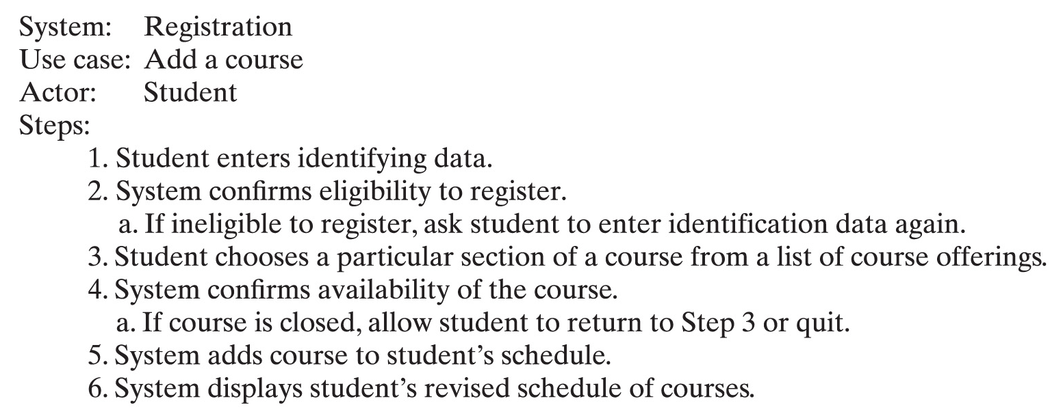
Identifying Classes
A description of a use case for adding a course:

Slide 17
Identifying Classes
Describe the system
  Identify nouns and verbs
    Nouns suggest classes
      Students
      Transactions
      Customers
    Verbs suggest appropriate methods
      Print an object
      Post a transaction
      Bill the customer

Slide 18
Specifying Methods
Specify what each method does
Precondition
  Defines responsibility of client code
Postcondition
  Specifies what will happen if the preconditions are met
Responsibility
  Precondition implies responsibility for guarantee of meeting certain conditions
Where to place responsibility
  Client? or …
  Method?
Best to comment this clearly before method's header
  Also good to have method check during debugging

Slide 19
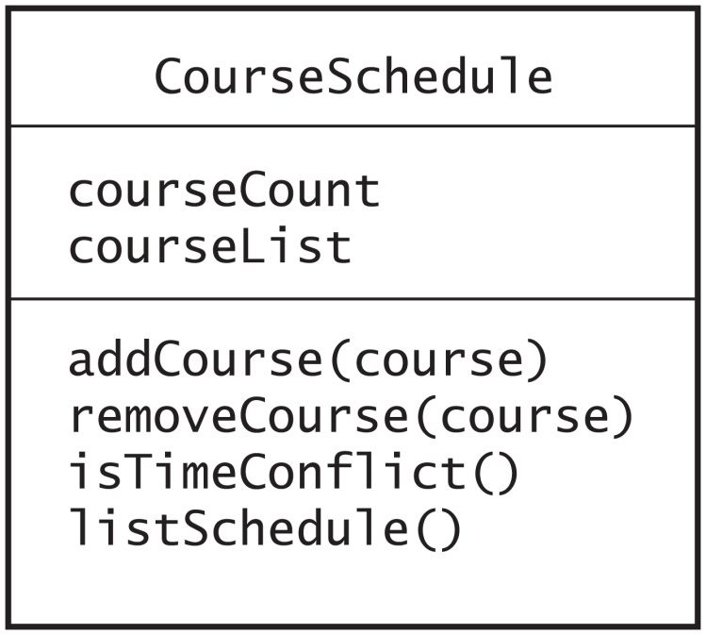
Unified Modeling Language
UML is used to illustrate system's classes and relationships
Provides a class diagram
  Class name
  Attributes (data members)
  Operations (methods)

Slide 20
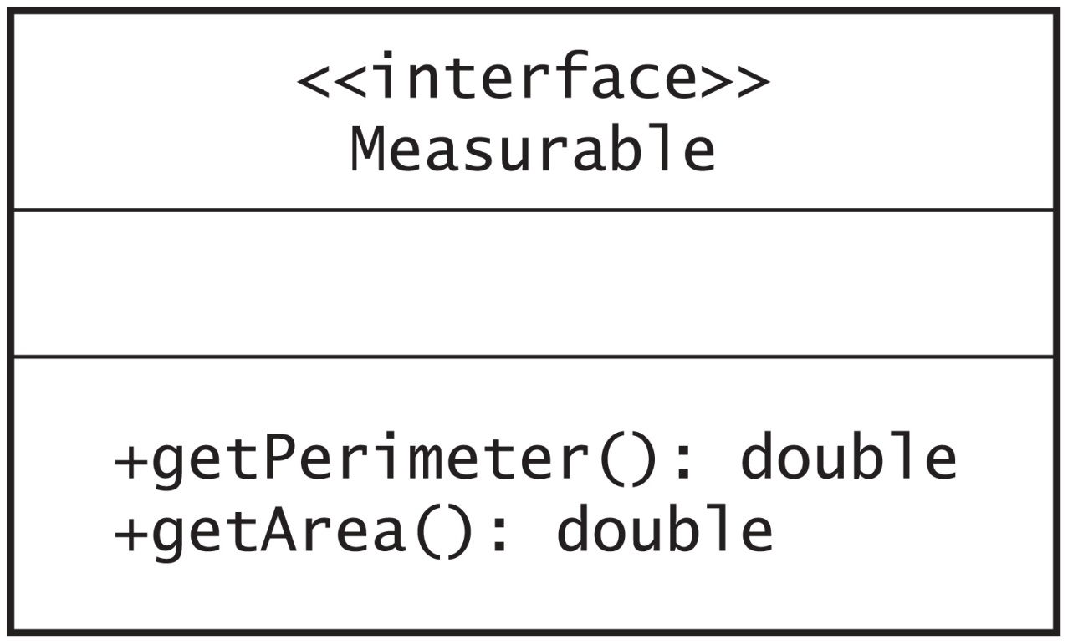
Unified Modeling Language
UML notation for an interface Measurable

Slide 21
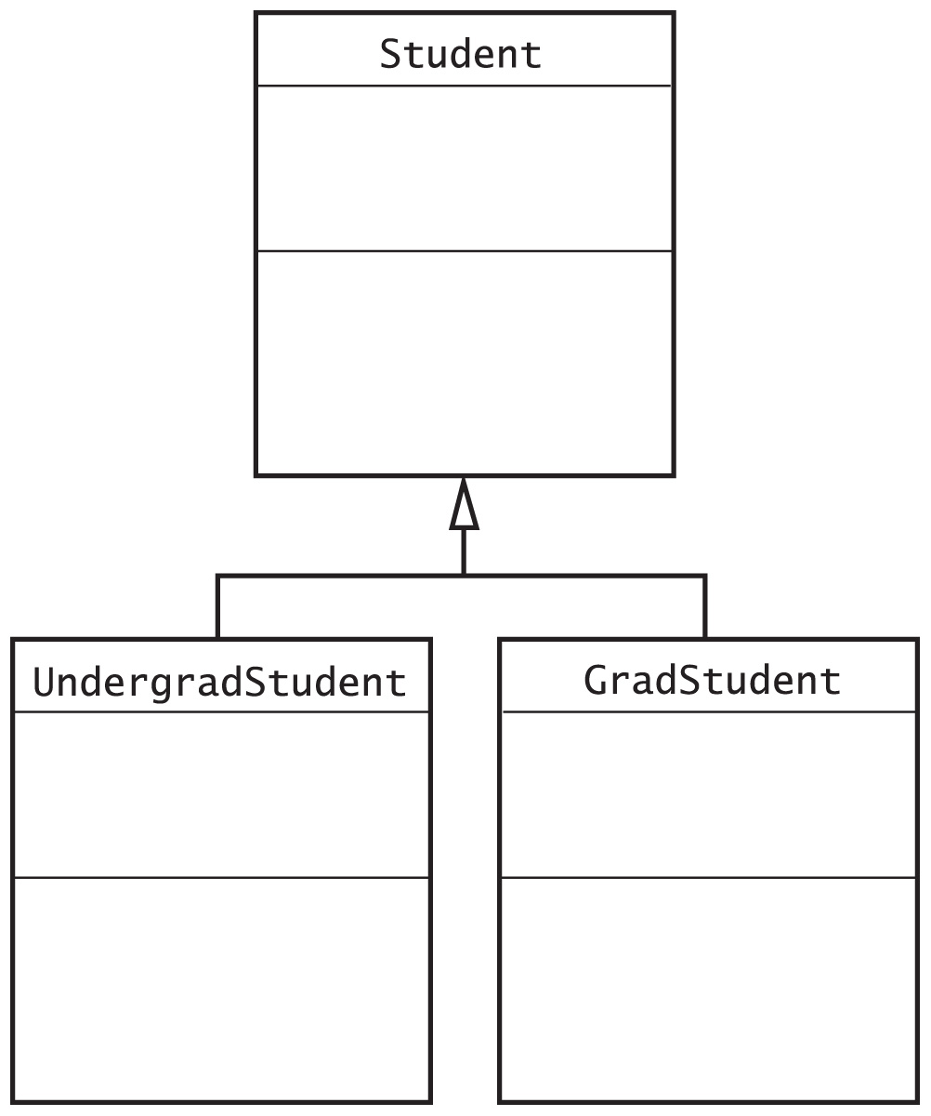
Unified Modeling Language
A class diagram showing the base class Student and two derived classes

Slide 22
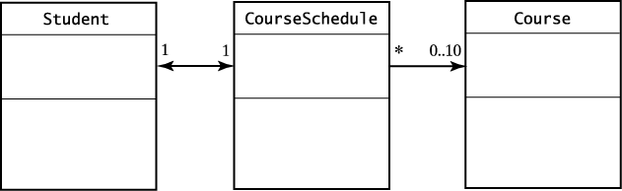
Unified Modeling Language
Part of a UML class diagram with associations:
  Student object can find its course schedule, and a CourseSchedule can discover the student to which it belongs.
  Each CourseSchedule object is associated with between zero and ten courses.

Slide 23
Unified Modeling Language
We will be utilizing UML diagrams generated by ItelliJ IDEA
See “UML Diagram Symbols” document posted in CI Learn “Lab Instructions” block
See example of a UML diagram on the next slide

Slide 24
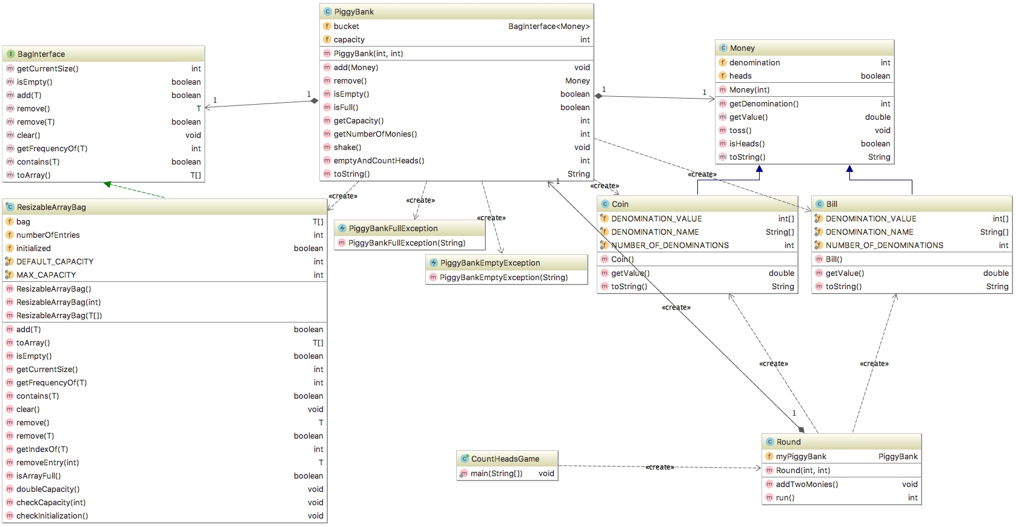
UML Diagram
2
1
3
1
ResizableArrayBag implements BagInterface
Bill extends Money
Relationship between classes; in this example Round contains PiggyBank objects; numbers represent multiplicity – in this example Round contains one PiggyBank object and a PiggyBank object belongs to one Round
2
3

Slide 25
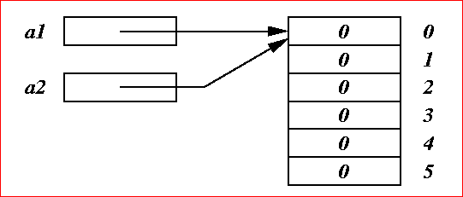
State-of-Memory Diagram
We will be drawing State-of-Memory diagrams for each application that we will be working on (also see memory diagram for strings)
Memory diagrams:
  focus on the state of memory during the execution of a program
  focus on the data
  they are a key technique to help understand abstraction through visualization
For example consider the following code:
      int [] a1 = new int[6];
      int [] a2 = a1;
  The Memory diagram for this code would be as follow:

Slide 26
Reusing Classes
Much software combines:
  Existing components
  New components
When designing new classes
  Plan for reusability in the future
  Make objects as general as possible
  Avoid dependencies that restrict later use by another programmer
Check Java API

Slide 27
printf method
To learn more about formatting in java check:
  printf method tutorial: http://www.java2s.com/Tutorial/Java/0120__Development/0200__printf-Method.htm
  printf cheat sheet: http://www.devdaily.com/blog/post/software-dev/cheat-sheet-reference-printf-format-specifier-syntax

Slide 28
Textbook Resources:
Appendices: A, B, C, D, E and Java Interlude: 1, 2, 7 provide a review of the material that you learned in COMP150 (or equivalent).

Slide 29
BAGS
CHAPTER1

Slide 30
Contents
The Bag
  A Bag’s Behaviors
Specifying a Bag
  An Interface
Using the ADT Bag
Using an ADT Is Like Using a Vending Machine

Slide 31
Objectives
Describe the concept of abstract data type (ADT)
Describe ADT bag
Use ADT bag in Java program

Slide 32
Abstract Data Type vs. Data Structure
ADT is a specification of a data set and the operations on that data
  independent of any programming language
  does not indicate how to store the data or how to implement the operations
  focuses on what without worrying about how
    the details of how to represent the data and how to manipulate it are left to implementing class
    more that one class can be available
Data structure is an implementation of an ADT within a programming language

Slide 33
Abstract Data Type Bag
What is it?
A finite collection of objects
In no particular order
May contain duplicate items

Slide 34
Abstract Data Type Bag
Behaviors?
Determine how many objects in bag
  Full?
  Empty?
Add, remove objects
Count duplicates
Test for specific object
View all objects

Slide 35
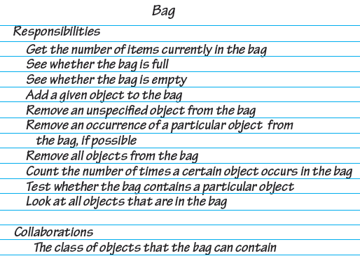
A CRC card for a class Bag

Slide 36
Specifying a Bag
Describe data
Specify methods for bag’s behaviors
  Name methods
  Choose parameters
  Decide return types
  Write comments

Slide 37
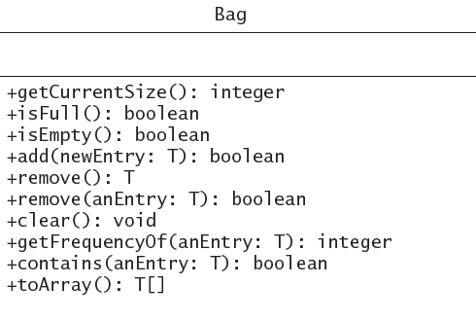
UML notation for the interface Bag
Bag

Slide 38
Design Decisions
What should the method add do when it cannot add a new entry?
  Nothing?
  Leave bag unchanged, signal client of condition?

Slide 39
Design Decisions
What should happen when an unusual condition occurs?
  Assume invalid never happens?
  Ignore invalid event?
  Guess at client’s intention?
  Return flag value?
  Return boolean value – success/failure?
  Throw exception?

Slide 40
Interface
Write Java headers
Organize into interface
Note items in bag are of same type
  Generic type <T>

Slide 41
An Interface (Part 1)
/** An interface that describes the operations of a bag of objects. */
public interface BagInterface<T>
{
/** Gets the current number of entries in this bag.
@return The integer number of entries currently in the bag. */
public int getCurrentSize();
/** Sees whether this bag is empty.
@return True if the bag is empty, or false if not. */
public boolean isEmpty();
/** Adds a new entry to this bag.
@param newEntry The object to be added as a new entry.
@return True if the addition is successful, or false if not. */
public boolean add(T newEntry);
/** Removes one unspecified entry from this bag, if possible.
@return Either the removed entry, if the removal.
was successful, or null. */
public T remove();

Slide 42
An Interface (Part 2)
/** Removes one occurrence of a given entry from this bag, if possible.
@param anEntry The entry to be removed.
@return True if the removal was successful, or false if not. */
public boolean remove(T anEntry);
/** Removes all entries from this bag. */
public void clear();
/** Counts the number of times a given entry appears in this bag.
@param anEntry The entry to be counted.
@return The number of times anEntry appears in the bag. */
public int getFrequencyOf(T anEntry);
/** Tests whether this bag contains a given entry.
@param anEntry The entry to find.
@return True if the bag contains anEntry, or false if not. */
public boolean contains(T anEntry);
/** Retrieves all entries that are in this bag.
@return A newly allocated array of all the entries in the bag.
Note: If the bag is empty, the returned array is empty. */
public T[] toArray();
} // end BagInterface

Slide 43
Using ADT Bag
Implementation done from specifications
  User needs to know what ADT does, not how
Type of object in bag specified by program using the ADT
See next slide for an example of using the ADT Bag for online shopping

Slide 44
Using ADT Bag
// A class that maintains a shopping cart for an online store.
public class OnlineShopper
{
public static void main(String[] args)
{
Item[] items = {new Item("Bird feeder", 20.50),
new Item("Squirrel guard", 15.47),
new Item("Bird bath", 44.99),
new Item("Sunflower seeds", 12.95)};
// Must use an implementing class to create an object defined as BagInterface:
BagInterface<Item> shoppingCart = new Bag<>();
// Statements that add selected items to the shopping cart:
for (int index = 0; index < items.length; index++)
shoppingCart.add(items[index]);
// Simulate checkout
double totalCost = 0;
Item item;
while (!shoppingCart.isEmpty())
{
item = shoppingCart.remove();
totalCost += item.getPrice();
System.out.println(item);
}
System.out.printf("Total cost: $%.2f%n", totalCost);
}
}
Program Output
Sunflower seeds $12.95
Bird bath $44.99
Squirrel guard $15.47
Bird feeder $20.50
Total cost: $93.91

Slide 45
Using ADT Bag
How to print the content of the Bag without removing all elements from it?
Must utilize toArray method (see the next slide):

Slide 46
Using ADT Bag
// A class that maintains a shopping cart for an online store.
public class OnlineShopper
{
public static void main(String[] args)
{
Item[] items = {new Item("Bird feeder", 20.50),
new Item("Squirrel guard", 15.47),
new Item("Bird bath", 44.99),
new Item("Sunflower seeds", 12.95)};
// Must use an implementing class to create an object defined as BagInterface:
BagInterface<Item> shoppingCart = new Bag<>();
// Statements that add selected items to the shopping cart:
for (int index = 0; index < items.length; index++)
shoppingCart.add(items[index]);
// Simulate checkout
double totalCost = 0;
Object[] content = shoppingCart.toArray();
for (int i = 0; i < content.length; i++)
{
totalCost += ((Item) content[i]).getPrice();
System.out.println(content[i]);
}
System.out.printf("Total cost: $%.2f%n", totalCost);
}
}
Program Output
Sunflower seeds $12.95
Bird bath $44.99
Squirrel guard $15.47
Bird feeder $20.50
Total cost: $93.91

Slide 47

Using ADT Bag
Example of Bag for class of piggy bank
Listing 1-3

Slide 48
Observations about ADT Bag
Can perform only tasks specific to ADT
Must adhere to the specifications of the operations of ADT
Cannot access data inside ADT without ADT operations
Use the ADT, even if don’t know how data is stored
Usable even with new implementation.

Slide 49
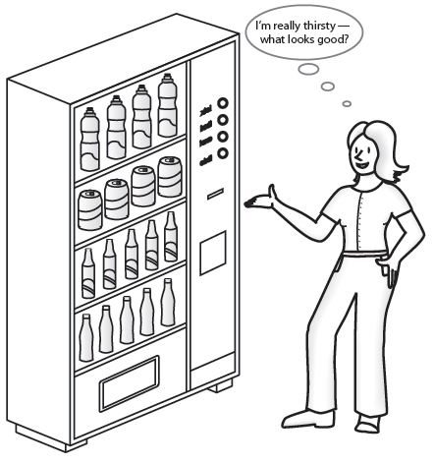
Vending Machine Like An ADT
Performs only available tasks
User must understand the tasks
Cannot access inside of mechanism
Usable without knowing inside implementation
New inside implementation unknown to users

Slide 50
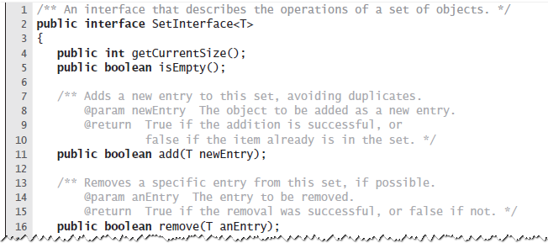
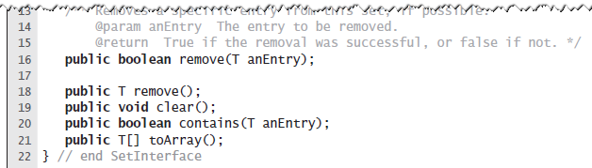
The Interface Set
A set is a special kind of bag, one that does not allow duplicate entries.
  Most of the bag operations are the same, but need different specifications for add and remove
  No need for getFrequencyOf as we can use contains instead

Slide 51
Java Class Library
The interface java.util.Set
  Standard interface which belongs to the package java.util within the Java Class Library
  Set that adhere to the specifications of this interface does not contain a pair of objects x and y such that x.equals(y) is true

Slide 52
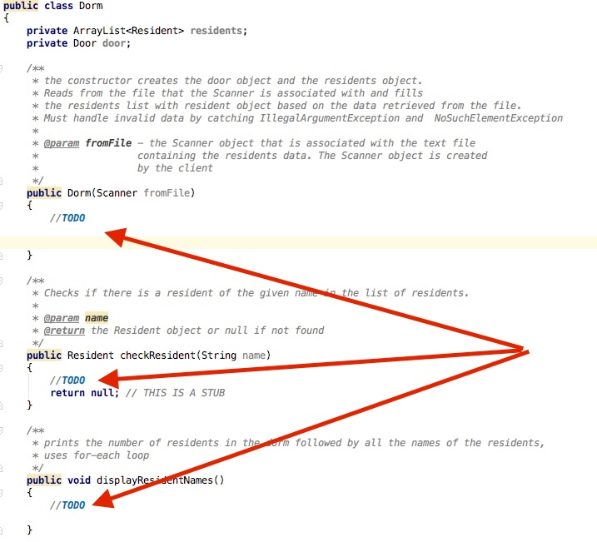
Comment on Programming Assignments
If a class skeleton is provided it will contain //TODO markers:
Please do not remove them when done coding, instead, alter them form //TODO to //TODO done for example

Slide 53
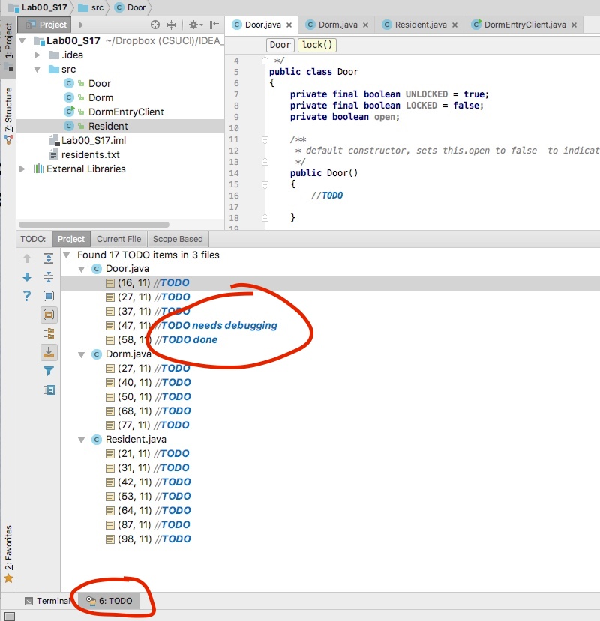
Comment on Programming Assignments
In IDEA you can click on TODO button to help you identify areas that need to be worked on:

Slide 54
Exercise Ch1#5
The union of two collections consists of their contents combined into a new collection.
Note that the union of two bags might contain duplicate items. For example, if object x occurs five times in one bag and twice in another, the union of these bags contains x seven times.
Specifically, suppose that bag1 and bag2 are Bag objects, where Bag implements BagInterface; bag1 contains the String objects a, b, and c; and bag2 contains the String objects b, b, d, and e.
  After the statement:
  BagInterface<String> everything = bag1.union(bag2);
  executes, the bag everything contains the strings a, b, c, b, b, d, and e.
  Note that the method union does not affect the contents of bag1 and bag2.
Add a method union to the interface BagInterface for the ADT bag that returns as a new bag the union of the bag receiving the call to the method and the bag that is the method’s one argument. Include sufficient javaDoc comments to fully specify the method.
Draw memory diagram for the above example

Slide 55
Solution – (1) union method defined
/**
Creates a new bag that combines the contents of
this bag and a second given bag without affecting the original two bags.
@param otherBag The given bag.
@return A bag that is the union of the two bags.
*/
public BagInterface<T> union(BagInterface<T> otherBag);

Slide 56
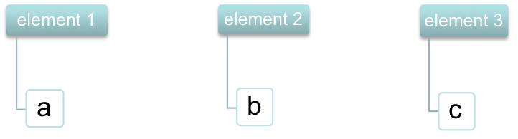
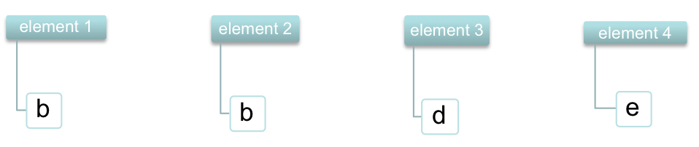
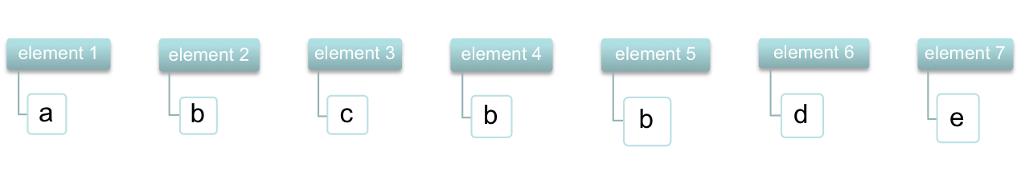
Solution – (2) memory diagram
bag1
bag2
everything

Slide 57
Exercise Ch1#6
The intersection of two collections is a new collection of the entries that occur in both collections. That is, it contains the overlapping entries.
Note that the intersection of two bags might contain duplicate items. For example, if object x occurs five times in one bag and twice in another, the intersection of these bags contains x twice.
Specifically, suppose that bag1 and bag2 are Bag objects, where Bag implements BagInterface; bag1 contains the String objects a, b, and c; and bag2 contains the String objects b, b, d, and e.
  After the statement:
  BagInterface<String> commonItems = bag1.intersection(bag2);
  executes, the bag commonItems contains only the string b. If b had occurred in bag1 twice, commonItems would have contained two occurrences of b, since bag2 also contains two occurrences of b.
  Note that method intersection does not affect the contents of bag1 and bag2.
Add a method intersection to the interface BagInterface for the ADT bag that returns as a new bag the intersection of the bag receiving the call to the method and the bag that is the method’s one argument. Include sufficient javaDoc comments to fully specify the method.
Draw memory diagram for the above example

Slide 58
Solution
/** Creates a new bag that contains those objects that occur in both this bag and a second given bag without affecting the original two bags.
@param otherBag The given bag.
@return A bag that is the intersection of the two bags.
*/
public BagInterface<T> intersection(BagInterface<T> otherBag);

Slide 59
Exercise Ch1#7
The difference of two collections is a new collection of the entries that would be left in one collection after removing those that also occur in the second.
Note that the difference of two bags might contain duplicate items. For example, if object x occurs five times in one bag and twice in another, the difference of these bags contains x three times.
Specifically, suppose that bag1 and bag2 are Bag objects, where Bag implements BagInterface; bag1 contains the String objects a, b, and c; and bag2 contains the String objects b, b, d, and e.
  After the statement:
  BagInterface leftOver1 = bag1.difference(bag2);
  executes, the bag leftOver1 contains the String objects a and c.
  After the statement:
  BagInterface leftOver2 = bag2.difference(bag1);
  executes, the bag leftOver2 contains the String objects b, d, and e.
  Note that method difference does not affect the contents of bag1 and bag2.
Add a method difference to the interface BagInterface for the ADT bag that returns as a new bag the difference of the bag receiving the call to the method and the bag that is the method’s one argument. Include sufficient javaDoc comments to fully specify the method.
Draw memory diagram for the above example

Slide 60
Solution
/** Creates a new bag of objects that would be left in this bag after removing those that also occur in a second given bag without affecting the original two bags.
@param otherBag The given bag.
@return A bag that is the difference of the two bags.
*/
public BagInterface<T> difference(BagInterface<T> otherBag);

Slide 61
Algorithm for removeBallsFromTable
Create Random object
Repeat for as long as there are balls on the table:
  remove random ball (call remove() method) and display its value
  if the ball number is 1 just print a message as shown in the sample run
  otherwise (the ball number is greater than 1)
    put the “ball number” of randomly generated balls within range of [1 ... ball number – 1] on the table
    print appropriate message as shown in the sample run
  display the content of the bag

