Slide 1
COMP / IT 420 Final Review 5/10/2021

Slide 2
Final Presentations
Presentation slides are due tomorrow, May 11th, at 11:59pm
Please review the assignment on Canvas to make sure you cover everything.
Will be timed, with time warnings at 3 and 1 minutes remaining.
Grading will be done by your classmates through Canvas

Slide 3
Final Grades and Assignments
Remaining final project items and final exam are 28% of your grade.
Canvas grades are not accurate, if you have grade concerns contact me directly.
I will try to get you grade estimates this week, if you want to figure them out yourself, please use the following slides.

Slide 4
Final Grades and Assignments
Total of 1500 points for class
Database Project 450 points or 30%
Mid-term and final are 150 points each (10% each)
Attendance and participation. 75 points for quiz completion, 75 points for quiz correctness. Scaled based on syllabus.

Slide 5
Incomplete Assignments
Incomplete assignments, labs and homeworks are due this Sunday, May 16th, at 11:59pm.
Max credit is effectively 60% of the assignment.

Slide 6
Final Grades and Assignments
Labs and Homeworks are 600 points. (Though due to an error there are 640 points available.)
92 points available through extra credit.
Final calculation:
DB Project ___/450 = I
Labs and Homework ___/600 = II
Attendance + Quiz ___/150 = III
Mid term ___/150 = IV
Final ___/150 = V
Grade = I+II+III+IV+V / 1500

Slide 7
Final Overview
Released at 8:00am on Wednesday, May 19th
There is a Zoom meeting at that time to talk over the exam
24-hour take home examination, based on an in-class 75 minute final
Cumulative exam, with a focus on the second half of the course
No topic outside of this review will be present on the exam
You will be asked to write SQL and NoSQL code (MongoDB)
It is integrated in that you will be working on a larger problem with a few related sub-components

Slide 8
Final Tentative Format
ERD to complete that is similar to the mid-term.
Correct connectivity
Correct data types
Correct attribute names
Aligns with specific business rules

Slide 9
Final Tentative Format
SQL:
Multiple join query on tables from your ERD
Fill-in-the-blank procedure / function declaration
Fill-in-the-blank transaction description
NoSQL:
Create a query based on multiple constraints
Fill-in-the-blank aggregate and MapReduce queries

Slide 10
Final Tentative Format
Normalization:
Extra credit on exam
Identify potential denormalization and normalization for the ERD
Concurrency
Identify what error a specific table of SQL commands will produce
Construct a precedence graph
Determine if there is a deadlock (waits-for graph can be used, but is not required
Timestamp ordering identical in form to problem from concurrency lab

Slide 11
Final Topics
ERD Generation and Analysis
SQL
Normalization and Denormalization
NoSQL Queries and NoSQL Data Models
Transaction Management and Concurrency
Optimization, Query Analysis and Indexing

Slide 12
ERD Generation and Analysis
Attributes and datatypes
- Primary and foreign keys
- Implications of datatypes (how to choose)
Connectivity
- Relationships and Crow’s Foot notation
Normalization
- Identifying normalization
- Implementing normalization and denormalization

Slide 13
Entity and Referential Integrity
A primary key ensures entity integrity and is required for 1NF.
A foreign key ensures referential integrity.
Entity integrity – uniquely identifies an entity instance
Referential integrity – references to an entity are valid and correct

Slide 14
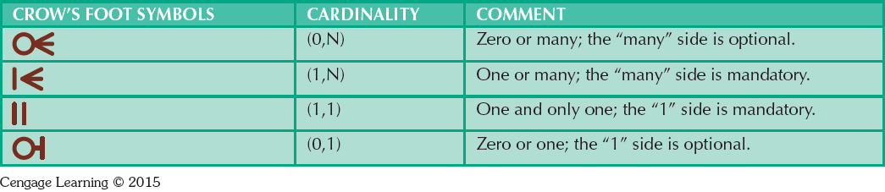
Entity Connectivity
One-to-many (1:M) – e.g. a PAINTER paints many PAINTINGS
Zero-to-many (0:M)
Many-to-many (M:N) – e.g. many STUDENTS can take many CLASSES
One-to-one (1:1) – e.g. a person has one social security number
Zero-to-one (0:1)

Slide 15
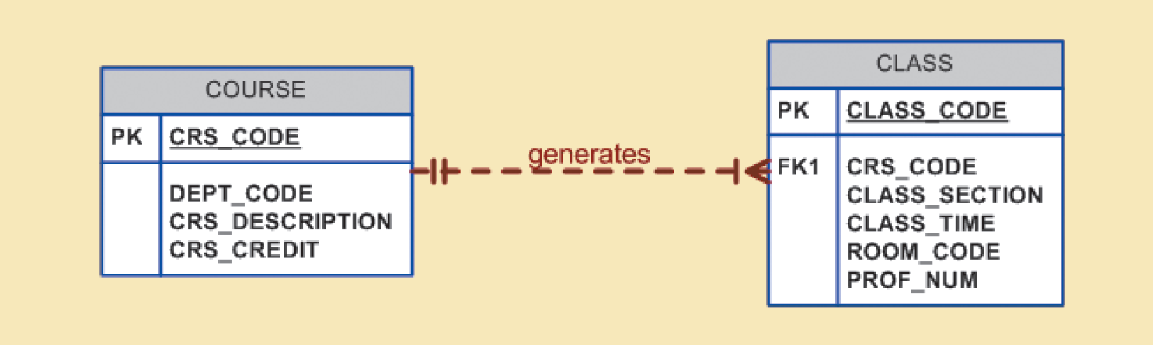
Strong and Weak Entities
Strong entities in weak relationships
Strong entity is entity independent and does not share a key component

Slide 16
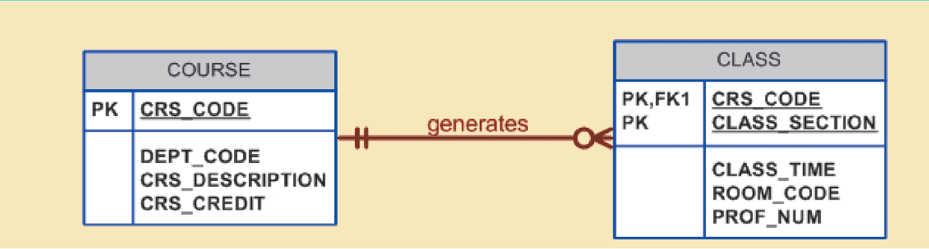
Strong and Weak Entities
Weak entities in strong relationships
Weak entities are entity dependent and share key components

Slide 17
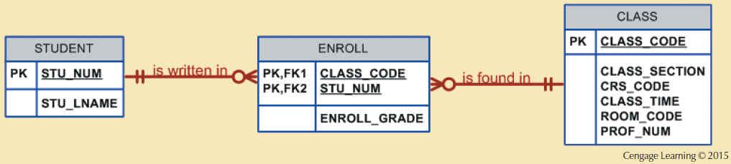
Associative Entities
Used to instantiate many-to-many relationships

Slide 18
Primary and Foreign Keys and ERDs
Use field / attribute names to identify potential foreign keys
Understand how foreign keys and primary keys dictate connectivity in a database
STUDENT(stu_id, stu_name, teach_id)
TEACHER(teach_id, teach_name)
What is the connectivity between TEACHER and STUDENT?
A) One-to-one B) One-to-Many C) Zero-to-One
What is the connectivity between STUDENT and TEACHER?
A) One-to-one B) One-to-Many C) Zero-to-Many

Slide 19
Foreign Keys and ERDs
STUDENT(stu_id, stu_name, teach_id)
TEACHER(teach_id, teach_name, stu_id)
What do we know about relationship between STUDENT and TEACHER?
How many records of each specific student are possible in STUDENT table?
A) Many B) One C) None
How many records of each specific student are possible in TEACHER table?
A) Many B) One C) None

Slide 20
Foreign Keys and ERDs
STUDENT(stu_id, stu_name, teach_id)
TEACHER(teach_id, teach_name, stu_id)
stu_id | stu_name | teach_id
123 | Algernon | 321
teach_id | teach_name | stu_id
321 | Zephyr | 123

Slide 21
Foreign Keys and ERDs
STUDENT(stu_id, stu_name, teach_id)
TEACHER(teach_id, teach_name, stu_id)
stu_id | stu_name | teach_id
123 | Algernon | 321
123???
teach_id | teach_name | stu_id
321 | Zephyr | 123
321???

Slide 22
Foreign Keys and ERDs
STUDENT(stu_id, stu_name, teach_id)
HELPS(stu_id, teach_id, help_topic)
TEACHER(teach_id, teach_name, stu_id)
What do we know about relationship between STUDENT, TEACHER and HELPS?

Slide 23
SQL DML
SELECT statements and projection
JOIN statements
Sub-queries, how to interpret them
Constraints and Conditions (WHERE, IN, IF…ELSE)
Stored procedures and functions
Aggregation (COUNT, AVG, MAX, GROUP BY, ORDER BY, etc.)
UPDATE, INSERT, DELETE

Slide 24
GROUP BY
Frequency distributions created by GROUP BY clause within SELECT statement
Syntax - SELECT columnlist
FROM tablelist
[WHERE conditionlist]
[GROUP BY columnlist]
[HAVING conditionlist]
[ORDER BY columnlist [ASC | DESC]];

Slide 25
GROUP BY
SELECT v_code, SUM(p_qoh * p_price) AS totcost
FROM product
GROUP BY v_code
HAVING totcost > 500
ORDER BY totcost desc

Slide 26
IF THEN ELSE
IF condition THEN
statements;
ELSE
else-statements
END IF;

Slide 27
IF THEN ELSE
IF some_value > 10 THEN
INSERT INTO some_table VALUES (a,b,some_value);
ELSE
INSERT INTO some_other_table VALUES (a,b,c);
END IF;

Slide 28
Datatypes
How do you select the correct datatype for a field?
What are the correct input and output datatypes (if applicable) if using stored procedures and functions?
INT, CHAR(N), VARCHAR(N), DECIMAL(N,M), etc.

Slide 29
Stored Procedure Syntax
DELIMITER delimiter_characters
CREATE PROCEDURE procedure_name ([IN] parameter_1, parameter_2)
BEGIN
…SQL statements;
END delimiter_characters
DELIMITER ;
parameter_1 = parameter_name parameter_data_type

Slide 30
Variable declaration in Procedures
DECLARE variable_1, variable_2 datatype [DEFAULT default_value];
DECLARE totalInvoices INT DEFAULT = 0;
DECLARE totalInvoices, totalLines INT DEFAULT = 0;
Can declare multiple variables in one statement if they are the same datatype.
Variable scope is valid inside BEGIN…END where declaration is made.

Slide 31
Variable assignment in procedures
SET command
SET totalInvoices = 10;
SELECT … INTO variable FROM table;
SELECT count(*) INTO totalInvoices FROM invoices;
SET is a direct declaration, SELECT INTO pulls information from database.

Slide 32
User Defined (Stored) Function Syntax
DELIMITER $$
CREATE FUNCTION function_name(param1, param2,…)
RETURNS datatype
[NOT] DETERMINISTIC
BEGIN
-- statements
END $$
DELIMITER ;

Slide 33
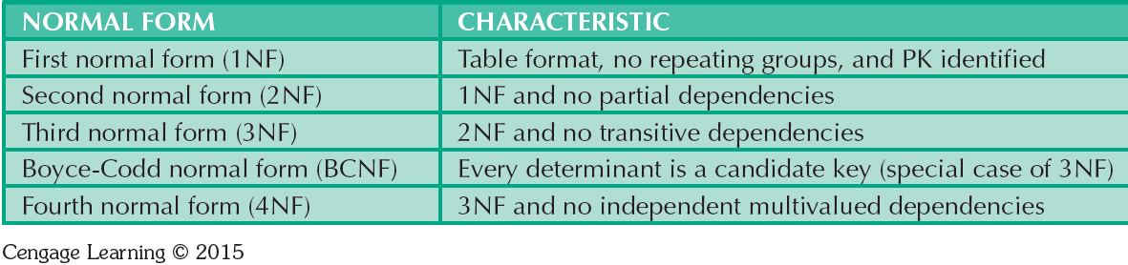
Normalization
Partial Dependency – ???
Attribute is dependent on part of a primary key
Attribute is dependent on part of a non-primary attribute
Attribute is existence dependent on another entity

Slide 34
Normalization
Transitive Dependency – ???
Attribute is dependent on part of a primary key
Attribute is dependent on part of a non-primary attribute
Attribute is existence independent

Slide 35
Normalization
Partial Dependency – Attribute is dependent on part of a primary key
Transitive Dependency – Attribute is dependent on a non-key attribute

Slide 36
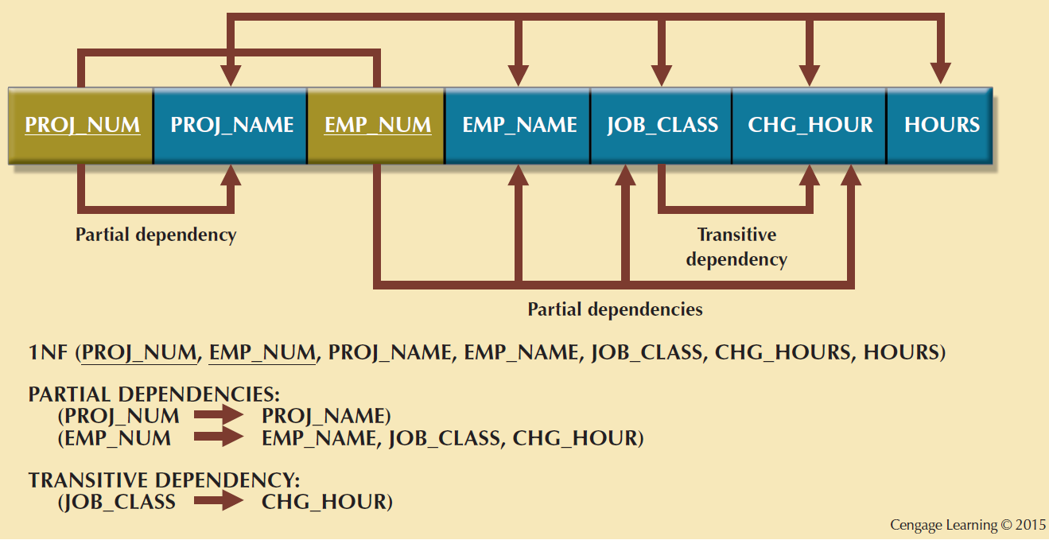
Normalization

Slide 37
Normalization
What data anomalies are influenced by normalization?
How to identify and propose normalization?
How are surrogate keys related to normalization?

Slide 38
Database Anomalies
Data redundancy → Data anomalies (i.e. inconsistent data)
Insertion
Certain data cannot be inserted without the presence of other data.
Deletion
Certain data are lost because of the deletion of other data.
Update
One or more instances of duplicated data is updated, but not all.

Slide 39
Anomalies Examples
TABLE: COURSES
COURSE# (PK) | SECTION# (PK) | C_NAME
CSIT420 | 072 | Database Design
CSIT420 | 073 | Database Design
CSIT520 | 072 | Advanced Database Design
CSIT420 | 074 | Database Design

Slide 40
Insertion Anomaly
TABLE: COURSES
COURSE# (PK) | SECTION# (PK) | C_NAME
CSIT420 | 072 | Database Design
CSIT420 | 073 | Database Design
CSIT520 | 072 | Advanced Database Design
CSIT420 | 074 | Database Design
Suppose our university has approved a new course called CSIT421: SQL & PL/SQL. Can this information about the new course be entered into COURSE in its present form? Why?

Slide 41
Deletion Anomaly
TABLE: COURSES
COURSE# (PK) | SECTION# (PK) | C_NAME
CSIT420 | 072 | Database Design
CSIT420 | 073 | Database Design
CSIT520 | 072 | Advanced Database Design
CSIT420 | 074 | Database Design
Suppose not enough students enrolled for the course CSIT520 which had only one section 072. The school decides to drop this section and CSIT520 from the table COURSE.
Can this be accomplished? What are the consequences?

Slide 42
Update Anomaly
TABLE: COURSES
COURSE# (PK) | SECTION# (PK) | C_NAME
CSIT420 | 072 | Database Design
CSIT420 | 073 | Database Design
CSIT520 | 072 | Advanced Database Design
CSIT420 | 074 | Database Design
Suppose course name for CSIT420 is changed to Database Theory.
How many times do you have to make this change in the COURSE table in its current form?

Slide 43
Surrogate Keys
System-defined attribute
Used by designers when the primary key is considered to be unsuitable
Created an managed via the DBMS
A numeric value which is automatically incremented for each new row

Slide 44
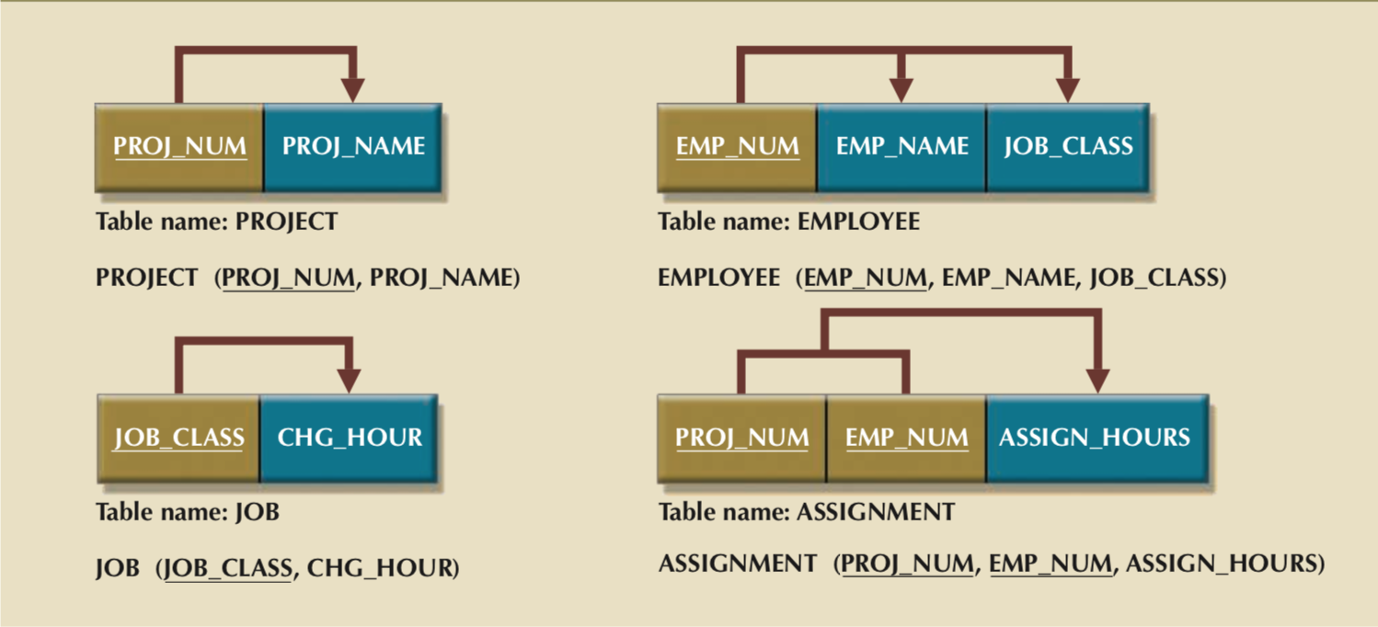
Third Normal Form (3NF) Results

Slide 45
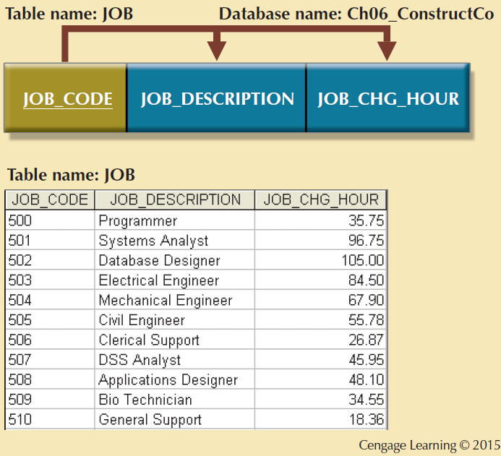
JOB_CODE

Slide 46
Third Normal Form (3NF) Results

Slide 47
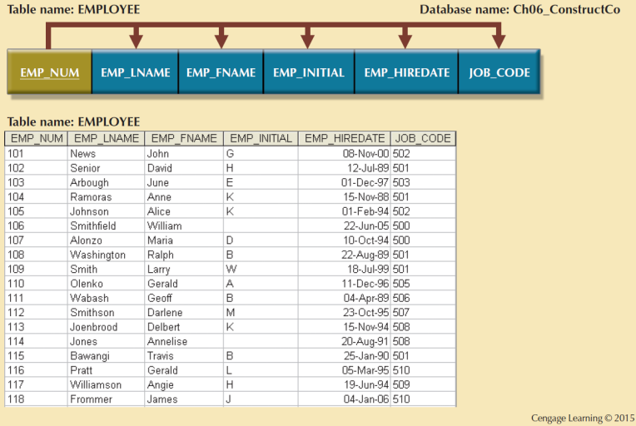
EMP_NUM

Slide 48
Denormalization
Reducing the normal form to aid in optimization and reduce I/O operations
Derived attributes are composed of other attributes, and are generally transitive dependencies
You may be asked to denormalize a table and optimize it with an index.
What are you combining?
Why is that more efficient?

Slide 49
MongoDB
Basic selection queries (.find)
- selection by fields (.find({name: <some name>})
- operators and constraints ($and, $or, $ge, etc.)
CRUD operators
Aggregation pipeline (.aggregate)
$unwind, $group, $sort, $match, $sum
MapReduce
Understanding of map reduce flow, no full programming

Slide 50
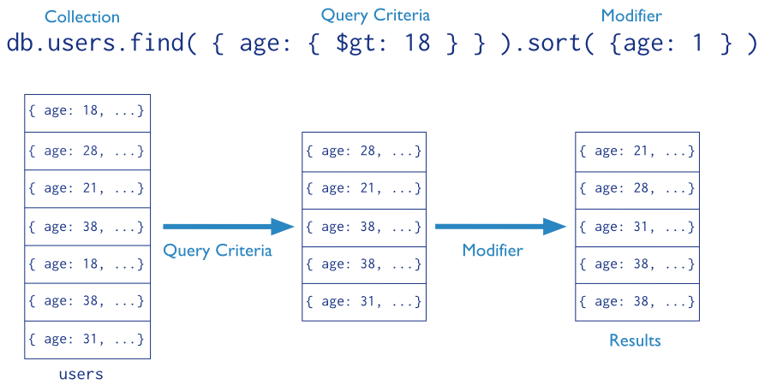
MongoDB Queries

Slide 51
MongoDB Create
> db.user.insert({
first: "John",
last : "Doe",
age: 39
})

Slide 52
MongoDB Update
> db.user.update(
{"_id" : ObjectId("51…")},
{
$set: {
age: 40,
salary: 7000}
}
)

Slide 53
MongoDB Aggregate
db.cities.aggregate([
{$match: {}},
{$group: {_id: “$city”, total: {$sum: “$population”}}}
])
input query
output document form
Match all documents, all fields return a document
grouped by “city” with a “total” sum of population

Slide 54
MongoDB Map Reduce
db.cities.mapReduce(
mapPopulation,
reducePopulation,
options
)

Slide 55
MongoDB Map Reduce
function mapPopulation(){
emit(this.city, this.population)
}
“city” and “population” are fields on “this” document
“this”document is a zip-code indexed document from the input set

Slide 56
MongoDB Map Reduce
function mapPopulation(){
emit(this.city, this.population)
}
“city” and “population” are fields on “this” document
“this”document is a zip-code indexed document from the input set

Slide 57
MongoDB Map Reduce
_id: 01001
city: “AGAWAM”, …,
population: NumberInt(15338)
_id: 01002
city: “CUSHMAN”, …,
population: NumberInt(36963)
emit(this.city, this.population)?
{”AGAWAM”: NumberInt(15338)}
{”CUSHMAN”: NumberInt(36963)}

Slide 58
MongoDB Map Reduce
function reducePopulation(key, values){
return Array.sum(values)
}
key = city_name
values = Array(population, population, population,…)

Slide 59
MapReduce
_id: ObjectId("52cdef7c4bab8bd675297d8a"),
name: "Wetpaint",
tag_list: "wiki, seattle, elowitz, media-industry, media-platform, social-distribution-system"
_id: ObjectId("52cdef7c4bab8bd675297d8c"),
name: "Zoho",
tag_list: "zoho, officesuite, spreadsheet, writer, projects, sheet, crm, show, creator, wiki, planner, suite, notebook, chat, meeting, mail"
How would you aggregate tags with MapReduce?

Slide 60
MapReduce
_id: ObjectId("52cdef7c4bab8bd675297d8a"),
name: "Wetpaint",
tag_list: "wiki, seattle, elowitz, media-industry, media-platform, social-distribution-system”
function mapTags(){
?????????
}
function reduceTags(key, values){
??????
}

Slide 61
MapReduce
_id: ObjectId("52cdef7c4bab8bd675297d8a"),
name: "Wetpaint",
tag_list: "wiki, seattle, elowitz, media-industry, media-platform, social-distribution-system”
function mapTags(){
var tags = this.tag_list.split(”,”);
for (var i = 0; i < tags.length; i++){
emit(tags[i], 1);
}
}

Slide 62
MapReduce
_id: ObjectId("52cdef7c4bab8bd675297d8a"),
name: "Wetpaint",
tag_list: "wiki, seattle, elowitz, media-industry, media-platform, social-distribution-system”
function reduceTags(key, values){
return Array.sum(values);
}

Slide 63
Transaction Management
Transaction terminology
COMMIT and ROLLBACK
Types of transactional errors
Isolation levels
Concurrency

Slide 64
Transaction Management
A transaction is a logical unit of work that must be completed in total to maintain a consistent database state.
The database manages transactions through concurrency control algorithms that make sure each transaction completes as if it was executed in a serial fashion.

Slide 65
MySQL Transaction Controls
START TRANSACTION signals the beginning of a series of statements align with a specific transaction.
COMMIT signals the end of a transaction, saves the changes to disk and makes them visible to other transactions
ROLLBACK signals an unsuccessful transaction and cancels all changes made thus far in a transaction

Slide 66
Concurrency Control Problems
Lost updates due to concurrent transactions overwriting each other
Uncommitted data due to transaction using data from another cancelled transaction
Inconsistent Retrievals occur when a transaction accesses data before and after one or more transactions finish working with such data.

Slide 67
Concurrency Control Problems
Lost updates due to concurrent transactions overwriting each other
Uncommitted data due to transaction using data from another cancelled transaction
Inconsistent Retrievals occur when a transaction accesses data before and after one or more transactions finish working with such data.

Slide 68
Concurrency Control Problems
Is this a lost update, read on uncommitted data or an inconsistent retrieval?
Transaction 1 | Transaction 2
Read (A)
Write (A)
 | Read (A)
ROLLBACK
 | Write(A)
 | COMMIT

Slide 69
Concurrency Control Problems
Is this a lost update, read on uncommitted data or an inconsistent retrieval?
Read on uncommitted data
Transaction 1 | Transaction 2
Read (A)
Write (A)
 | Read (A)
ROLLBACK
 | Write(A)
 | COMMIT

Slide 70
Concurrency Control Problems
Is this a lost update, read on uncommitted data or an inconsistent retrieval?
Transaction 1 | Transaction 2
Read (A)
 | Read(A)
Write (A) = 20
 | Write(A) = 10
COMMIT
 | COMMIT

Slide 71
Concurrency Control Problems
Is this a lost update, read on uncommitted data or an inconsistent retrieval?
Lost update.
Transaction 1 | Transaction 2
Read (A)
 | Read(A)
Write (A) = 20
 | Write(A) = 10
COMMIT
 | COMMIT

Slide 72
Concurrency Control Problems
Is this a lost update, read on uncommitted data or an inconsistent retrieval?
Transaction 1 | Transaction 2
Update(A) | Avg(A + B)
Update(B)
 | Avg( A + B)
COMMIT

Slide 73
Concurrency Control Problems
Is this a lost update, read on uncommitted data or an inconsistent retrieval?
Inconsistent retrieval
Transaction 1 | Transaction 2
Update(A) | Avg(A + B)
Update(B)
 | Avg( A + B)
COMMIT

Slide 74
Transaction Isolation Levels
Isolation levels based on permitted types of “reads” used during a transaction
Dirty read is a read of uncommitted data
Nonrepeatable read allows for the same read at two different points in a transaction to return different results
Phantom read allows for a query to return a different amount of results depending on when it is run in a transaction

Slide 75
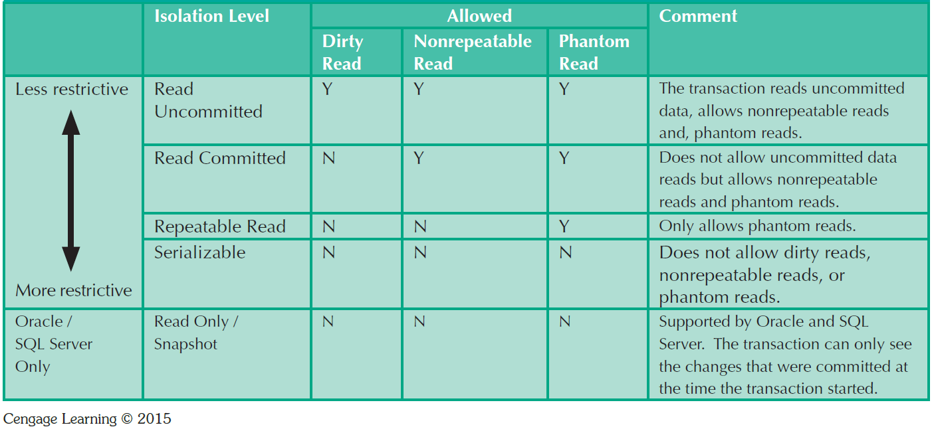
Transaction Isolation Levels

Slide 76
Locking Mechanisms
Binary locking is a simple on/off locking scheme
Exclusive locking (Write locking) ensures exclusive access to locked resources for reading and writing
Shared locking (Read locking) shares access to resources for read-only operations
Deadlocks occur when two transactions have mutually dependent locks on resources

Slide 77
Locking Mechanisms
Two-phase locking (2PL) – locking featuring two phases:
Growing phase – all locks are acquired sequentially
Operations committed – all work is conducted with all locks
Shrinking phase – all locks are released
Main observation, locks cannot be acquired after any are released.

Slide 78
Binary Locking
Transaction 1 | Transaction 2
Lock(A)
Write(A)
 | Lock(A)
Unlock(A)
Lock(B)
 | Write(A)
 | Unlock(A)
Write(B)
Unlock(B)
Commit
Granted (T1 -> A)
Denied (T2 -> A)
Released (T1 -> A) Granted (T2 -> A)
Granted(T1 -> B)
Released (T1 -> A)
Released (T1 -> B)

Slide 79
2PL
Transaction 1 | Transaction 2
Lock(A)
Write(A)
 | Lock(A)
Unlock(A)
Lock(B)
 | Write(A)
 | Unlock(A)
Write(B)
Unlock(B)
Commit
Granted (T1 -> A)
Denied (T2 -> A)
Released (T1 -> A) Granted (T2 -> A)
Denied(T1 -> B)
Released (T1 -> A)
Nope

Slide 80
Precedence Graph
Algorithm to create a directed graph to describe the schedule of operations
Precedence graph S consisting of vertex-edge pairs (V, E)
where V = ( T₀, T₁, …, T_{n} ) or transactions
and E = ( T_{i} → T_{j} ) where an operation O_{i} in T_{i} conflicts with operation O_{j} in T_{j}
and O_{i} appears earlier in schedule than O_{j}
Conflict serializable if-and-only-if graph S is acyclic. Whew…

Slide 81
T_{i}
T_{j}
Connect transaction i (T_{i}) to transaction j (T_{j}) in precedence graph S if:
T_{i} writes (O_{i}) to object A before T_{j} executes a read (O_{j}) on object A
T_{i} reads (O_{i}) an object A before T_{j} executes a write (O_{j}) to object A
T_{i} writes (O_{i}) to object A before T_{j} executes a write (O_{j}) to object A

Slide 82
Transaction 1 | Transaction 2
Read (A)
Write (A)
 | Read (A)
 | Write (A)
 | Read (B)
 | Write (B)
 | COMMIT
Read (B)
Write (B)
COMMIT
T₁
T₂
Cycle in graph, so NOT conflict serializable.
Because output of T₁ depends on T₂ and output
of T₂ depends on output of T₁

Slide 83
Transaction 1 | Transaction 2
Read (A)
Write (A)
 | Read (A)
 | Write (A)
Read (B)
Write (B)
COMMIT
 | Read (B)
 | Write (B)
 | COMMIT
T₁
T₂
No cycle in graph!
Conflict serializable! Yay!

Slide 84
Waits-For Graph
Transaction 1 | Transaction 2 | Transaction 3
Shared Lock(A)
 | Exclusive Lock (B)
 |  | Shared Lock (C)
Shared Lock(B)
 | Exclusive Lock(C)
 |  | Exclusive Lock(A)
T₁
T₂
T₃

Slide 85
Waits-For Graph
Transaction 1 | Transaction 2 | Transaction 3
Shared Lock(A)
 | Exclusive Lock (B)
 |  | Shared Lock (C)
Shared Lock(B)
 | Exclusive Lock(C)
 |  | Exclusive Lock(A)
T₁
T₂
T₃

Slide 86
Waits-For Graph
Transaction 1 | Transaction 2 | Transaction 3
Shared Lock(A)
 | Exclusive Lock (B)
 |  | Shared Lock (C)
Shared Lock(B)
 | Exclusive Lock(C)
 |  | Exclusive Lock(A)
T₁
T₂
T₃

Slide 87
Waits-For Graph
Transaction 1 | Transaction 2 | Transaction 3
Shared Lock(A)
 | Exclusive Lock (B)
 |  | Shared Lock (C)
Shared Lock(B)
 | Exclusive Lock(C)
 |  | Exclusive Lock(A)
T₁
T₂
T₃

Slide 88
Timestamp Ordering
Optimistic Concurrency
R-TS (Read Timestamp)
object tagged with transaction timestamp of last read
W-TS (Write Timesamp)
object tagged with transaction timestamp of last write

Slide 89
Timestamp Ordering
If a transaction wants to read an object A and:
TS(T_{i}) < W-TS(A)
reject read and rollback T_{i}
TS(T_{i}) >= W-TS(A)
read A and set R-TS(A) to equal max(R-TS(A), TS(T_{i}))

Slide 90
Timestamp Ordering
If a transaction wants to write to object A and:
TS(T_{i}) < R-TS(A)
reject write and rollback T_{i}
TS(T_{i}) < W-TS(A)
reject write and rollback T_{i}
Otherwise, execute write and set W-TS = TS(T_{i})

Slide 91
Simple Timestamp Ordering
Transaction 1 TS = 1 | Transaction 2 TS = 2
Read (B)
 | Read (B)
 | Write (B)
Read (A)
 | Read (A)
 | Write (A)
COMMIT | COMMIT
Object | Read Timestamp (R-TS) | Write Timestamp (W-TS)

Slide 92
Simple Timestamp Ordering
Transaction 1 TS = 1 | Transaction 2 TS = 2
Read (B)
 | Read (B)
 | Write (B)
Read (A)
 | Read (A)
 | Write (A)
COMMIT | COMMIT
Object | Read Timestamp (R-TS) | Write Timestamp (W-TS)
B | 1 | 0

Slide 93
Simple Timestamp Ordering
Transaction 1 TS = 1 | Transaction 2 TS = 2
Read (B)
 | Read (B)
 | Write (B)
Read (A)
 | Read (A)
 | Write (A)
COMMIT | COMMIT
Object | Read Timestamp (R-TS) | Write Timestamp (W-TS)
B | 1 | 0
B | 2 | 0

Slide 94
Simple Timestamp Ordering
Transaction 1 TS = 1 | Transaction 2 TS = 2
Read (B)
 | Read (B)
 | Write (B)
Read (A)
 | Read (A)
 | Write (A)
COMMIT | COMMIT
Object | Read Timestamp (R-TS) | Write Timestamp (W-TS)
B | 1 | 0
B | 2 | 0
B | 2 | 2

Slide 95
Simple Timestamp Ordering
Transaction 1 TS = 1 | Transaction 2 TS = 2
Read (B)
 | Read (B)
 | Write (B)
Read (A)
 | Read (A)
 | Write (A)
COMMIT | COMMIT
Object | Read Timestamp (R-TS) | Write Timestamp (W-TS)
B | 1 | 0
B | 2 | 0
B | 2 | 2
A | 1 | 0

Slide 96
Simple Timestamp Ordering
Transaction 1 TS = 1 | Transaction 2 TS = 2
Read (B)
 | Read (B)
 | Write (B)
Read (A)
 | Read (A)
 | Write (A)
COMMIT | COMMIT
Object | Read Timestamp (R-TS) | Write Timestamp (W-TS)
B | 1 | 0
B | 2 | 0
B | 2 | 2
A | 1 | 0
A | 2 | 0

Slide 97
Simple Timestamp Ordering
Transaction 1 TS = 1 | Transaction 2 TS = 2
Read (B)
 | Read (B)
 | Write (B)
Read (A)
 | Read (A)
 | Write (A)
COMMIT | COMMIT
Object | Read Timestamp (R-TS) | Write Timestamp (W-TS)
B | 1 | 0
B | 2 | 0
B | 2 | 2
A | 1 | 0
A | 2 | 0
A | 2 | 2

Slide 98
Simple Timestamp Ordering
Transaction 1 TS = 1 | Transaction 2 TS = 2
Read (A)
 | Write (A)
Write (A)
Read (A)
Object | Read Timestamp (R-TS) | Write Timestamp (W-TS)
A | 1 | 0

Slide 99
Simple Timestamp Ordering
Transaction 1 TS = 1 | Transaction 2 TS = 2
Read (A)
 | Write (A)
Write (A)
Read (A)
Object | Read Timestamp (R-TS) | Write Timestamp (W-TS)
A | 1 | 0
A | 1 | 2

Slide 100
Simple Timestamp Ordering
Transaction 1 TS = 1 | Transaction 2 TS = 2
Read (A)
 | Write (A)
Write (A)
Read (A)
Object | Read Timestamp (R-TS) | Write Timestamp (W-TS)
A | 1 | 0
A | 1 | 2
A | 1 | ?

Slide 101
Simple Timestamp Ordering
Transaction 1 TS = 1 | Transaction 2 TS = 2
Read (A)
 | Write (A)
Write (A)
Read (A)
Object | Read Timestamp (R-TS) | Write Timestamp (W-TS)
A | 1 | 0
A | 1 | 2
A | 1 | ?
TS(Ti) < W-TS(A)
reject Ti and rollback

Slide 102
Optimization
Types of indexes and their uses
Choosing correct indexing
Query planning example, what order is better?

Slide 103
Index Data Structures
Hash indexes are based on a ordered-list of hash values good for equality conditions
B-tree or B+-tree (balanced) are an ordered tree data structure organized by pointers to row data
Bitmap indexes are a collection of bit-arrays denoting the existence of a field value

Slide 104
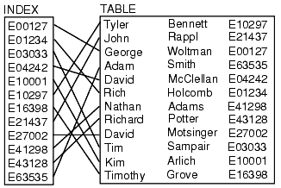
Index Data Structures

Slide 105
Index Data Structures
E03033
E03033

Slide 106
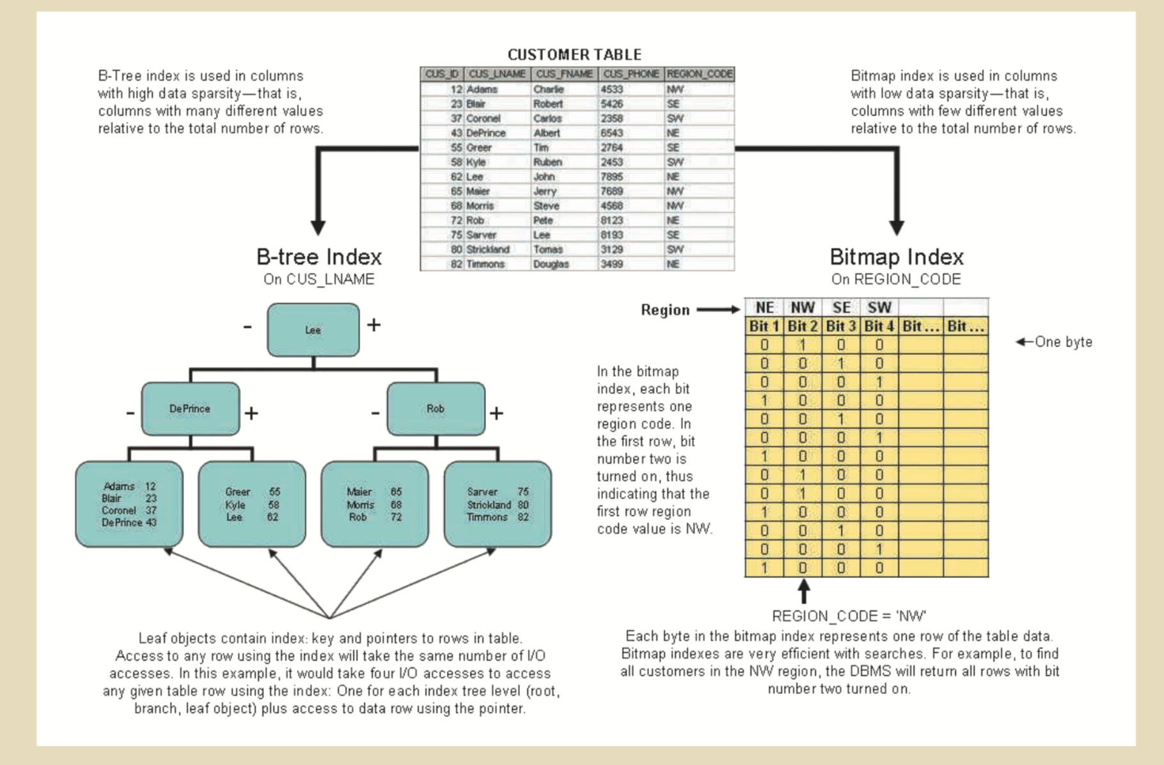

Slide 107
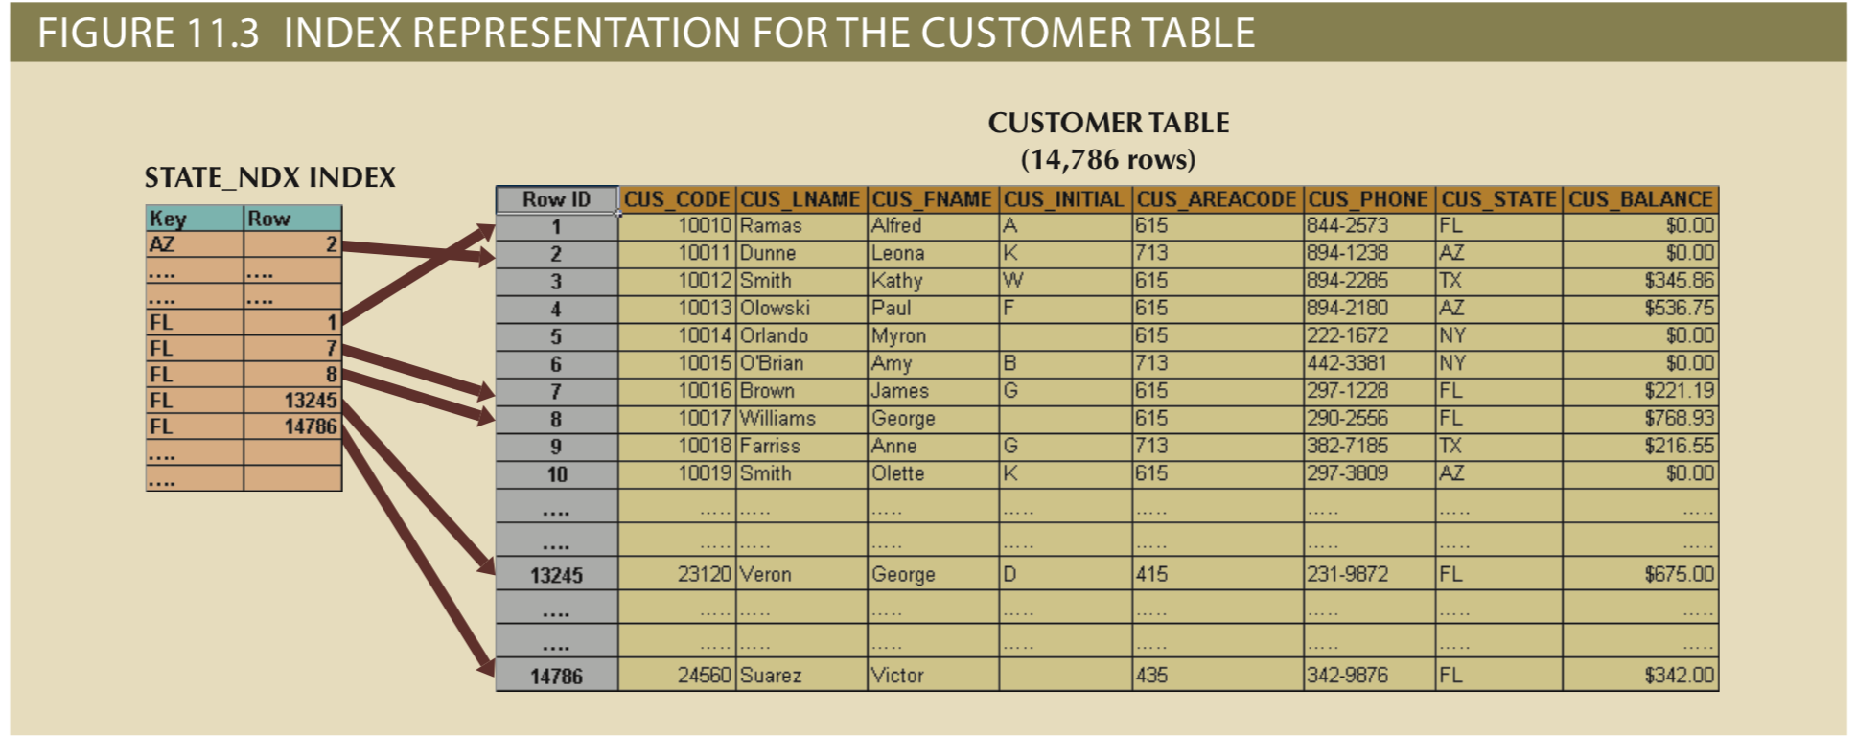
SELECT cus_name, cus_state
FROM customer
WHERE cus_state = “FL”
How many I/O reads if there is not an index on CUS_STATE?
How many I/O reads if there is an index on CUS_STATE?

Slide 108
Query Execution Planning
SELECT P_CODE, P_DESCRIPT, V_STATE
FROM PRODUCT P, VENDOR V
WHERE P.V_CODE = V.V_CODE
AND V.V_STATE = “FL”;
The PRODUCT table has 7,000 rows.
The VENDOR table has 300 rows.
Ten vendors are located in Florida.
One thousand products come from vendors in Florida.

Slide 109
Query Execution Planning
1. SELECT P_CODE, P_DESCRIPT, V_STATE
2. FROM PRODUCT P, VENDOR V
3. WHERE P.V_CODE = V.V_CODE
4. AND V.V_STATE = “FL”;
The PRODUCT table has 7,000 rows.
The VENDOR table has 300 rows.
Ten vendors are located in Florida.
One thousand products come from vendors in Florida.

Slide 110
Query Execution Planning
1. SELECT P_CODE, P_DESCRIPT, V_STATE
2. FROM PRODUCT P, VENDOR V
3. WHERE P.V_CODE = V.V_CODE
4. AND V.V_STATE = “FL”;
The PRODUCT table has 7,000 rows.
The VENDOR table has 300 rows.
Ten vendors are located in Florida.
One thousand products come from vendors in Florida.

Slide 111
Query Execution Planning
1. SELECT P_CODE, P_DESCRIPT, V_STATE
2. FROM PRODUCT P, VENDOR V
3. WHERE P.V_CODE = V.V_CODE
4. AND V.V_STATE = “FL”;
The PRODUCT table has 7,000 rows.
The VENDOR table has 300 rows.
Ten vendors are located in Florida.
One thousand products come from vendors in Florida.

Slide 112
Query Execution Planning
1. SELECT P_CODE, P_DESCRIPT, V_STATE
2. FROM PRODUCT P, VENDOR V
3. WHERE P.V_CODE = V.V_CODE
4. AND V.V_STATE = “FL”;
The PRODUCT table has 7,000 rows.
The VENDOR table has 300 rows.
Ten vendors are located in Florida.
One thousand products come from vendors in Florida.

Slide 113
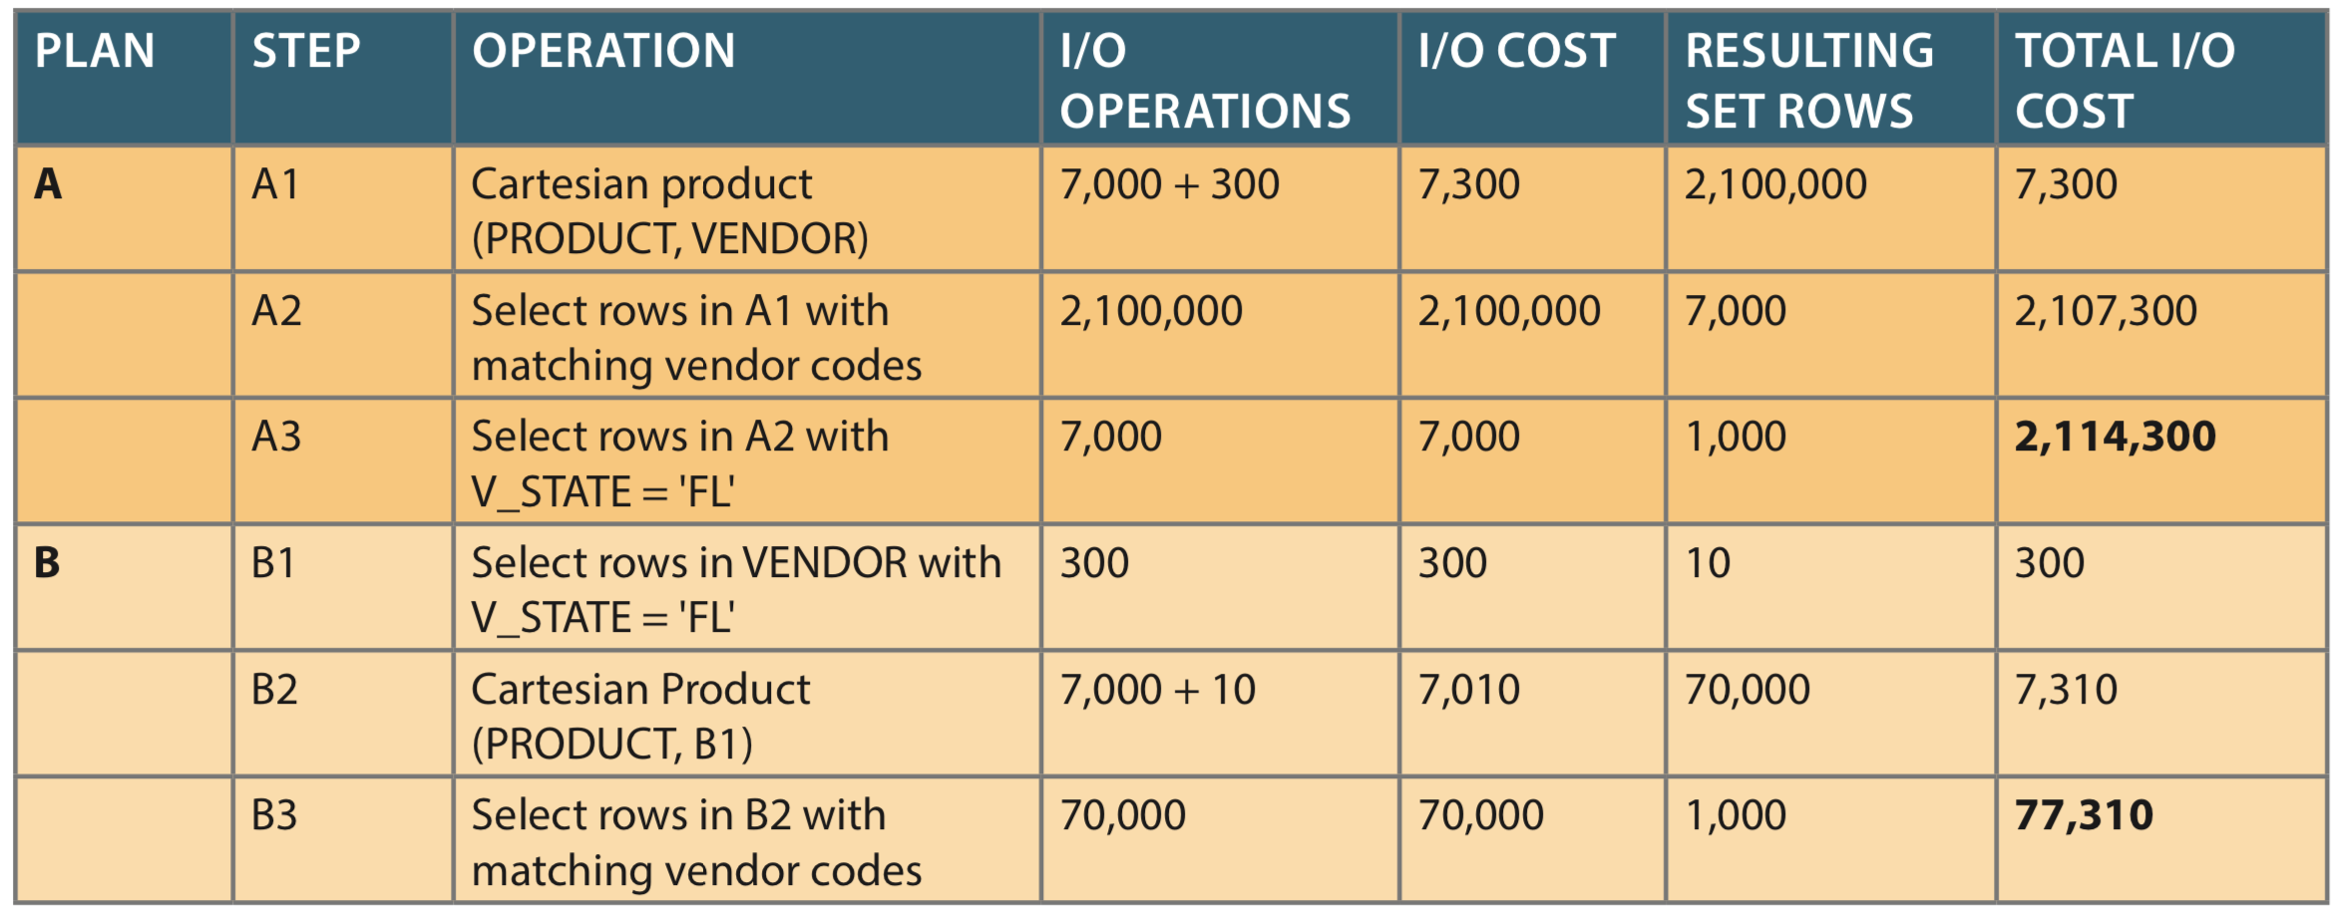
Query Execution Planning

Slide 114
Thank You All!
Contact me if you have concerns about anything.
Please fill out course surveys, they are a major way for you to influence teaching and the program.

