Slide 1
Database Administration and Security
COMP / IT 420 Lecture 14
5/03/2021

Slide 2
Upcoming Schedule
Wednesday 5/05/2021
Lab Period
Review of labs 8, 9, and 10
Optional Lab
Question time for implementation and procedures
Monday 5/10/2021
Final Exam Review Period
Will cover basic exam categories, bring questions

Slide 3
Upcoming Schedule
Wednesday 5/12/2021
Final Database Project Presentations
11 projects, 7-10 minute each
11 * 7 + 3 = 110 minutes ~ 2 hours
Wednesday 5/19/2021
8:00am-10:00am Exam Release and Overview Session
Friday 5/23/2021
Final Database Projects Due

Slide 4
Presentation Requirements
Your presentation should be 7-10 minutes long and cover the following information:
Who are you?
How does your database solve a particular problem for a specific domain?
What is the problem?
Why is it a problem?
What is your solution?
Why is it a solution?
How does your application work?
What are the features?
How does the user interact with it?
How is your application and database implemented?
What technologies did you use?
Explain, briefly, the database schema and ERD diagram.
What advanced views, triggers and queries are possible in your implementation?

Slide 5
Presentation Grading
Objective: The DB and application solve a business need or problem
Design: The DB design was correct and complete.
Interest: The DB and application was creative and / or interesting.
Complexity: The DB was of suitable complexity. (12 or more entities with 3 or more attributes each)
Presentation: The presentation communicated the DB and application design and intent successfully.
You will need to include diagrams, UI mock-ups and workflows, etc. To get full credit, presentations consisting of basic text only will not receive full credit.

Slide 6
Presentation Submission
Slides are due at 11:59pm on Tuesday May 11th, 2021
Submit online through Canvas
Must be in Microsoft Powerpoint format

Slide 7
Topics
Data as an asset
Data politics
Administration
Security
MySQL Specifics
MySQL Advanced SQL Review (Views, Triggers, Procedures)

Slide 8
Data as an Asset
Corporate Data Usage
Resource for decision-making at all levels of organization
“Dirty” data is a threat to business operations and business intelligence
Information derived from data as the motivation for decisive action with “evidential” support
Security and privacy are paramount
Focus on improving return on investment

Slide 9
Data as an Asset
Personal Data Usage
Resource for personal decision making
Resource to be used by others, including corporations, for furthering their interests
Security and privacy are paramount
Data use awareness

Slide 10


Cambridge Analytica - Facebook

Slide 11
Cambridge Analytica - Facebook
Initial voluntary personality quiz survey for “academic purposes only”
Facebook API allowed for access to friends of survey participants, leading to 47+ million people
CA used this unauthorized data collection to provide business intelligence to political campaigns, notably Ted Cruz’s 2016 presidential campaign
Criminal investigation, 13% drop in Facebook valuation, CA no more, $5 billion dollar fine for Facebook

Slide 12
Data as an Asset
Data Usage
Governmental
Non-governmental
Academic research
Etc.
All predominantly built on some form of database or have a need for databases.

Slide 13
Security and Privacy
Data security
protecting data against accidental or intentional use by unauthorized users
Data privacy
the extent to which individuals and organizations have the right to determine the details of data usage

Slide 14
Equifax Leak
147,000,000 people PII leaked an available
Breach in May, discovered in July!
Data accessible in numerous ways:
Employee only informational portal on open Internet with a simple unencrypted API
Un-updated Apache Web Server
$800 million in annual operating income
Insecure network design without proper data segmentation
Lack of encryption for PII
Lack of break detection and metrics
Currently have largest class-action lawsuit in US history pending
“admin” “admin” user / pass!

Slide 15
Equifax Leak
How many larger data breaches have been revealed since this leak?
20!
Two largest are now the CAM4 adult website breach (11 billion records) and the Yahoo breach of 2013 (revealed 2017) of 3 billion user records

Slide 16
Data and Politics
Who are you working for and what are the effects of data collection? Who is supplying the data? How is it influencing others and their decisions?
What are the social and politics ramifications of your work?
How does your application / system challenge or reinforce current power structures?
What do things look like through other lenses besides business and corporate interests?

Slide 17
Data and Politics
National census data as earliest use in US of tabulating machines for data collection and analysis
Third Reich used tabulation and data analysis tools to locate and track minority populations provided by a subsidiary of IBM
Current political discourse giving way to “data” journalism, basing opinions on aggregate statistics and databases

Slide 18
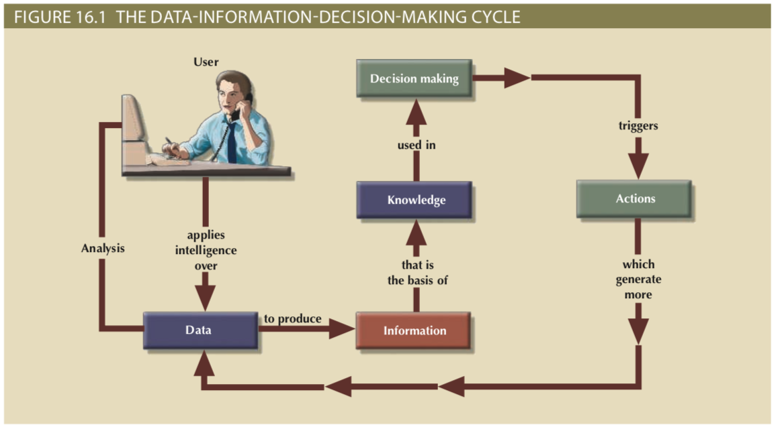
Database Administration

Slide 19
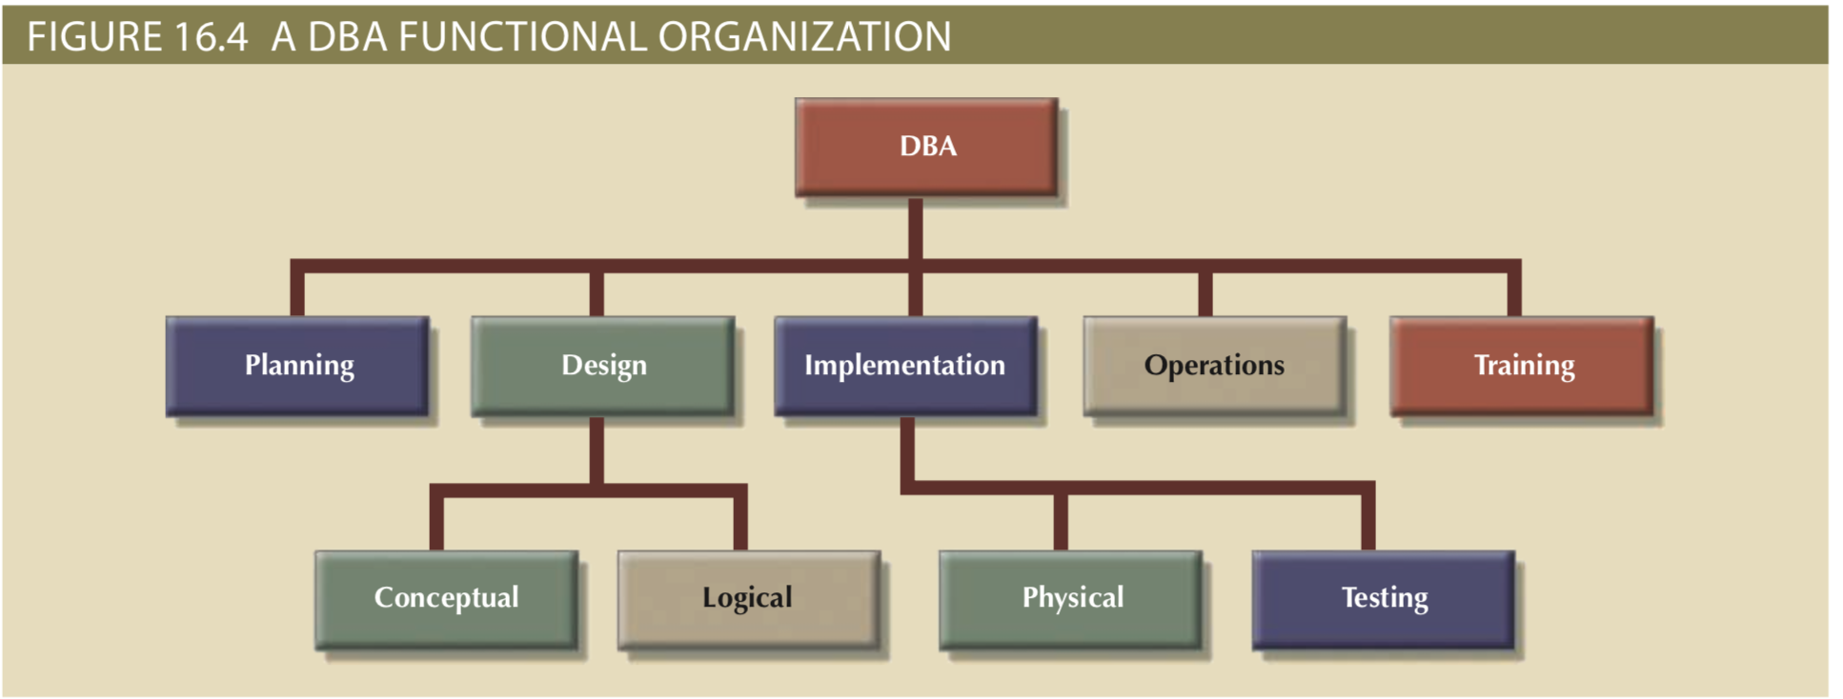

Slide 20
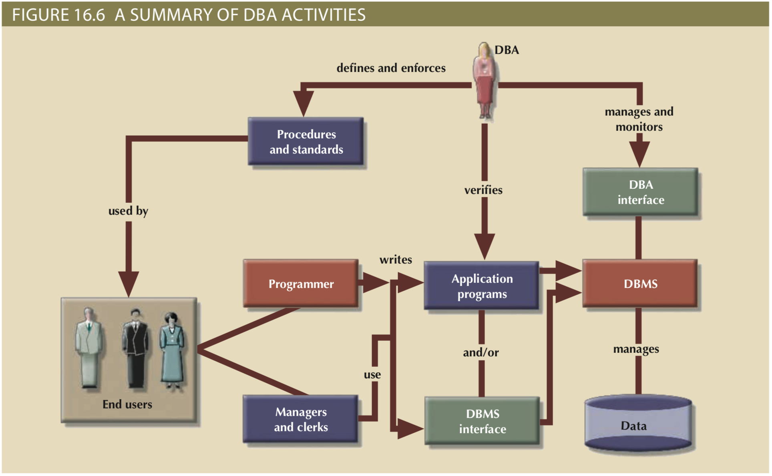

Slide 21
Database Administration
Planning
Organizing
Testing
Monitoring
Delivering
End-user support
Policies, procedures, and standards
Data security, privacy, and integrity
Data backup and recovery
Data distribution and use

Slide 22
Security Terminology
Confidentiality
access by authorized users for authorized purposes
Compliance
activities that meet internal data procedures or government regulations, like FERPA (Family Educational Records Privacy Act)
Integrity
data consistency and anomalies are remedied
Availability
continuous, uninterrupted access to sweet, sweet data

Slide 23
Security Terminology
Security Vulnerability
a weakness in a system component that can be exploited
to allow for disruption or malicious access
Security Threat
a vulnerability that is left unaddressed after discovery
Security Breach
a security threat is exploited that hurts integrity, confidentiality or availability

Slide 24
Security Terminology
Security Vulnerability
Equifax notified of a security vulnerability in Apache Struts framework
Security Threat
Equifax does not patch vulnerability for months
Security Breach
One of many contributions to the eventual data breach

Slide 25
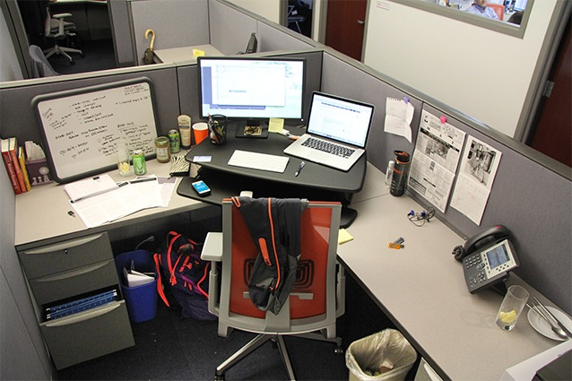

Slide 26
Security Problems
Computer screen left on with no password protection – passer by has access to information on the device
Unshredded files in trash could contain sensitive information
File cabinet open - easy for someone to steal sensitive information
Cell phone left out in the open - may display sensitive information and/or can be easily stolen
Notes left on whiteboard - could contain confidential product updates, information or ideas
Backpack left out and open
Usernames and passwords left out in the open
Key to locked drawer left out in the open - easy access to confidential files
Calendar out in the open - could contain sensitive dates and/or information
Credit card left out on desk
Documents left out on desk that could contain sensitive information
USB drive left out in the open
Wallet left on desk

Slide 27
Security Vulnerability Vectors
People – passwords, computer open, physical security issues
Workstation and servers - multi-user permissions, hardware failure, data storage issues
Operating system – viruses, spyware, malware
Applications – bugs, SQL injection, session hijacking, email phishing
Network – IP spoofing, unencrypted data
Data – shared data access and lack of access control

Slide 28
Database Security
Authorization Management
User access management
User creation and access privileges
User – allow a given person access
Role – authorize a user to use some portion of system
Profile – control how many resources someone can use
View definition
Access rights to derived views
DBMS access control
DBMS usage monitoring

Slide 29
MySQL Database Security
Only root user has ability to manipulate USER table
GRANT and REVOKE statements control access
MySQL provides for password hashing and other encryption protections

Slide 30
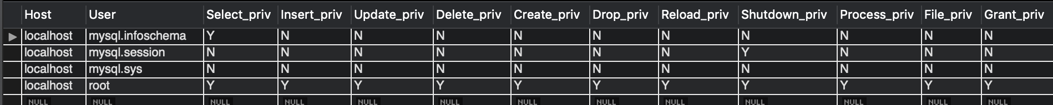
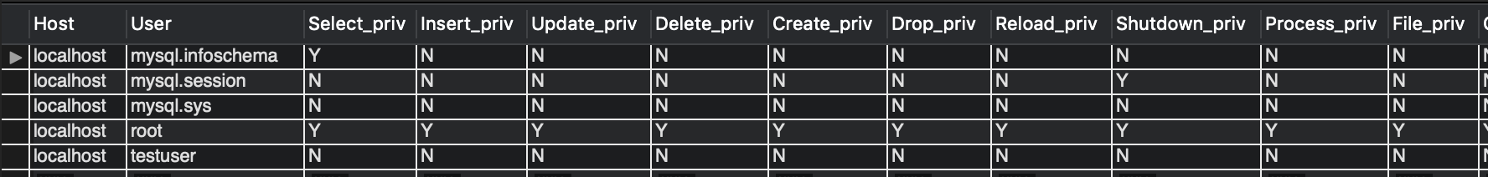
Mysql.User
SELECT * FROM mysql.user;
CREATE USER `testuser`@`localhost` IDENTIFIED BY ‘password123’

Slide 31
GRANT and REVOKE
SHOW GRANTS;
GRANT {function} ON {table} TO `{user}`@`{domain}`
GRANT SELECT ON “*” TO `root`@`localhost`
REVOKE {function} ON {table} TO `{user}`@`{domain}`
REVOKE SELECT ON “*” TO `root`@`localhost`

Slide 32
MySQL Encryption
Full Disk Encryption (FDE) means that the entire disk used by MySQL for storing the database is encrypted.
Simple, transparent and less error prone.
Transparent Data Encryption encrypts specific files since MySQL can be configured so that each DB table gets saved into a separate file.
Encrypting specific rows, fields or columns in MySQL through SQL or program code.

Slide 33
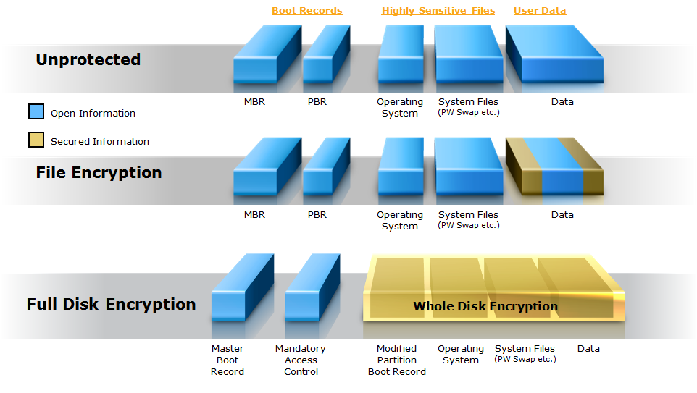
MySQL Encryption

Slide 34
MySQL Encryption
MySQL needs to have SSL configured for secure access through API
Many encryption functions available
AES_ENCRYPT and AES_DECRYPT are examples

Slide 35



Slide 36
MySQL Advanced Objects
Procedures
Organized collections of SQL statements that take variable inputs
Triggers
Organized collections of SQL statements that activate on specific database conditions
Views
Limited subsets of larger tables for security or other needs

Slide 37
Stored Procedure Format
DELIMITER //
CREATE PROCEDURE procedure_name(parameter_list)
BEGIN
...statements
END
DELIMITER ;

Slide 38
Stored Procedure Format
CREATE PROCEDURE procedure_name(parameter_list)
Parameter list can use IN, OUT or INOUT types.
OUT and INOUT will be discussed briefly after variables.
Once a procedure is written you can CALL it.

Slide 39
Stored Procedure Format
CREATE PROCEDURE procedure_name(parameter_list)
parameter_list -> IN param_1 param_1_datatype
CREATE PROCEDURE procedure_name(IN param_1 VARCHAR(255))
IN parameters are now available as read-only values inside procedure block (between BEGIN and END)

Slide 40
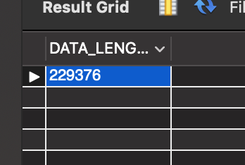
Stored Procedure Example
CREATE PROCEDURE largeco_table_size(IN t_name VARCHAR(255))
BEGIN
SELECT data_length FROM information_schema.tables
WHERE table_schema = “largeco” AND
table_name = t_name;
END
CALL largeco_table_size(“lgcustomer”);

Slide 41
Stored Procedure Example
Procedures will return all SELECT statements that output results.
Procedures can also store OUT values (more on that after variables).

Slide 42
MySQL Variables
Values stored in a named location for future reference in the current procedure, trigger or session.
Multiple types of variables:
Locally declared variables
User session declared variables (use the @ symbol)
Mainly want to use local variables in this course, since they are scoped inside procedures.

Slide 43
MySQL Variables
DECLARE variable_name data_type [DEFAULT value]
DECLARE temp_data_length int DEFAULT 0;
DECLARE only between BEGIN and END blocks.
Local variables are DECLAREd and then SET, or SELECTed INTO.

Slide 44
MySQL Local Variables
DECLARE temp_data_length int DEFAULT 0;
SET temp_data_length = 10;
SET temp_data_length = (select max(data_length) from table;)
SELECT max(data_length) INTO temp_data_length from table;

Slide 45
MySQL Local Variables
CREATE PROCEDURE largeco_table_size(IN t_name VARCHAR(255))
BEGIN
DECLARE temp_data_length int DEFAULT 0;
SET or SELECT ... INTO statements
END

Slide 46
MySQL Session Variables
Session variables are prepended by a @ symbol. They do not need to be declared before initialization.
SET @test = 10;
SET @test := 10;
SELECT @prod_max:=max(prod_price) FROM lgproduct;
DO NOT use session variables inside procedures unless you need to retain that value for subsequent calls.
Session variables are initialized for the session scope, not the procedure.

Slide 47
0 set @total = 10;
1 delimiter //
2 create procedure add_one (num int)
3 begin
4 declare var_to_add int;
5 set var_to_add = (select max(prod_price) from lgproduct);
6 set @total = @total + num;
7 select var_to_add;
8 select @total;
9 end //
10 delimiter ;

Slide 48
MySQL OUT and INOUT Variables
SET @max_price = 0;
CREATE PROCEDURE price(OUT max_price int)
BEGIN
SET max_price = (SELECT max(prod_price) FROM lgproduct);
END
CALL price(@max_price);
SELECT @max_price; # this will return value set inside proc

Slide 49
MySQL OUT and INOUT Variables
SET @count = 0;
CREATE PROCEDURE counter(INOUT count int, IN interval int)
BEGIN
SET count = count + interval;
END
CALL counter(@count, 1);
SELECT @count; # will return 1

Slide 50
Triggers
SQL code that is invoked (triggered) when a DML event occurs
Triggering timing - Indicates when trigger’s PL/SQL code executes
Triggering event - Statement that causes trigger execution (UPDATE, INSERT, DELETE)
Triggering level - Statement- and row-level
Triggering action - PL/SQL code enclosed between the BEGIN and END keywords

Slide 51
Triggers
DROP TRIGGER trigger_name command
Deletes a trigger without deleting the table
Trigger action based on DML predicates
Actions depend on the type of DML statement that fires the trigger

Slide 52
Triggers
BEFORE and AFTER triggers
Both triggers will fire on triggering statement
Manipulation occurs before or after triggering statement operation
NEW and OLD
States of values to change in trigger body
NEW values on INSERT and UPDATE
OLD values on UPDATE and DELETE
OLD is read-only (since it is being modified by the triggering statement)

Slide 53
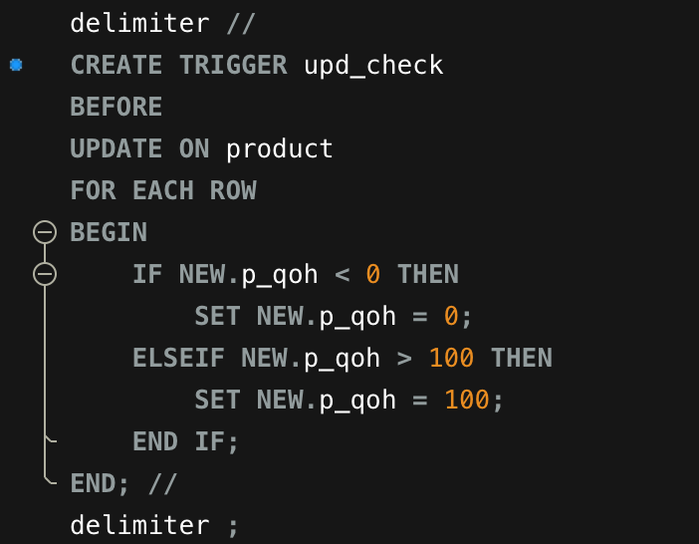
Trigger Example (1)
Triggering Timing
Triggering Event
Triggering Level
Triggering Statement

