Slide 1

Milestone Presentation: Archway
CSI 43C9 Pariveda 3 Section 2 Group 3

Slide 2

Team Introduction

Slide 3
Presentation Overview
Business Problem
Solution
Process
Progress
Demo
Future

Slide 4
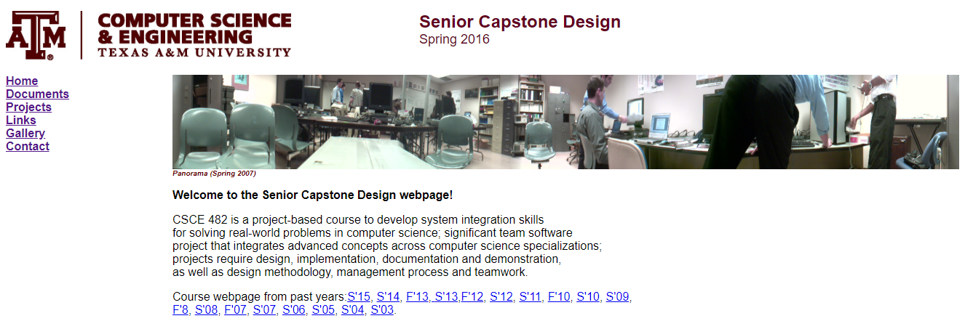
The Business Problem
Universities are missing out on possible sponsorships
Sponsors currently have no way of proposing new projects
Notes:
Needs images with very little textual explanation

Slide 5
Our solution:
Archway is a content management system that gives universities the tools they need to get their capstone projects seen by sponsors.
Notes:
Mission statement

Slide 6
Why Archway?

Slide 7
Technical Solution

Slide 8
Technical Architecture
React.js- Javascript library, reusable components, compiled in browser-> fast rendering without reloading the page
Strapi.io- Node.js based, headless-CMS- manages all content and serves it as raw data via its API
MongoDB- NoSQL database, schema-less and scalable
Docker- applications are packaged into lightweight, portable, self-sufficient containers that can run on any OS

Slide 9
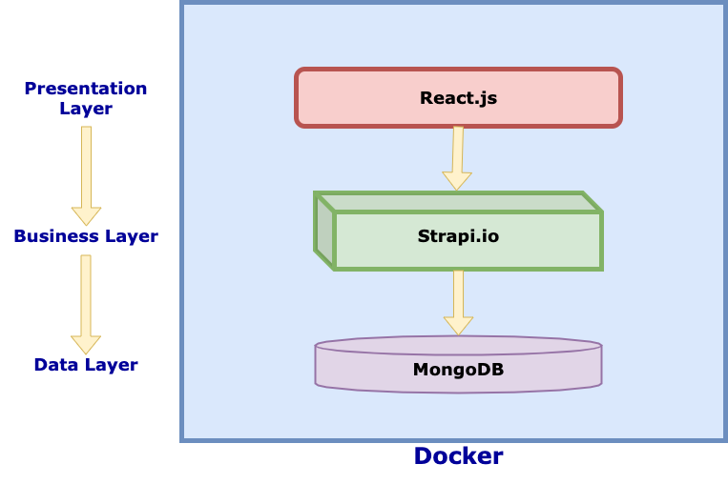
Technical Architecture

Slide 10
Our Process

Slide 11
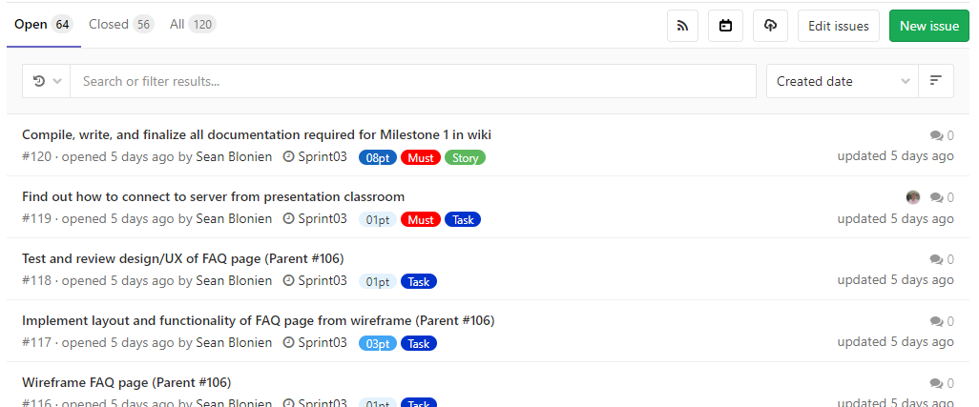
Gitlab Issues Workflow

Slide 12

No strict roles, everyone takes high priority tasks

Slide 13
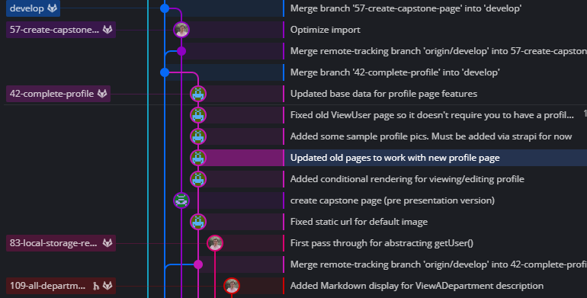
Repo Workflow

Slide 14
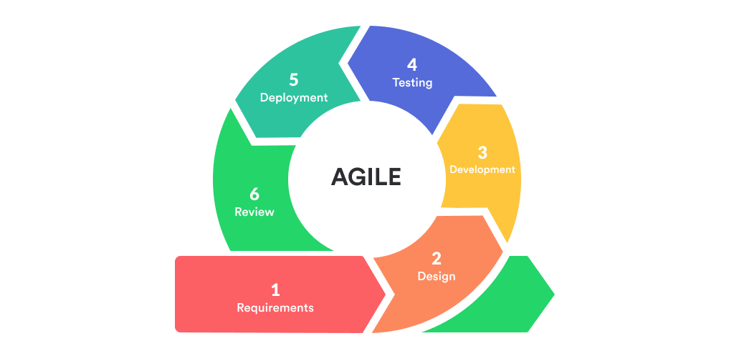
Agile Development

Slide 15
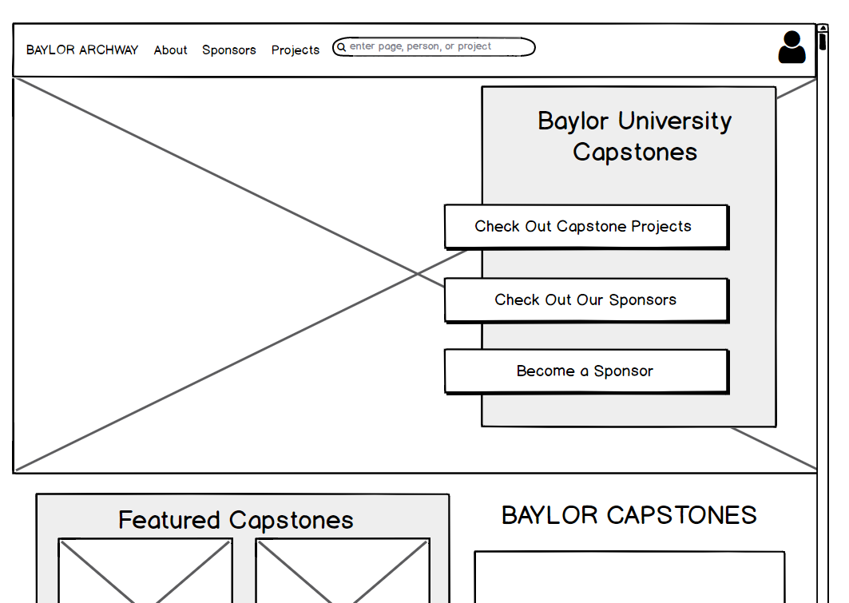

Wireframes
Balsamiq

Slide 16






Our Timeline
Evaluate Business Problem
Develop Initial Solutions
Research Technologies
Rebrand
Rework home page, sponsor page, footer
Wireframe other pages
Search page
University Marketing
User Dashboards
Advanced Permissions
We are here!
Sprint 0
Sprint 1
Sprint 2
Sprint 3
Sprint 4
Sprint 5
Define user stories
Setup environments
Update tech, packages
Export/Import scripts
Create all major form pages
Rework existing pages into updated look
Redesign backend schema
Email notifications
Better TA/Prof management
CI/CD
Sitemap
In depth documentation

Slide 17
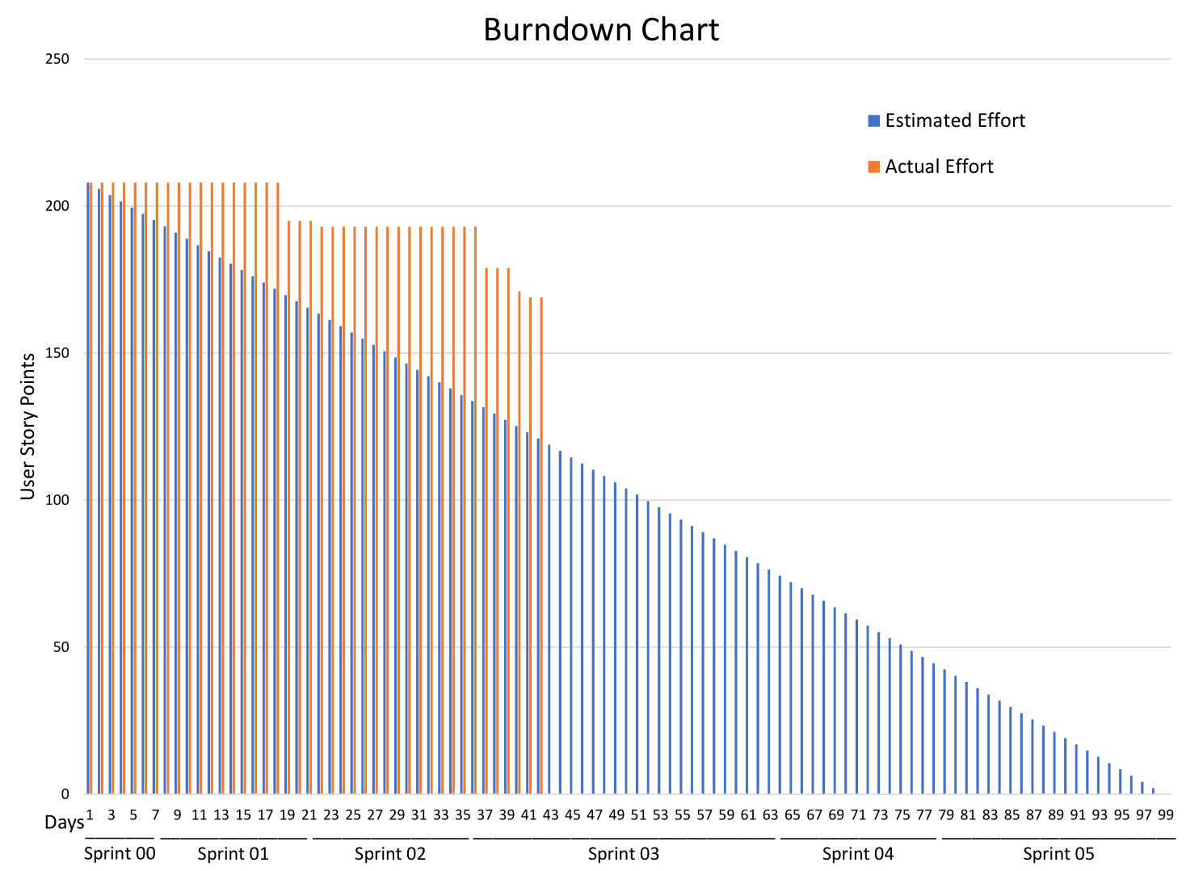

Slide 18
Demo

Slide 19
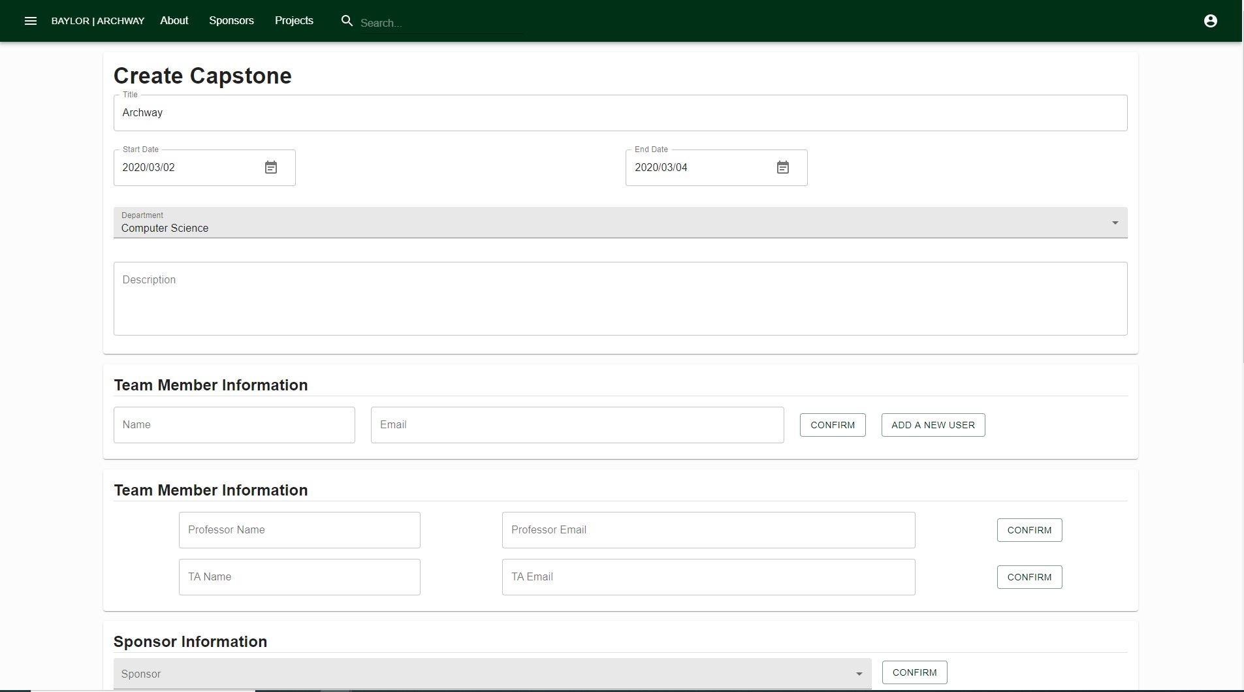

Slide 20
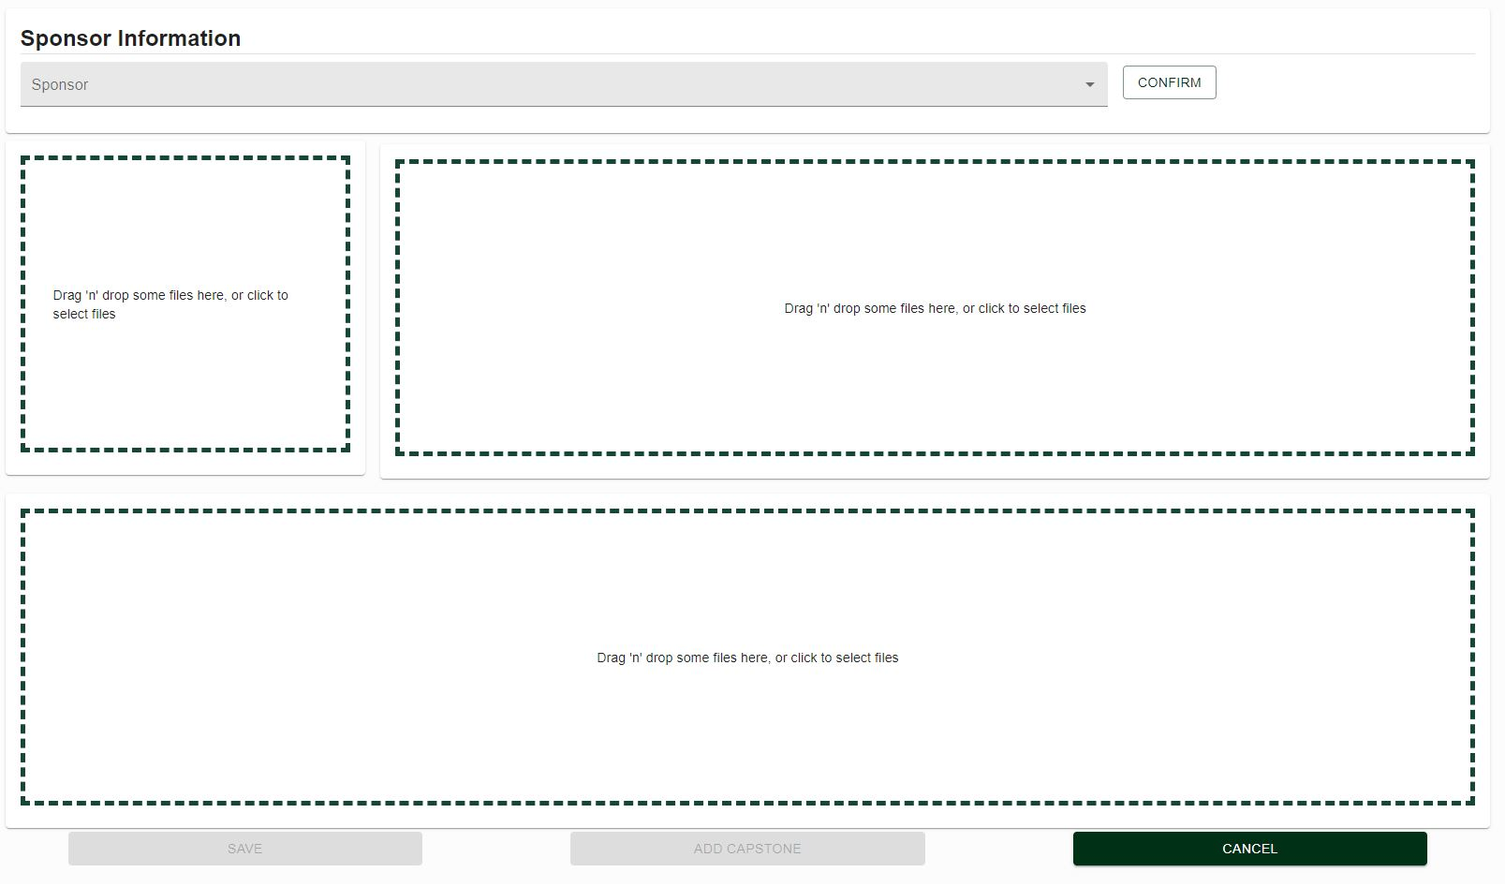

Slide 21
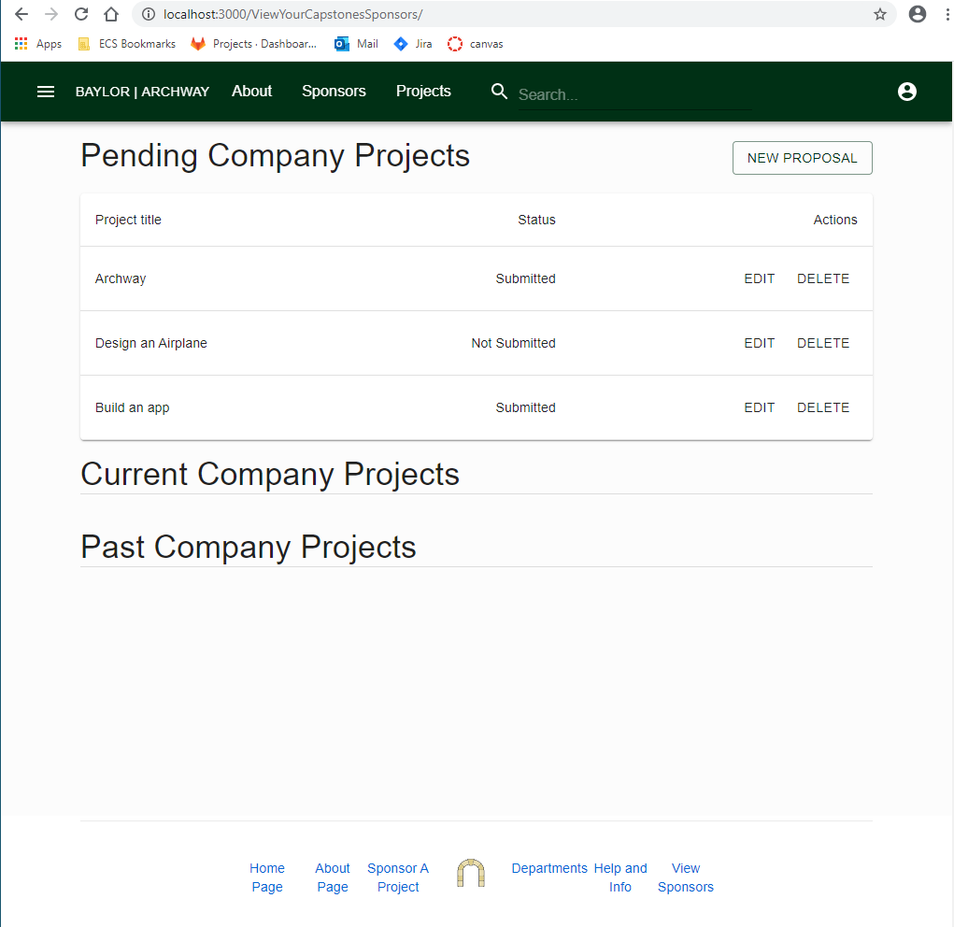

Slide 22
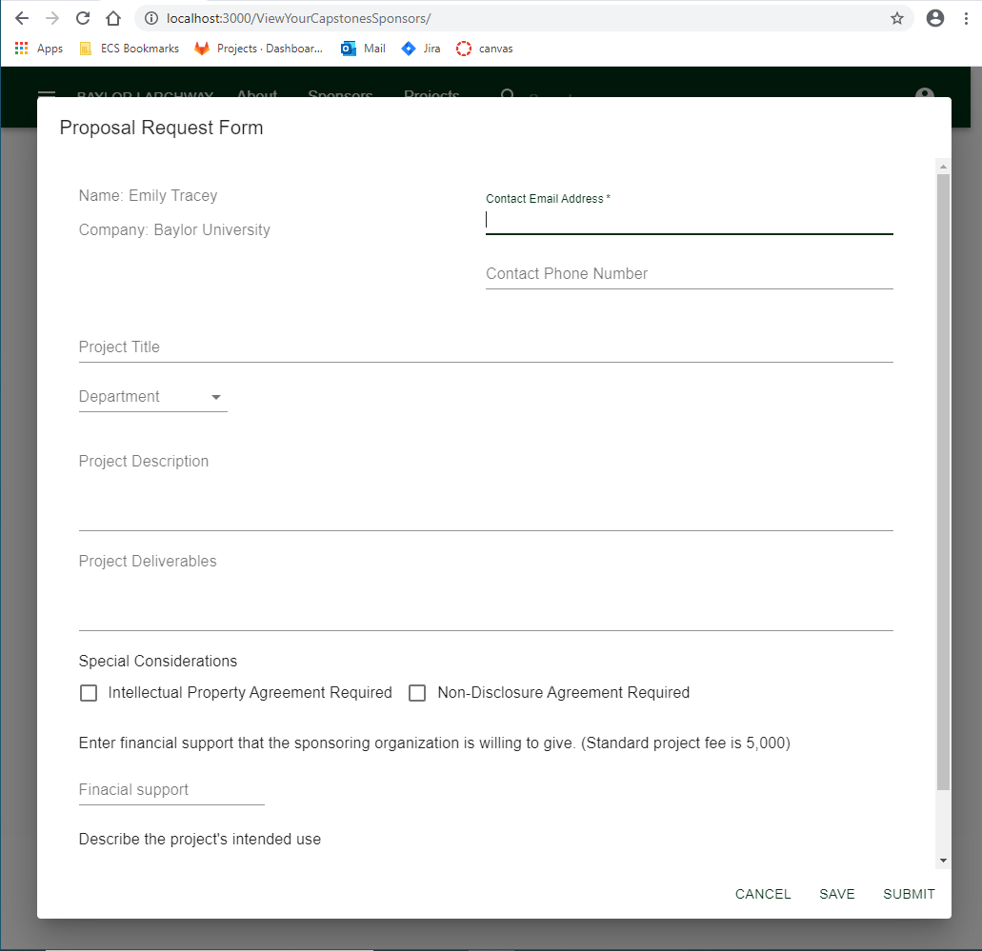

Slide 23
New Features for Final Milestone
Must Haves
Should Have
Could Have
Reworked Strapi schema
Refactored FAQ/About pages
Search Page
User Dashboards
Advanced Permissions
Final Documentation
Sitemap
CI/CD
Updated login Auth0 library
Better default information on Archway
Auto disable accounts after set time
Tags/filters for professors on capstones
Edit capstones
University Marketing
Email Notifications

Slide 24
Potential Risks
Requirements Risk
Project Conflict Risk
Scope Creep
Unplanned Work Risk
Auth0 and Strapi Integration Risk
Scalability Risk
Notes:
Requirements Risk - building the wrong product
Project Conflict Risk - risk of disputing what we want to build in what priority
Scope Creep (i.e. advanced searching/filtering) - wanting to build too much without enough time
Unplanned Work Risk - work that has not been foreseen comes up and doesn’t fit into schedule easily
Auth0 and Strapi Integration Risk - integration of these services with each other to work smoothly and with easy transferability when shipping Archway
Scalability Risk - Kubernetes not on roadmap

Slide 25
Questions?

