Slide 1
Battle of the Neighborhoods
Toronto, CA
By Sean Kelly

Slide 2
Introduction
Toronto is a vibrant, big-time city abuzz with activity. Some of the world's finest restaurants are found here, alongside happening bars and clubs and eclectic festivals. Toronto stands out as a prime candidate as a place to open a new bar.
However, a key piece of criteria when making a decision about where to open a new bar is getting the location right.
This project aims to help businesspeople to choose an area that is not saturated with bars and in a small way help them find a gap in the market.

Slide 3
Business Problem
What are the best Neighborhoods in downtown Toronto for setting up a new bar?
Armed with data, this project uses Machine Learn and Data Science methods to provide answers to this business problem.
Q. What are the best Neighborhoods in downtown Toronto for setting up a new bar?

Slide 4
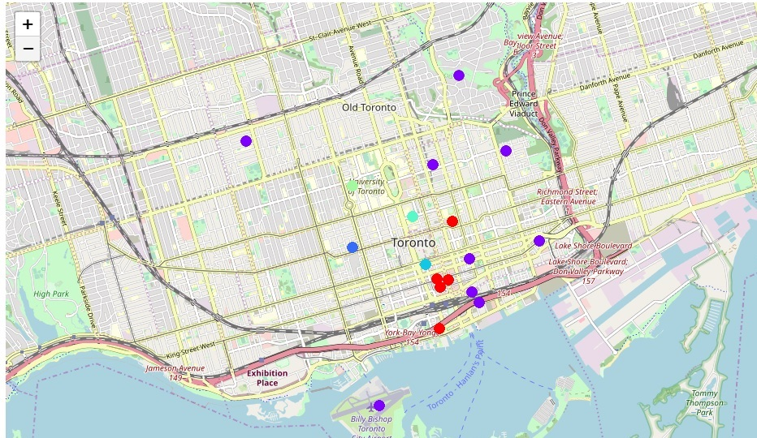
Data Description
1) Data was scraped from the CanadianPostal Code Wikip page and merged Toronto geospatial data.
2) I used Geocoder Package. To get the co-ordinates of neighborhoods in downtown Toronto,
3)Data regardingbars retrived from Foursquare API.

Slide 5
Methodology
I used K-Means Clustering Method to group different venues in group.
This data is classed as unsupervised data.
K-Means Clustering is the simplest and most widely used unsupervised machine learning algorithm for clustering.

Slide 6
Results/Clusters
Cluster (0) – A decent variety of neighbourhoods with a moderate concentration of bars.
Cluster (1) : The most variety of neighbourhoods with a moderate concentration of bars.
Cluster (2) : Harbord and University of Toronto areas, contains a high amount of bars.
Cluster (3) : Covers 3 neighbourhoods (Adelaide, King, Richmond) and has a moderate level of bars.
Cluster (4) : Two neighbourhood (Ryerson, Garden District) with a low level of bars.
Cluster (5) : Single neighbourhood (Central Bay Street) with a moderate concentration of bars.
Cluster (6) : This cluster contains a high concentration of bars, which contains the Chinatown, Grange Park and Kensington

Slide 7
Observations/Conclusion
Cluster 4, the Ryerson and Garden District areas have the lowest concentration of bars so would be a great place to consider investing in opening a new bar.
Cluster 2 unsurprisingly has a high concentration of bars because it covers a student area (University of Toronto neighborhood).
Cluster 6 has the highest concentration of bars (Chinatown, Grange Park and Kensington Market regions)
Clusters 0, 1, 3, and 5 have moderately high concentrations of bars.

