Slide 1
Team TAPS
Tiffany Cole
Andrew Wilson
Philippine Tembo
Sean Bruce

Slide 2
Family Photo Share App for Android
Android App for taking photos and posting them to a Server
User can take picture, or select from existing pictures for upload
Photos can be shared with other users
Compatible with older Android OS versions, as well as latest

Slide 3
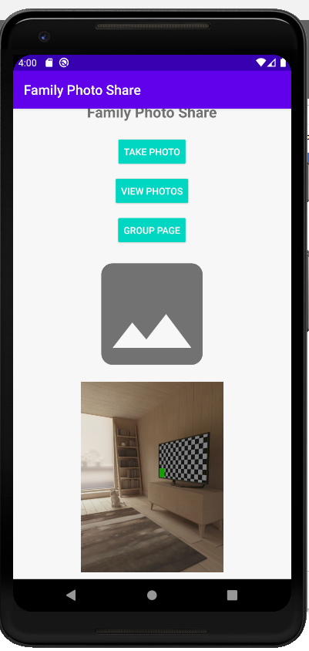
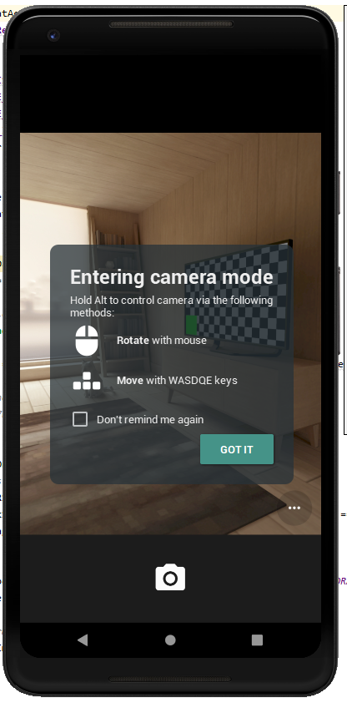
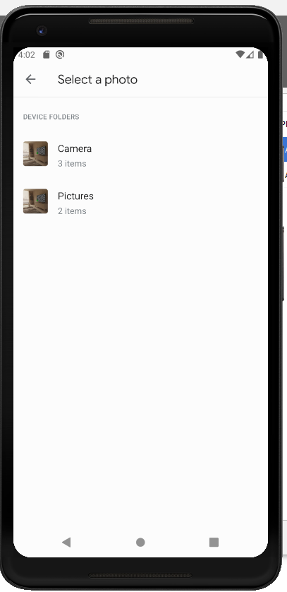
Screenshots of App

Slide 4
Code & Server Choices
Android Coding
Team choice was Kotlin
Reasons
Already started tutorials for it
Native to Android
APIs exist in Kotlin to accomplish our app goals

Slide 5
Code & Server Choices
Photo Server
Team choice was Firebase
Reasons
Most photo servers like Google Photos, IMGUR, and OneDrive require O-Auth code to handle sign in – not enough time
API for Firebase was available as tutorial
API for Google Photos and IMGUR were present, but couldn’t make them work

Slide 6
Team Challenges
APIs we chose for Google Photos or IMGR did not work
API we used for Firebase kept using a personal account, instead of the team account that we made
Personal life issues impacted time to spend on project
Android Studio had issues with app and performance
Adding code to App sometimes caused crashes that took time to find and fix root cause
Time constraints prevented work on original intended features, like App log in, and Fingerprint ID

Slide 7
Retrospective
We got to learn actual mobile development, using language for Android
APIs from Tutorials may not work as expected. The tutorials sometimes assume preconditions that we don’t know about yet
1 month to make a functioning app that uses sensors and connects with a server is very challenging
Android Studio requires significant resources on CPU and memory to run reliably and at acceptable speed

