Slide 1
Installing SQL for
SQL Server
Analysis Services (BI)
SS Integration Services
DESKTOP-IEQ6AAD\SQLEXPRESS
DESKTOP-IEQ6AAD\MSSQLSERVER
DESKTOP-IEQ6AAD\seanb (seanb)

Slide 2
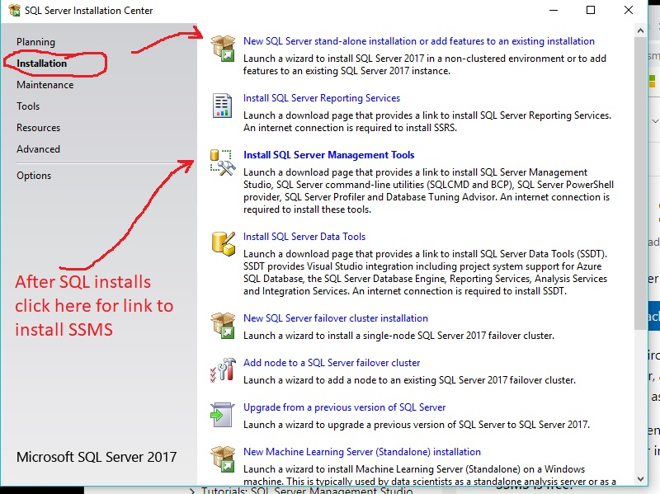
First install SQL

Slide 3
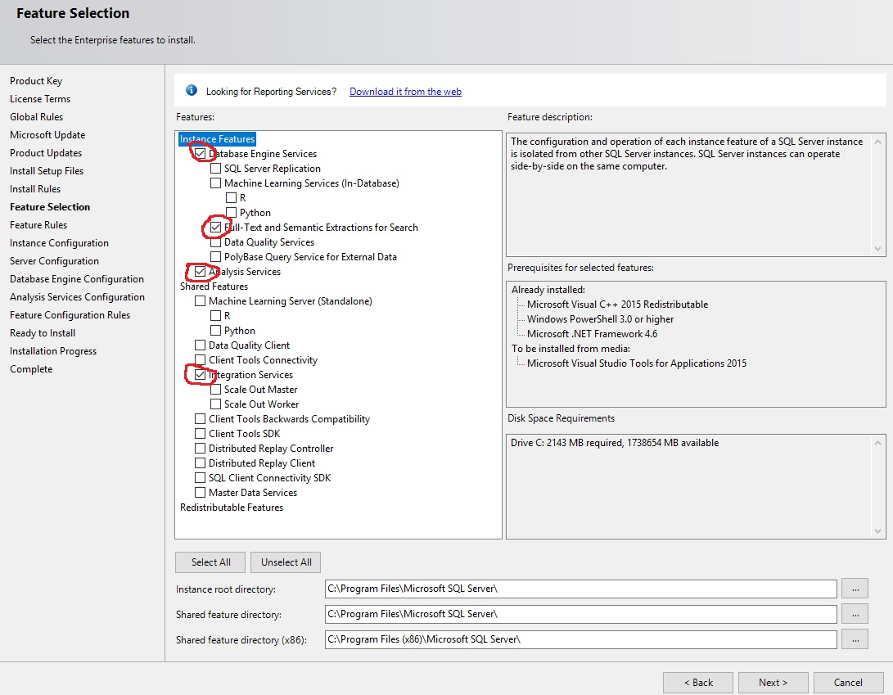

Slide 4
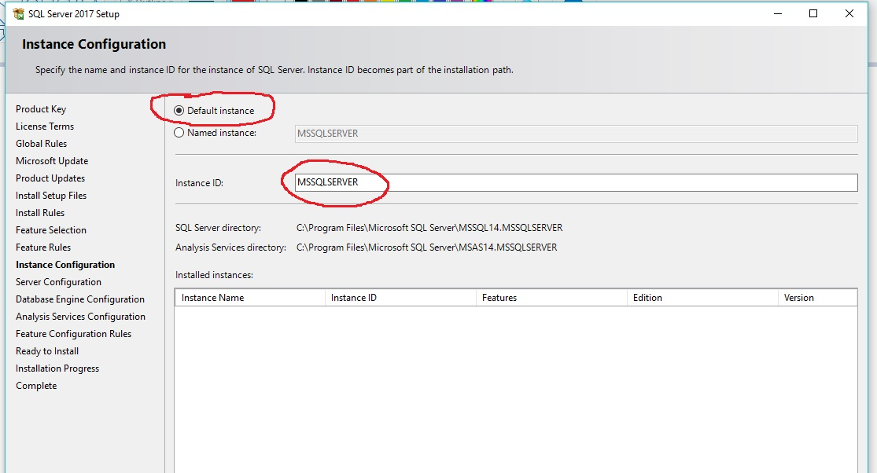
You can pick another name for your instance, most people leave the default

Slide 5
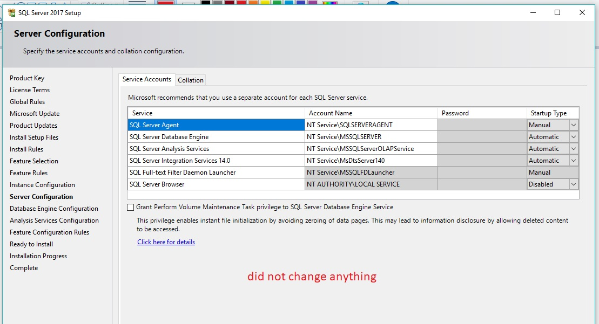

Slide 6
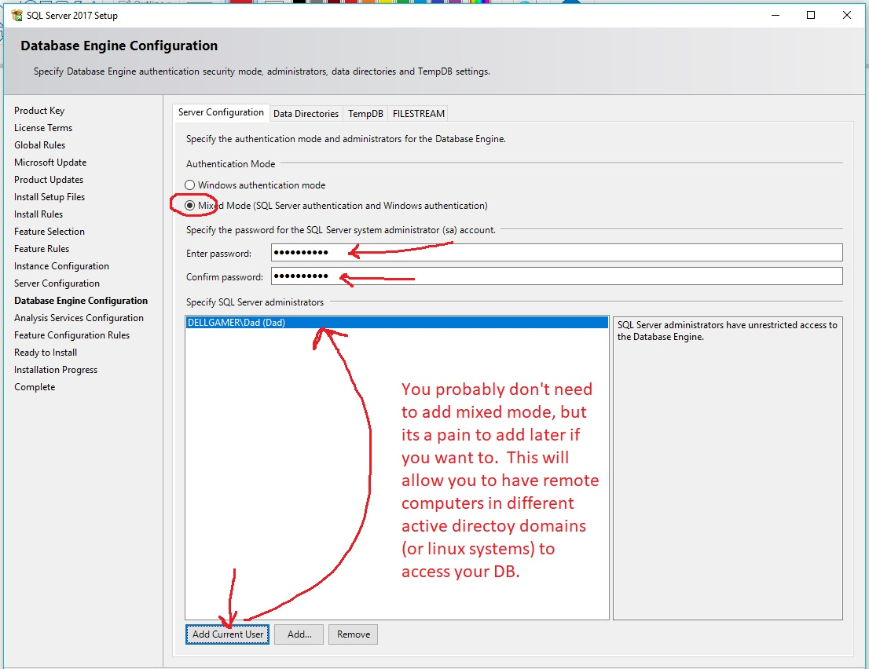

Slide 7
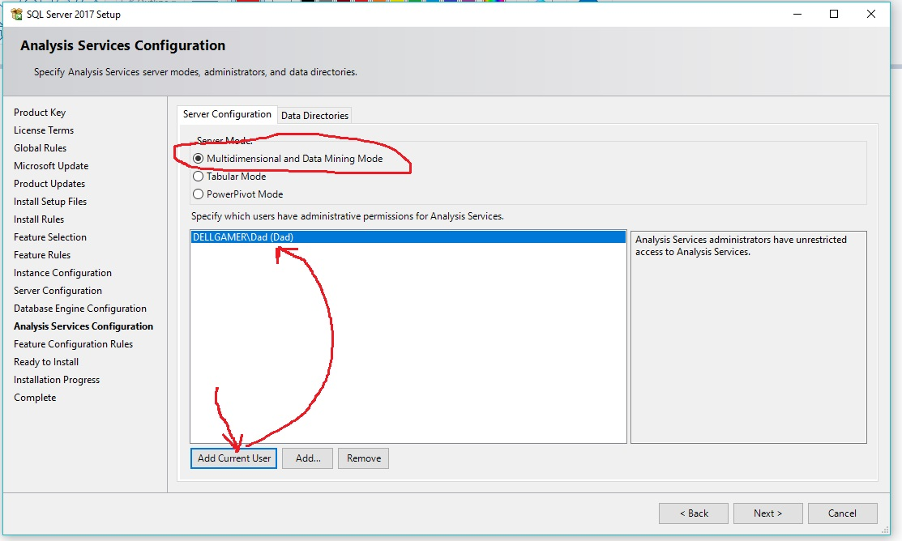

Slide 8
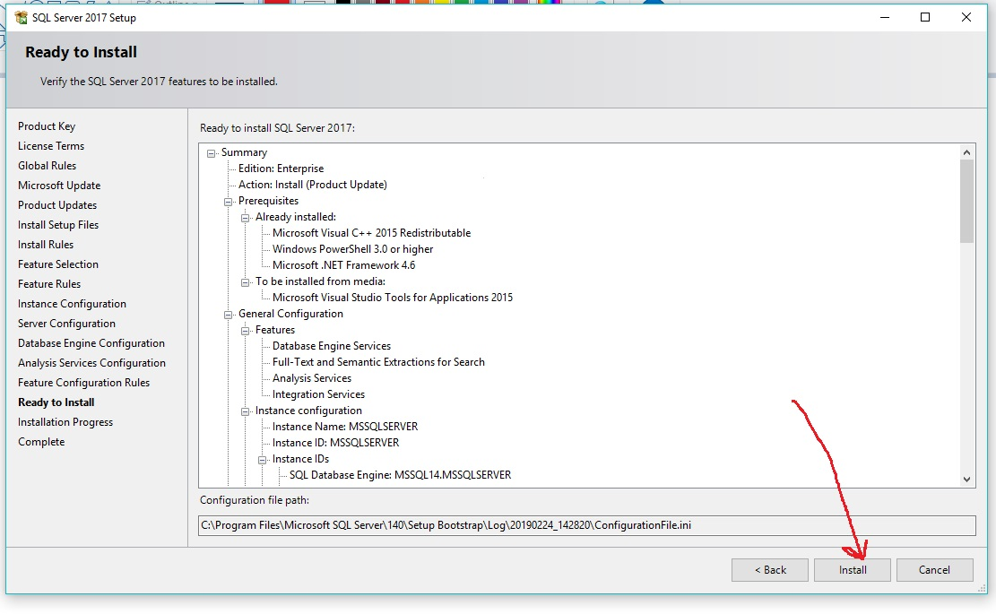

Slide 9
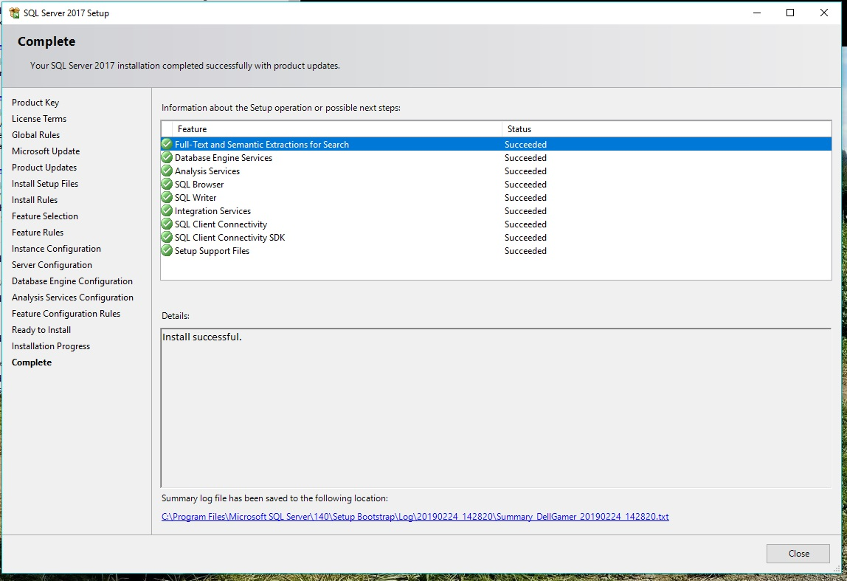

Slide 10
Now install the Management Tool, SSMS

Slide 11
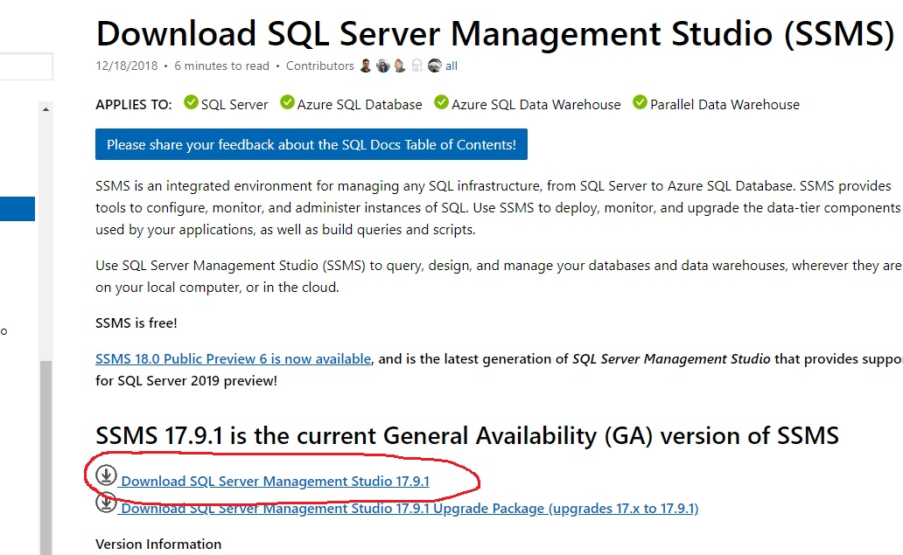

Slide 12
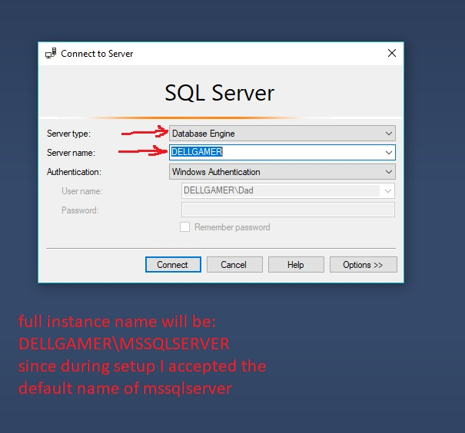

Slide 13
