Slide 1
Course Project
ISIT 420 Spring 2020
Sean Bruce

Slide 2
Sources
FBI Crime Statistics
Census Bureau Statistics
https://ucr.fbi.gov/crime-in-the-u.s/2016/crime-in-the-u.s.-2016/topic-pages/tables/table-1
https://www.multpl.com/united-states-population/table/by-year

Slide 3
PIG: FBI & Census Bureau
data = LOAD 'FBI2.txt' USING PigStorage(':') AS (Year:int, ViolentCrime:chararray, Murder :chararray, Rape :chararray, Robbery :chararray, Assault :chararray, PropertyCrime :chararray, Burglary :chararray, LarcenyTheft :chararray, MoterVehicleTheft :chararray );
dump data;
STORE data INTO 'FBI2_Output/ ' USING PigStorage (',');
data = LOAD 'CensusBureau.txt' USING PigStorage(',') AS (Datetime:chararray, Population:chararray);
dump data;
STORE data INTO 'CensusBureau_Output/ ' USING PigStorage (',');
Year | ViolentCrime | Murder | Rape | Robbery | Assault | PropertyCrime | Burglary | LarcenyTheft | MoterVehicleTheft
1997 | 1636096 | 18208 | 96153 | 498534 | 1023201 | 11558475 | 2460526 | 7743760 | 1354189
1998 | 1533887 | 16974 | 93144 | 447186 | 976583 | 10951827 | 2332735 | 7376311 | 1242781
… | … | … | … | … | … | … | … | … | …
2015 | 1199310 | 15883 | 91261 | 328109 | 764057 | 8024115 | 1587564 | 5723488 | 713063
2016 | 1248185 | 17250 | 95730 | 332198 | 803007 | 7919035 | 1515096 | 5638455 | 765484
Date | Population Value
4/1/2020 | 329460000
7/1/2019 | 328240000
… | …
7/1/1901 | 77580000
7/1/1900 | 76090000

Slide 4
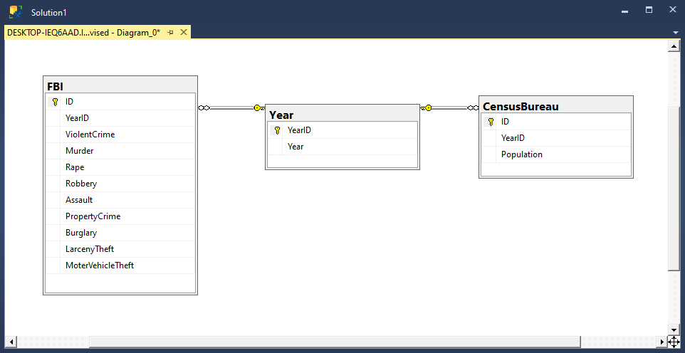
SQL Diagram

Slide 5
Questions
Search population and crime statistics by year
Year by year comparison of population to murders
Year by year comparison of population to violent crimes

Slide 6
Problems
The biggest problem I encountered was displaying data. I kept receiving undefined messages when I thought I had everything correct. I did get it to display properly, but unfortunately, I have no idea how I did it. But my guess is fixing typos and allowing the project to properly refresh to reflect the changes made in code.
If I had a second biggest problem, it would be the trying to come up with interesting questions to ask of the data.

