Slide 1
ISIT 328
Week 10
Stored Procedure

Slide 2
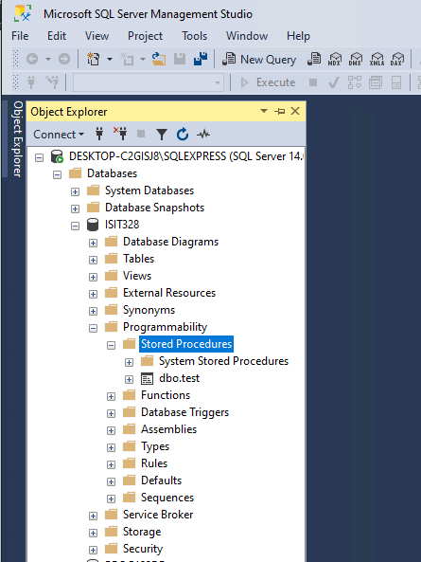
Store Procedure
On SSMS, navigate to the “Stored Procedure” folder

Slide 3
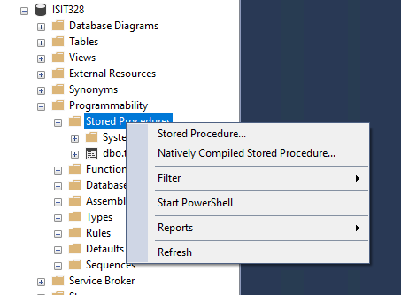
Store Procedure
Right click on the “Stored Procedure” folder then click on “Stored Procedure …”

Slide 4
Store Procedure
Right click on the “Stored Procedure” folder then click on “Stored Procedure …”

Slide 5
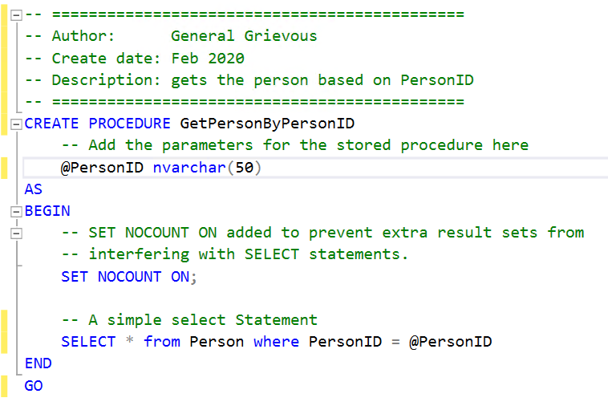
Store Procedure
Receives a @PersonID as a parameter. Returns a row of the the Person table

Slide 6
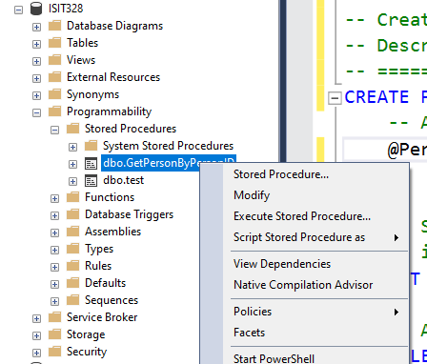
Store Procedure
To modify it, right click an dmodify

Slide 7
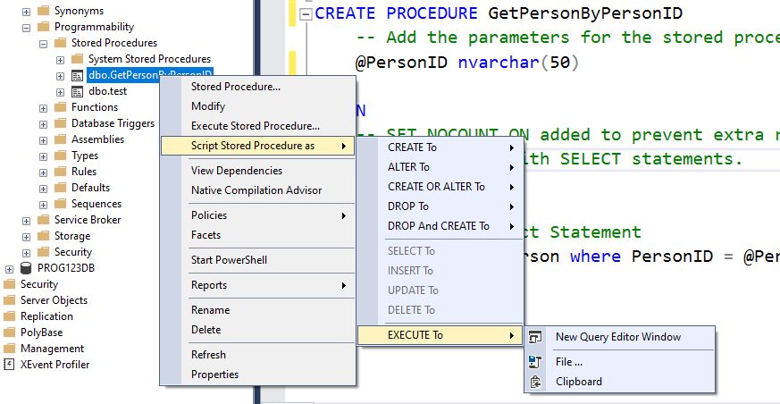
Store Procedure
To execute/run it

Slide 8
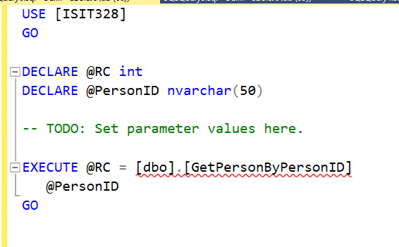
Store Procedure
You get something like this
You now need to set the parameter

Slide 9
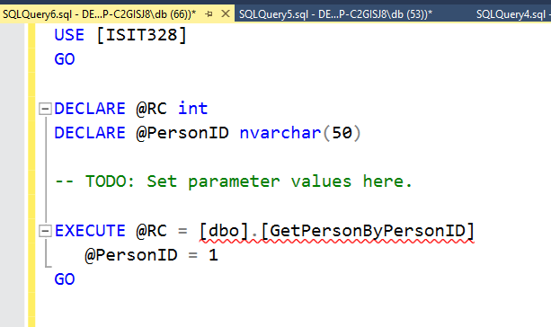
Store Procedure
Set the parameter
I set it to 1 because I know there’s a PersonID in my DB with value 1

Slide 10
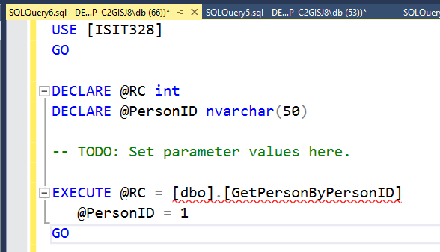
Store Procedure
Execute the Store Procedure an you get this

Slide 11
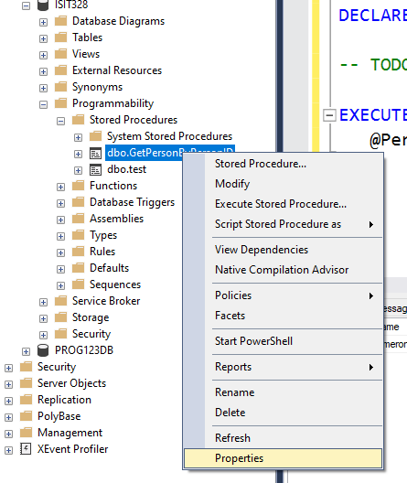
Store Procedure
Give access to the ISIT328_user
Right click on the Stored Procedure > Propersties

Slide 12
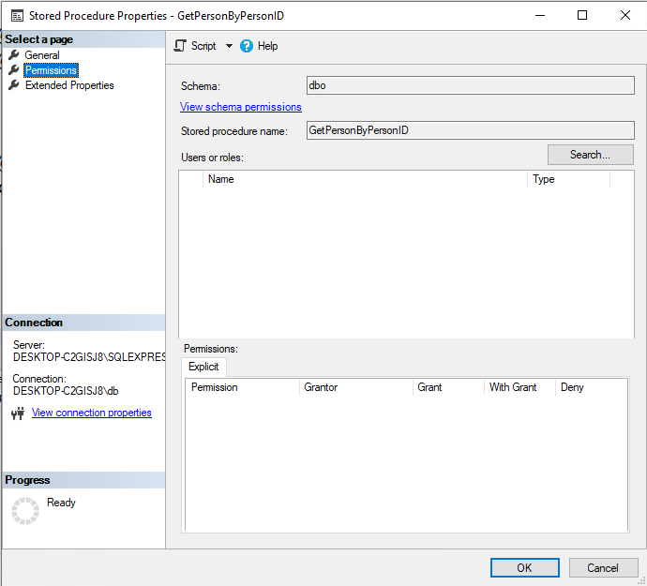
Store Procedure
On Permisisons, click on Search

Slide 13
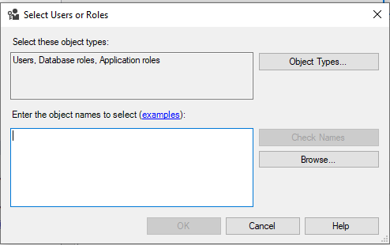
Store Procedure
click on Browse …

Slide 14
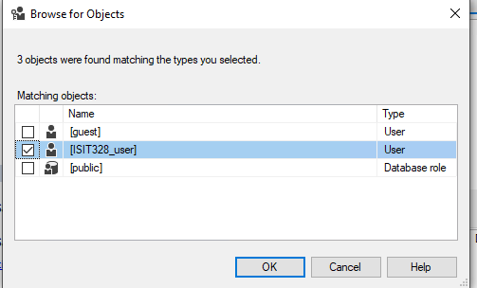
Store Procedure
check the user you want to give access
My user is ISIT328_user
Click OK

Slide 15
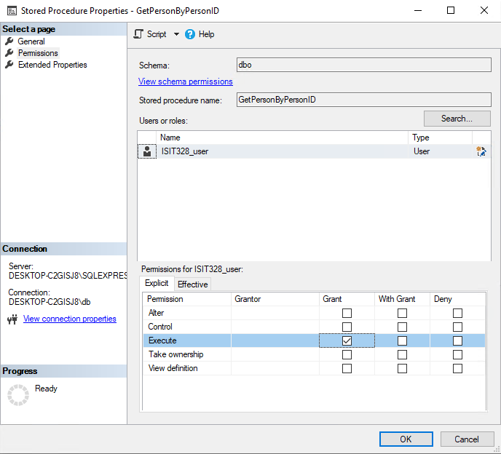
Store Procedure
Click ok a coujple of times until you get to this screen
Check on Execute
OK

Slide 16
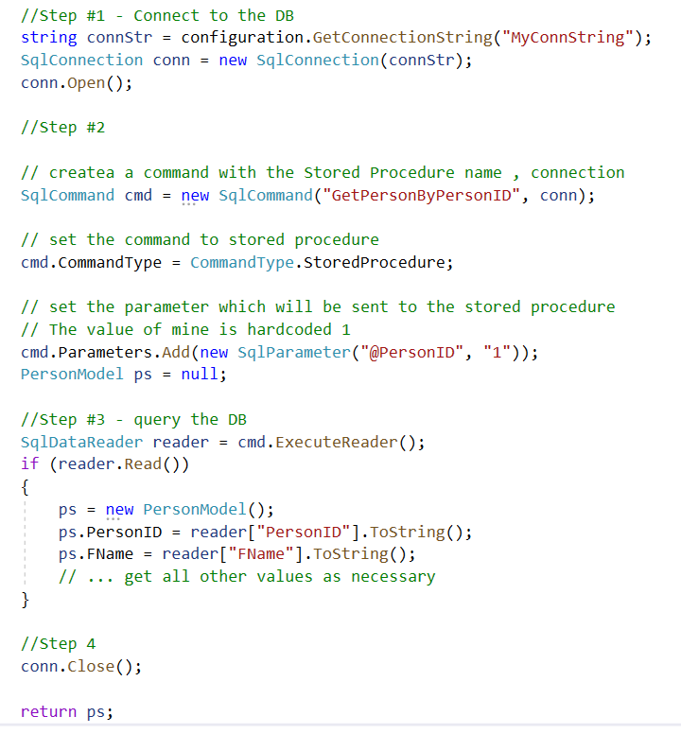
Store Procedure
For the Visual Studio project, then change is easy

Slide 17
Store Procedure
For the Visual Studio project, then change is easy

Slide 18

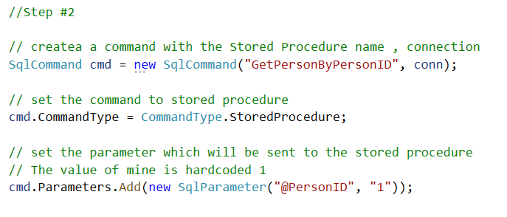
Store Procedure
For the Visual Studio project, then change is easy

Slide 19
Store Procedure
For the Visual Studio project, then change is easy

