Slide 1
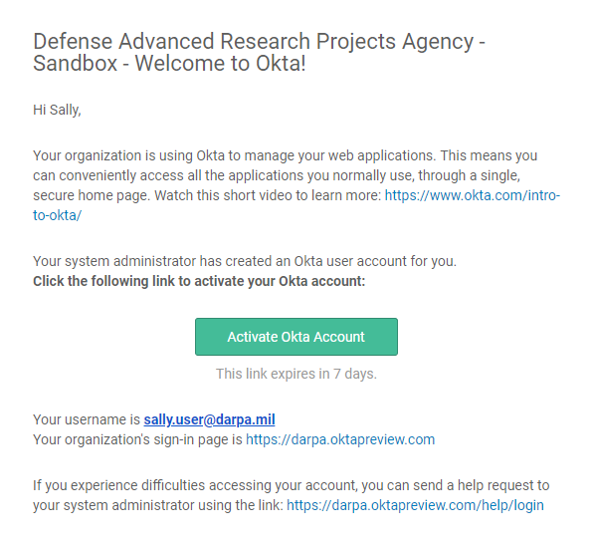
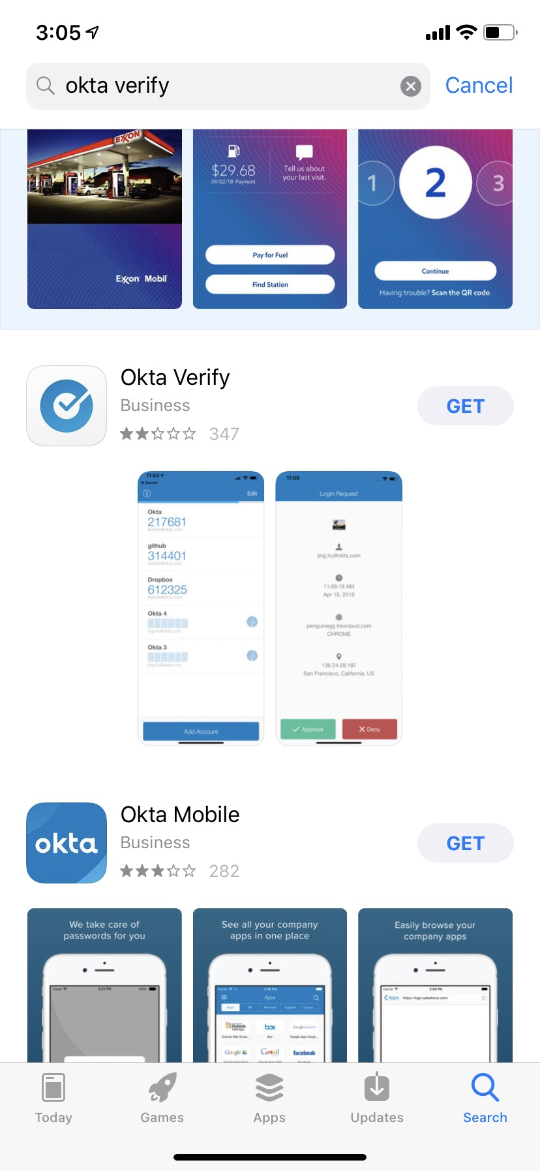
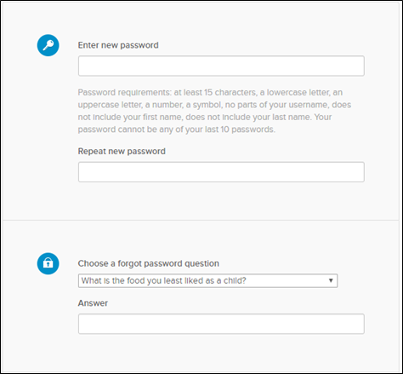
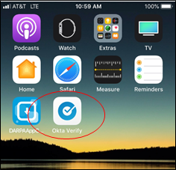
Skype for Business Quick Start Guide—Audio Setup and Making Calls—pages 1 and 4
BAA and your DARPA Extranet Account
Activate Your DARPA Extranet Account at Login.darpa.mil/darpa.okta.com You will receive an email with the subject, "Welcome to Okta!". The email will provide a link to Activate your Okta Account and your username.
DARPA is migrating BAA to OKTA for account authentication. When your account is migrated to Okta you will receive a “Welcome to Okta” email with a link to set up your Okta account. To activate your account you must use the link in that Email. The initial activation takes place at login.darpa.mil/darpa.okta.com.
In addition to being where you will activate your DARPA extranet account, login.darpa.mil/darpa.okta.com is a home page where you can see a list of your DARPA Extranet applications. You will be able to access BAA from login.darpa.mil/darpa.okta.com or directly at BAA.darpa.mil after you activate your account.
DARPA Extranet account customers must log in using a username, password, and multi-factor authentication (MFA). DARPA supports two MFA options: Okta Verify and Email Authentication.
Please download the Okta Verify App from the Apple App or Google Play stores. You must have an active Apple App Store or Google Play account to download the app.
Note: DARPA Extranet customers must setup both Okta Verify and Email Verification initially. When accessing BAA.darpa.mil or Login.darpa.mil, DARPA Extranet customers are required to use either Okta Verify or Email Authentication as the second Multi-factor Authentication (MFA).
1. Click on the link, "Activate Okta Account" to set up your account. This link expires 7 days from receipt. Take note of your username in the email. If you don’t receive an email or the link doesn’t work, contact the DARPA Help Desk at action@darpa.mil.
External users will enter a new password, choose or create a “forgot password question”, and choose a security picture to setup their account.
Download Okta Verify
1. Using your smart phone, search and download the Okta Verity app from the Apple App or Google Play store.
Note: You must have an active Apple App store or Google Play account to download the app.
Pages 1 and 4
1. Type and repeat your new password. It must be a minimum of 15 characters and include a lowercase letter, an uppercase letter, a number, a symbol and no parts of your username, first or last names. Your password cannot be any of your last 10 passwords.
2. Click on the “down arrow”, select a password reset question or create your own question and type your answer. It must be at least 4 characters.

Slide 2
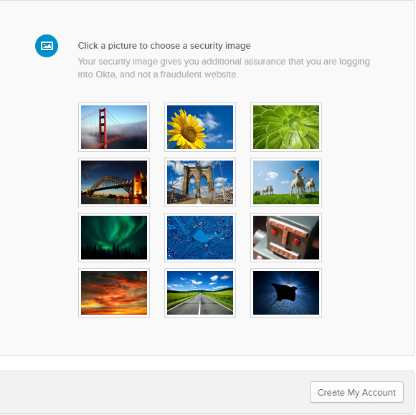
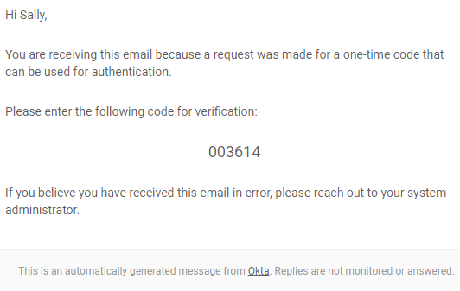
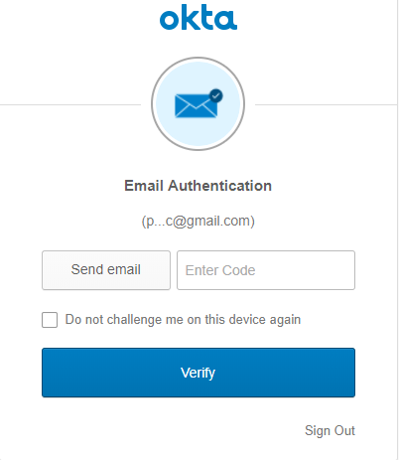
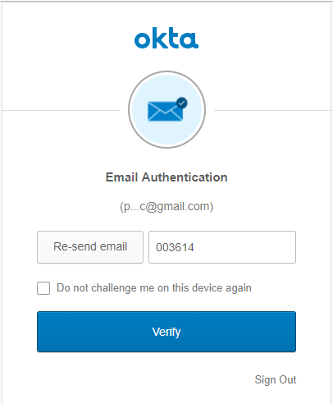
Skype for Business Quick Start Guide—Audio Setup and Making Calls—pages 2 and 3
6. Open the email from “Okta” for the 6-digit setup verification code
3. Click on a picture to choose your security image.
4. Click “Create my Account”
5. Click “Send Email” to receive a code in your email.
Note: The email will be sent to the email address used to set up your Login.darpa.mil account.
7. Type in the 6 digit code you received in your email. Click “Verify”. Your email MFA is now set up. You will be prompted next to set up up your Okta Verify MFA.
Pages 2 and 3

Slide 3
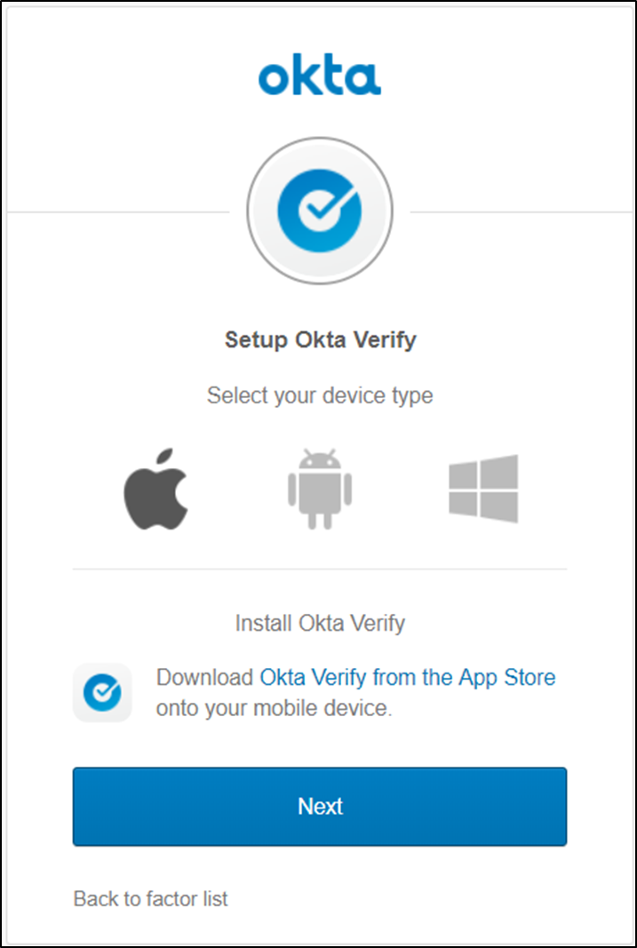
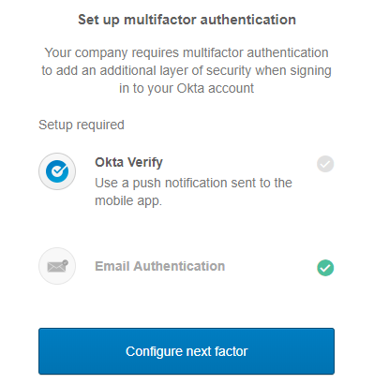
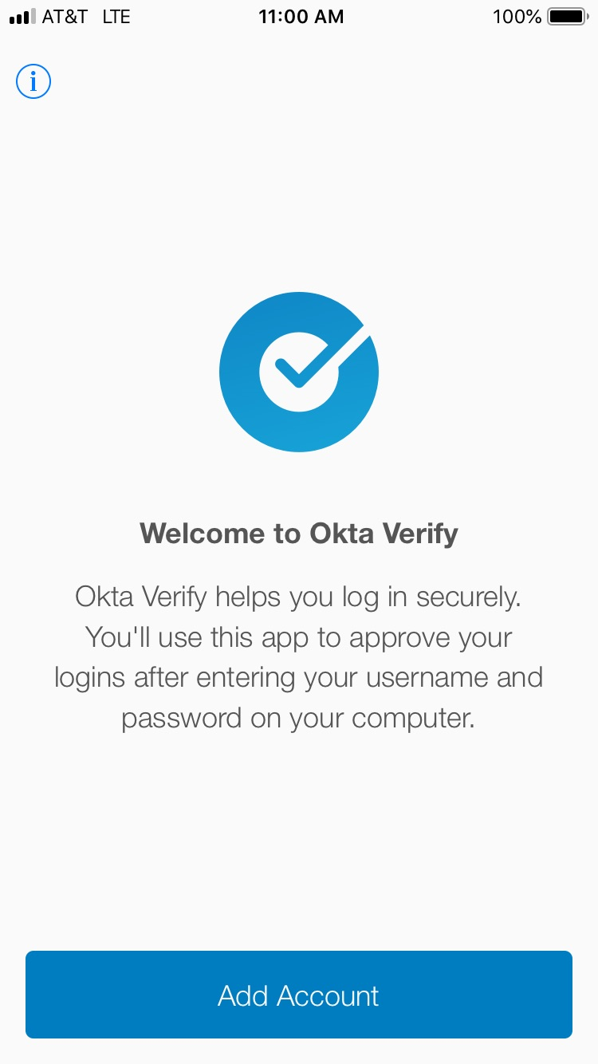

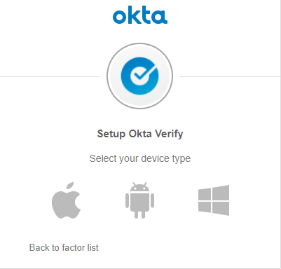
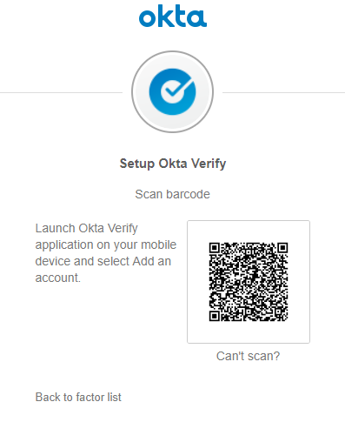
Skype for Business Quick Start Guide—Audio Setup and Making Calls—pages 1 and 4
Set Up Okta Verify MFA
(One-time SMS Push Registration)
3. Select “Next” to continue.
You must complete your second multi-factor authentication (MFA).
Note: You must have Okta Verify installed on your smart phone prior to this setup.
1. “Okta Verify” will be highlighted. Click “Configure next factor” to set up your Okta Verify registration.
4. Using your smart phone, open the previously downloaded Okta Verify App and click “Add Account”
Pages 1 and 4
2. Select your device type. Click on the “Apple Icon (or Android)”, as applicable.
5. Using your smart phone, click on “allow camera use” and “scan” the QR code on the “Setup Okta Verify” screen. Your Okta Verify MFA setup is now complete.
Note: If camera use is not allowed, click on the link “Can’t Scan?” to use the alternate ways to set up Okta Verify.

Slide 4
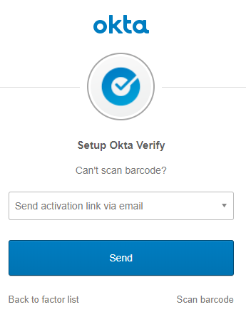
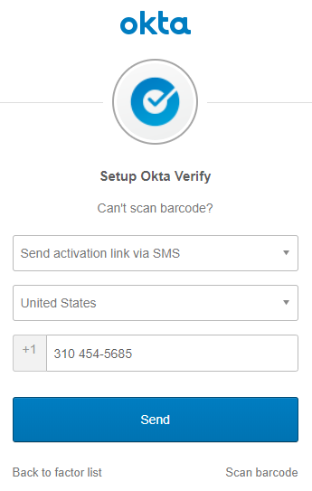
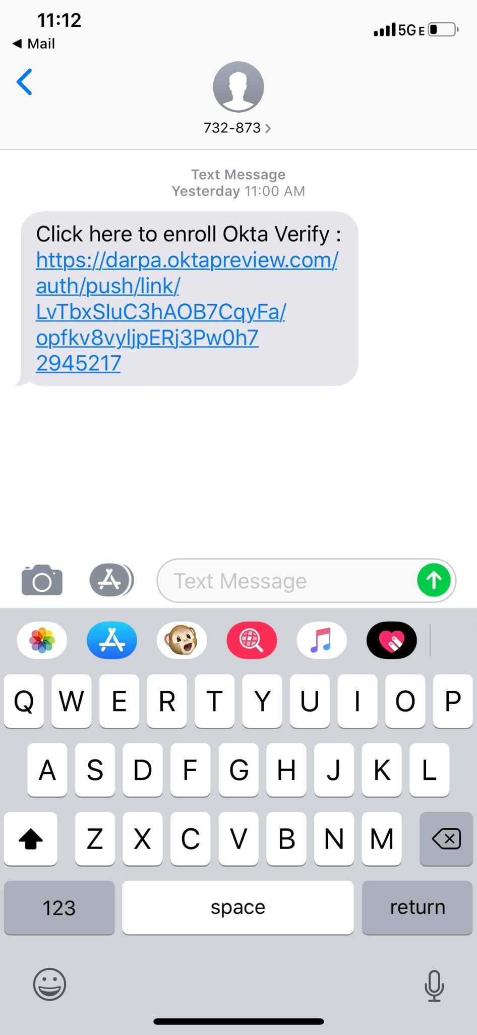
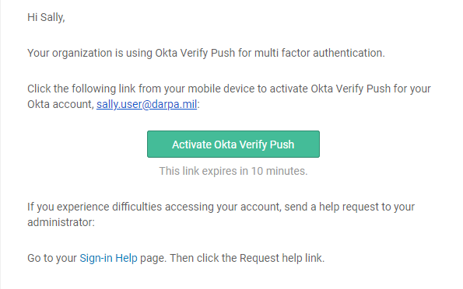
Skype for Business Quick Start Guide—Audio Setup and Making Calls—pages 1 and 4
Alternate Okta Verify Setup
There are two alternate ways to set up Okta push authentication on your smartphone: SMS and Email.
Okta Verify Setup using Email
1. Click on the “Down arrow” to switch between SMS and email verification and select “Email”
2. Click “Send” from your smart phone.
Okta Verify Setup using SMS
1. Click on the “Down arrow” to switch between SMS and email verification and select “SMS”
2. Enter your smart phone number and click “Send”.
Pages 1 and 4
3. Using your smart phone, open the Okta Verify enroll text and click the “text link”.
3. Open the email and click “Activate Okta Verify Push”.

Slide 5
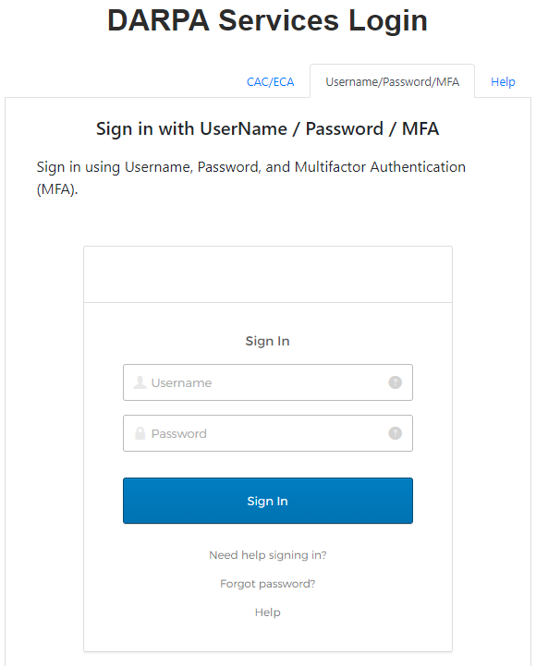
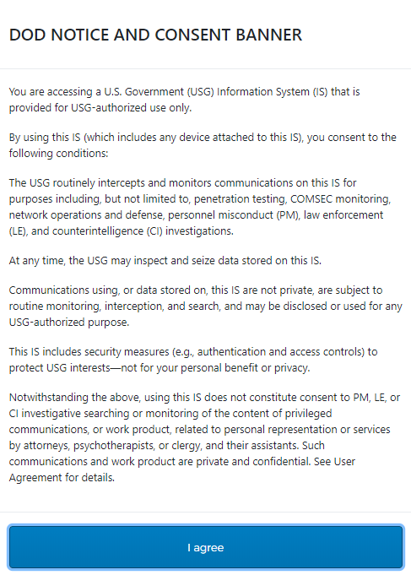
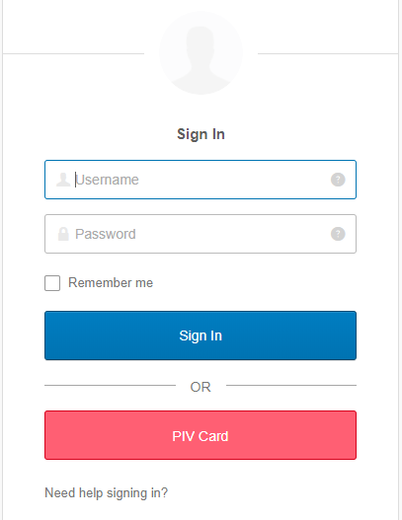
Skype for Business Quick Start Guide—Audio Setup and Making Calls—pages 1 and 4
Logging into Login.darpa.mil Using Username, Password, and MFA.
1. Go to https://login.darpa.mil on your PC or Mac.
2. Review the DoD notice and consent Banner and Click “I agree”.
3. Click on the “Username/Password/MFA” tab.
4. Type in your username and password, and click “Sign in”
5. Follow the MFA prompts to complete the login.
6. You can also log on using the Okta native login page: https://darpa.okta.com/
7. Type in your username and password, and click “Sign in”
8. Follow the MFA prompts to complete the login.
Pages 1 and 4

Slide 6
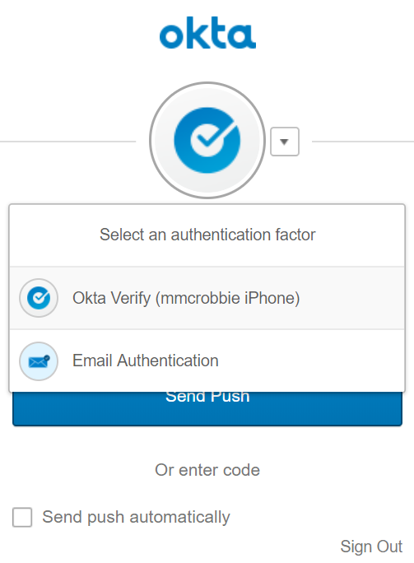
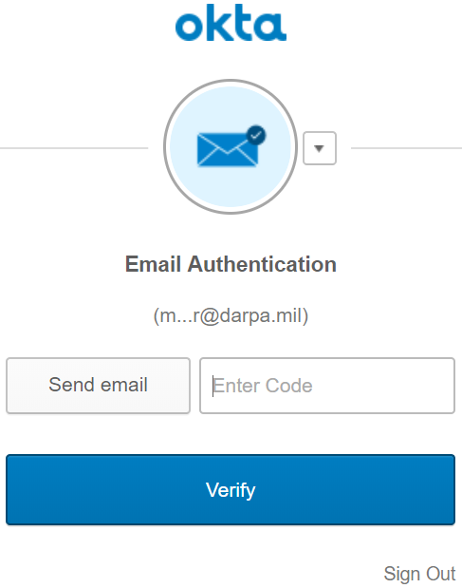
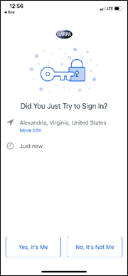
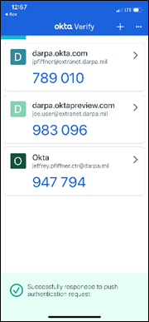
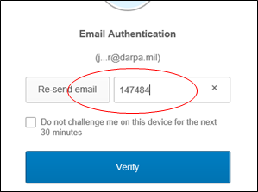
Selecting the MFA Authentication
You must select a MFA to complete the login.
Using Email Authentication:
1. Click “Email Authentication” and then click “Verify”
1. Click on the dropdown menu to display “Okta Verify” or “Email Authentication”.
2. Click “Send Email”
3. Retrieve the 6-digit verification code from your email.
Note: It could take 1-2 minutes to receive the email.
4. Type the 6-digit code in the “Email Authentication” and click on “Verify”
Using Okta Verify:
1. Select “Okta Verify”
2. Select “Send Push”
3. Use your smart phone, open the Okta Verify app and click “Yes, It’s Me”

Slide 7
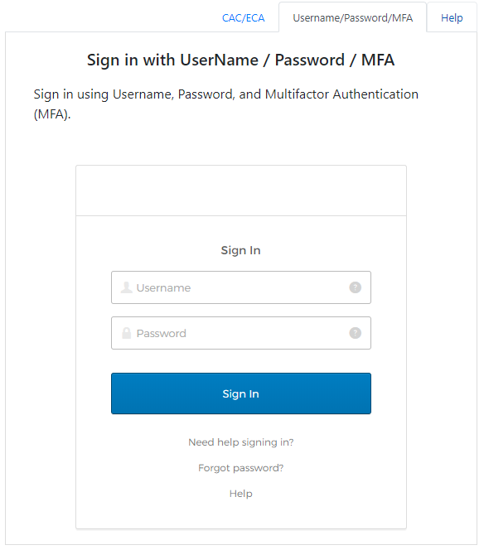
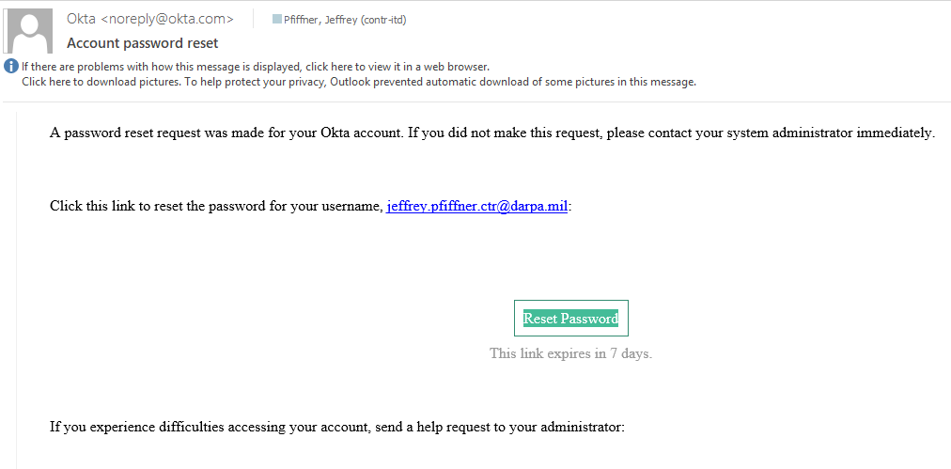
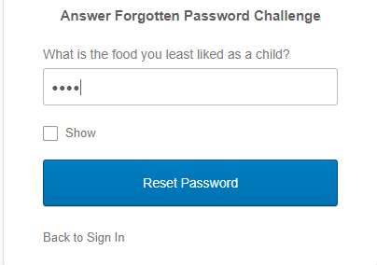
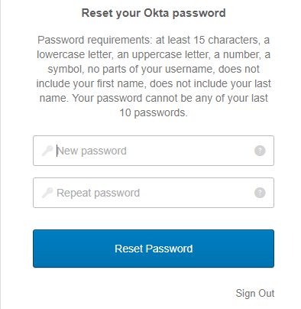
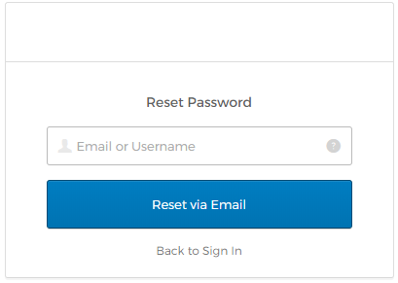
Skype for Business Quick Start Guide—Audio Setup and Making Calls—pages 2 and 3
Resetting your DARPA Extranet Account Password
3. Go to your email and click on “Reset Password”
Extranet customers can use the password reset link on the login prompt at BAA.darpa.mil login.darpa.mil/darpa.okta.com to reset their password.
1. Click on the “Username / Password / MFA” tab, then click “Need help signing in?” or “Forgot Password”
4. On the “Answer Forgotten Password Challenge” screen, type in your answer and select “Reset Password”. If you don’t know or have not set up up your challenge question, contact the DARPA Help Desk at action@darpa.mil or 703 527-5527 (toll free at 1-888-562-6742).
5. Enter your “New password” and “Repeat password” then select “Reset Password”
Pages 2 and 3
2. Type in your email or username, and click “Reset via Email”

Slide 8
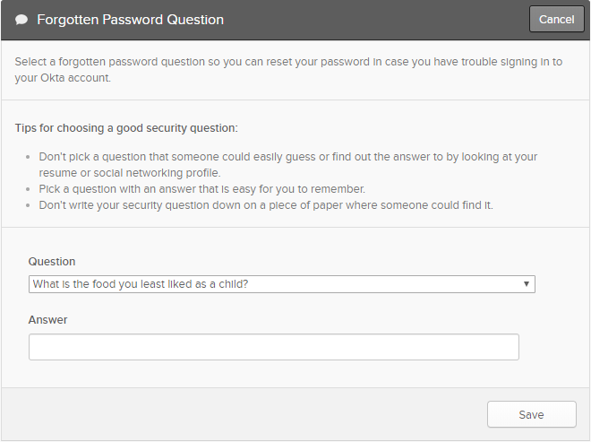
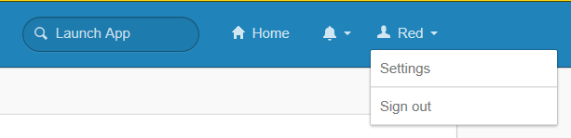
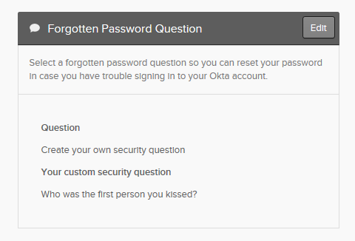
Creating or Resetting “Forgotten Password Question”
From your Login.darpa.mil/darpa.okta.com portal, you can manage account settings including: Personal Information, Security Image, MFA Reset, Display Language, Change Password, and “Forgotten Password Question”.
3. Select a Question from the “Create your own Security Question” drop down
4. Enter your security question answer. Your answer must be least 4 characters.
5. Select “Save”. Your Forgotten Password Question has been created/changed.
1. When logged into Login.darpa.mil (Okta), Click on “Your user name” and then select “Settings”
2. Scroll down to “Forgotten Password Question” and select “Edit”

