Slide 1

Investing in Golf Courses: a Data Exploration
Sean Coneys

Slide 2
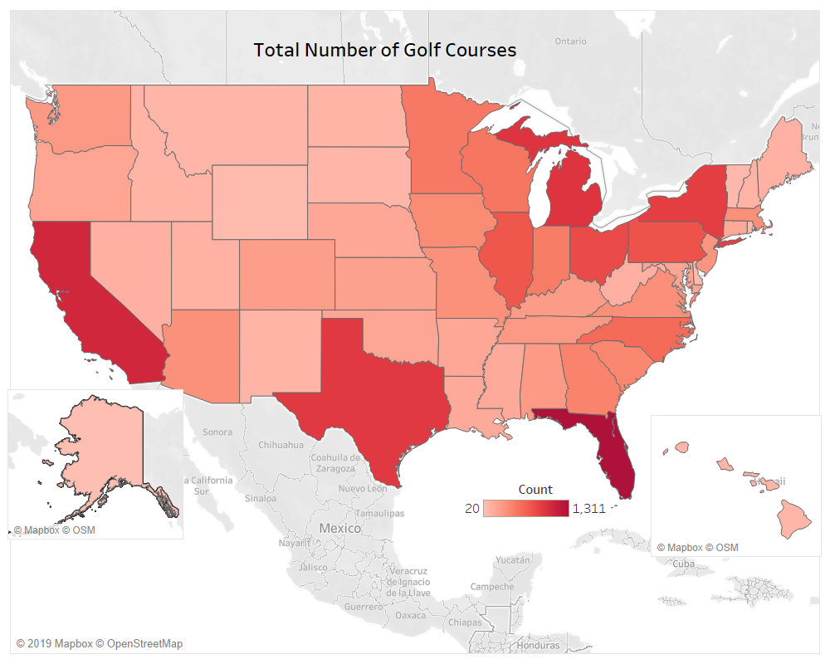

Slide 3
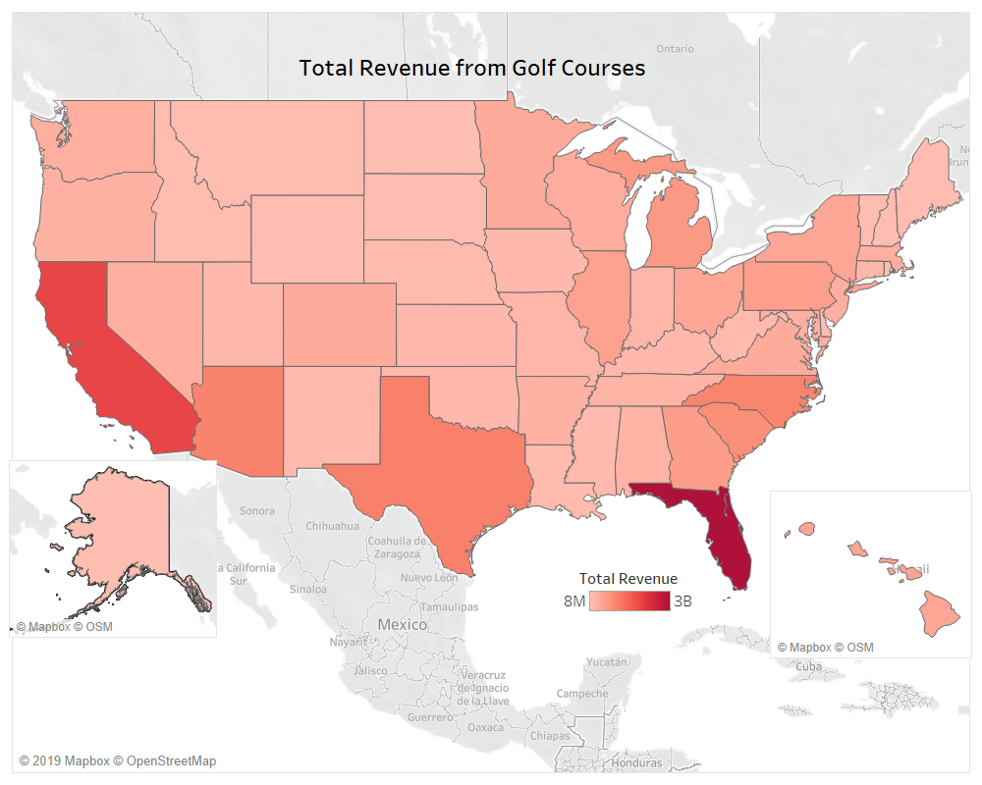

Slide 4
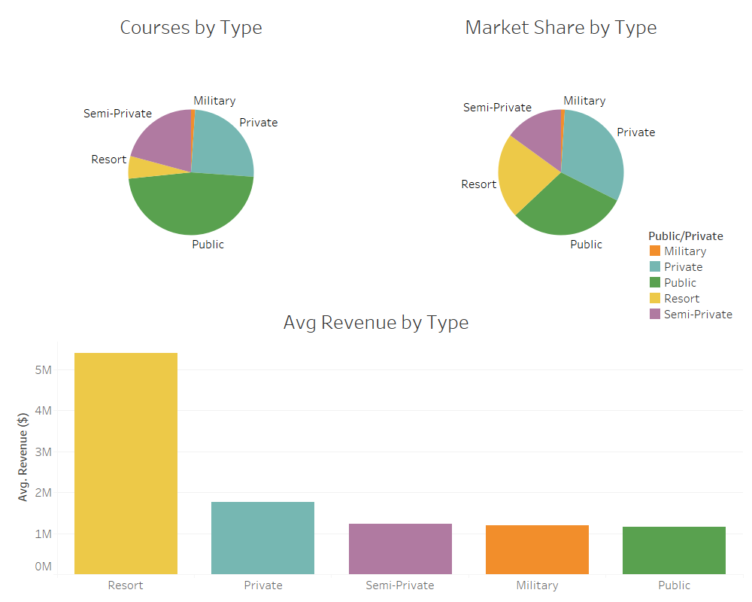

Slide 5
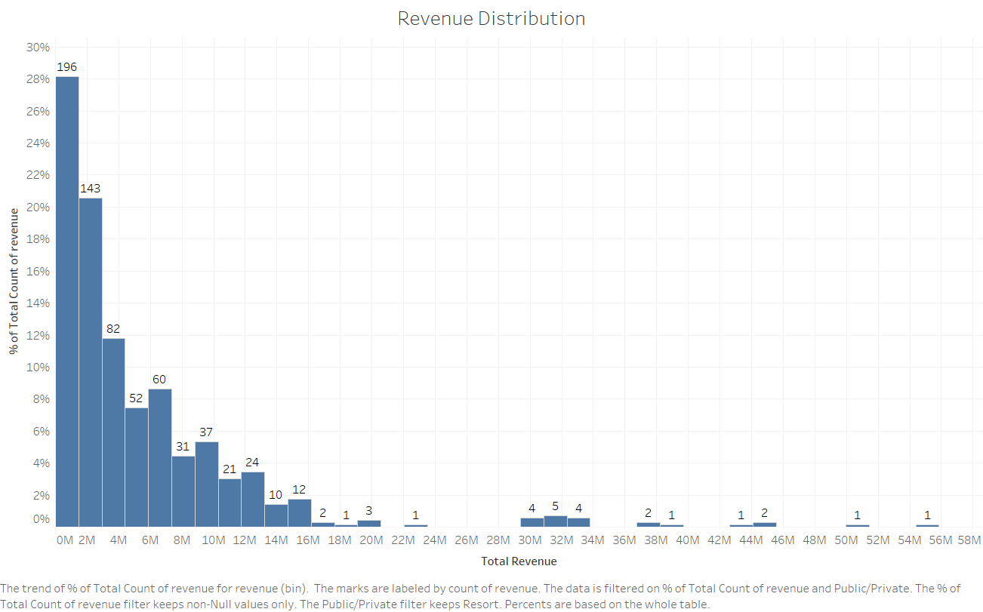

Slide 6
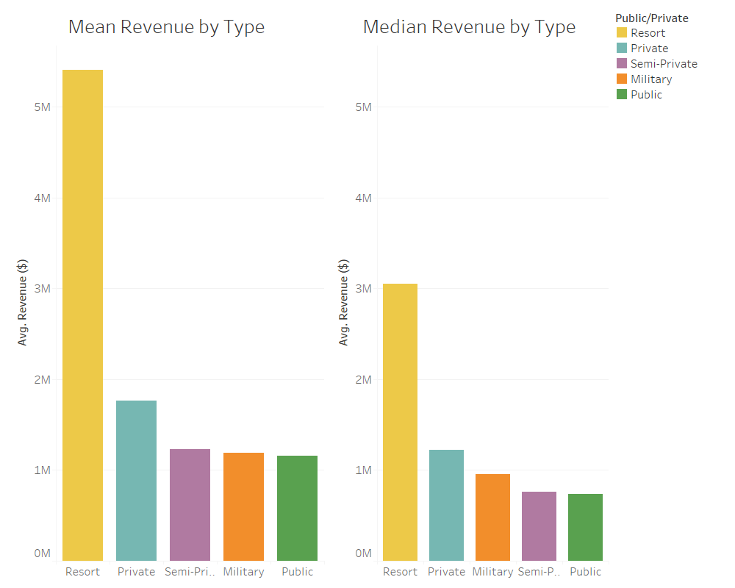

Slide 7
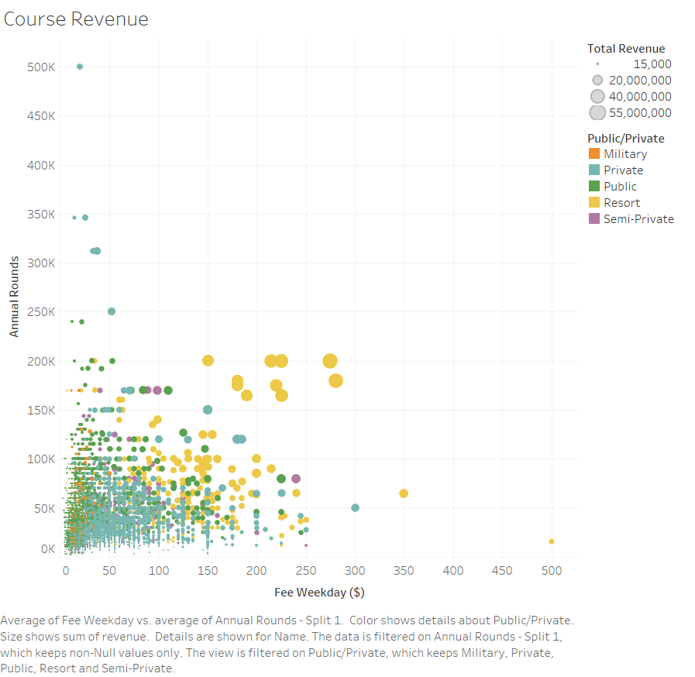

Slide 8
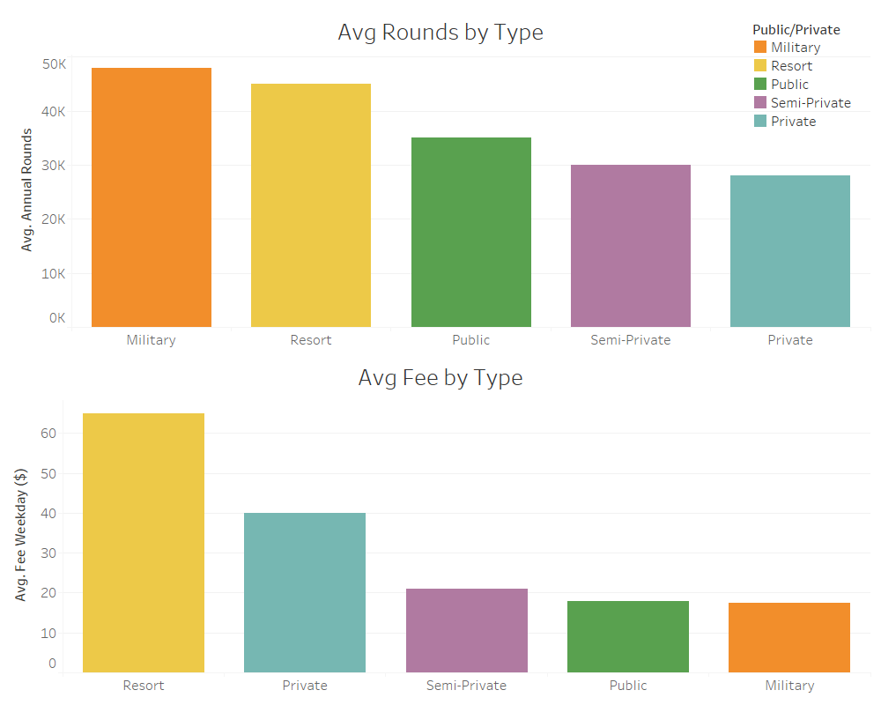

Slide 9
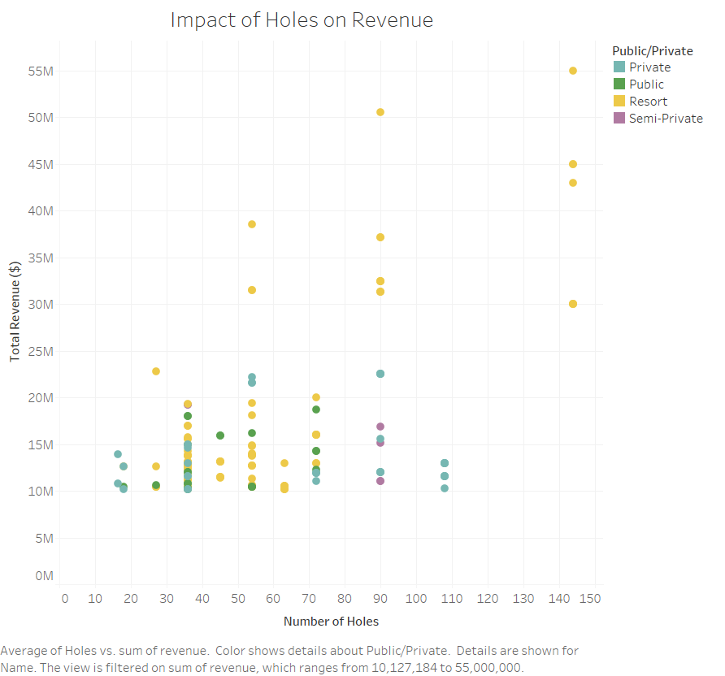

Slide 10
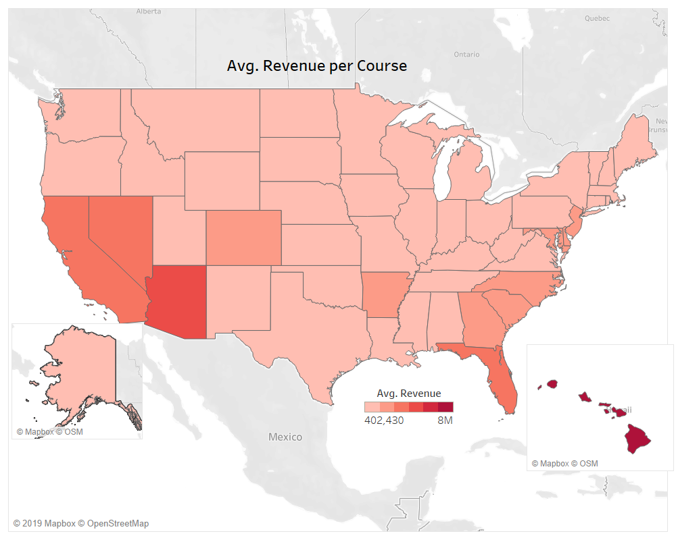

Slide 11
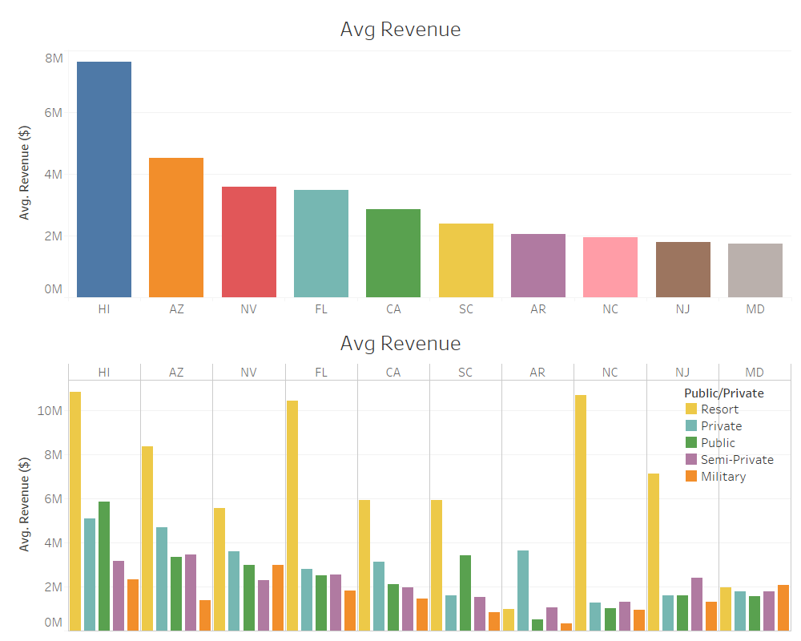

Slide 12
Designing a new Golf Course
Create machine learning model to predict annual rounds and therefore revenue
Design course and plug in information to estimate revenue and compare with the estimated cost to build and run

Slide 13
Golf Courses are oversupplied
  Over 100 closed last year and only 6 were built
  Drives golf course purchase prices down
Real Estate Prices are up
Bad time to:
  Build a new golf course
Good time to:
  Buy courses in order to sell the land
  Purchase a mismanaged golf course

Slide 14
Sell Courses for land
Estimate real estate sales prices and compare with cost of course

Slide 15
Identifying Mismanaged Courses
Create machine learning model to estimate annual rounds and therefore revenue
Find courses with large disparities in estimated revenue and actual revenue
Find courses with large disparities between actual revenue and estimated revenue after we change controllable parameters(i.e price, season open, etc.)

