Slide 1
Dynamic Coloring
Brent Barbachem and Sean Coogan

Slide 2
What are we trying to accomplish?
A dynamic method of choosing colors to represent data accurately
Choosing colors that are easily distinguishable
Creating options for those that exhibit the colorblind traits
Notes:
Allow users to dynamically choose colors to represent data while maintaining the integrality of the data.
Guideline 4.14 – To create a set of symbol colors that can be distinguished by the most colorblind individuals, ensure variation in the yellow-blue direction (Ware, 2013).
5-8% men colorblind
0.5-1% women colorblind

Slide 3
Current Software Examples
Geographic Information Systems (GIS)
Computer-Aided Design (CAD)
3D/2D Modeling Software
Visualized satellite data
General Case: software that utilizes color differences to display data.

Slide 4
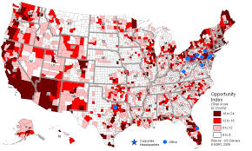
Geographic Information Systems (GIS)

Slide 5
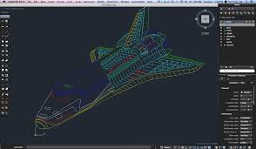
Computer-Aided Design (CAD)

Slide 6
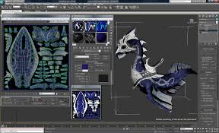
3D/2D Modeling Software

Slide 7
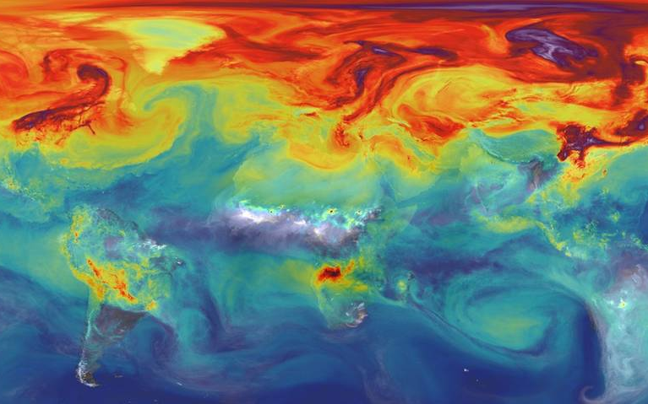
Visualized satellite data
Notes:
Image generated from a NASA supercomputer model that simulates carbon dioxide in the atmosphere based on data from the OCO-2 mission

Slide 8
Target audience?
Colorblind options
Colorblind individuals (most positive impact)
All Users
Dynamic color options
All Users
Notes:
The colorblind individuals will be most effected because it will level the field of data interpretation if all users see the same information. All users will be effected by the ability to dynamically change the colors, because it will provide the option of finding new colors if the current color pattern is not what they want to see.

Slide 9
Purposes
Ability to change the color scheme dynamically
Ability to choose colors that are visually distinct
Certain distance apart
Ability to choose saturated colors
Unambiguous data interpretation

Slide 10
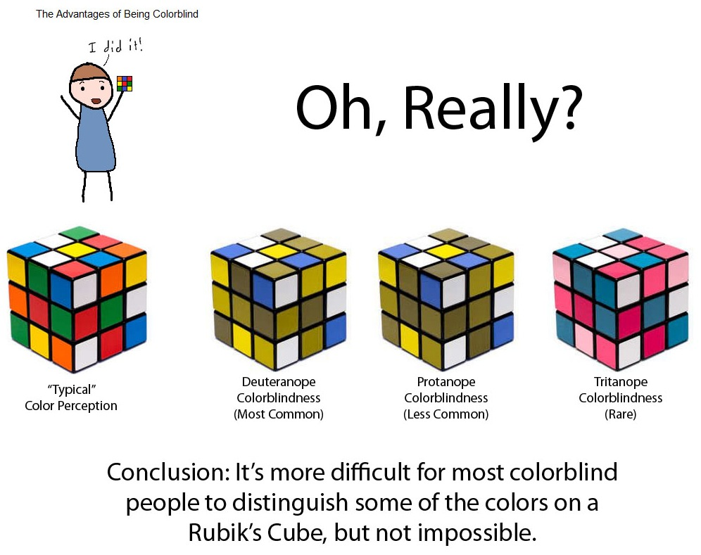
Purposes

Slide 11
Methodology

Slide 12
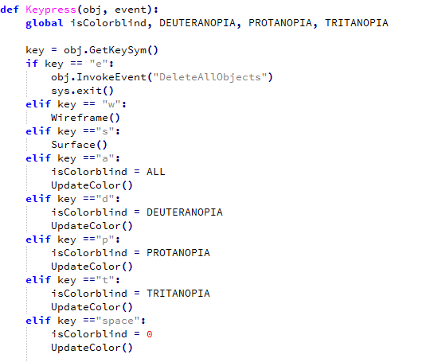
Dynamic Abilities

Slide 13
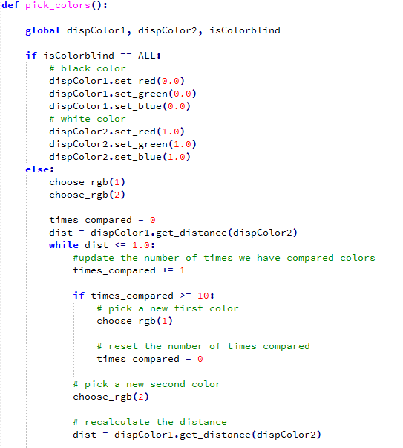
Random Color Selection

Slide 14
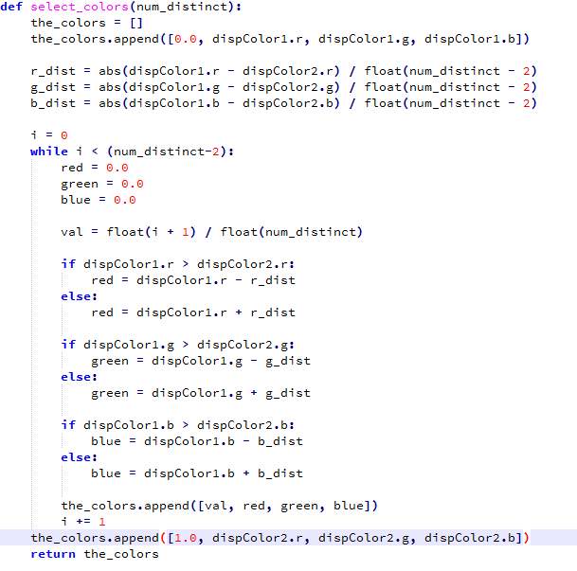
Color Selection

Slide 15
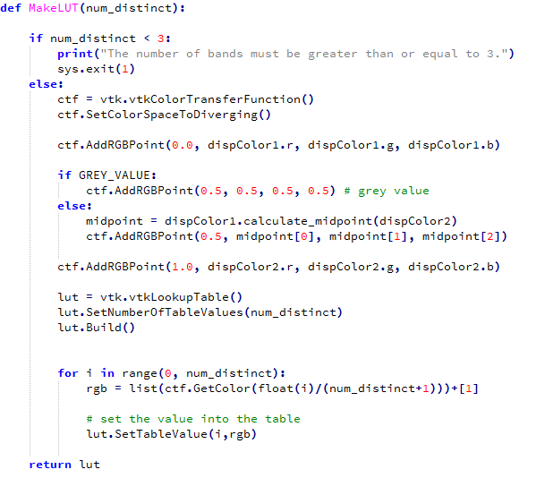
Lookup Table Creation

Slide 16
Results

Slide 17
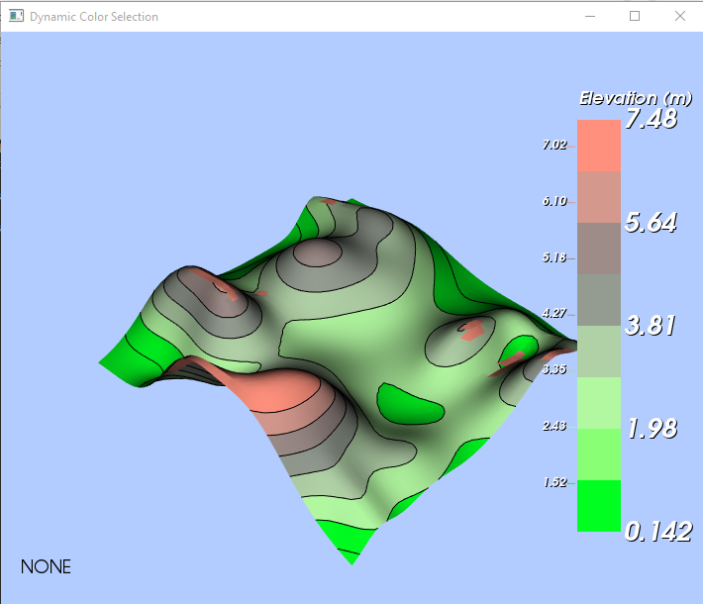
Normal Execution
Notes:
No limitations on color scale

Slide 18
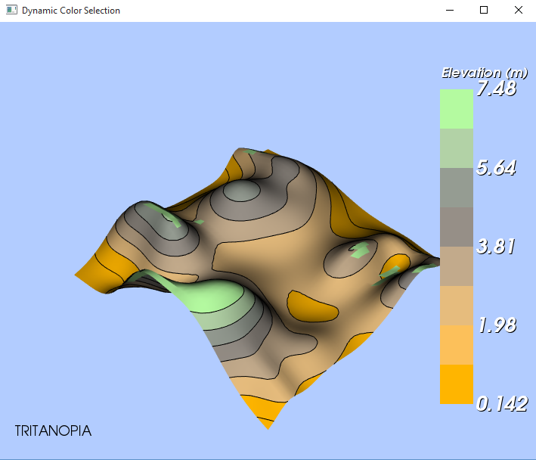
Short Wavelength Sensitivity
Notes:
No blue or yellow
Tritanopia is defined as the inability to differentiate between blue and yellow colors

Slide 19
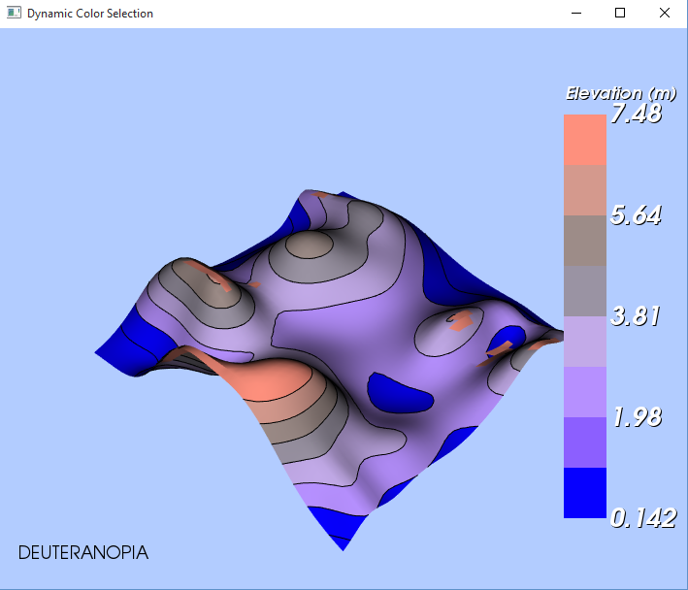
Medium Wavelength Sensitivity
Notes:
No green

Slide 20
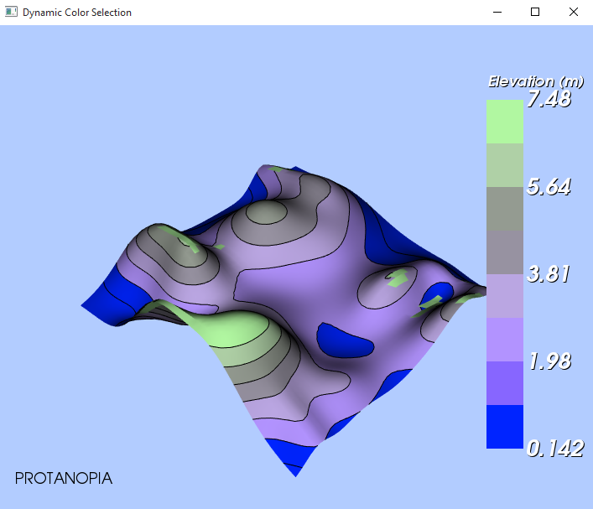
Long Wavelength Sensitivity
Notes:
No red
Protanopia and Deuteranopia characterized by the inability to differentiate red and green shades
In order to display a visual difference between Protanopia and Deuteranopia options
eliminate the red colors when the user selects Protanopia,
eliminate the green colors when the user selects Deuteranopia

Slide 21
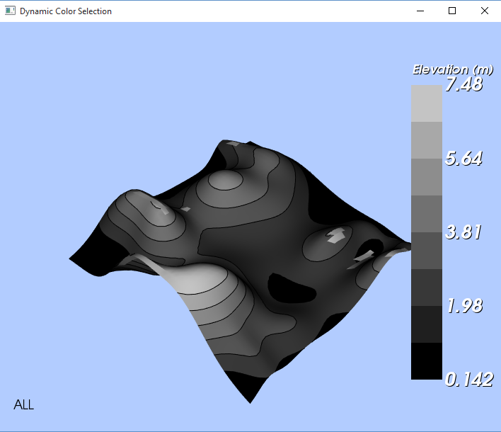
Completely Colorblind
Notes:
Gray scale

Slide 22
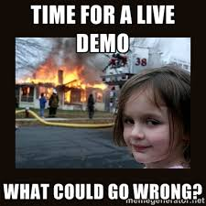
Demonstration

Slide 23
Future
More accurate data interpretation
Less confusion
Possible incorporation into computer graphics systems

