Slide 1
Dynamic Coloring
Brent Barbachem and Sean Coogan

Slide 2
What are we trying to accomplish?
A dynamic method of choosing colors to represent data accurately
Choosing colors that are easily distinguishable
Creating options for those that exhibit the colorblind traits

Slide 3
Current Software Examples
Geographic Information Systems (GIS)
Computer-Aided Design (CAD)
3D/2D Modeling Software
General Case: software that utilizes color differences to display data.

Slide 4
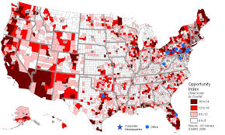
Geographic Information Systems (GIS)

Slide 5
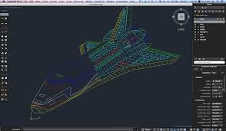
Computer-Aided Design (CAD)

Slide 6
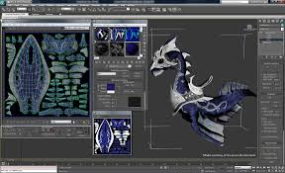
3D/2D Modeling Software

Slide 7
Target audience?
Colorblind options
Colorblind individuals (most positive impact)
All Users
Dynamic color options
All Users
Notes:
The colorblind individuals will be most effected because it will level the field of data interpretation if all users see the same information. All users will be effected by the ability to dynamically change the colors, because it will provide the option of finding new colors if the current color pattern is not what they want to see.

Slide 8
Purposes
Ability to change the color scheme dynamically
Ability to choose colors that are visually distinct
Certain distance apart
Ability to choose saturated colors
Unambiguous data interpretation

Slide 9
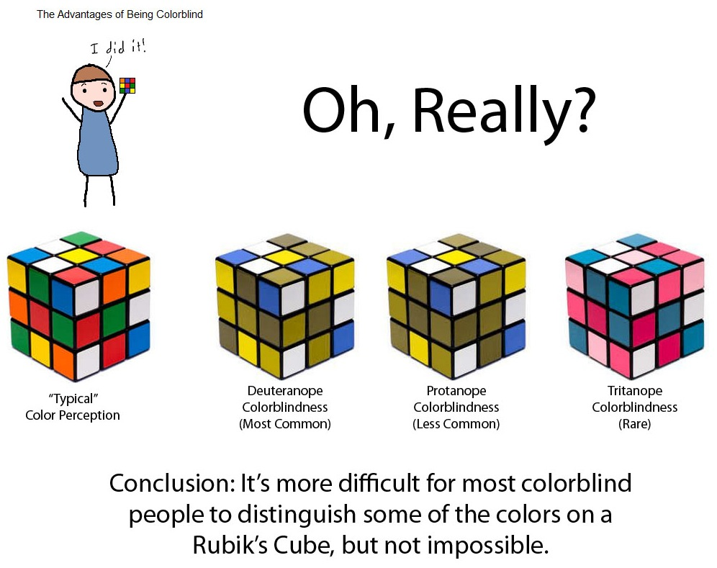
Purposes

Slide 10
Methodology

Slide 11
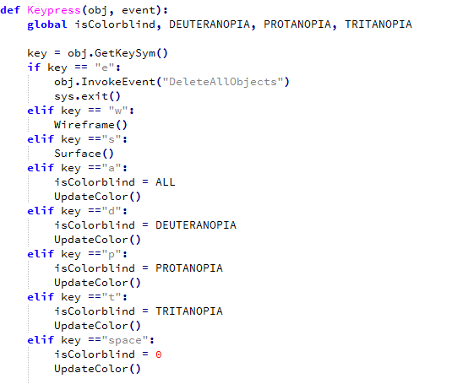
Dynamic Abilities

Slide 12
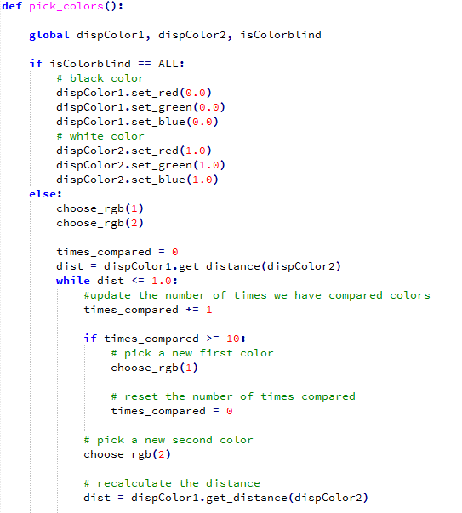
Random Color Selection

Slide 13
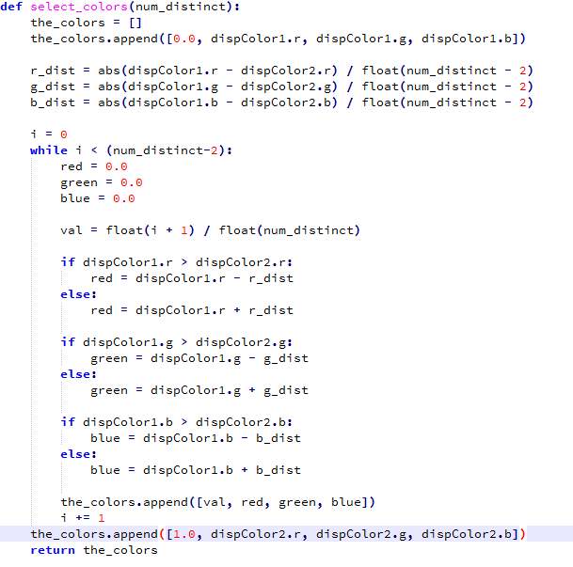
Color Selection

Slide 14
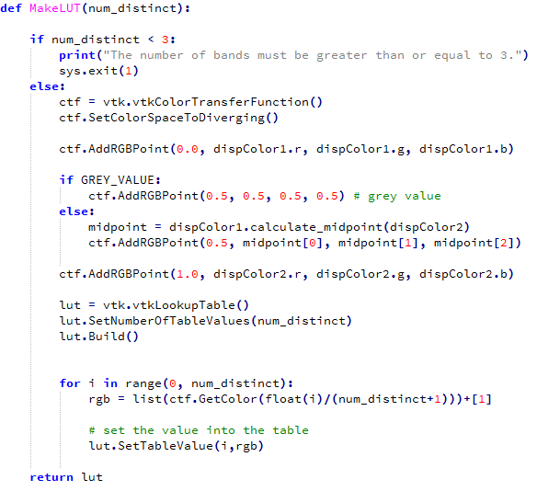
Lookup Table Creation

Slide 15
Results

Slide 16
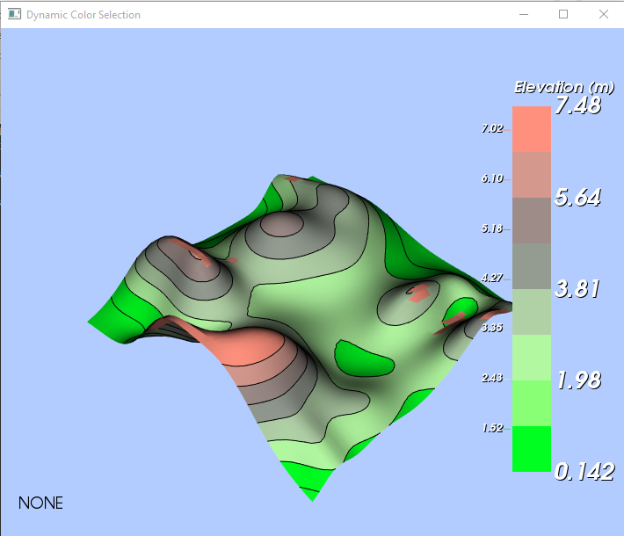
Normal Execution

Slide 17
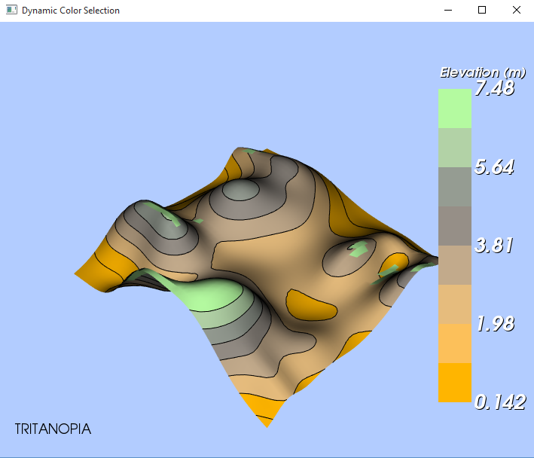
Short Wavelength Sensitivity

Slide 18
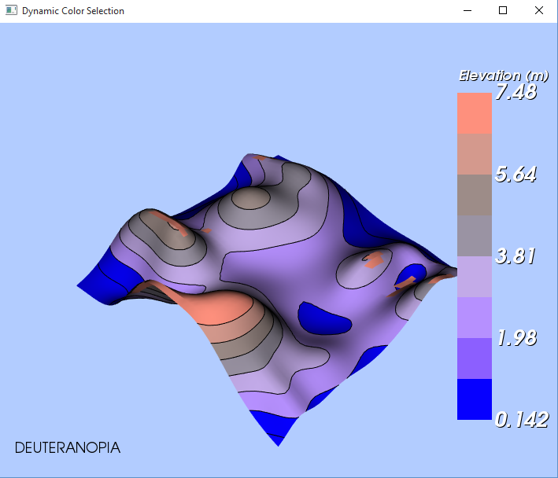
Medium Wavelength Sensitivity

Slide 19
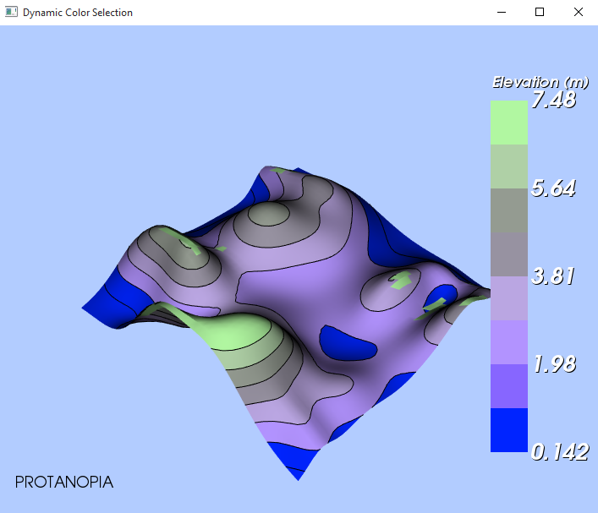
Long Wavelength Sensitivity

Slide 20
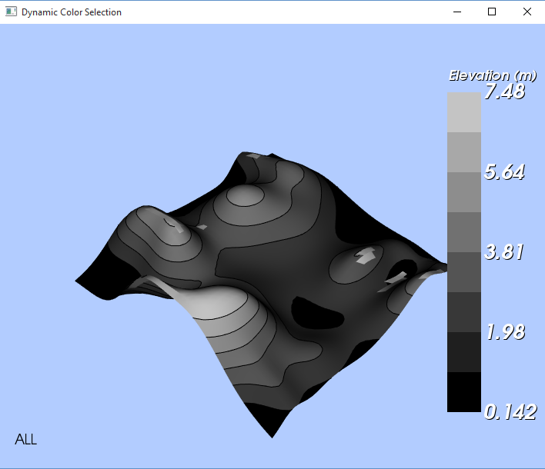
Completely Colorblind

Slide 21
Demonstration

Slide 22
Future
More accurate data interpretation
Less confusion
Possible incorporation into computer graphics systems

