Slide 1
The Goal Gradient Hypothesis 90 Years Later: Cognitive Effort and Goal Proximity
Pilot data, follow-up design, and future directions
If you get tired, look here

Slide 2
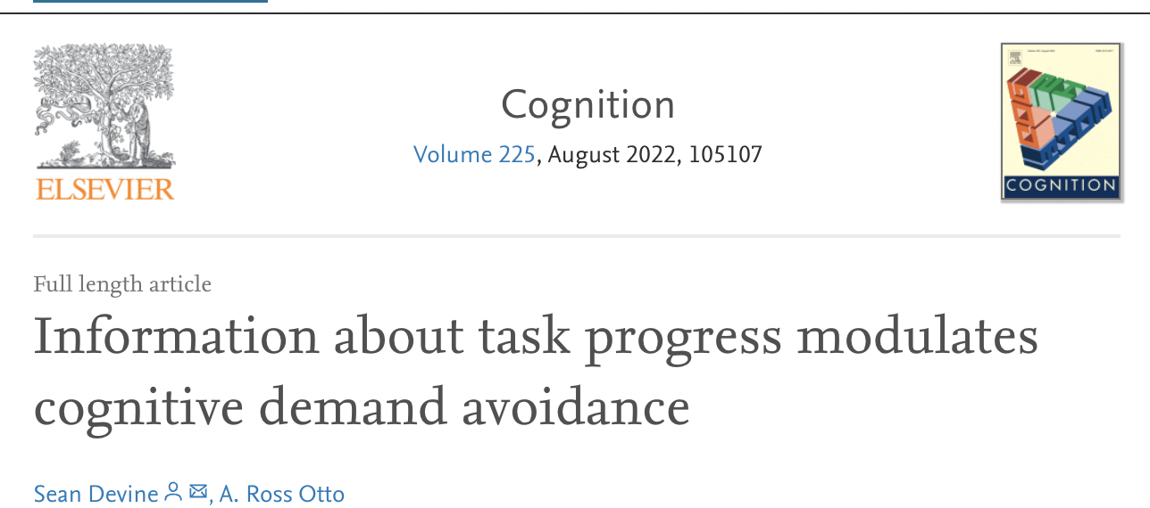
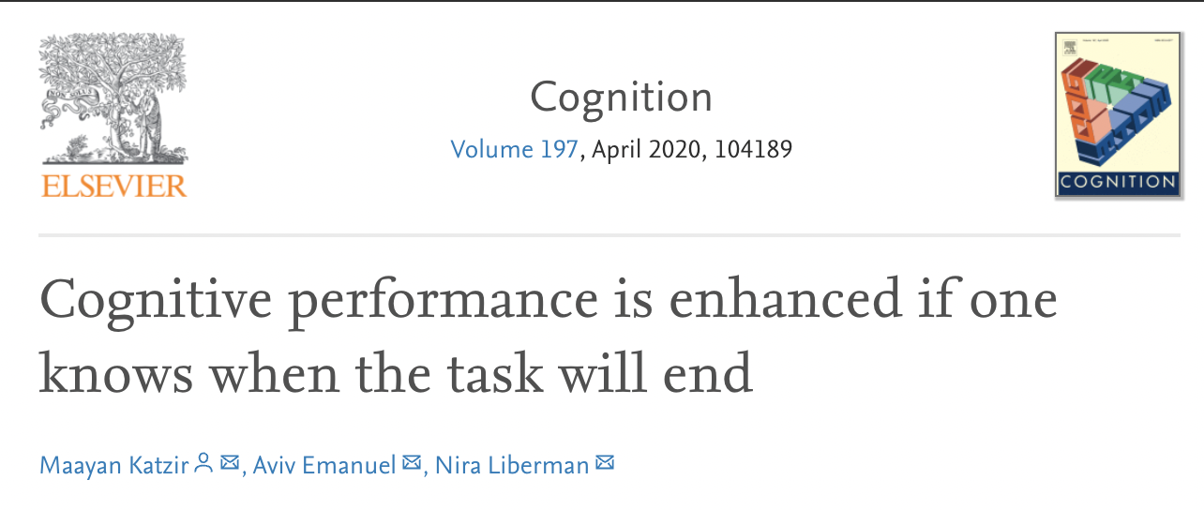



Background
Progress and proximity to a goal motivates effort exertion [1,2]
Devine & Otto, 2022, Cognition
Katzir et al., 2020, Cognition

Slide 3
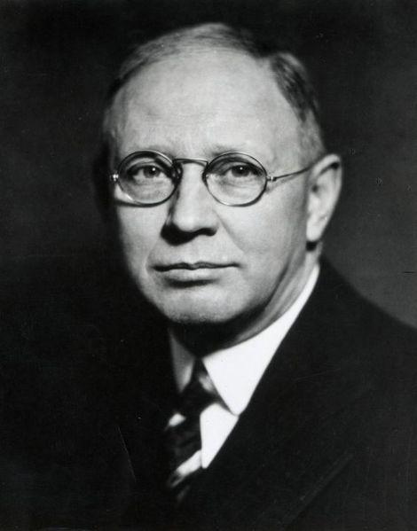
Background
Progress and proximity to a goal motivates effort exertion [1,2]
This is captured by the goal-gradient hypothesis [3]
Derived initially by Hull in 1932
Original paper cited almost 800 times
Resurgence of the topic in social and consumer psychology [e.g., 4,5]
Devine & Otto, 2022, Cognition
Katzir et al., 2020, Cognition
Hull, 1932, Psych. Rev.
Cryder et al., 2013, JESP
Kivetz et al., 2006, JMR

Slide 4



Task from Brown (1948)

Slide 5
Task from Brown (1948)

Slide 6
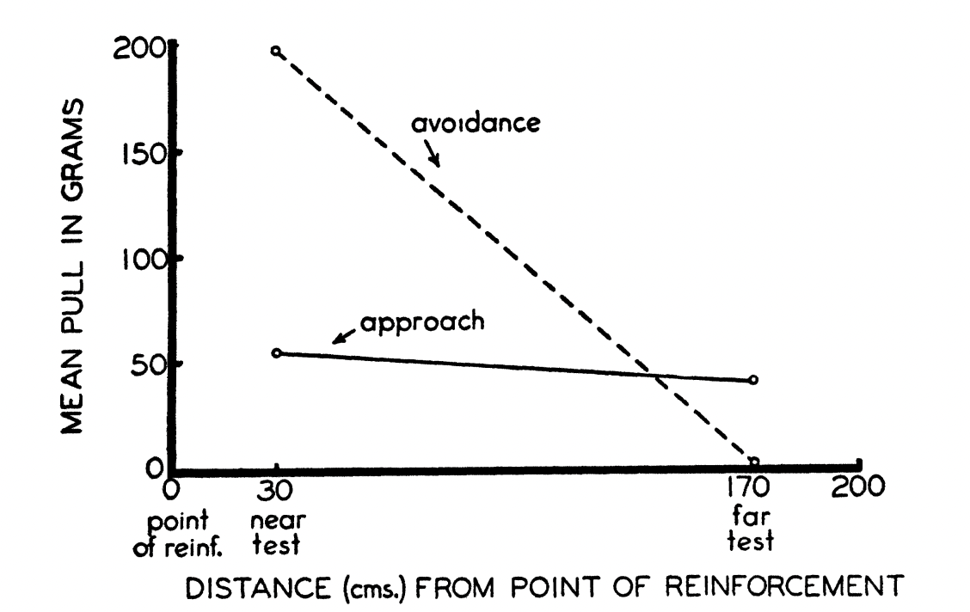
Gradients of approach vs. avoid
Miller (1944), reproduced by Brown (1948)

Slide 7
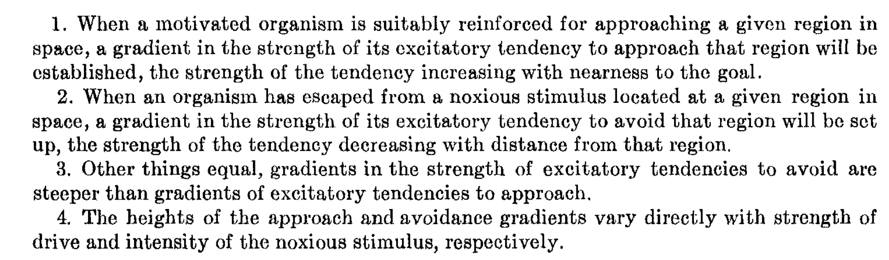
Four postulates of Goal Gradient Behaviour
Brown (1948)

Slide 8
Four postulates of Goal Gradient Behaviour
In non-behaviourist English:
A subject will invest more effort to acquire a nearby rewarding stimulus
A subject will invest more effort to avoid a nearby aversive stimulus
All else being equal, the increase in 2. will be greater than the increase in 1.
The effects in both 2. and 1. depend on the magnitude of the stimulus

Slide 9
Background
Despite being around for decades:
Key postulates of the goal-gradient hypothesis have not been tested in humans
The computational mechanisms underpinning how progress motivates effort exertion is unknown

Slide 10
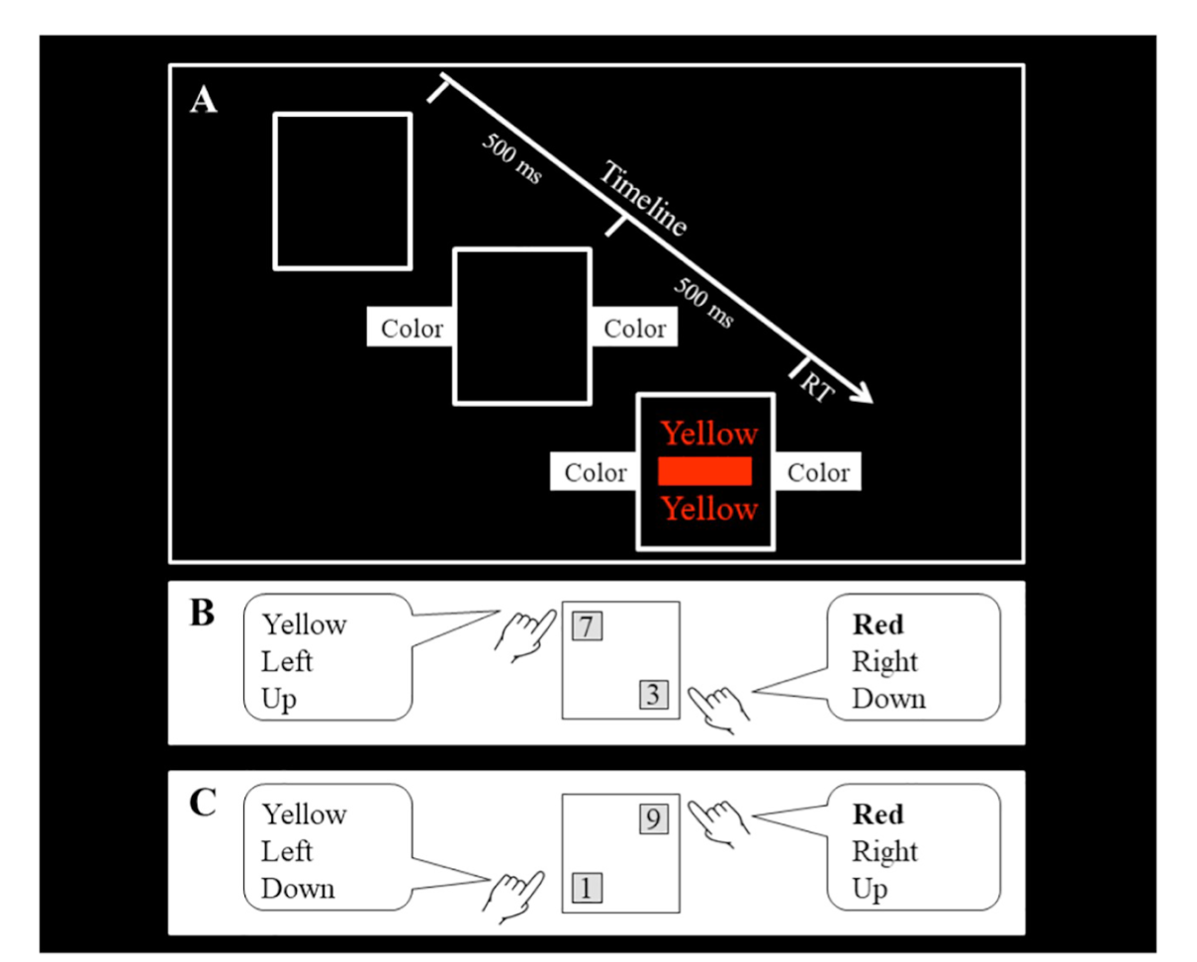
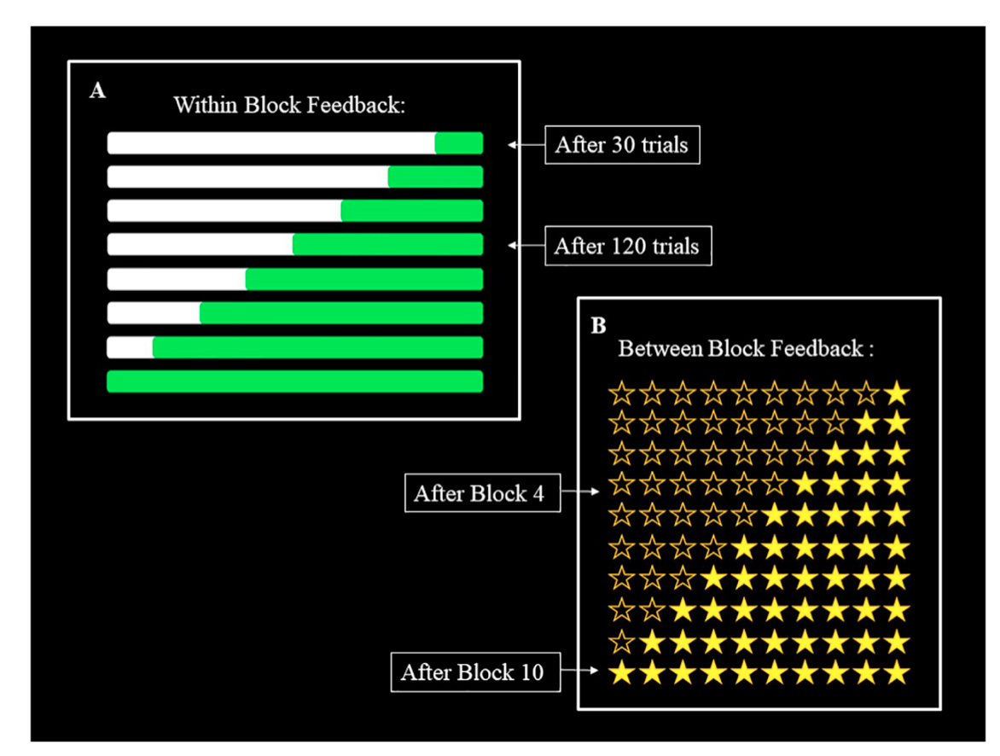
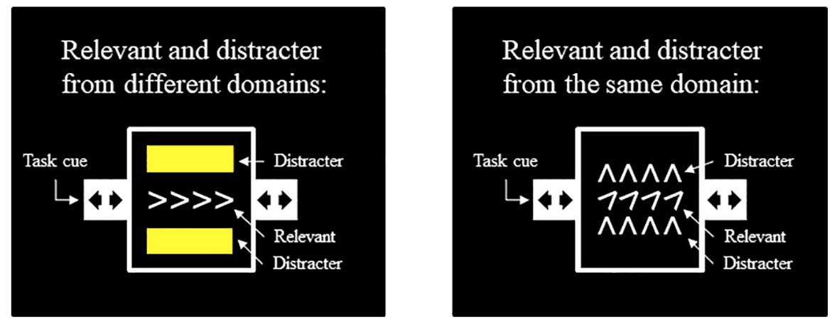
Recently: Psychologically
Katzir et al. (2020) found that progress indicators increase cognitive performance in an effortful task

Slide 11
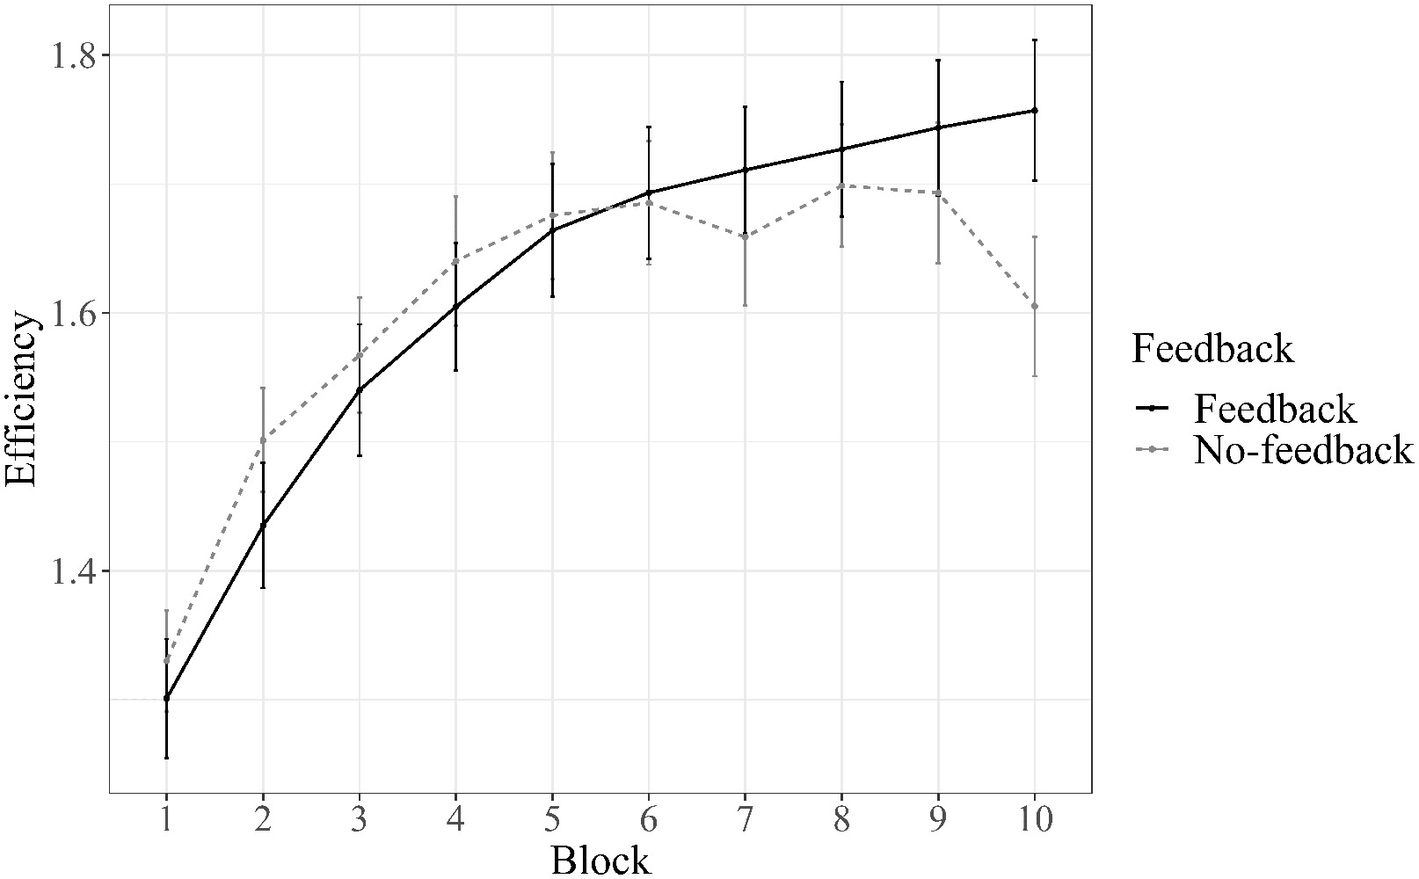
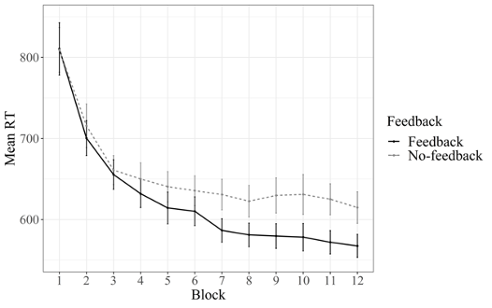
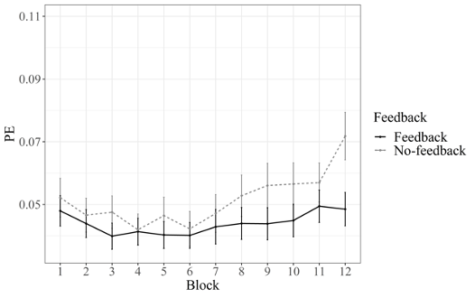
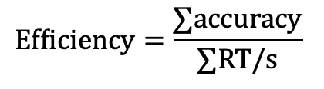
Recently: Psychologically
Katzir et al. (2020)
$$Efficiency=\frac{∑accuracy}{∑RT/s}$$

Slide 12
Recently: Computationally
But this only explains what progress is doing to people’s behaviour, not why it is doing it…
What underlies this uptick in performance?
- Increased motivation vs. reduced caution?

Slide 13
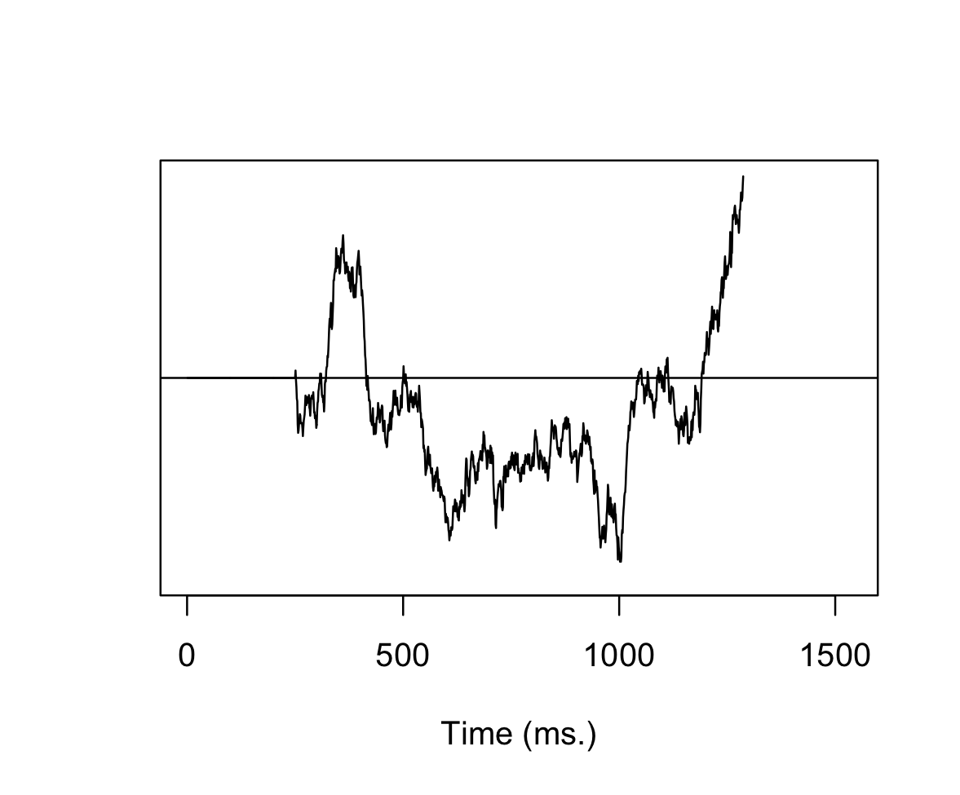
Drift diffusion model (DDM)
Correct
a = decision boundary
v = drift rate
z = starting point
t = non-decision time
v
t
z
a
Incorrect

Slide 14
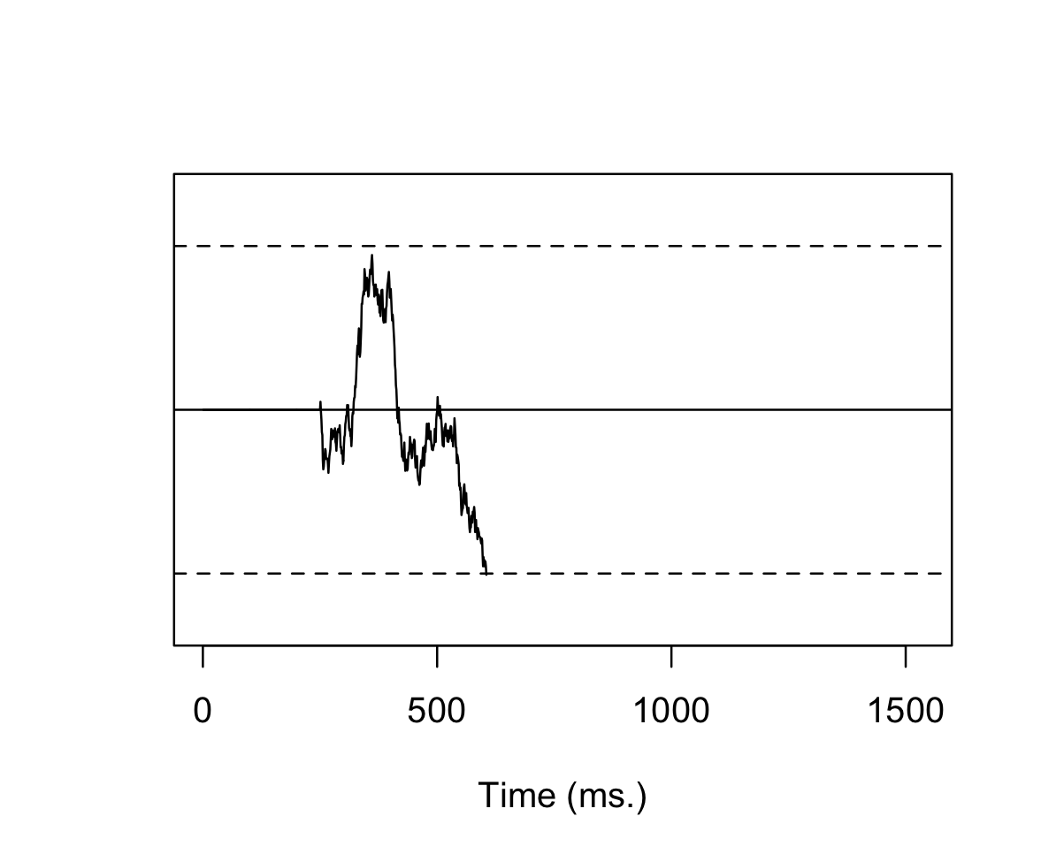
Drift diffusion model (DDM)
Correct
a = decision boundary
v = drift rate
z = starting point
t = non-decision time
v
t
z
a (narrower)
Reduces RTs, increases errors
Incorrect

Slide 15
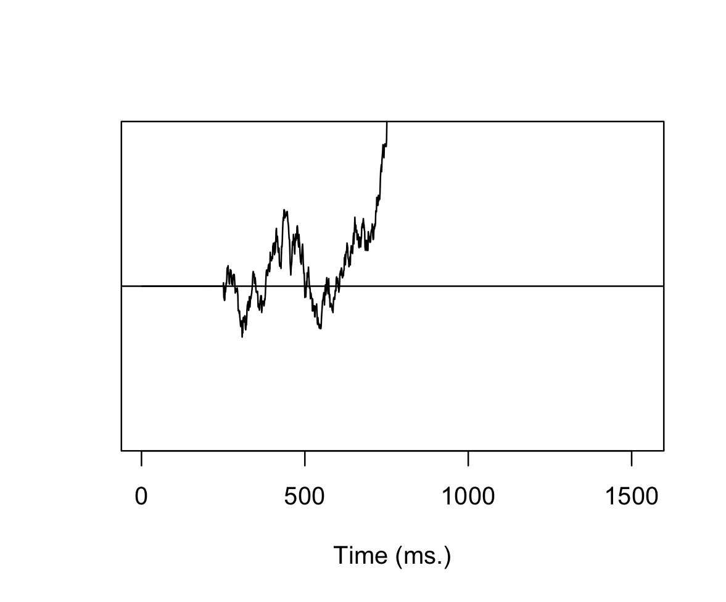
Drift diffusion model (DDM)
Correct
v (larger)
a = decision boundary
v = drift rate
z = starting point
t = non-decision time
t
z
a
Reduces RTs, reduces errors
If v < 0, increases errors
Incorrect

Slide 16
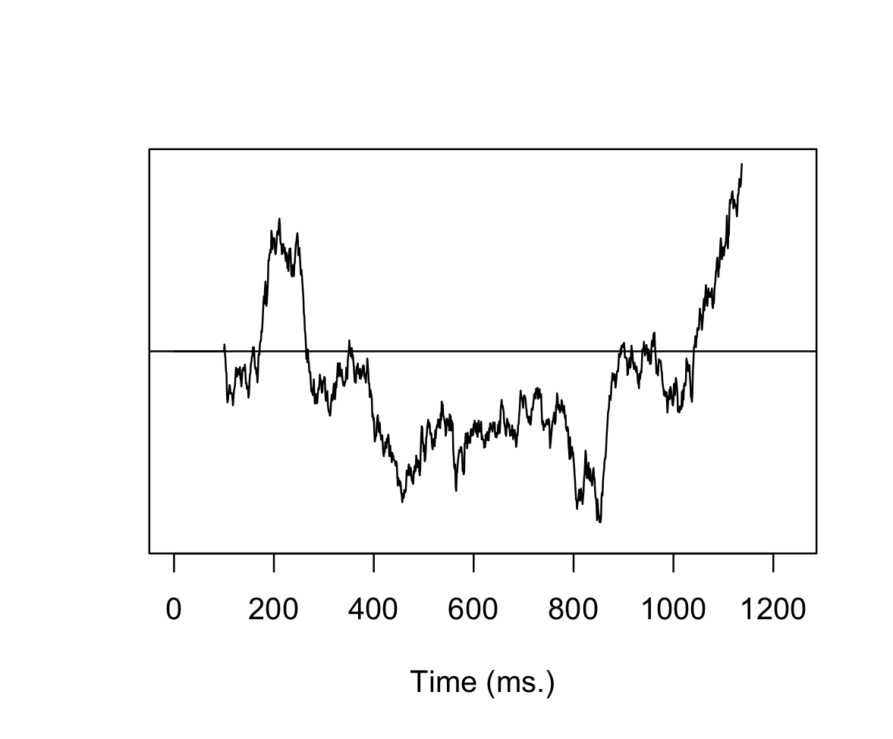
Drift diffusion model (DDM)
Correct
a = decision boundary
v = drift rate
z = starting point
t = non-decision time
v
t
(smaller)
z
a
Reduces RTs, no effect on errors (excluding timeouts)
Incorrect

Slide 17
Drift diffusion model (DDM)
Goal gradient behaviour could manifest in:
Narrower decision thresholds
less caution as one approaches the end goal
Larger drift rate
more task-relevant processing near a goal
Faster non-decision time
Quicker motor action (vigour) near the end

Slide 18
Summary + Plan
Test key postulates of goal gradient hypothesis in human cognition
Approach—weak gradient
Avoidance—strong gradient
Model behaviour in the task with a DDM to infer underlying mechanisms
Does goal gradient behaviour load onto the drift rate, non-decision time, threshold, or some combination of all three?

Slide 19





Approach Task
$0.20
$0.20
$0.20
$0.20
You win $0.20
$0.02
$0.02
$0.02
$0.02
You win $0.02
Rewards ∈ {$0.02, $0.20}
Block-length = 60
Progress or No-Progress
16 blocks total
Task progress is performance-contingent
Response deadline: 750 ms

Slide 20
Descriptives
N = 29, in person
Mean age = 22.85, SD = 3.72
82% female

Slide 21
Exclusion Criteria
Remaining N = 16
13 excluded, worth reconsidering…
P(Timeouts) > 0.33
11 subjects
P(Correct) < 0.44
8 subjects
Mean RT < 100
0 subjects

Slide 22
Post-exclusion

Slide 23
Progress effects
b_{show_prog} = -0.07, p = .04
b_{progress_bin} = n.s.
b_{interaction} = n.s.
b_{show_prog} = -11.20, p = .02
b_{progress_bin} = 2.11, p = .57
b_{interaction} = -15.65, p = .03

Slide 24
Progress effects

Slide 25
Progress effects

Slide 26
Reward effects

Slide 27
Descriptive Modeling: GAM
Progress effects are non-linear
Instead of multilevel linear regressions, which assume linear effects, I used a Generalized additive model (GAM), which estimates the non-linearity of the function using a series of splines (a.k.a. base functions; polynomials)
Linear effects are interpreted as usual
Non-linearity parameter (edf) indexes degree of “wiggliness” (edf = 1 is a linear function, edf = 2 is quadratic, etc.)
p-value for non-linear effects test against a horizontal null (e.g., b = constant)
Happy to explain this if there are questions

Slide 28
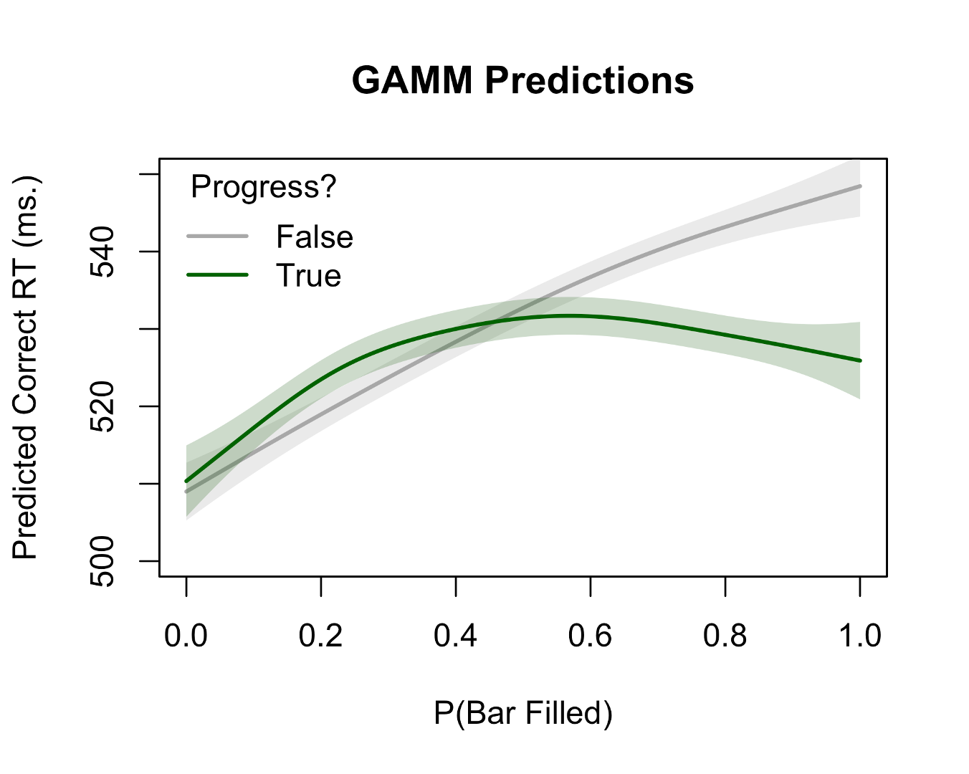
GAM (RT)
Linear effects
Coefficient | b | p
Show_prog | -4.29 | .0367
Reward | 4.47 | .0295
Non-linear effects
Coefficient | edf | p
trial:no_prog | 1.73 | < .001
Trial:prog | 2.72 | .00158
People speed up towards the end when progress is shown (quadratic/cubic fx)
People slow down when progress is not shown (semi-linearly)

Slide 29
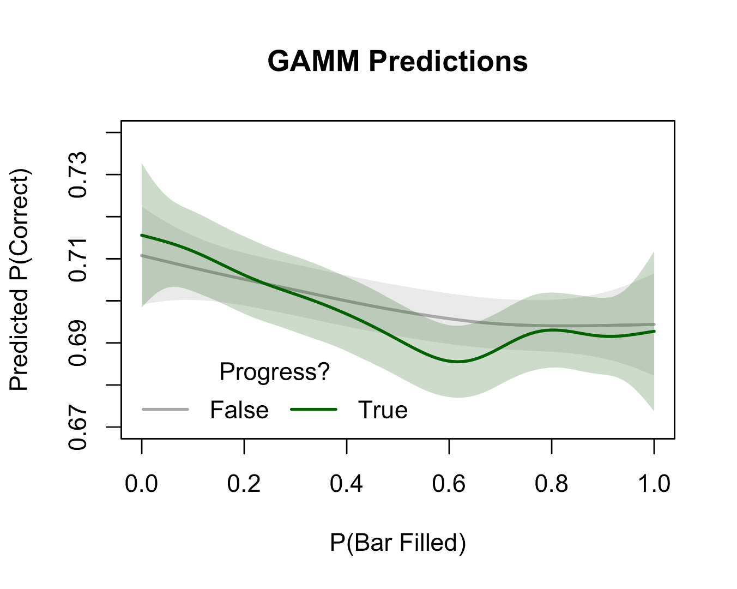
GAM (accuracy)
Linear effects
Coefficient | b | p
Show_prog | -0.01 | .0312
Reward | 0.02 | < .001
Non-linear effects
Coefficient | edf | p
trial:no_prog | 2.37 | < .0001
Trial:prog | 5.43 | < .0001
When progress is shown, people get a little worse, but boost up more at the end (complicated fx)

Slide 30
Drift-Diffusion Modeling
Preliminary
Currently modeled predicting DDM parameters as a linear combination of progress and condition
Not yet sure how to incorporate non-linearity here (suggestions welcome)
One idea: Use polynomials from GAM as inspiration, but these differ wildly between RT and accuracy so ¯\_(ツ)_/¯
Rewards not included yet (took too long to fit for this meeting…)
“P”-values = Bayesian p-values; P(posterior) > 0

Slide 31
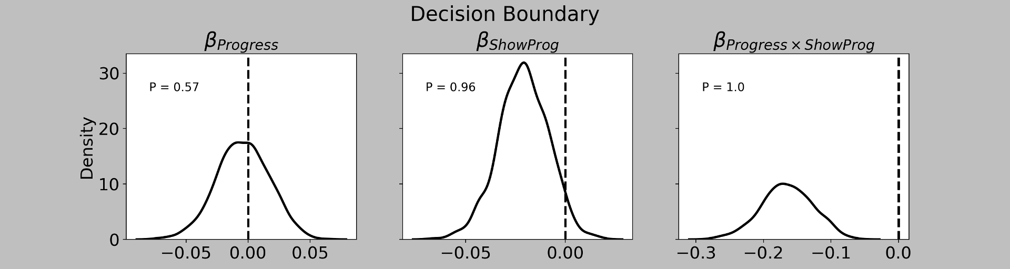
Drift-Diffusion Modeling

Slide 32
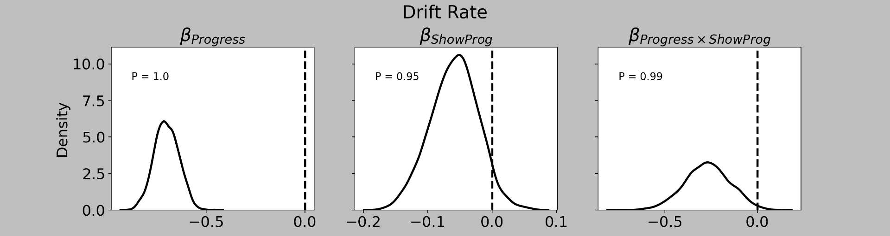
Drift-Diffusion Modeling

Slide 33
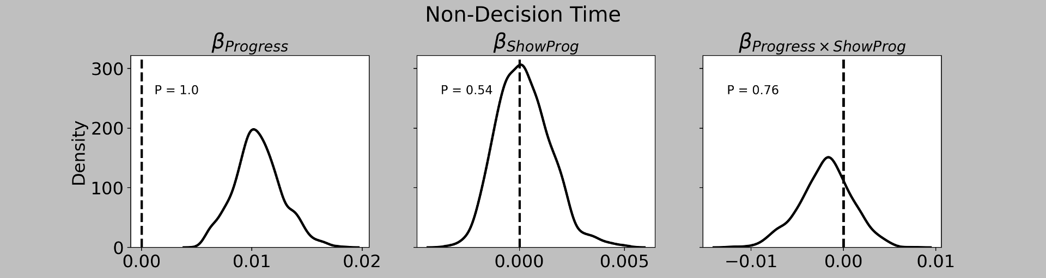
Drift-Diffusion Modeling

Slide 34
Summary of approach task
Evidence for goal-gradient behaviour in basic cognitive (vigor) task
Behavioural: Speeding and maintenance (or small boost) of accuracy near end
Not present when progress information is not shown
Some evidence this interacts with reward magnitude (to be explored)
Computational: Effects driven by changes in threshold and drift rate
Reduced threshold = less cautious
Smaller drift rate = more prone to error/reduced perceptual sensitivity [6]
Current hypothesis: Proximity to reward leads to a “mad dash” for the finish
6. Voss et al., 2004, Mem & Cog

Slide 35
Four postulates
cognitive
v
A subject will invest more effort to acquire a nearby rewarding stimulus ✅
A subject will invest more effort to avoid a nearby aversive stimulus
All else being equal, the increase in 2. will be greater than the increase in 1.
The effects in both 2. and 1. depend on the magnitude of the stimulus
What about in an aversive domain?

Slide 36

Avoidance task
Distal
Proximal
Shock bar fills at constant rate per s.
Fill-rate calibrated to baseline RTs
Pain levels ∈ {.1, .9} of tolerance
Block-length = 60
Only progress condition
16 blocks total
Task progress is performance-contingent
Response deadline: 750 ms

Slide 37
Predictions for avoidance task
Faster responses near shocks overall
Faster responses in proximal condition
Qualitative similar time-series
Possibility of a U-shape curve, reflecting proximity to pain but also to end-goal, as seen in the Approach Task
Qualitatively similar DDM parameters
↓ Threshold
↓ Drift rate
? Non-decision time
Overall, we predict to see similar results to the approach domain, but steeper

Slide 38
You did it!

