Slide 1
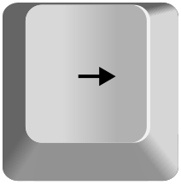
Welcome to this study!
Use the LEFT and RIGHT arrow keys on the keyboard to navigate through the instructions.
The LEFT key will go back to the previous instruction screen.
The RIGHT key will go to the next instruction screen

Slide 2
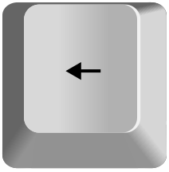
Today we will ask you to play a game.
The rules are simple. You will see three shapes appear on the screen beside each other.
Two of the shapes will be identical, and one will be the odd one out.
Your job is to identify the odd one out.
We will show you an example on the next screen.

Slide 3


Here, the middle shape is the odd one out.
In other words, the white circle in the left and right shape are pointing up,
but the circle in the middle shape is pointing down.

Slide 4

In this example, the right shape is the odd one out because
the left and middle shape are pointing down and the right
shape is pointing up.

Slide 5


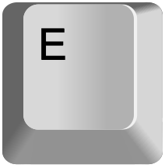
To pick which shape is the odd one out, use the
Q, W, and E keys on your keyboard to choose the
left, middle, or right shape respectively.

Slide 6
So here, you would press the E key because the
right shape is the odd one out.

Slide 7
To get the hang of the game, you will now have the chance to practice.
During this practice phase, you will see the three shapes appear one at a time.
You will then have to press the correct key based on which shape is the odd one out.
After you press a key, we will tell you whether you got the answer correct or not.
If you did not understand the instructions so far, press LEFT to go back and read them again.
If you feel ready to start practicing, press RIGHT.

Slide 8
Great job!
You should now have a good understanding of how the game works.
Moving forward, the main rules will be the same but a couple of things will be different.
We’ll review these changes on the next screen.

Slide 9
Change #1: Time limit
You will now be under time pressure to answer.
If you don’t answer in time, the shapes on the screen will change.
Because of this, you will need to do your best to answer both quickly and accurately.
NOTE: This time limit may feel fast, so stay focused!
Change #2: No correct feedback
We will no longer tell you whether you picked the correct shape.
We will only tell you if you were TOO SLOW.
These messages themselves take time to display, so try to answer correctly!

Slide 10
Change #3: Money
You will now also be able to earn real money from the game.
Every time you finish judging a series of shapes, you will earn bonus money.
You can earn an extra $5.00, depending on how you perform during the game.

Slide 11
Change #4: Progress
To help you figure out how close you are to getting your reward, sometimes you will see a progress bar. The progress bar will look like this:
The closer the green bar gets to the right side,
the closer you are to the reward.
Sometimes the bar will fill up quickly, sometimes it will fill up slowly,
and sometimes it will not appear at all.

Slide 12
Change #4: Progress
For example, here, when the green bar gets to the end, you will win $1.00
$ 1.00

Slide 13
Change #4: Progress
And, here, when the green bar gets to the end, you will win $0.25.
$ 0.25
In other words, you can think of the green part of the bar as you and the white part as the distance between you and the points.

Slide 14
Change #4: Progress
IMPORTANT: The bar will only increase if you answer correctly!
If you misjudge which shape is the odd one, the bar will not fill up.
Even when the progress bar doesn’t show up, the game will
only progress if you answer correctly.
So, the faster you answer correctly, the faster you get your money.

Slide 15
Change #4: Progress
ALSO IMPORTANT:
You will only win the money if you respond accurately. Specifically,
you have to correctly pick the odd shape out 75% of the time.
Otherwise you will not win any money that round.

Slide 16
These are all the instructions for today. Here is a quick review.
Judge which shape is the odd one out of the three.
Press Q, W, or E to pick the left, middle, or right shape respectively.
You have a time limit to answer.
If you are too slow, a message will appear telling you so.
The progress bar only fills up if you get the answer right.
When the progress bar is full, you will get money.
You will only get money if you are at least 75% accurate.
At the end of the experiment, this money will be added to your base pay.

Slide 17
To be sure you understand all the instructions, we will ask you to complete a short quiz on what you have just learned.
Press RIGHT to answer these short questions.

Slide 18
Thank you for answering these questions.
Those are all the instructions for today.
If anything is unclear to you, use the LEFT key to go back through the instructions.
Otherwise, press the RIGHT key to start the game!
Good luck!

