Slide 1
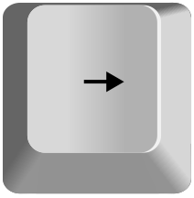
Welcome to this study!
Use the LEFT and RIGHT arrow keys on the keyboard to navigate through the instructions.
The LEFT key will go back to the previous instruction screen.
The RIGHT key will go to the next instruction screen

Slide 2
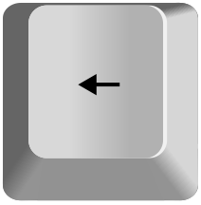
Today we will ask you to play a game. The rules are simple.
You will pick one of two cards chosen randomly from a deck.
If the card you pick is bigger than 5, you win.
If the card you pick is smaller than 5, you lose.
We explain more in the next slides.

Slide 3


Before picking a card, you will see a deck of cards appear on the screen.
This deck of cards can be either black or red.

Slide 4

Decks of cards can also either have stars or moons.
The color and shape on the decks tell you important information.

Slide 5

We will randomly select two cards from each of these decks and
place them face-down on the screen.
For example, below are two cards randomly chosen from the red moon deck.

Slide 6

And here are two cards randomly chosen from the red star deck.

Slide 7
Your job will be to flip one of these cards.
But, how you flip the cards will depend on the color of the deck.

Slide 8



If the cards are black (stars or moons), you will be able to choose
whichever card you’d like to flip.
To do so, you will use the Z and M keys on your keyboard to choose
either the left or the right card.

Slide 9
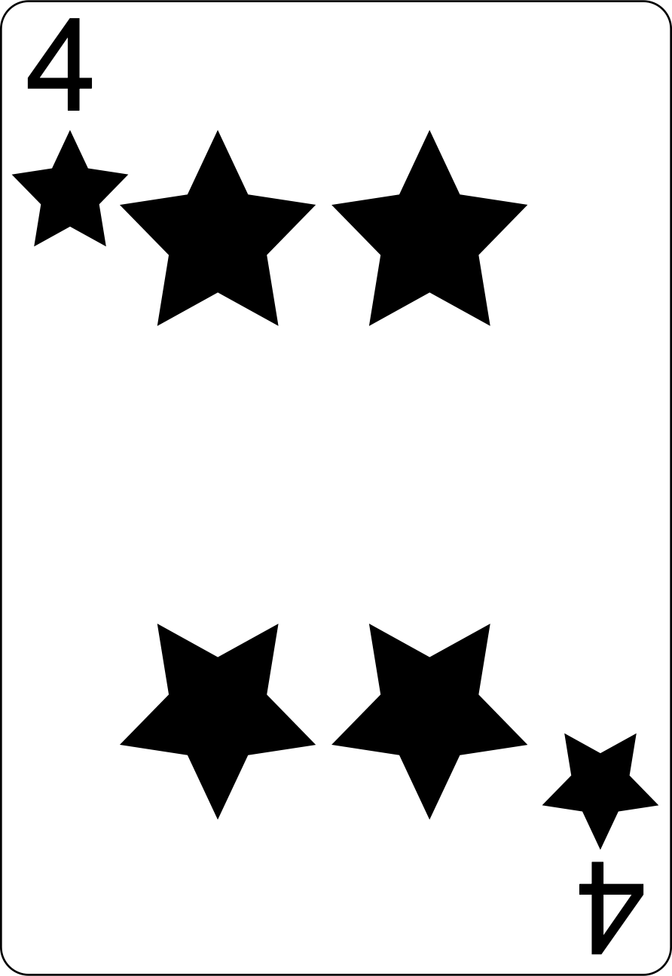
For example, if you press the Z key, the left card would flip over.
Here, doing so reveals a 4, which is smaller than 5, and so
you would lose the game.

Slide 10
When the cards are red (stars or moons), you will not be able to choose which card to flip.
Instead, a key will appear below one of the cards.
You will have to press that key to flip the card it is under.
You will not be able to flip the other card.
For example, here, you would have to press the Z key.

Slide 11
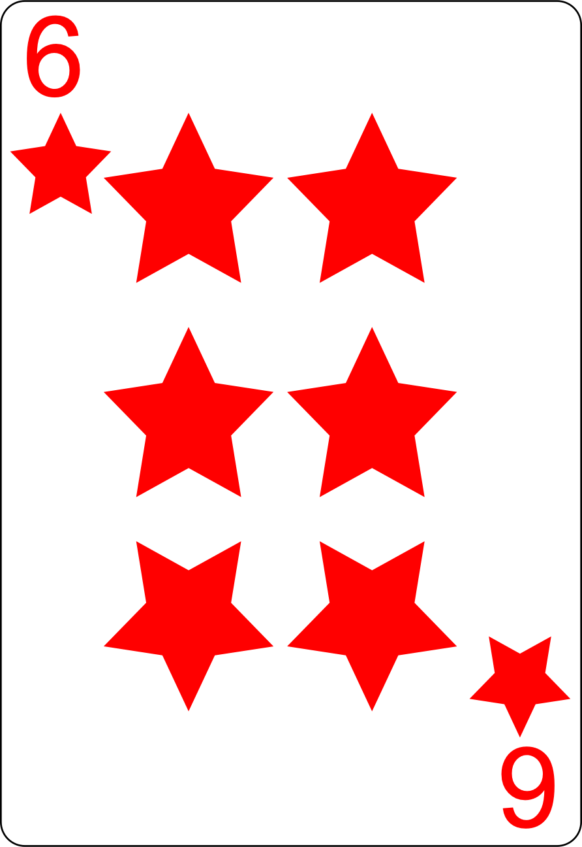
After pressing the specified key, the rules are the same: the card will flip and if it is larger than 5, you will win.
For example, here, the flipped card is a 6, which is larger than 5,
so you would win the game.

Slide 12
If you win the game, you will win some points.
Points will be converted to a cash bonus of $6 USD.
The more points you earn, the higher your bonus pay.
This bonus will be added to your base pay ($1.00).
If you lose, you will not get any bonus pay,
but you will still receive your pay ($1.00).

Slide 13
How you win bonus points will depend on the shape on the card.
If the cards are stars (black or red), you will only sometimes win points
when the card you pick is above 5.
OR

Slide 14

But, if the cards are moons (black or red), you will win points
every time the card you pick is above 5.
OR

Slide 15


You also will be sometimes shown bolt cards. With bolt cards, you will
always win regardless of what card you pick. This is true for both black
And red bolt cards.
OR

Slide 16
You will have a time limit to choose the cards,
so be sure to answer as soon as you know which card you want to pick.
If you don’t answer in time a “Too Slow!” message will appear on the screen and
you automatically lose your potential bonus.

Slide 17
In the next part of the study, you will practice playing this game many times.
This part may feel a little long, but it is important that you have experience playing with the red, black, moons and stars cards before you play the game for real money.
On the next screen, we will review the instructions you have just learned and
then you can start playing!

Slide 18
REMEMBER THE RULES:
When the cards are black, you can choose whichever card you prefer;
When the cards are red, you must pick the card with a key below it;
If the card you picked is greater than 5, you win;
When the cards are moons, you win points every time the card is greater than 5;
When the cards are stars, you win points sometimes when the card is greater than 5;
When the cards are bolts, you always win;
To choose a card, use the Z and M keys on your keyboard;
You have a time limit to answer.

Slide 19
These are all the instructions for now.
During the practice phase, you cannot earn any extra money, but we will still show you the bonus when you win so you can learn how the game works for later.
If you are confused about anything, go back through the instructions and
read them again using the LEFT key.
When you are ready to start, press the RIGHT key.

Slide 20
Great job!
You should now understand how the game works.
In the next part of the study,
we are going to ask you which deck you want to play with.
Press RIGHT to learn more.

Slide 21
You will now be able to choose the deck you want to play with.
As you learned, the deck can either be black or red, stars or moons.
We will ask you to pick between decks. Please select the deck you
would rather play with.
For example, below we show you a choice between the red stars and the black moons.

Slide 22


To choose the red stars deck, press the key under the red stars deck.
To choose the black moon deck, press the key under the black moon deck.

Slide 23
REMEMBER THE RULES:
When the cards are black, you can choose whichever card you prefer;
When the cards are red, you must pick the card with a key below it;
If the card you picked is greater than 5, you win;
When the cards are moons, you win points every time the card is greater than 5;
When the cards are stars, you win points sometimes when the card is greater than 5;
When the cards are bolts, you always win;
To choose a deck, use the W and O keys on your keyboard;
To choose a card, use the Z and M keys on your keyboard;
The more points you earn the higher the bonus pay;
You have a time limit to answer.

Slide 24
These are all the instructions for now.
If you are confused about anything, go back through the instructions and
read them again using the LEFT key.
When you are ready to start the task, press the RIGHT key.

Slide 25
Great job! We just have a few more questions for you.
You will now play the same game again, but after each round you will be asked how likely you think it is you will receive your additional points after choosing a card.
To answer, you will use a slider. Slide it to the right to indicate that it is very likely you will receive your points given the card you picked, to the left if you think it is very unlikely, and near the middle if you think it is 50/50.
Press RIGHT to start.

Slide 26
Almost done! We just have a couple more questions for you.
We will now ask you about your subjective opinion about each deck. We want to know how much did you feel like you could control whether you earned points or not.
To answer, you will use a slider. Slide it to the right to indicate that you felt in complete control, to the left if you felt like you had no control, and near the middle if you had intermediate levels of control.
Press RIGHT to start.

