Slide 1
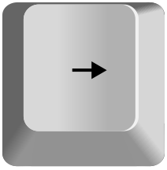
Welcome to this study!
Use the LEFT and RIGHT arrow keys on the keyboard to navigate through the instructions.
The LEFT key will go back to the previous instruction screen.
The RIGHT key will go to the next instruction screen

Slide 2
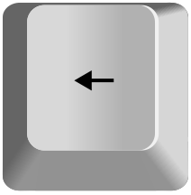
Today we will ask you to imagine you are playing a game at the casino.
The rules are simple.
You will pick one of two cards chosen randomly from a deck.
If the card you pick is bigger than 5, you win.
If the card you pick is smaller than 5, you lose.
We explain more in the next slides.

Slide 3


Before picking a card, you will see a deck of cards appear on the screen.
This deck of cards can be either black or red.

Slide 4

The dealer at the casino will randomly select two cards from each of these decks and
place them face-down on the screen.
For example, below are two cards randomly chosen from the red deck.

Slide 5
Your job will be to flip one of these cards.
But, how you flip the cards will depend on the color of the deck.

Slide 6



If the cards are black, you will be able to choose
whichever card you’d like to flip.
To do so, you will use the Z and M keys on your keyboard to choose
either the left or the right card.

Slide 7
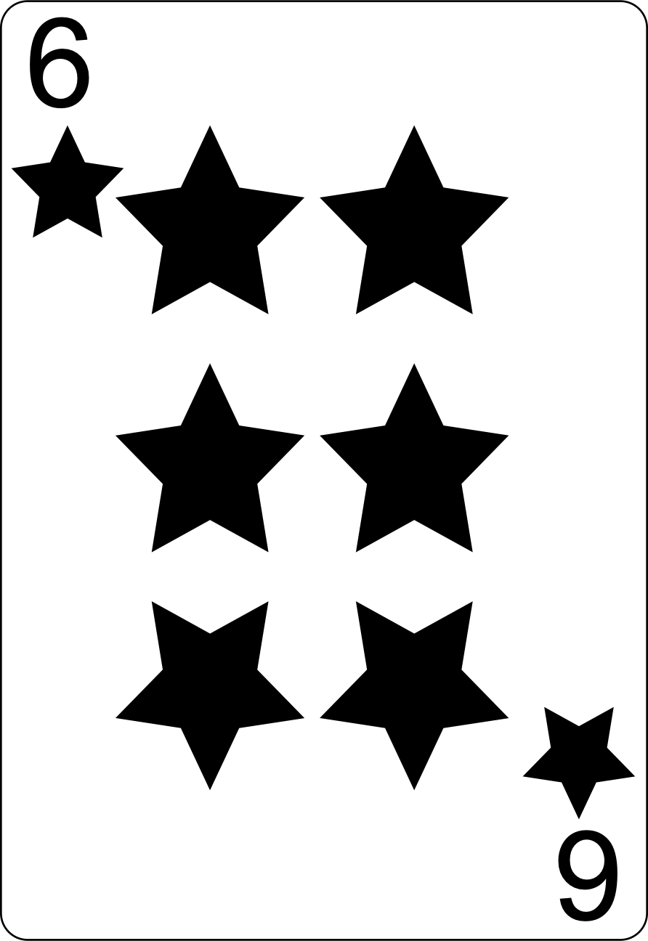
For example, if you press the Z key, the left card would flip over.
Here, doing so reveals a 6, which is bigger than 5, and so
you would win the game.

Slide 8
When the cards are red, you will not be able to choose which card to flip.
Instead, a key will appear below one of the cards.
You will have to press that key to flip the card it is under.
You will not be able to flip the other card.
For example, here, you would have to press the Z key.

Slide 9
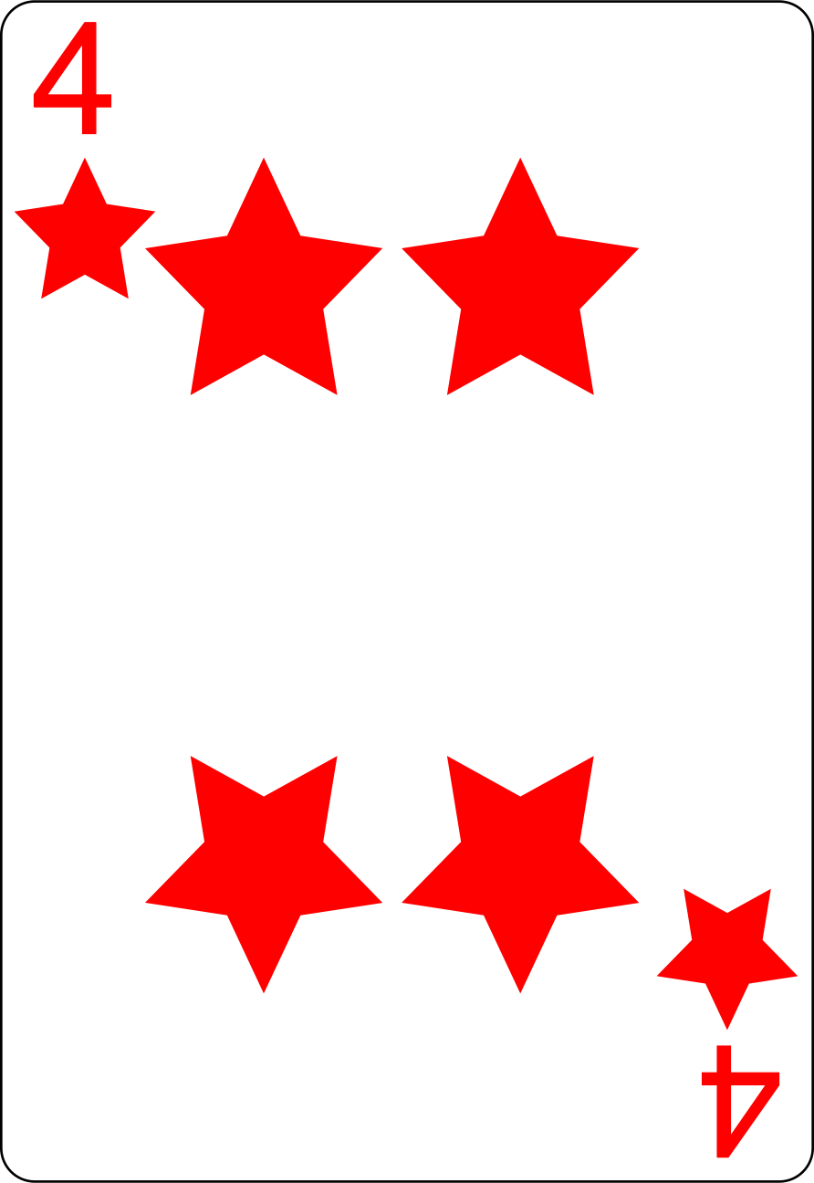
After pressing the specified key, the rules are the same: the card will flip and if it is larger than 5, you will win.
For example, here, the flipped card is a 4, which is smaller than 5,
so you would lose the game.

Slide 10
If you win the game, you will win some points.
Points will be converted to a cash bonus of up to $4 USD.
The more points you earn, the higher your bonus pay.
If you lose, you will not get any bonus pay,
but you will still receive your base pay ($3.00).

Slide 11
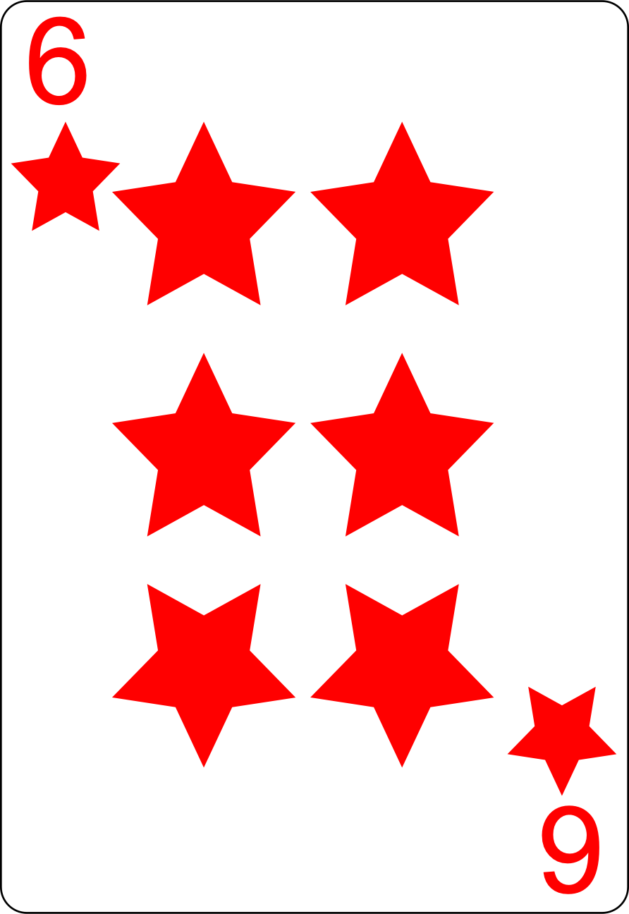
How you win bonus points will depend on the day you are playing at the casino.
On some days, you will win points every time the card you pick is above 5. In examples below, you would win points in both cases.
OR

Slide 12
Other days, you will only sometimes win points when the card you pick is above 5.
In examples below, even though the chosen card is above 5, there is a chance you would still not win points.
OR

Slide 13


There is one exception.
Sometimes you will be shown lightning cards. With lightning cards, you will
always win points regardless of what card you pick. This is true for both black
And red lightning cards.
OR

Slide 14
You will have a time limit to choose the cards,
so be sure to answer as soon as you know which card you want to pick.
If you don’t answer in time a “Too Slow!” message will appear on the screen and
you automatically lose your potential bonus.

Slide 15
In the next part of the study, you will practice playing this game many times.
This part may feel a little long, but it is important that you have experience playing with the red and black cards before you play the game for real money.
On the next screen, we will review the instructions you have just learned and
then you can start playing!

Slide 16
REMEMBER THE RULES:
When the cards are black, you can choose whichever card you prefer;
When the cards are red, you must pick the card with a key below it;
If the card you picked is greater than 5, you win;
When you win, you will sometimes earn points and sometimes not, depending on the day;
When the cards are lightning cards, you always win;
To choose a card, use the Z and M keys on your keyboard;
You have a time limit to answer.

Slide 17
These are all the instructions for now.
During the practice phase, you cannot earn any extra money, but we will still show you the bonus when you win so you can learn how the game works for later.
If you are confused about anything, go back through the instructions and
read them again using the LEFT key.
When you are ready to start, press the RIGHT key.

Slide 18
Great job!
You should now understand how the game works.
In the next part of the study,
we are going to ask you which deck you want to play with.
Press RIGHT to learn more.

Slide 19
You will now be able to choose the deck you want to play with.
As you learned, the deck can either be black or red.
We will ask you to pick between red and black decks. Please select the deck you
would rather play with.

Slide 20


To choose the red deck, press the key under the red deck.
To choose the black deck, press the key under the black deck.

Slide 21
Like we said earlier, whether or not a winning card (a card above 5) will always give you points or sometimes give you points depends on the day you are playing at the casino.
Every time a day at the casino finishes, you will see the picture below.
The next time you play at the casino, the relationship between winning cards and points may change, so be sure to pay attention!

Slide 22
To be sure you are paying attention to the different days at the casino, we will sometimes ask you how likely you think it is you will receive your additional points after choosing a card.
To answer, you will use a slider. Slide it to the right to indicate that it is very likely you will receive your points given the card you picked, to the left if you think it is very unlikely, and near the middle if you think it is 50/50.
How confident are you that you will win points?
0%
50%
100%

Slide 23
REMEMBER THE RULES:
When the cards are black, you can choose whichever card you prefer;
When the cards are red, you must pick the card with a key below it;
If the card you picked is greater than 5, you win;
When you win, you will sometimes win points and sometimes not;
Whether you are certain to get points when you win depends on the day;
To choose a deck, use the W and O keys on your keyboard;
To choose a card, use the Z and M keys on your keyboard;
The more points you earn the higher the bonus pay;
You have a time limit to answer.
Sometimes you will rate how likely you think it is to receive points after choosing a card.

Slide 24
These are all the instructions for now.
If you are confused about anything, go back through the instructions and
read them again using the LEFT key.
When you are ready to start the task, press the RIGHT key.

Slide 25
Almost done! We just have a couple more questions for you.
We will now ask you about your subjective opinion about each deck. We want to know how much did you feel like you could control whether you earned points or not.
To answer, you will use a slider. Slide it to the right to indicate that you felt in complete control, to the left if you felt like you had no control, and near the middle if you had intermediate levels of control.
Press RIGHT to start.

