Slide 1
The History of Artificial Intelligence and Machine Learning

Slide 2
Introduction
Artificial Intelligence (AI) and Machine Learning (ML) have a rich history
From early concepts to modern applications
This presentation covers key milestones and breakthroughs

Slide 3
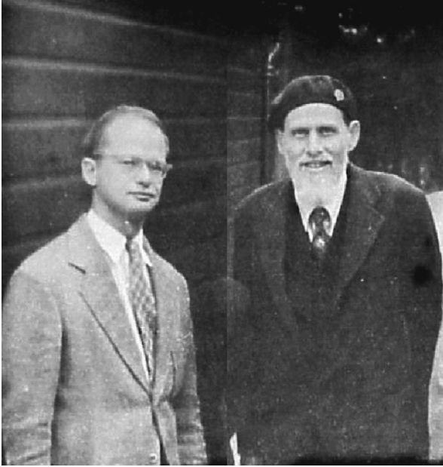
Early Beginnings (1940s-1950s)
1943: McCulloch and Pitts create a computational model for neural networks
1950: Alan Turing proposes the Turing Test
1956: Dartmouth Conference coins the term “Artificial Intelligence”

Slide 4
The Golden Years (1956-1974)
Development of early AI programs
1957: Frank Rosenblatt develops the Perceptron
1964: ELIZA, one of the first chatbots, is created by Joseph Weizenbaum

Slide 5
Expert Systems Era (1970s-1980s)
Focus on rule-based systems and knowledge representation
1972: MYCIN, an expert system for diagnosing blood infections
1980: XCON expert system for computer configurations

Slide 6
AI Winter (1974-1980 and 1987-1993)
Periods of reduced funding and interest in AI
Overpromising and underdelivering led to skepticism
Shift towards more practical, focused applications

Slide 7
Revival of Machine Learning (1990s)
Increased focus on data-driven approaches
1997: IBM’s Deep Blue defeats world chess champion Garry Kasparov
Growing interest in neural networks and statistical methods

Slide 8
The Rise of Big Data (2000s)
Explosion of digital data and increased computing power
2006: Geoffrey Hinton introduces deep learning techniques
2010: ImageNet project accelerates computer vision research

Slide 9
Deep Learning Revolution (2010s)
2012: AlexNet wins ImageNet competition, marking a breakthrough in deep learning
2014: Generative Adversarial Networks (GANs) introduced by Ian Goodfellow
2016: Google’s AlphaGo defeats world champion Go player Lee Sedol

Slide 10
Natural Language Processing Advancements
2018: BERT (Bidirectional Encoder Representations from Transformers) by Google
2019: GPT-2 by OpenAI demonstrates impressive text generation capabilities
2020: GPT-3 sets new standards for language models

Slide 11
AI in Healthcare
2015: DeepMind’s AI diagnoses eye diseases from retinal scans
2019: AI models predict antibiotic resistance and discover new antibiotics
2020-2021: AI assists in COVID-19 research and vaccine development

Slide 12
AI in Autonomous Vehicles
2009: Google starts self-driving car project (later Waymo)
2015: Tesla introduces Autopilot
2020: Waymo launches fully driverless taxi service in Phoenix

Slide 13
AI in Art and Creativity
2015: DeepDream generates dreamlike images
2018: AI-generated art piece sells at Christie’s auction
2022: Text-to-image models like DALL-E 2 and Midjourney gain popularity

Slide 14
Ethical Considerations and AI Safety
Growing concern over AI bias and fairness
2016: Partnership on AI founded to address ethical concerns
Ongoing debates on AI regulation and responsible development

Slide 15
AI and Climate Change
AI used for climate modeling and prediction
2019: DeepMind AI reduces Google data center cooling energy by 40%
AI optimizing renewable energy integration and resource management

Slide 16
Recent Breakthroughs (2020-2023)
2020: AlphaFold 2 solves protein folding problem
2022: ChatGPT demonstrates advanced conversational abilities
2023: Multimodal models like GPT-4 show improved reasoning and task completion

Slide 17
Current State of AI and ML (2024)
Rapid advancements in large language models
Increasing focus on AI alignment and safety
Integration of AI in various industries and everyday applications

Slide 18
Future Directions
Artificial General Intelligence (AGI) research
Quantum computing and AI
Neuromorphic computing
Human-AI collaboration

Slide 19
Challenges and Opportunities
Ethical AI development
AI governance and regulation
Addressing AI bias and fairness
Balancing innovation with responsible development

Slide 20
Conclusion
AI and ML have come a long way since their inception
Continued rapid progress and integration into various aspects of life
Importance of responsible development and ethical considerations

Slide 21
Questions?
Thank you for your attention!

Slide 22
References
[List of key references and further reading]

