Slide 1
Getting started
On Sakai:
“Resources” – “Anshul Kundaje” – “expression-prediction.zip"
Software:
R: http://cran.rstudio.com/
Rstudio IDE
caret package:
install.packages(‘caret’, dependencies=T)
This takes a while (10-15mins) so start this now
may need to install ‘glmnet’ and ‘randomForest’ manually if the dependencies didn’t work out

Slide 2
Machine learning in 1 slide Example: predict TF binding
Input
Output
Features: histone marks
Prediction
Output (true)
Continuous
=> Regression
Gene expression
Examples:
Genes
Machine learning
Examples:
Genes
Minimize loss
Binary
Classification
Gene on/off
Loss: predicted – true
Data split: train, validation (for parameter tuning), test
Method to evaluate performance: e.g ROC (classification), square error (regression)

Slide 3
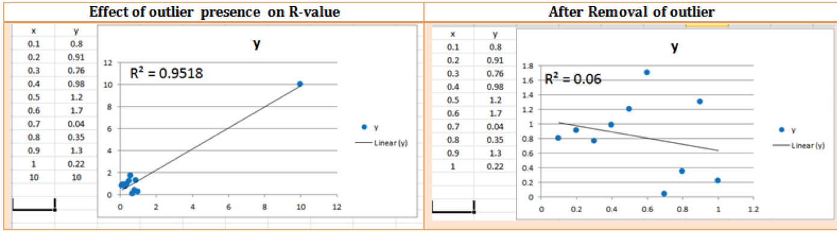
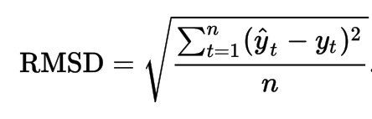
Evaluating predictions with continuous output
Correlation: Pearson, Spearman
Note: be VERY suspicious about Pearson correlation most of the time, because it can be driven by outliers
RMSE – Root mean squared error
Plots from http://www.simafore.com/blog/bid/101387/A-simple-example-to-show-value-of-good-data-preparation-for-analytics

Slide 4
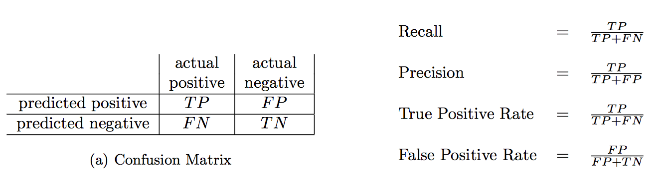
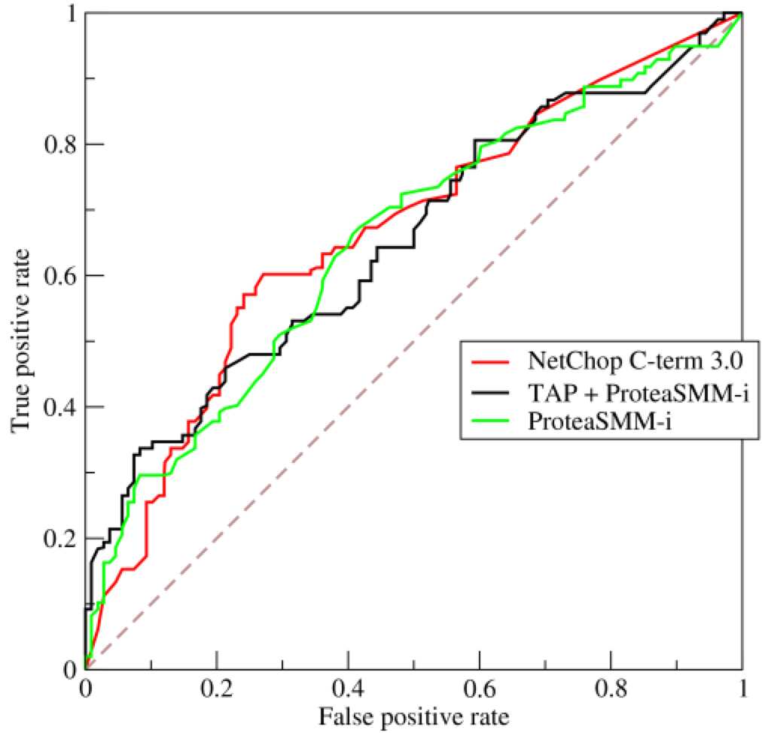
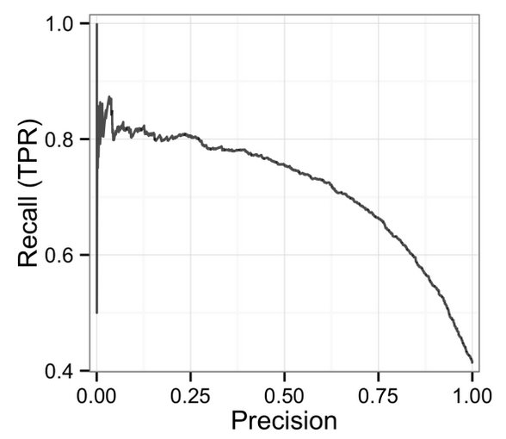
Evaluating predictions with binary output
Text from http://pages.cs.wisc.edu/~jdavis davisgoadrichcamera2.pdf
Popular performance measures for classification
ROC curve and auROC Precision-recall curve and auPRC
Picture from Wikipedia
Picture from https://andybeger.com/2015/03/16/precision-recall-curves/

Slide 5
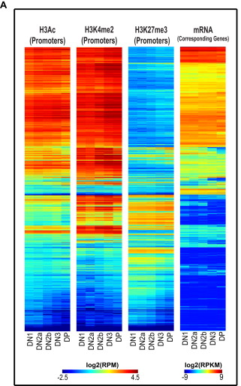
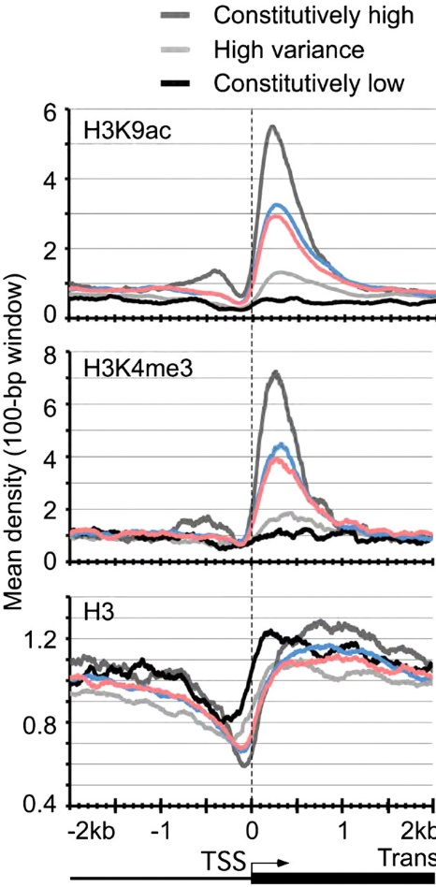

Relationship between chromatin marks and gene expression
Aggregation analysis and simple univariate correlation analysis suggest strong positive or negative relationships between gene expression and enrichment of chromatin marks at gene promoters
$$Expr \sim H3K4me3$$
What is the collective predictive power of a set of chromatin marks? Which ones are more predictive?

Slide 6
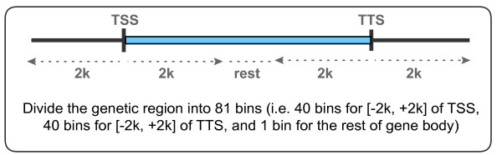
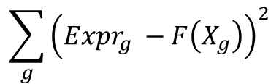
Multivariate predictive model
Input variables (features)
$$Expr=F(H3K4me3, H3K4me1,H3K27ac,H3K27me3 …in each window)$$
Linear Regression model
$$Expr=β_{1}∗H3K4me3, +β_{2}∗H3K4me1+β_{3}∗H3K27ac+β_{4}∗H3K27me3 …$$
$$\sum_{g}{{\left(Expr_{g} −F\left(X_{g}\right)\right)}^{2}}$$
Minimize square error to find betas

Slide 7
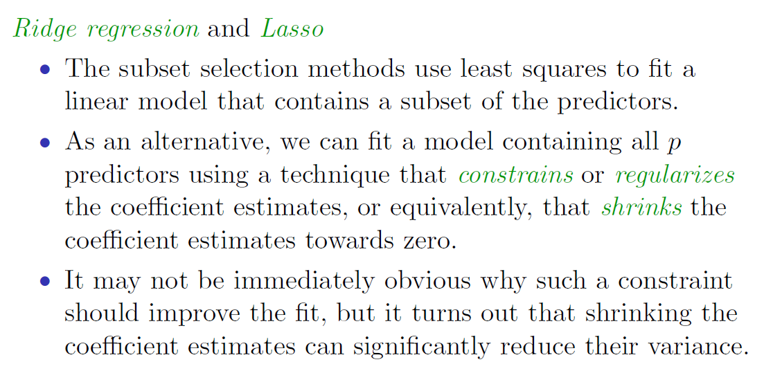
Regularization / Shrinkage methods

Slide 8
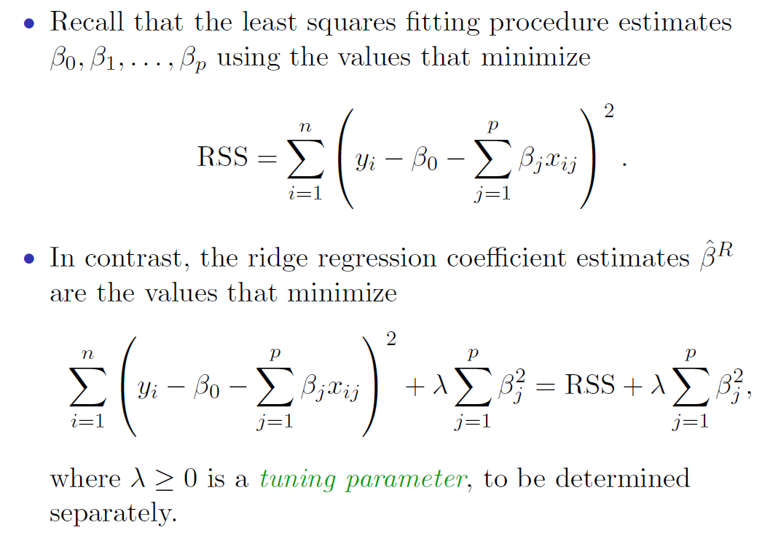
Ridge Regression (L2 regularization)
Notes:
RSS residual sum of squares

Slide 9
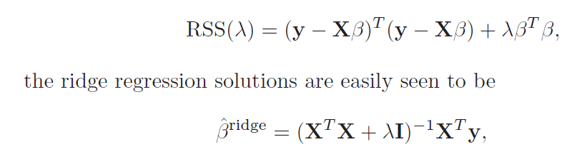
Ridge Regression (L2 regularization)

Slide 10
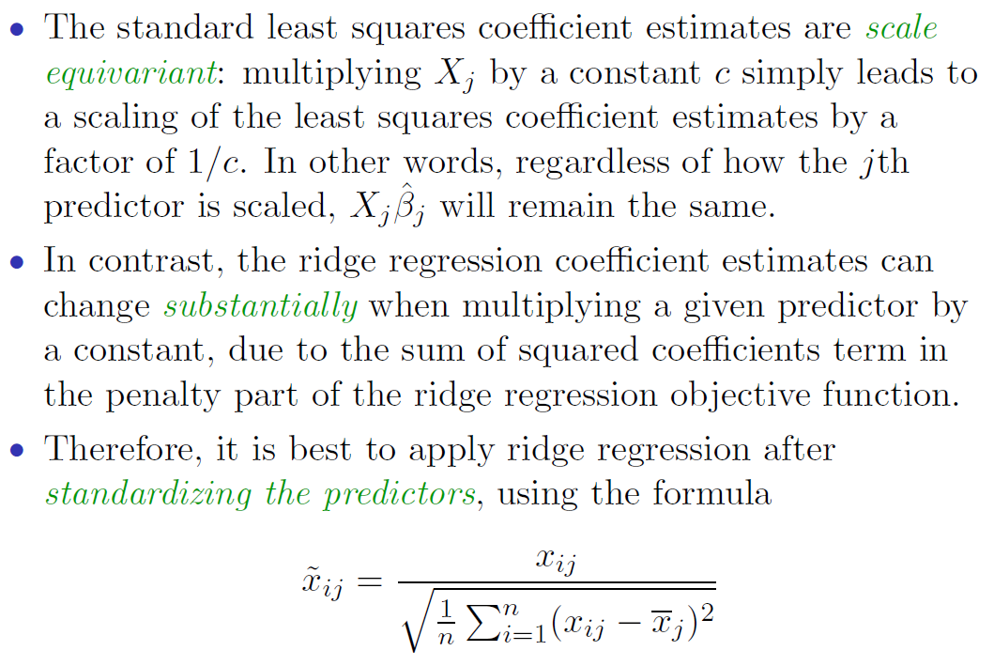
Ridge Regression (L2 regularization)

Slide 11
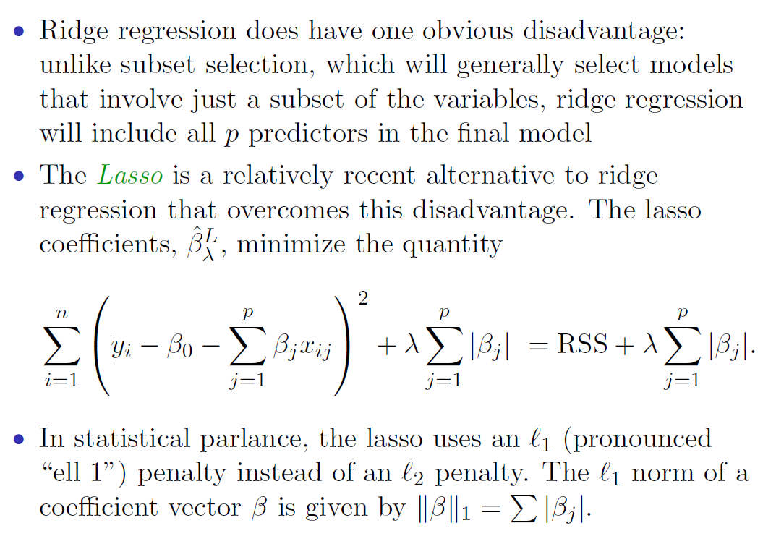
The Lasso (L1 regularization)

Slide 12
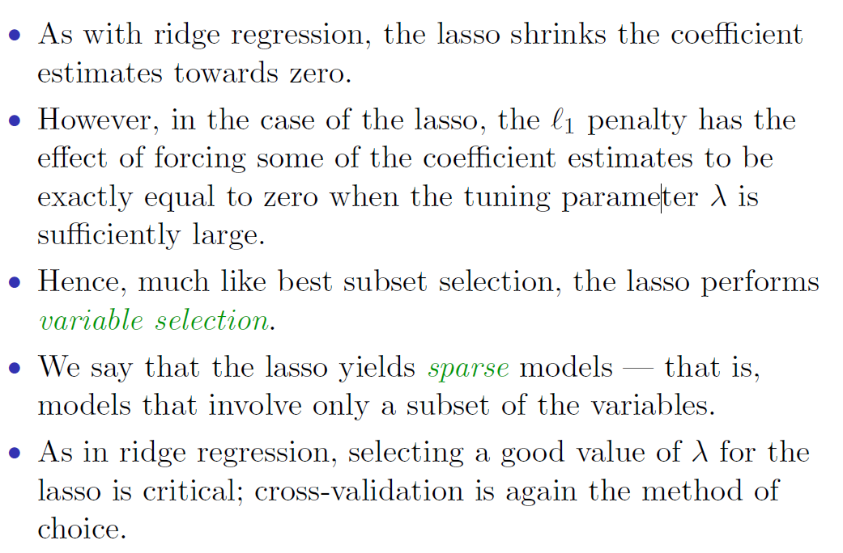
The Lasso (L1 regularization)

Slide 13
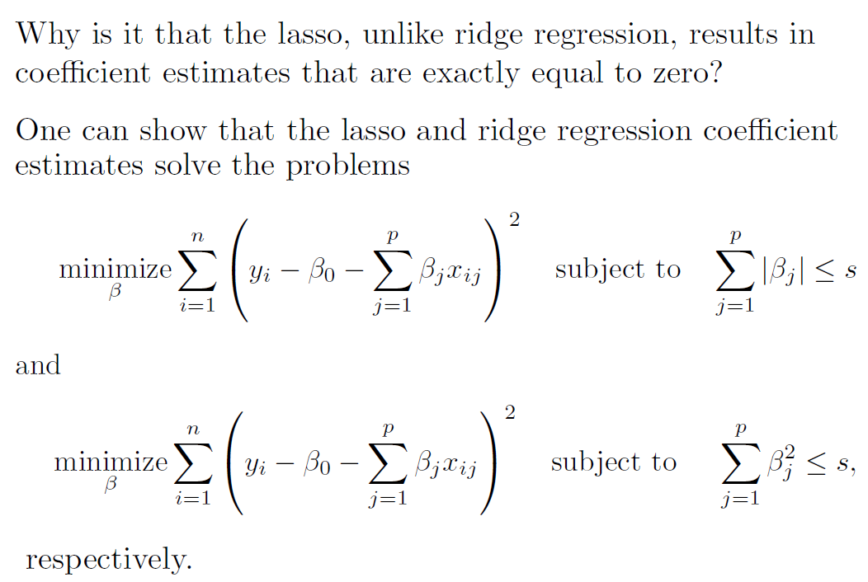
Variable selection property of Lasso

Slide 14
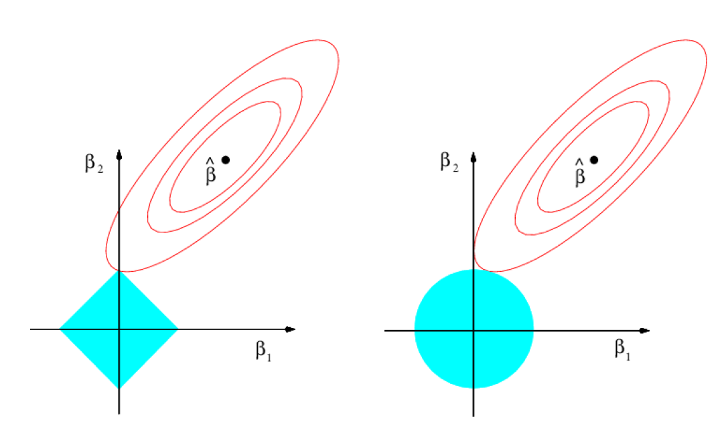
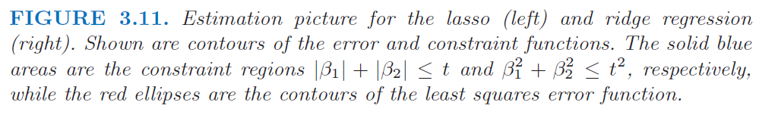
Lasso (L1) vs. Ridge (L2)

Slide 15
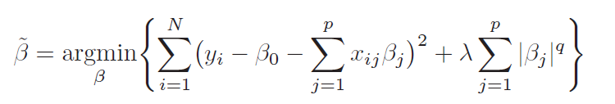
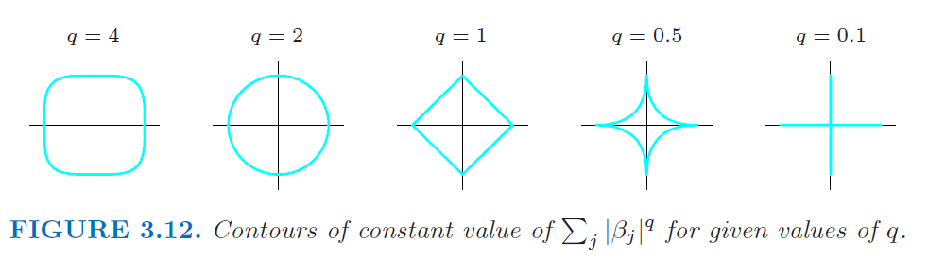
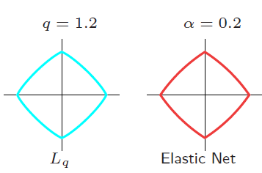
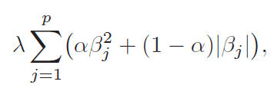
Other regularizers
Elastic net

Slide 16
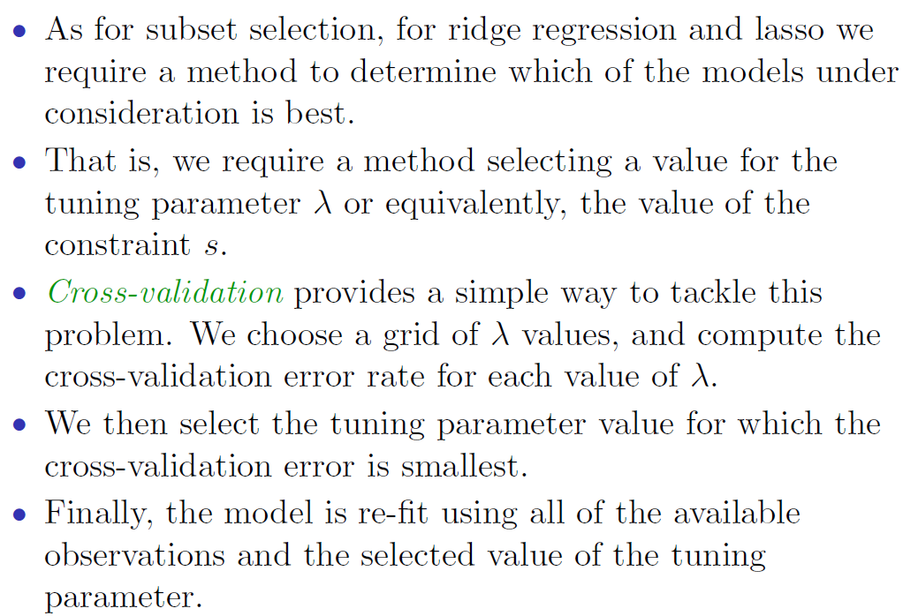
Selecting

Slide 17
Data and code
Expression data:
CAGE PolyA+ K562 Whole-cell extracts
Preprocessing – obtain signals in bins
Pick the best bin location (for speed)
log-transform
Main script – lab.R
Learn a lasso model (runLasso.R)
Learn a random forest regression model (runRF.R)

Slide 18
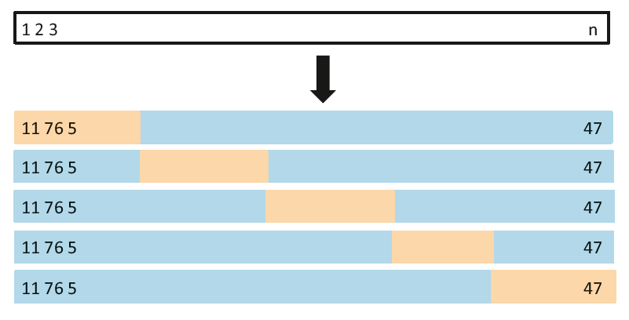
Cross-validation
An Introduction to Statistical Learning with Applications in R
Notes:
Assume you’ve already split out the test data. How do we maximize use of the remaining data for model tuning? CV.
Orange blocks are the validation set. Blue blocks are the training set. This way we can evaluate the model on the entire training set.

Slide 19
caret: R package for model building
Streamlines the process of building predictive models
Takes care of parameter tuning, pre-processing, feature selection, variable importance estimation
Supports many predictive model packages
http://topepo.github.io/caret/index.html

Slide 20
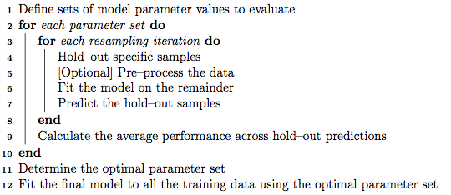
caret: R package for model building

Slide 21
TF ChIP-seq IDR pipeline
https://sites.google.com/site/anshulkundaje/projects/idr
Latest ENCODE3 pipeline in beta
https://docs.google.com/document/d/1lG_Rd7fnYgRpSIqrIfuVlAz2dW1VaSQThzk836Db99c/edit

Slide 22
ENCODE portals
Primary new portal: http://encodeproject.org
Tutorial for new portal https://www.encodeproject.org/tutorials/
Older UCSC DCC portal: http://genome.ucsc.edu/ENCODE/
As far as possible use “Uniformly processed data”
Latest ENCODE annotations https://www.encodeproject.org/data/annotations/
Older ENCODE data access hands-on tutorials http://www.genome.gov/27555330

Slide 23
Epigenome Roadmap Portal
Primary portal http://www.roadmapepigenomics.org/
Uniformly processed data (Roadmap+ENCODE) http://compbio.mit.edu/roadmap

