Slide 1

Software Emulator for the Nintendo Game Boy Color
Sean Dewar

Slide 2
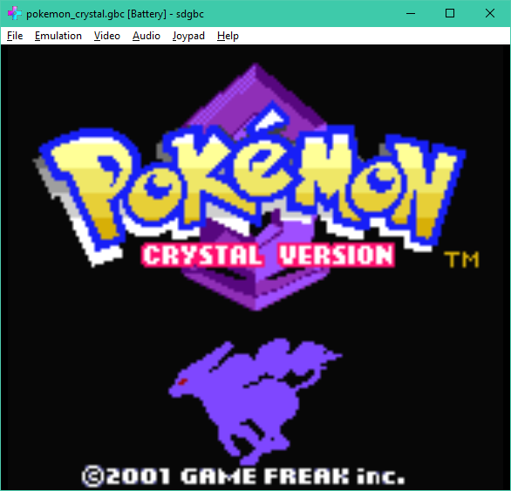
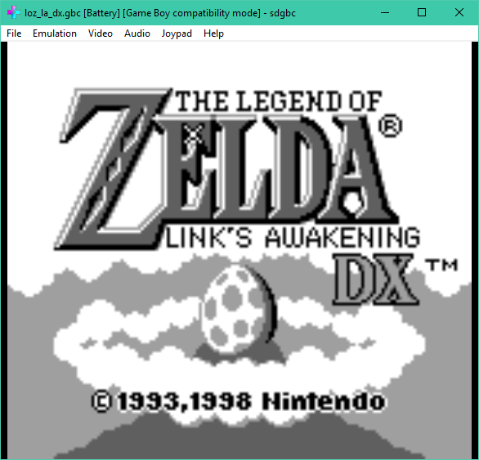
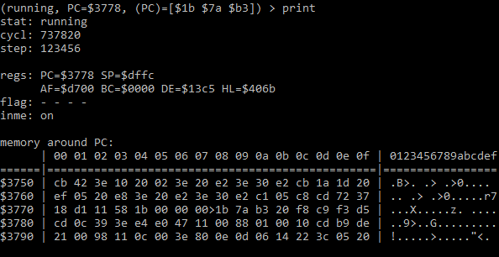
Introduction
Developed software that can run Game Boy and Game Boy Color programs on modern systems
Reads programs from ROM dumps (.gb, .gbc files)
Uses a low-level emulation (LLE) approach
Replicates the operation of the GBC’s hardware in code
Essentially runs a virtual GBC guest machine
Two modes of operation
GUI for interacting with programs (using wxWidgets)
Command-line interface for debugging CPU emulation

Slide 3
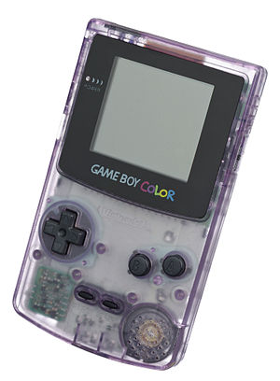

So, what is a Game Boy Color?
Handheld video game console made by Nintendo
Released in 1998
Successor to the Game Boy
Both systems sold a combined total of ~120 million units worldwide
Contributed to the success of media franchises such as Pokémon, which saw its first few games released for the system

Slide 4
So, what is a Game Boy Color?
8-bit Sharp LR35902 CPU
Based on the Zilog Z80 and Intel 8080
Clock speed of ~4.2 or ~8.4 MHz
32 KB WRAM
16 KB VRAM
160 x 144-pixel colour LCD
Joypad
Has a directional pad and four extra buttons
Mono speaker
2-channel stereo output possible with headphones

Slide 5
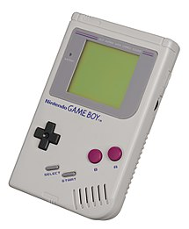

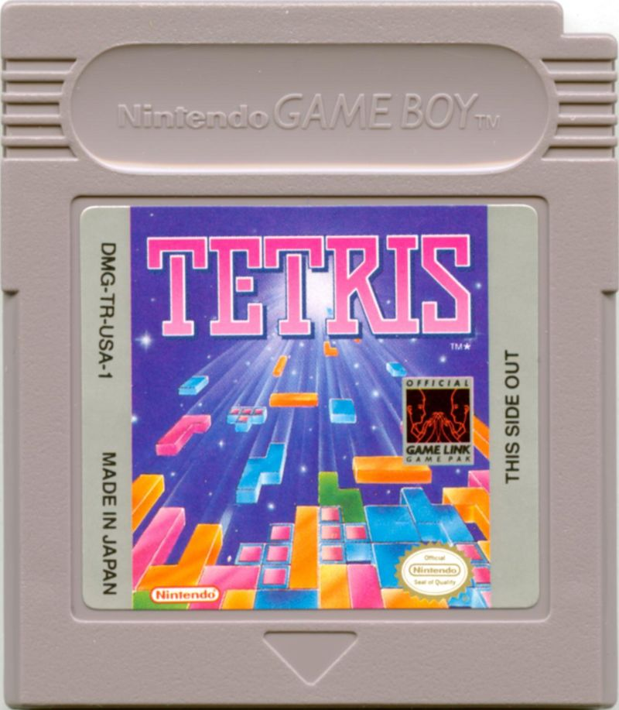
So, what is a Game Boy Color?
The GBC is backwards compatible with its predecessor, the Game Boy
Monochrome dot-matrix screen (vs colour LCD)
CPU locked at a 4.2 MHz clock speed (vs 8.4 MHz max)
8 KB WRAM (vs 32 KB)
8 KB VRAM (vs 16 KB)
GB and GBC programs distributed in cartridges
8 MB ROM maximum
128 KB RAM maximum
Sometimes bundled with a battery and used for storing persistent data (leader board scores, player saves, etc.)

Slide 6
Why a Game Boy Color emulator?
Interest in computer systems and video games
Emulation of video game consoles combines these two interests!
Increase my knowledge of low-level programming and C++
C++ provides speed of native code and abstractions of low-level features such as pointers
In a general, social context: hardware eventually fails
Emulation is necessary in the preservation of their history
In the case of the GBC, production of units stopped in 2003

Slide 7
Project Objectives
Key Objectives (musts)
Emulation of important hardware components ✓
Implementation of a basic GUI ✓
Extensive testing ✓
Optional Objectives (mostly mays)
Implementation of debugging tools ✓
Implementation of save states ?
Implementation of key remapping ✗
Implementation of input playback ✗
Legend:
✓ Fully met
? Partially met
✗ Not met

Slide 8
Testing Strategy
Critical Hardware Emulation Tests
Automated unit tests that verify important hardware aspects
Failing these tests greatly affects emulated program compatibility
Many of these tests verify aspects of the emulated CPU
Miscellaneous Hardware Emulation Tests
Typically automated unit tests that verify non-critical or obscure hardware aspects
Failing these tests produce superficial or no visible issues (e.g. minor graphical bugs)
Not a huge priority to pass all these tests
Manual Program Compatibility Tests
Involves manually running real games released for the GB and GBC
Programs typically utilise all emulated hardware components to some degree
Mainly acts as full system tests

Slide 9
A Few Important Hardware & Emulation Aspects

Slide 10
Emulation
All emulated hardware components are represented using classes
Contain methods for updating and hard resetting their states
Emulation is driven by a loop that is run on a separate thread to the GUI
Emulates the GBC’s clock speed via sleep() and frame skipping
Supports pausing and fast-forwarding
The Emulator class contains methods for interacting with the emulated system in a thread-safe manner
The emulator automatically detects whether the loaded program should be ran in GB backwards compatibility mode
Achieved by parsing header data included inside of every program’s ROM

Slide 11
Memory
Emulated memory is represented using arrays
Dynamic sized arrays (std::vectors) are used for storing program ROM data and cartridge RAM
Fixed size arrays are used for all other memory
All GBC memory is mapped within a single 16-bit address space
Emulated memory is mapped using simple if-else statements that test against each mapped address range
Mapped I/O registers are used to configure and query the status of hardware components

Slide 12
CPU
The emulated CPU is responsible for determining how many clock cycles other hardware components run for every time it is updated
Implements 5 types of maskable interrupt
Requested by the program or other hardware when specific time sensitive conditions are met (e.g. when a frame of video has finished rendering)
Program instructions are represented as machine code in ROM
500 opcodes exist for representing all instruction and addressing mode configurations
Because opcodes are 8 bits, a special opcode (0xCB) is used as a prefix for representing 256 opcodes in an extended instruction set
Instruction decoding is implemented using a large switch statement, which compiles into a jump table

Slide 13
CPU
The CPU exposes numerous program registers
Six 8-bit General Purpose registers (B, C, D, E, H, L)
An 8-bit Accumulator (A) stores the result of arithmetic and logical operations
An 8-bit Status Flag (F) stores the result of the previously executed arithmetic or logical operation
A 16-bit Program Counter (PC)
A 16-bit Stack Pointer (SP)
Many 8-bit registers can be addressed as 16-bit register pairs
AF, BC, DE & HL
The Curiously Recurring Template Pattern (CRTP) C++ idiom is used to represent the emulated CPU registers in code
This optimization allows emulated registers to inherit behaviour without virtual function call overhead
Requires concrete types to be known at compile-time

Slide 14
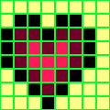
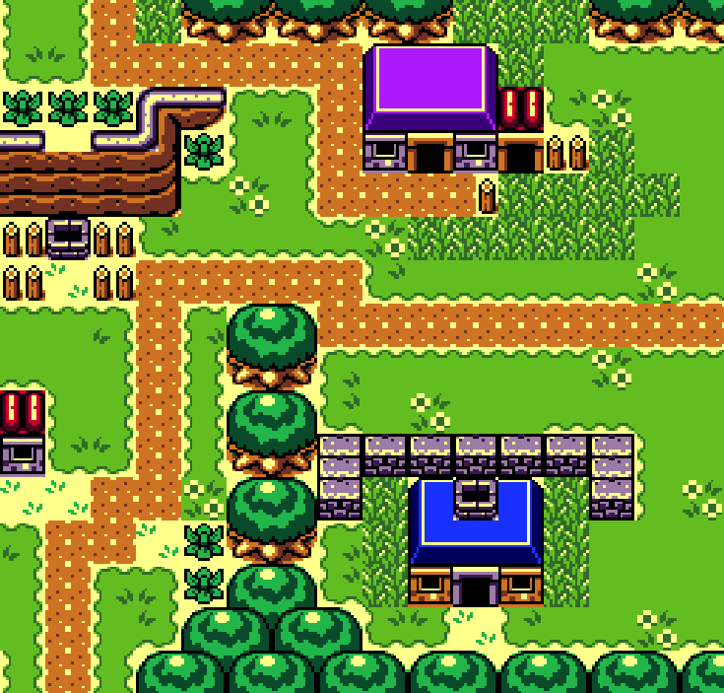
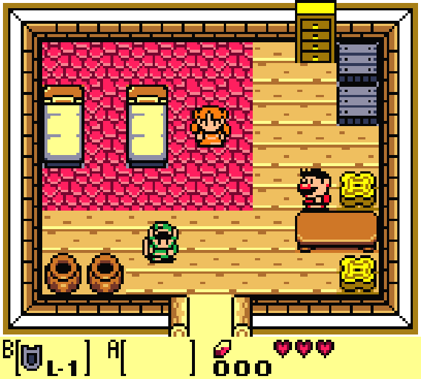
LCD Controller (PPU)
All graphics to be rendered are stored in VRAM as individual 8 x 8-pixel bitmap tiles
Assortments of 32 x 32 tiles, known as tile maps, are also stored in VRAM
3 tile layers are combined together to produce an output image
Background layer (back)
Uses a tile map for BG graphics
Window layer (middle)
Uses a tile map for UI graphics
Object layer (front)
Uses object attribute memory (OAM-RAM) for representing graphics that move independently from the other layers (e.g. projectiles)

Slide 15
LCD Controller (PPU)
Emulated LCD output rendered using the SFML library
Provides cross-platform hardware acceleration for rendering (via OpenGL)
The PPU renders on a per-scanline basis, alternating between 4 different modes of operation. The most important are:
H-Blank: when a single scanline has rendered
V-Blank: when a full frame of video has rendered (occurs at ~59.7 Hz)
Implements direct memory access (DMA) circuitry
Allows programs to quickly copy data to VRAM and OAM-RAM

Slide 16
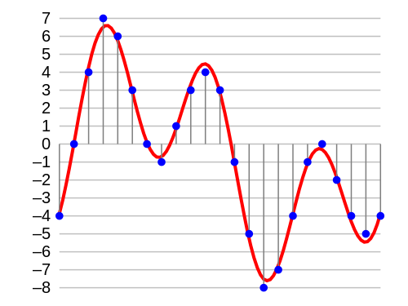
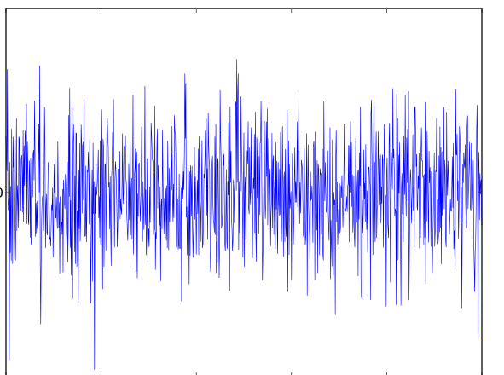
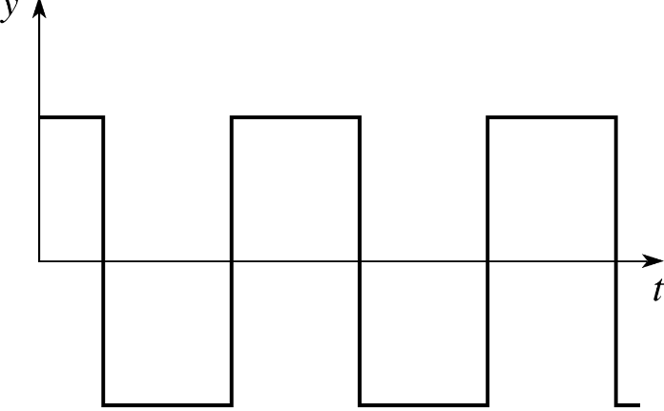
Audio Controller (APU)
2-channel stereo sound output streamed using SFML (via OpenAL)
Emulated output down-sampled to 44,100 Hz for compatibility with modern sound cards
Implements 4 waveform generation channels
Square wave with sweep and envelope
Square wave with envelope
Voluntary waveforms (from 4-bit PCM samples in wave RAM)
Pseudorandom white noise with envelope
Square wave
Voluntary wave
White noise wave

Slide 17
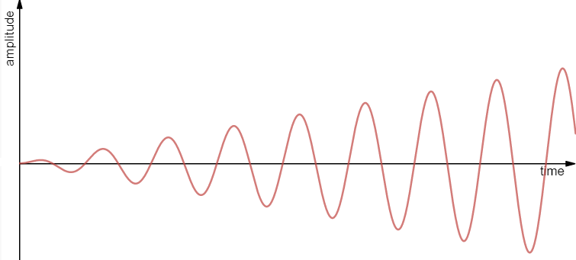
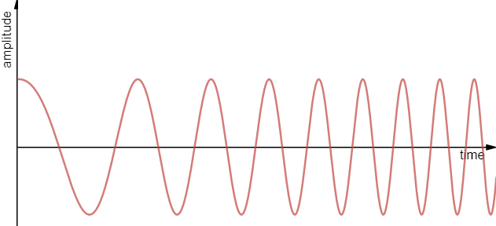
Audio Controller (APU)
Volume envelope units
Gradually increases or decreases waveform volume over time, typically by modifying amplitude
Frequency sweep units
Gradually increases or decreases waveform frequency over time
Additionally, all channels include a length counter
Silences a channel after a specific amount of time
These units are updated by a frame sequencer
Volume envelope units are updated at 64 Hz
Frequency sweep units are updated at 128 Hz
Length counters are updated at 256 Hz
Increasing amplitude
Increasing frequency

