Slide 1
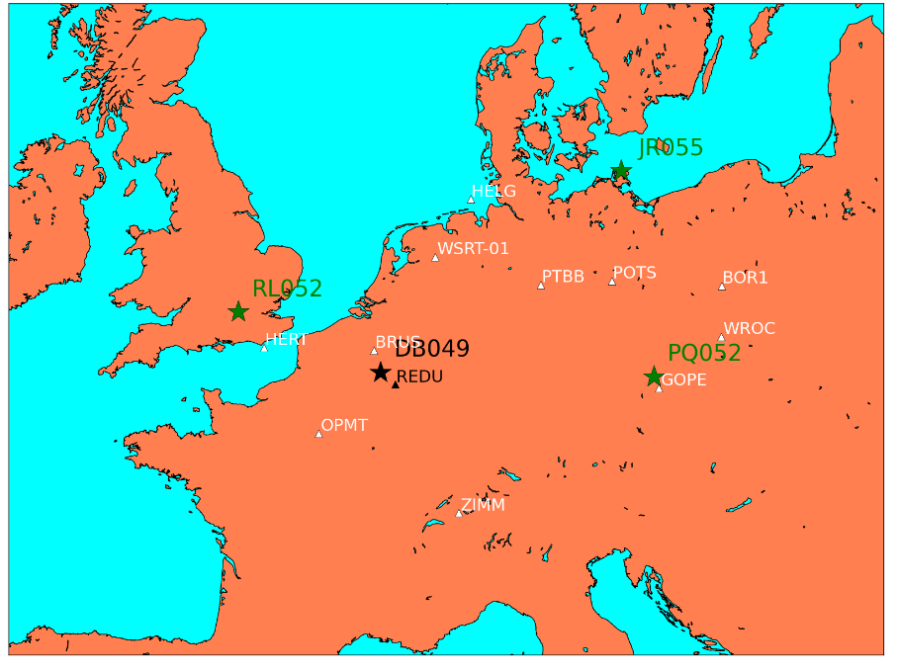
Test Dates: December 8th 2008 – January 7th 2009
Assimilated
Ionosondes:
Chilton (RL052)
Juliusruh (JR055)
Pruhonice (PQ052)
Test station:
Dourbes (DB049)
Assimilated
GNSS:
BOR1
BRUS
GOPE
HELG
HERT
OBEC
OPMT
POTS
PTBB
WROC
WSRT
ZIMM
Test station:
REDU

Slide 2
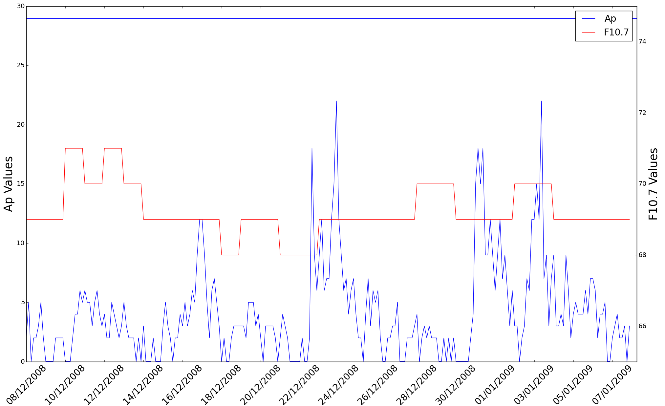
Test Dates: December 8th 2008 – January 7th 2009
Assimilated
Ionosondes:
Chilton (RL052)
Juliusruh (JR055)
Pruhonice (PQ052)
Test station:
Dourbes (DB049)
Assimilated
GNSS:
BOR1
BRUS
GOPE
HELG
HERT
OBEC
OPMT
POTS
PTBB
WROC
WSRT
ZIMM
Test station:
REDU

Slide 3
Data Locations & Procedures
Ionosonde data should be downloaded from NGDC (ftp.ngdc.noaa.gov).
GPS data should be downloaded from the SOPAC/CSRC archive (garner.ucsd.edu).
dSTEC data should be downloaded from: http://tinyurl.com/testscenario
All of this information, including Python code to download the required data is available at: http://tinyurl.com/testscenario
If you are interested in performing the test please speak to me afterwards or email me: s.elvidge@bham.ac.uk

Slide 4

European Space Weather Week 12
SESSION 11 - SPACE WEATHER METRICS, VERIFICATION AND VALIDATION
Splinter – Ionospheric effects on Radio Systems working group
Splinter – SPACE WEATHER METRICS, VERIFICATION AND VALIDATION working meeting
November 23-27, 2015.
Ostend, Belgium.
Submission deadline June 1st.

