Slide 1


Refinement, Redrafting and Relaunching the Veterinary Antimicrobial Treatment Survey
WG1
Sean Farrell

Slide 2
Contributors
Ana
Vale
Marit
Gaastra
Maaland
Ulrika
Windahl
Fergus
Allerton
David
Singleton
Dorina
Timofte
Myself
Farah
Gonul
Aydin
Arzu
Funda
Bagcigil
Cassia Hare

Slide 3
Areas Improved from Pilot Study
Reducing Overall length
Dedicated Website Platform
Individual Surveys for each languages
Reducing free-text options
Clearer Questions with more direct Answers
Survey Specifically Focussed on Small Animal
Improving Mobile Useability

Slide 4
Languages
Albanian
Bosnian
Bulgarian
Croatian
Czech
Danish
Dutch
English
Estonian
Finnish
French
German
Greek
Hebrew
Italian
Lithuanian
Macedonian
Norwegian
Polish
Romanian
Serbian
Slovak
Spanish
Swedish
Turkish

Slide 5
Contributors
Danijela/
Zrinka
Stritof
Tereza
Bodnárová
Aneliya
Milanova
Serafeim
Chaintoutis
Peter
Panduro
Damborg
Ana
Vale
Ana
Vale
Marit
Gaastra
Maaland
Ulrika
Windahl
Ulrika
Windahl
Marit
Gaastra
Maaland
David
Singleton
Fergus
Allerton
Els
Broens
Fergus
Allerton
Ahmed
Smajlovic
David
Singleton
Dorina
Timofte
Dorina
Timofte
Anne-Grete
Martson
Myself
Myself
Jana Koščová
Farah
Gonul
Aydin
Cassia
Hare
Farah
Gonul
Aydin
Arzu
Funda
Bagcigil
Arzu
Funda
Bagcigil
Cassia Hare
Alvaro
Salmoral Lopez
Erika
Villedieu
Vassillis
Aleksandr
Novoslavskij
Dragana
Bozic
Simona
Giustino
Mento
Alishani

Slide 6
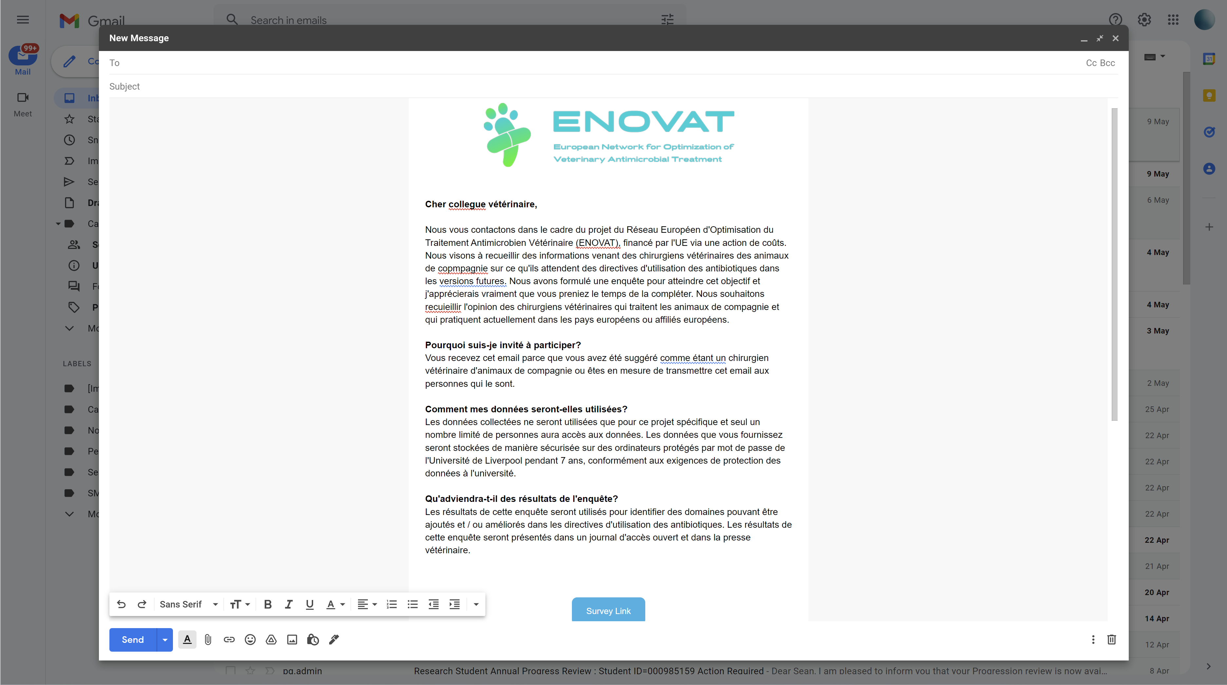

Slide 7


















Slide 8
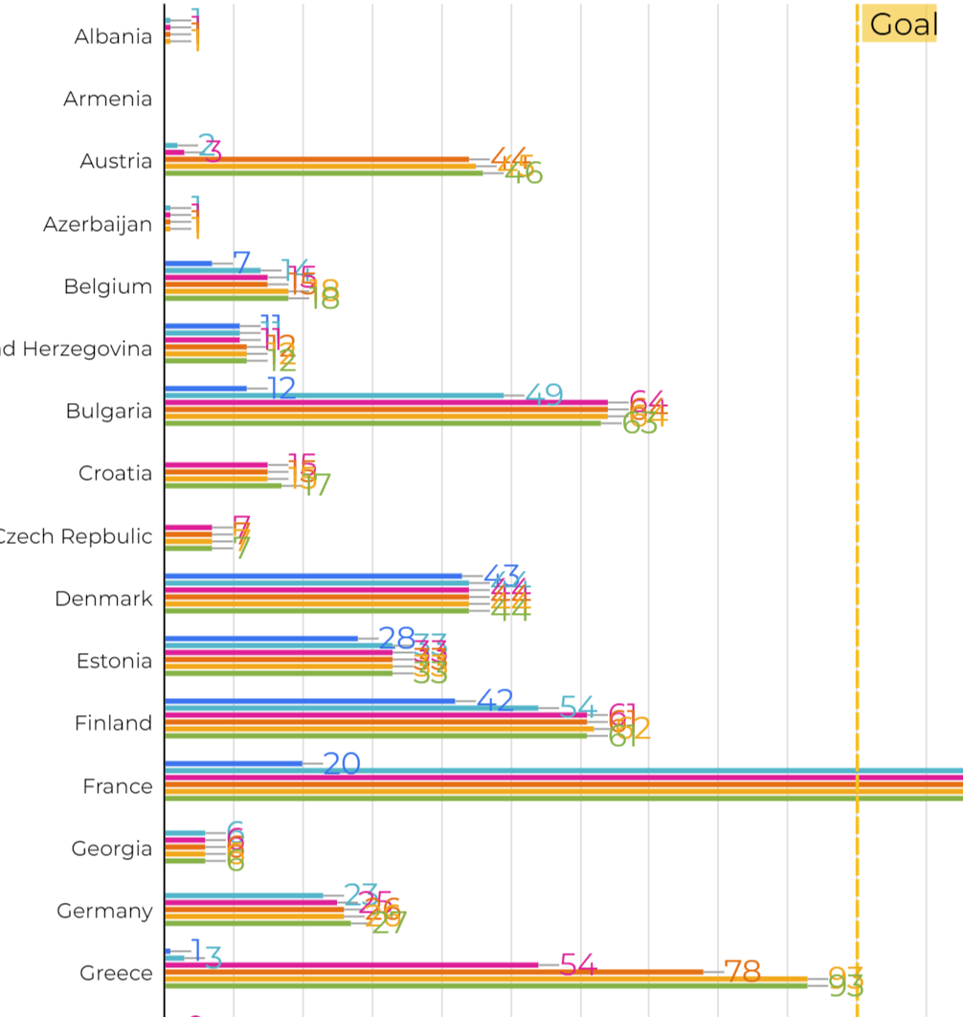
Top Performing Countries
Countries Surpassed “100” Goal | Survey Contributors
Turkey | Funda/Farah
Greece | Serafeim Chaintoutis (N= 93 – close enough)
Norway | Marit
Sweden | Ulrika
France | Fergus
Romania | Dorina
United Kingdom | David/Fergus/Cassia/Dorina/Ana/Me

Slide 9
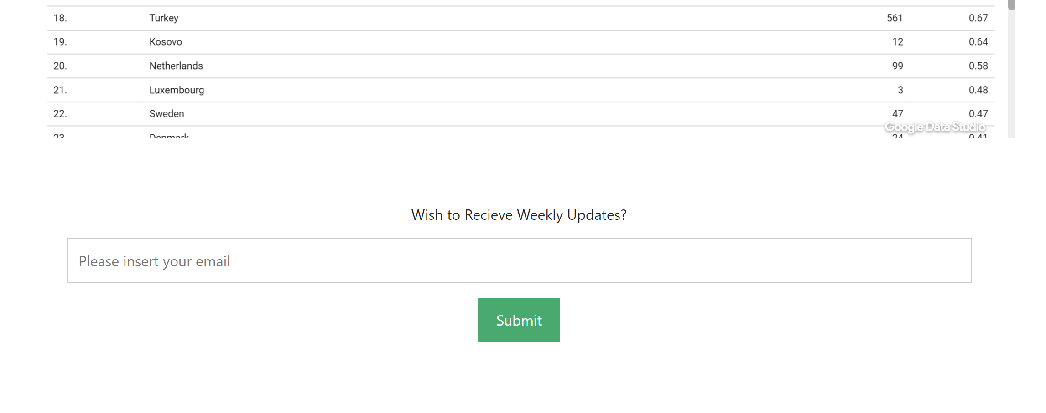
Getting Involved
Survey Website ➔ League Table

Slide 10
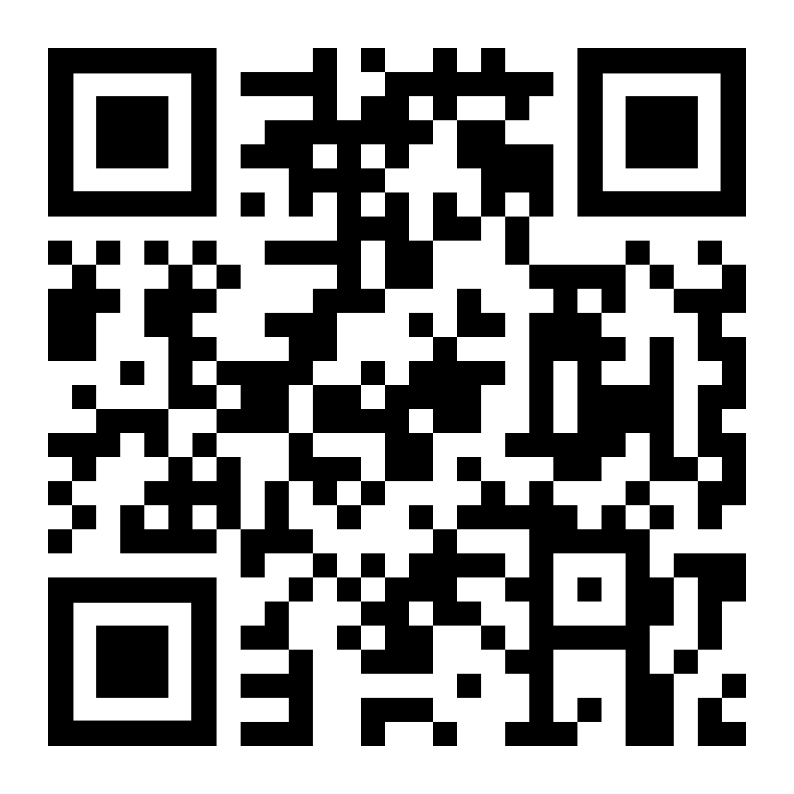
Thank you.
Sean Farrell
sean.farrell2@durham.ac.uk

