Slide 1

RiceXPro: a platform for monitoring gene expression in japonica rice grown under natural field conditions

Slide 2
Why study rice?
Major cereal crop that provides food for roughly half of the world's population.
Genetically interesting species to study
Oryza sativa is the cereal with the smallest genome.
  430Mb across 12 chromosomes
  Easy to genetically modify
  Model organism for cereal biology
Lots of interesting problems to solve!
  Better crop yields through selective cross-breeding of hardy strains
  Bio-fortification (Golden rice project)
  Evolutionary modeling (The rice diversity project)

Slide 3
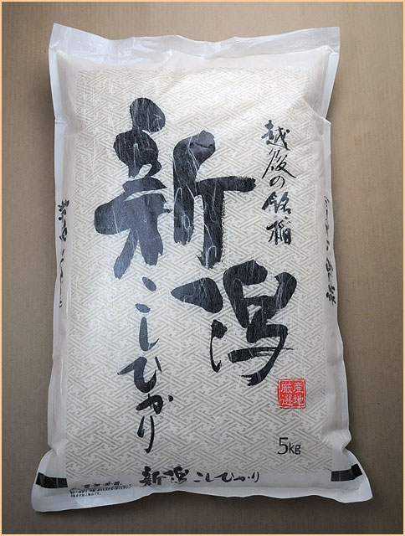
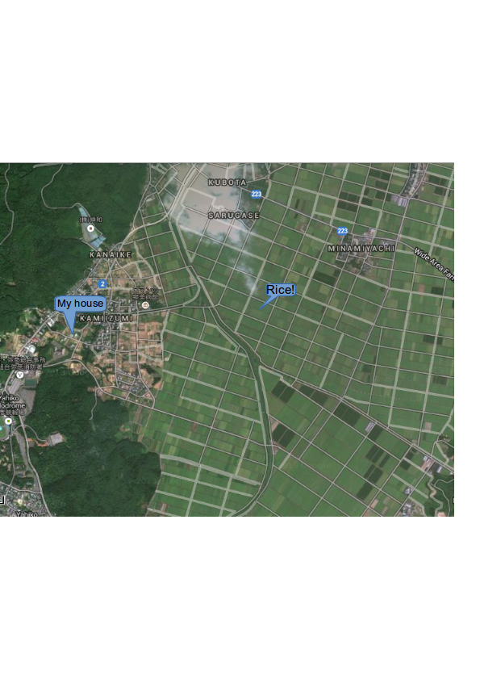

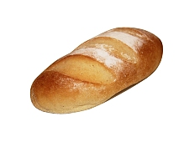

僕は新潟県に住んでいます。
I live in the heart of rice growing country in Niigata Prefecture.
Rice is our life!

Slide 4
What is RiceXPro?
Global gene expression database
Provides an overview of the transcriptional changes throughout the growth of rice plants in the field under natural conditions.
A repository of expression data encompassing growth in the field, providing a baseline for genes that underlie various agronomically important traits in rice.

Slide 5
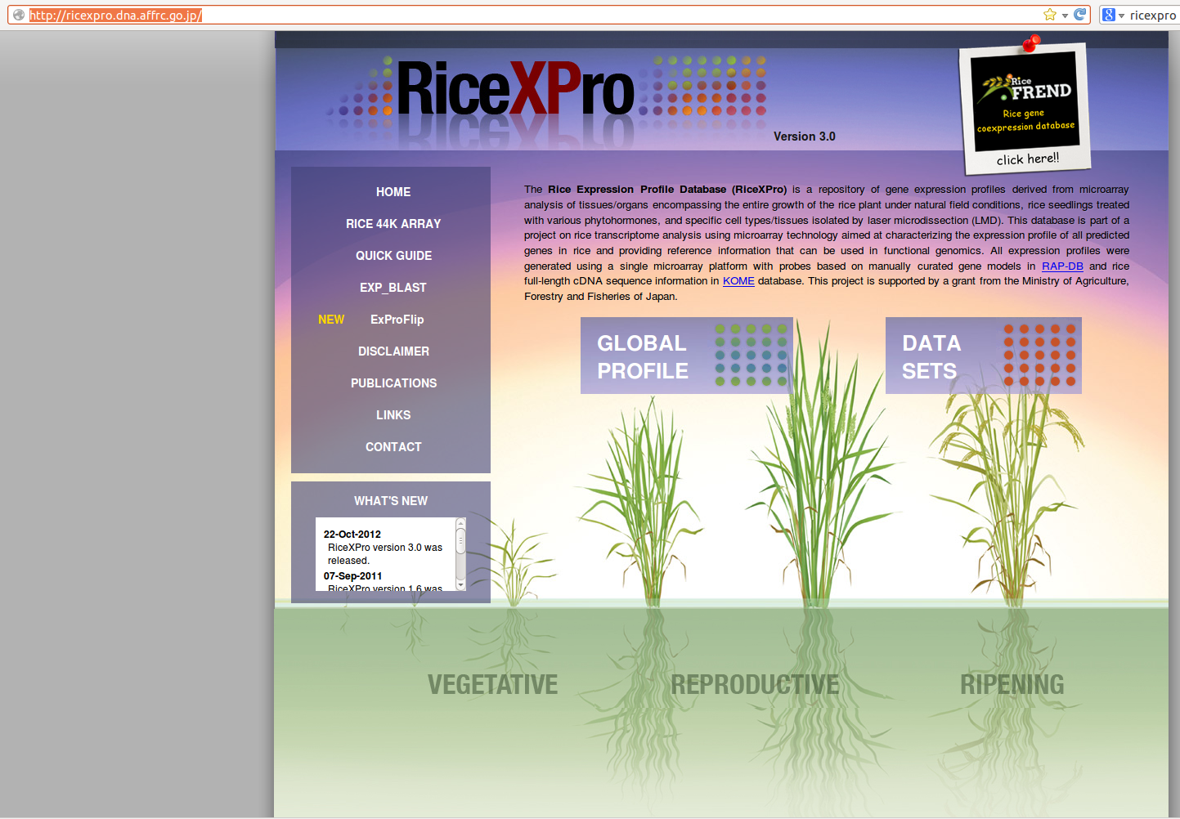
Let's have a look at RiceXPro!
Website: http://ricexpro.dna.affrc.go.jp/

Slide 6
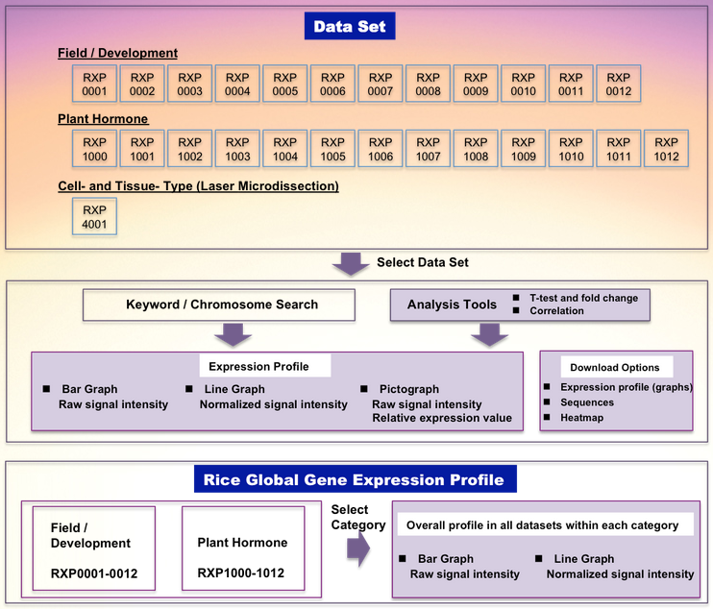
The Data Sets

Slide 7
Where the data comes from
The RiceXPro database is part of a project on rice transcriptome analysis using microarray technology.
Aimed at characterizing the expression profile of all predicted genes in rice and providing reference information that can be used in functional genomics.
All expression profiles were generated using a single microarray platform (Agilent 44k Rice ChiP microarray)
Based on manually curated gene models in RAP-DB and rice full-length cDNA sequence information in the KOME database.

Slide 8
More on the data
RiceXPro currently contains gene expression data sets corresponding to spatio-temporal gene expression profiling
Based on 48 different tissue and organ types at various developmental stages using continuous profiling of leaves from transplanting until harvesting
Grown under natural field conditions
All expression data were generated by one-color cyanine fluorescent dye (Cy3) micro array hybridization protocol.
Background correction of the Cy3 raw signals was performed with the Agilent Feature Extraction software (version 9.5.3.1).
Each expression data was subjected to 75 percentile normalization and log2 transformation using R

Slide 9
Micro array construction
Design based on the manually curated rice genome detailed by the Rice Annotation Project Database (RAPD)
  60-mer oligo sequence probes, corresponding to 27,800 RAP loci
  Transcripts based on full length cDNA
  Transcripts based on expressed sequence tag (EST) support
  And predicted loci
For RAP locus with several mapped full length cDNAs, multiple 60-mer probes were used
  These redundant probes provide evidence of replicability and reliability of genome expression

Slide 10
An example of using RiceXPro
Let's walk through an example of using RiceXPro to examine the difference in gene expression at various stages of a rice plant's development.
First, we will select “Global Profile”
Clicking the “Example” button will auto-populate the search field with sample search values.
  Os01g0102700 [a RAP Locus ID for Oryza Sativa]
  LOC_Os01g01070 [MSU ID]
  AK067670 [an accession number]

Slide 11
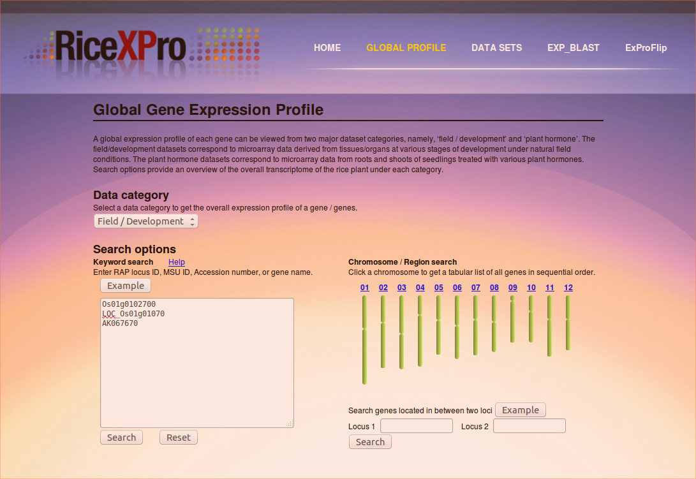
Global Profile

Slide 12
Searching the database
Keywords placed alone on separate lines in the search box are logically joined together by the OR operator.
Terms placed on the same line are logically joined by AND.
In our example search, clicking “Search” will take us to the next screen and show us the results.

Slide 13
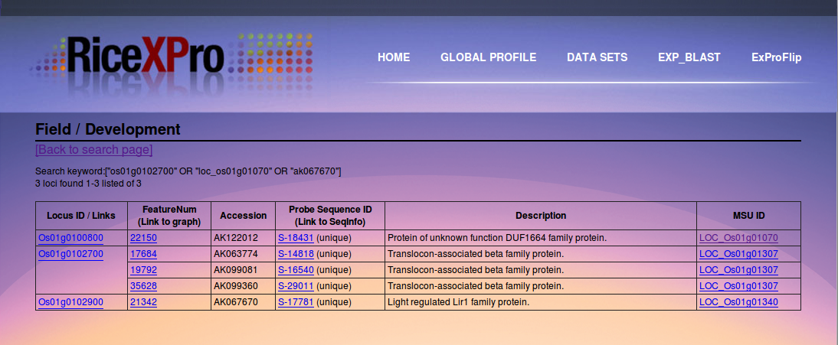
Search Results

Slide 14
Chromosomes and Loci-based searching
If we return to the search screen, we notice there are chromosomes on the right hand side. Clicking on a chromosome will give us a table with all the known genes in sequential order.
We can also search between two known loci by populating the locus1 and locus2 fields with known RAP Locus IDs.
Let's select Example here and run a search!

Slide 15
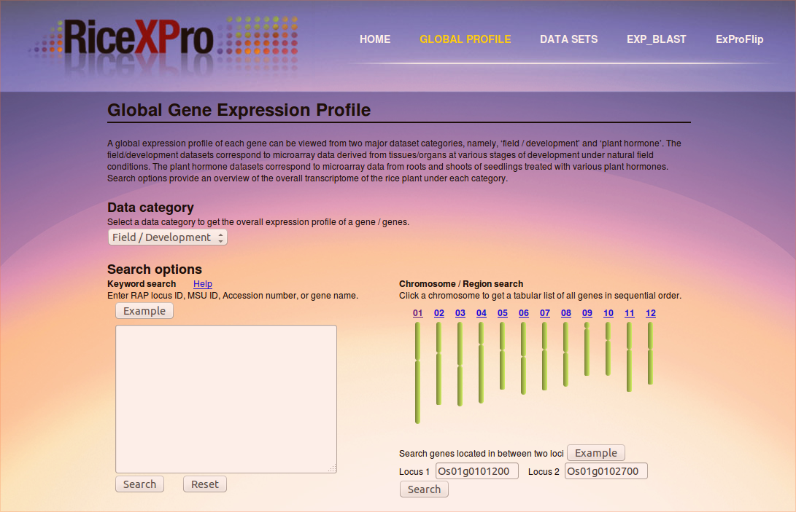
Loci Search

Slide 16
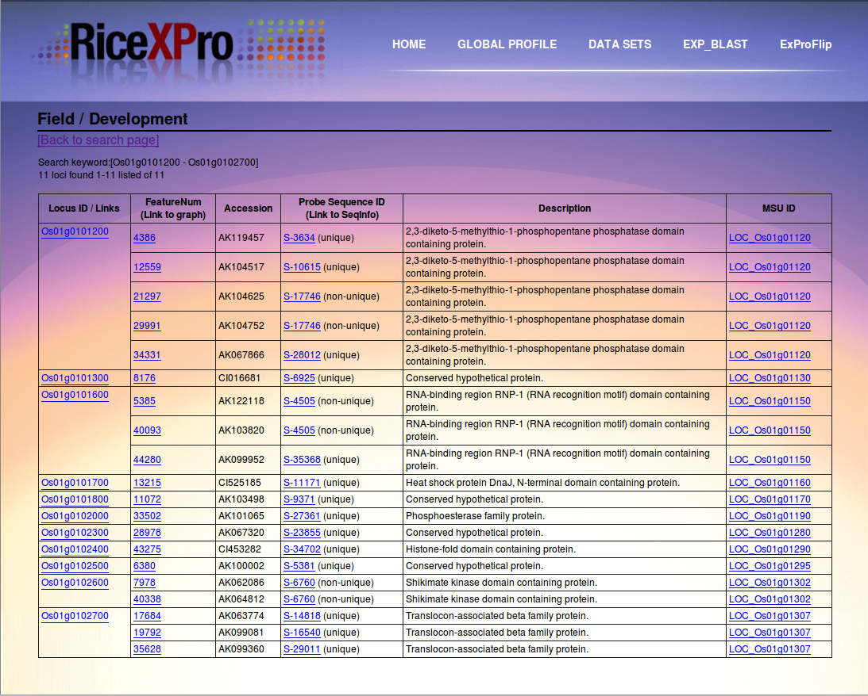
Loci Search Results

Slide 17
Great, now what?!?!?!
If you mouse over the links, you will be presented with sub-menus In our example search we have a RAP Locus ID Os01g0101200.
Mousing over this, we get a menu, from here we can select a Database to draw results from. I have selected Field/Development, which will present us with the next screen to select further options to get at the data we are searching for.

Slide 18
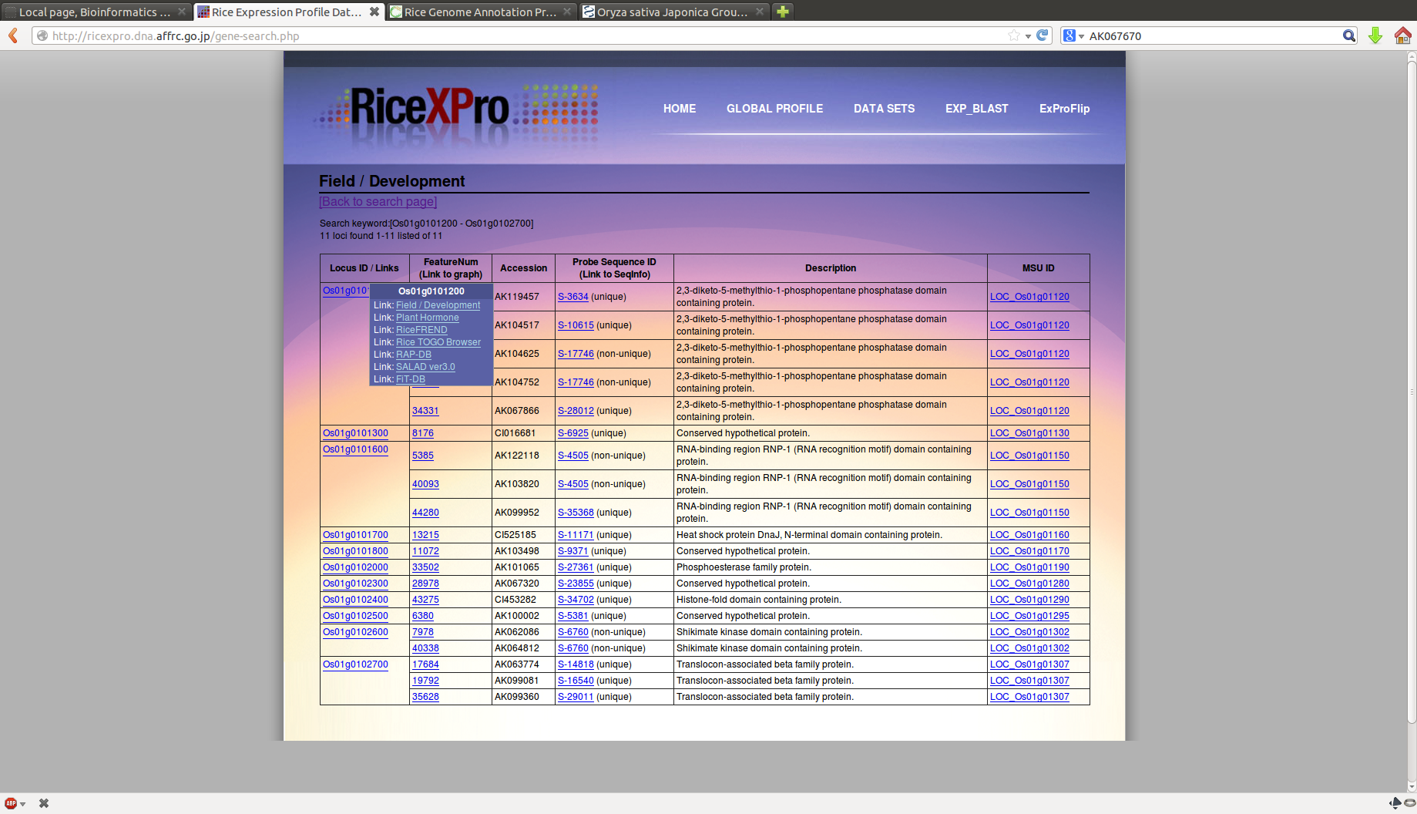
Mousing over a result

Slide 19
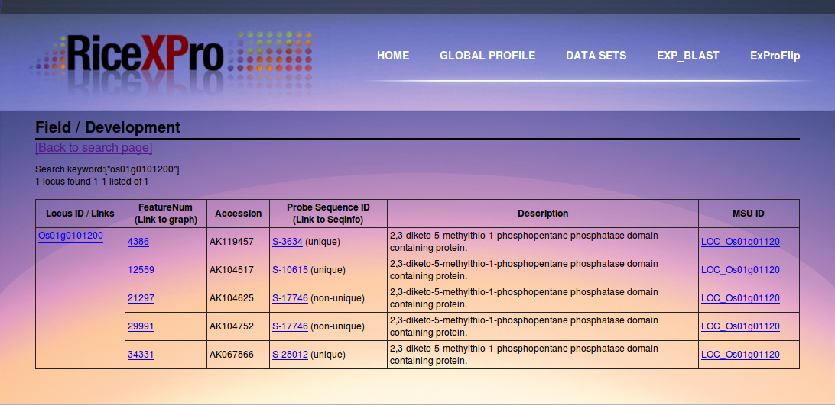
Field/Development DB Results

Slide 20
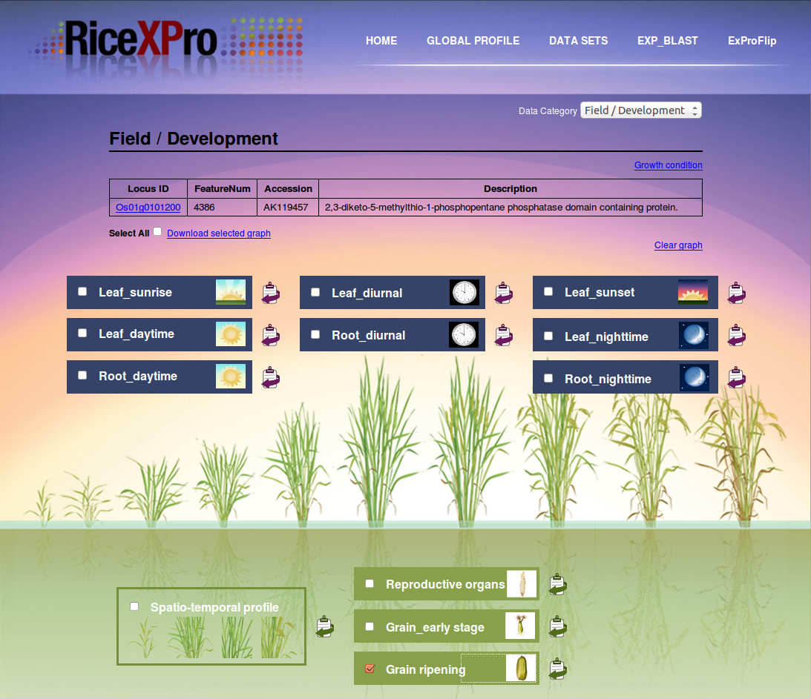
Field/Development Results for Feature 4386

Slide 21
What is the expression profile at various stages of grain ripening?
Selecting grain ripening, I am taken to a new window that shows me the gene expression data for Os01g0101200 at various stages of grain ripening.
The first tab is a chart of the raw signal intensity at various stages of the rice grain's development as an embryo, transitioning to an endosperm.
The second tab shows the same data normalized.

Slide 22
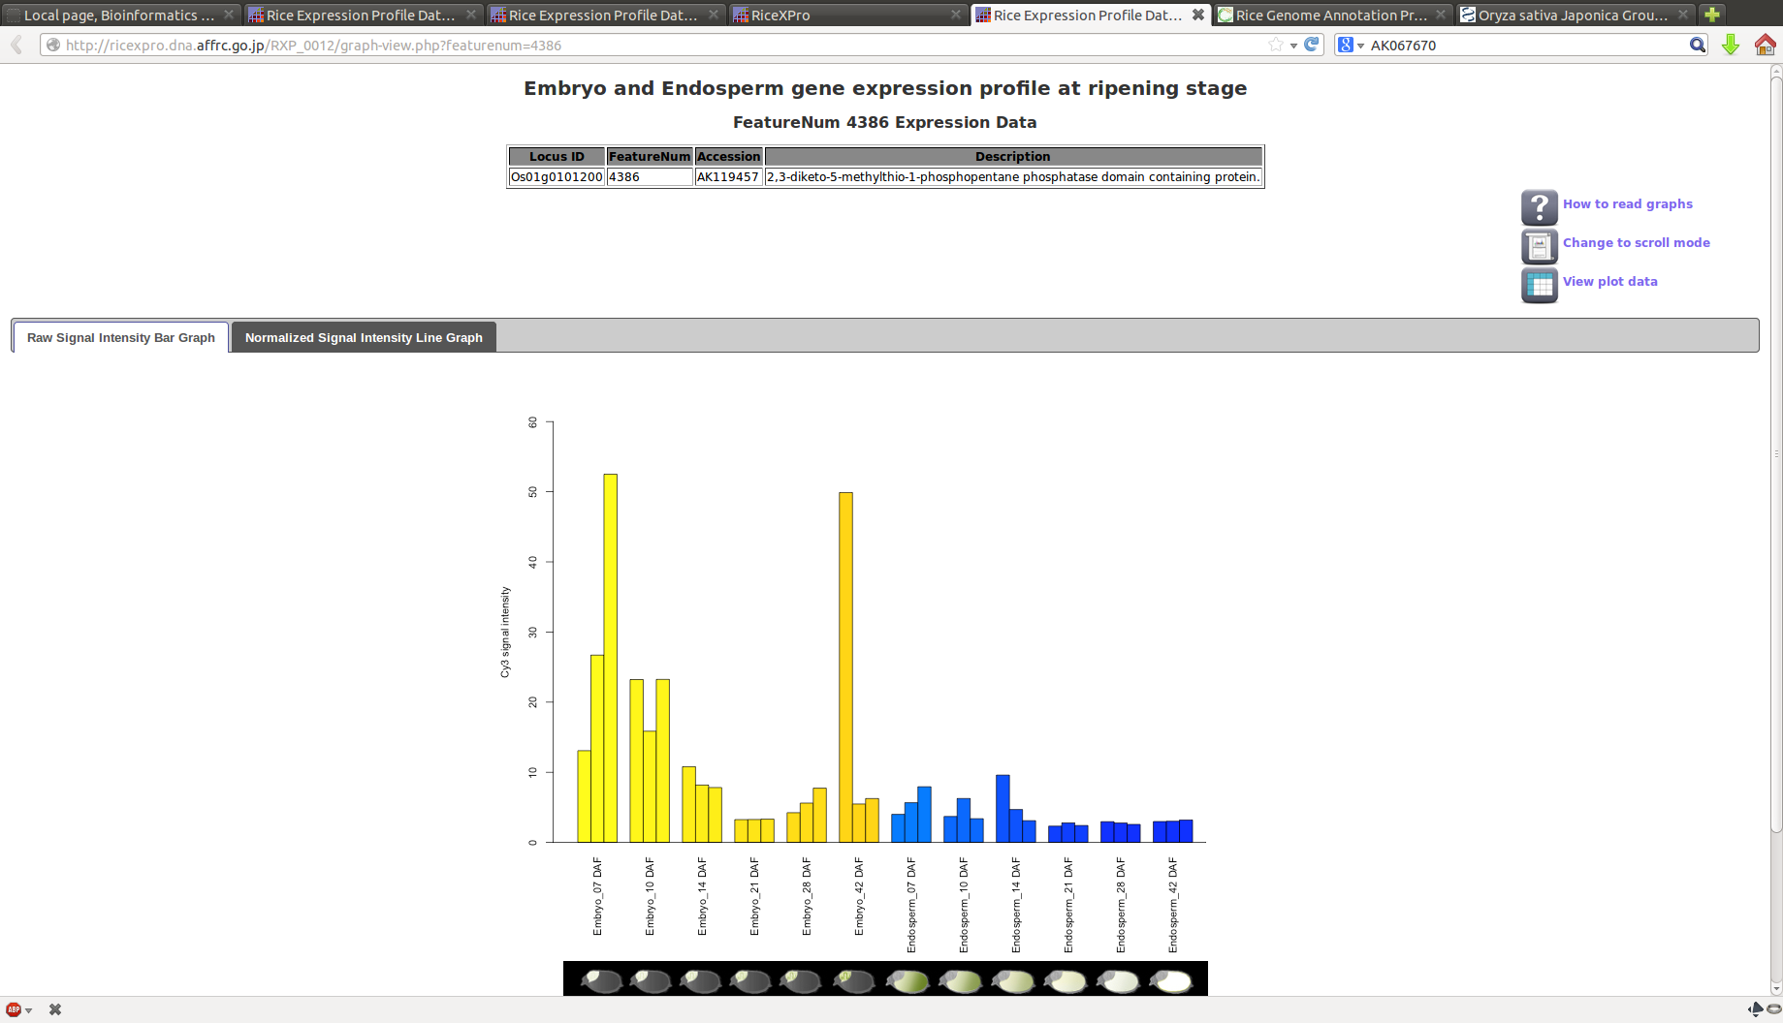
Expression Data
Raw Signal Intensity

Slide 23
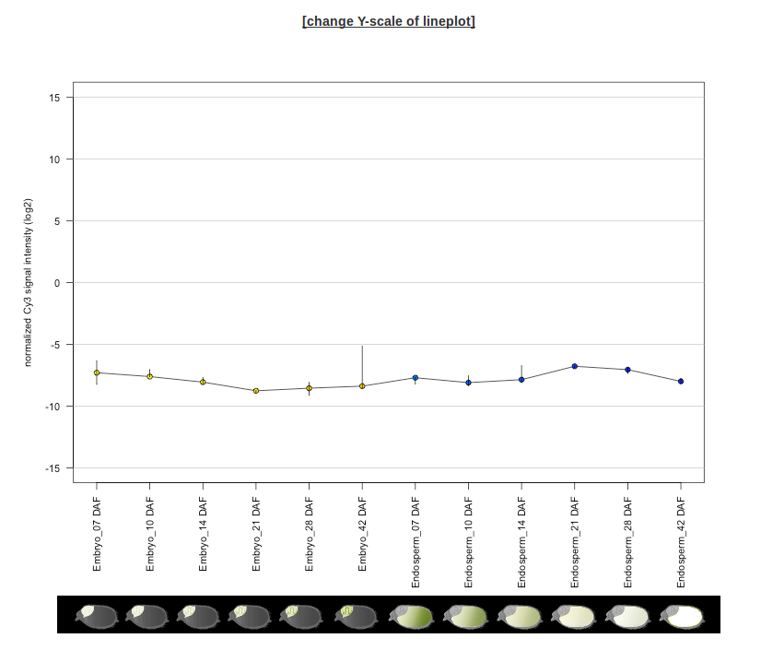
Expression Data
Normalized

Slide 24
What about across the entire plant?
Going back to our results, we can view a spatio-temporal profile for a more complete picture of where, and at what time, expression occurs within the plant.
Spatio-temporal data will display results from samples taken from all major parts of the plant.

Slide 25
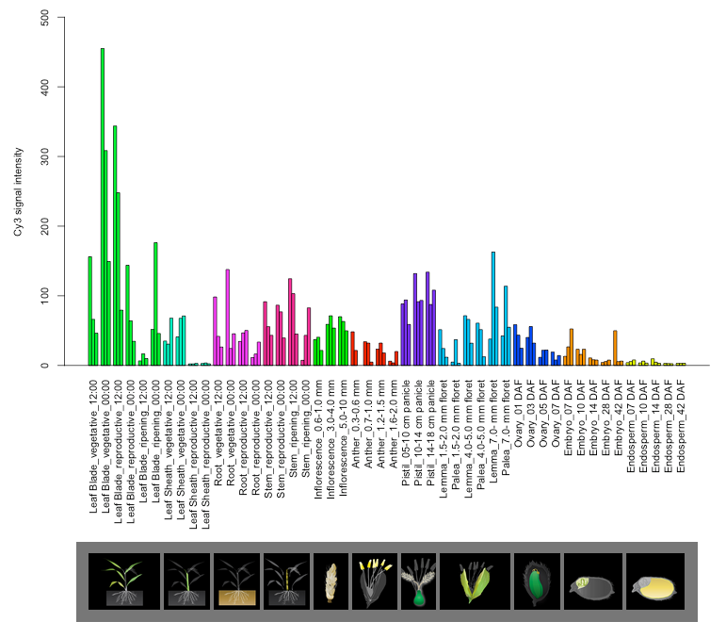
Spatio-Temporal Profile
Raw Signal Intensity

Slide 26
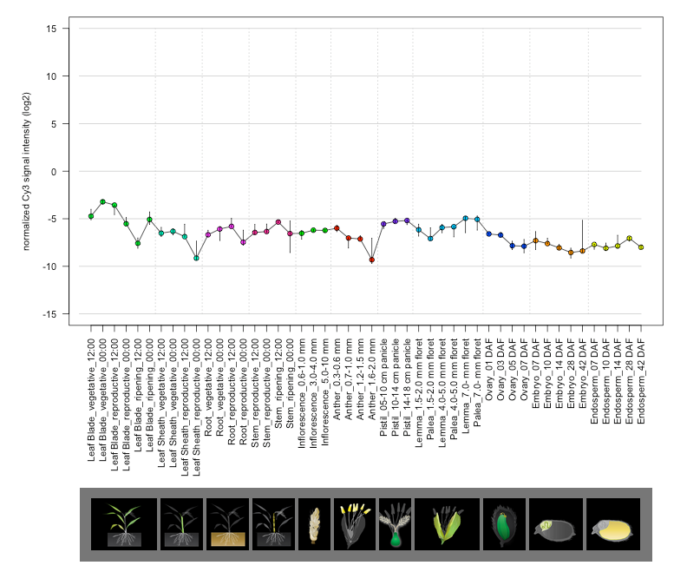
Spatio-Temporal Profile
Normalized

Slide 27
Hormone Response
The expression profile of all genes in root and shoot from rice seedlings treated with six plant hormones
  abscisic acid (ABA), gibberellic acid (GA3), indole-3-acetic acid (IAA), brassinolide (BL) trans-zeatin (tZ) and jasmonic acid (JA)
Seeds were germinated and grown hydroponically in a growth chamber at 28ºC under continuous light. Seven-day old seedlings were transferred in culture solution containing the hormone and in culture solution without hormone to serve as control (mock treatment).
Samples were collected after 15 min, 30 min, 1 h, 3 h and 6 h incubation for root with three replicates
Samples collected 1 h, 3 h, 6 h and 12 h incubation for shoot with two replicates.
RNA isolated from a total of 138 samples were labeled with Cy3 (mock treatment) and Cy5 (hormone treatment), and used for hybridization using the Agilent two-color microarray analysis system
Time-course expression profile for each gene is shown as the log-ratio of signal intensity (log2 Cy5/Cy3).

Slide 28
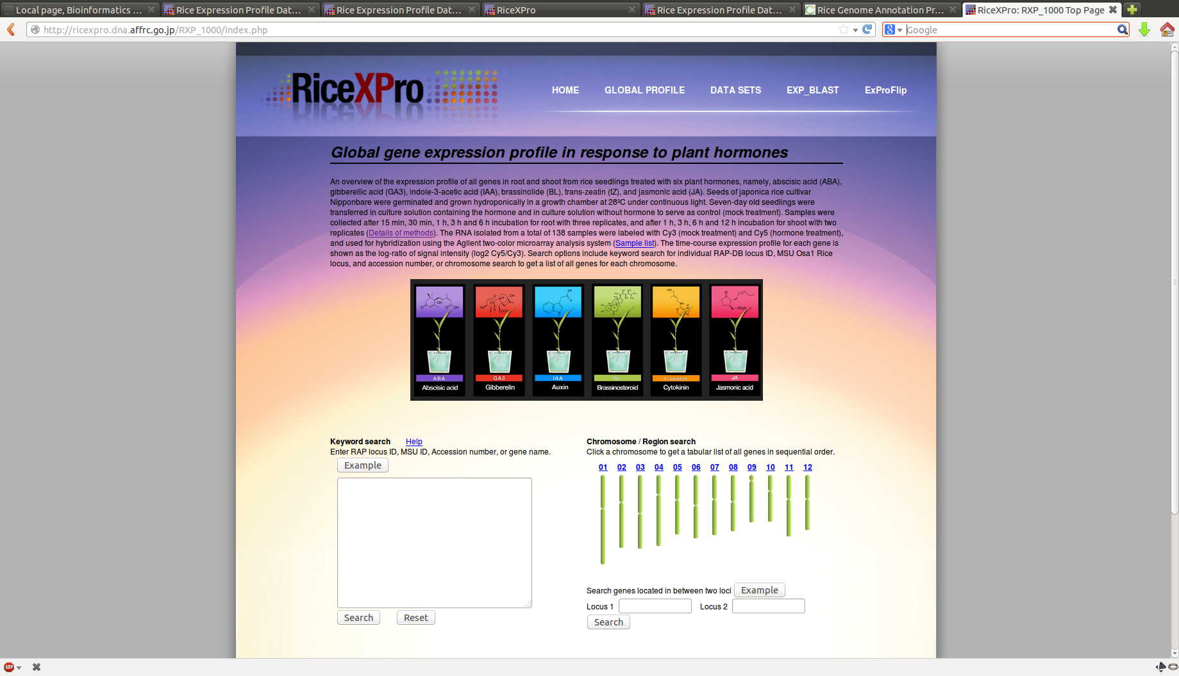
Plant Hormone DB Search

Slide 29
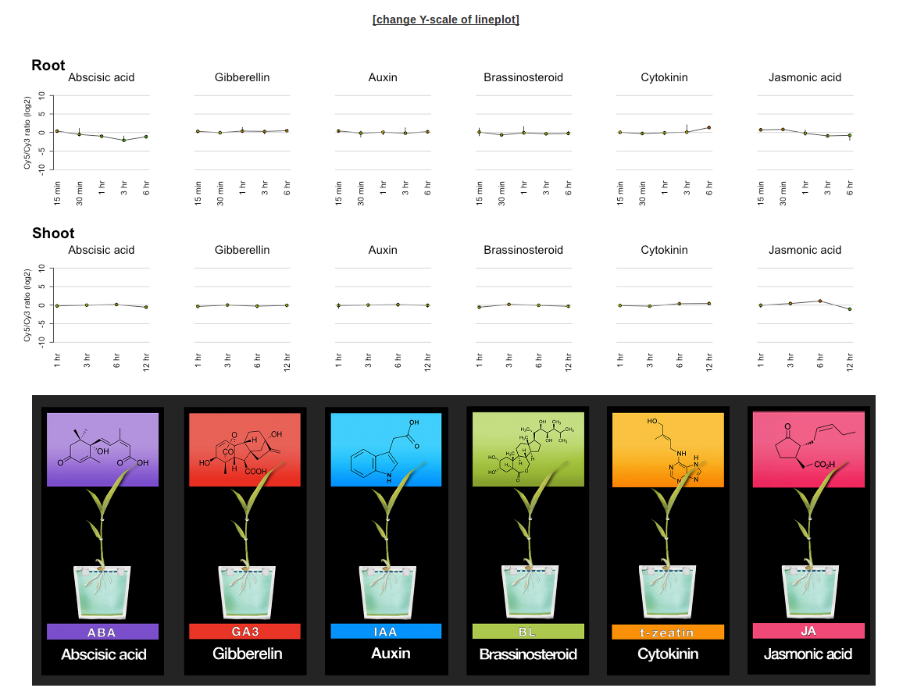
Plant Hormone Search Results

Slide 30
Cross-Linked Sites
RiceXPro also provides links to various other sites to determine more information about a particular gene of interest.
  RiceFrend
  Rice TOGO
  Salad
These various resources can be accessed from the results menu when you mouse over the result link

Slide 31
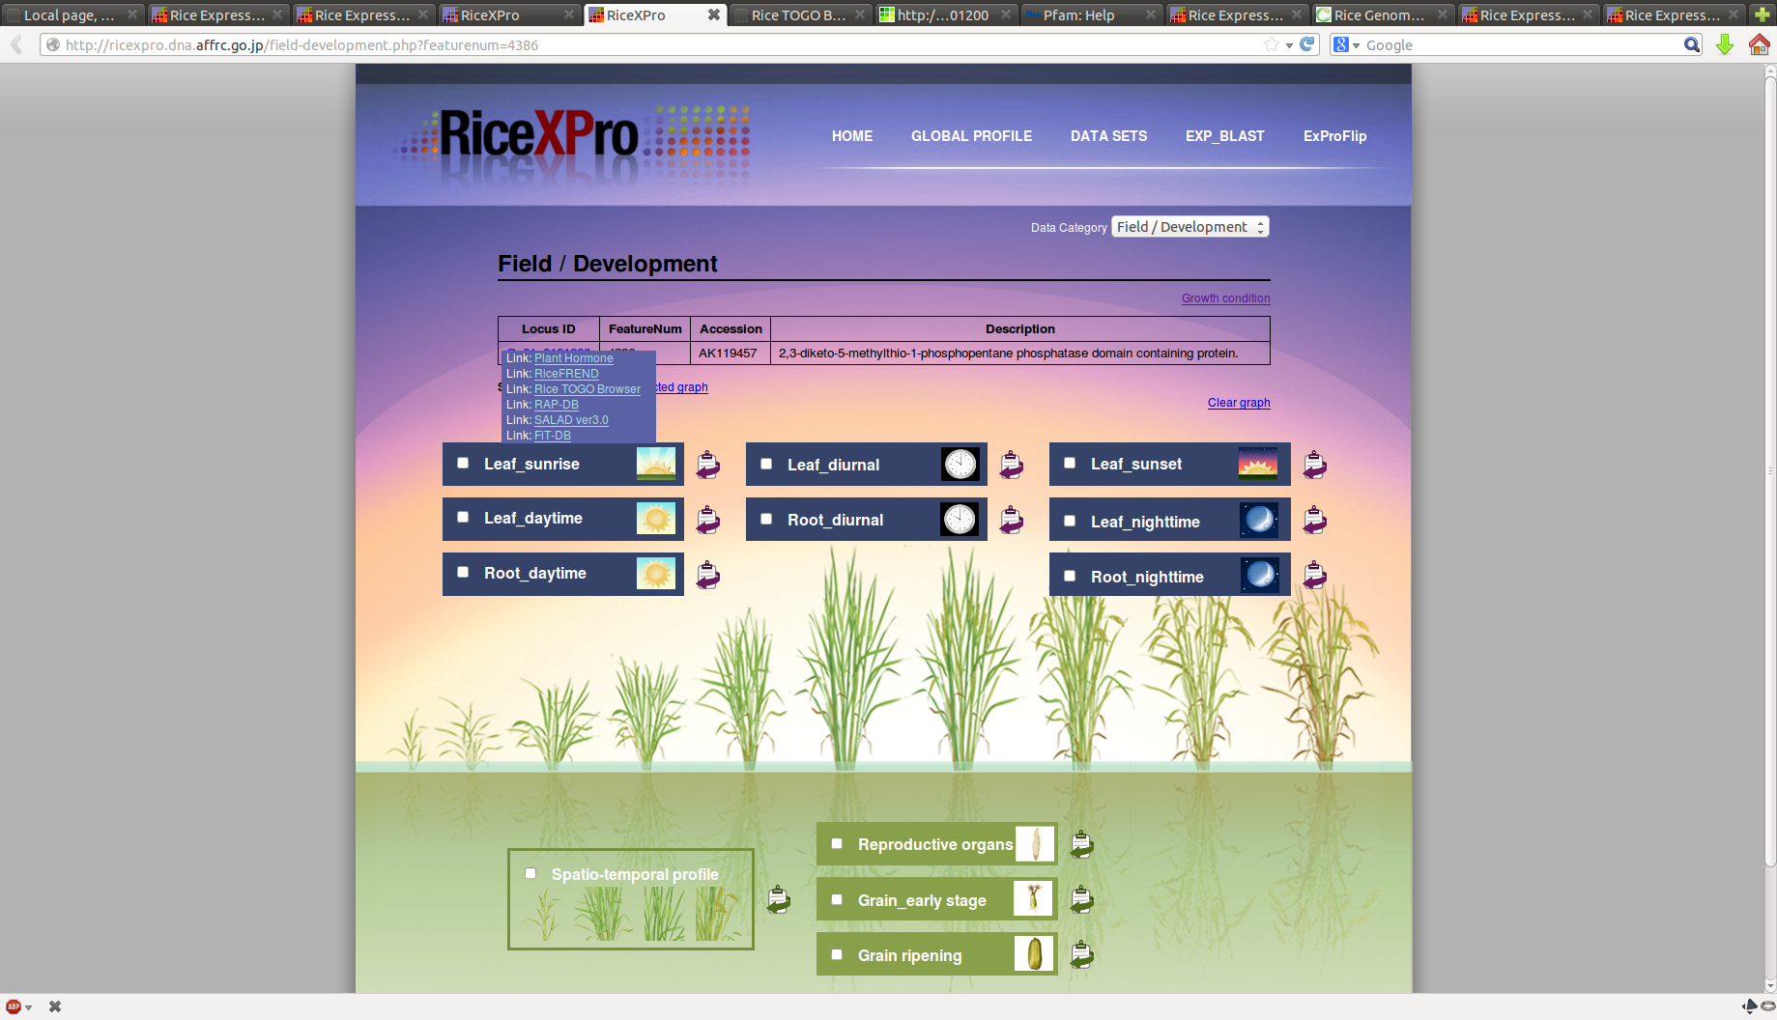
Link Menu

Slide 32
Laser Micro-dissection
The final DB, is the laser micro-dissection database.
It covers the expression profile of all genes in different developmental stages along the longitudinal axis and distinct tissue types along the radial axis of a rice crown root.
Searching this DB is performed through the same interface as the previous two databases.

Slide 33
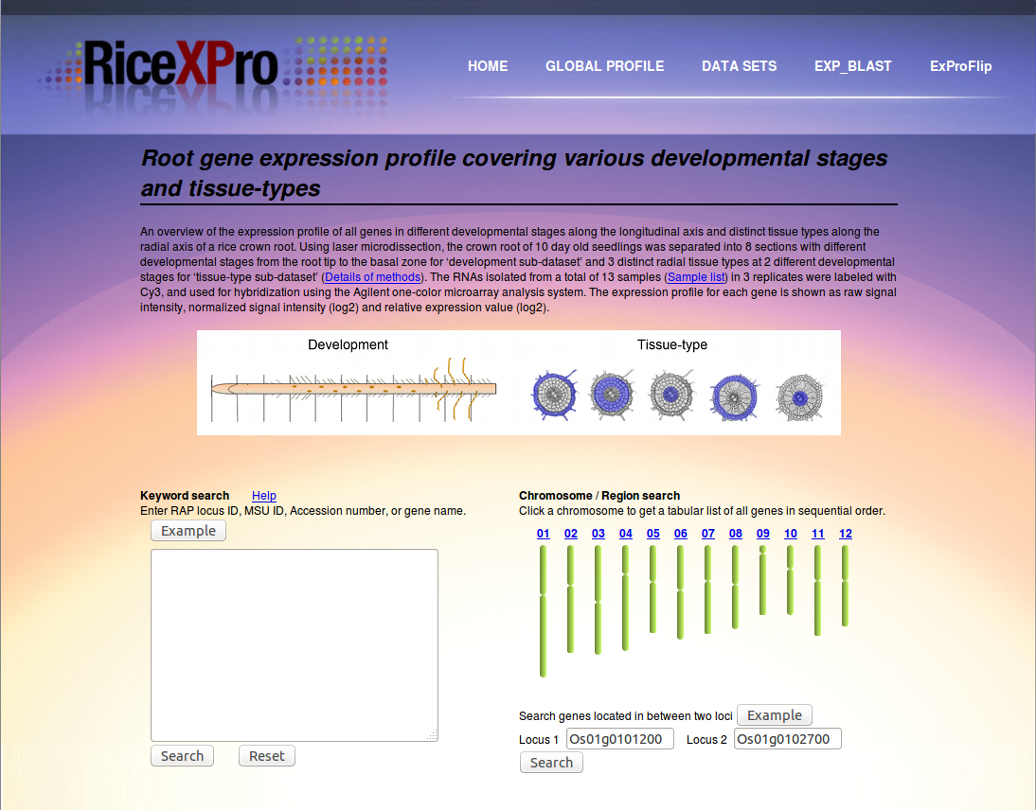
Root gene expression

Slide 34
Additional Result Data
On the next slide notice the warning graphics, denoting low signal intensity. Mousing over the warning explains the meaning of the warning in detail.
  The raw signal intensities for these results all had median values of less than 50, generating a warning in the upper left of the graph.
There are also pictograph tabs available, showing raw signal and expression data in relation to the location of a sample on the root.

Slide 35
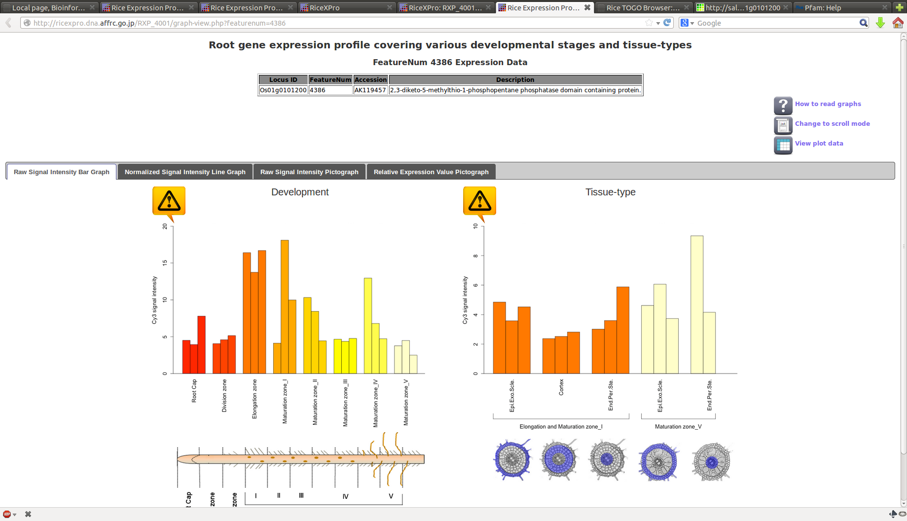
Results for root gene expression
Raw Signal Intensity

Slide 36
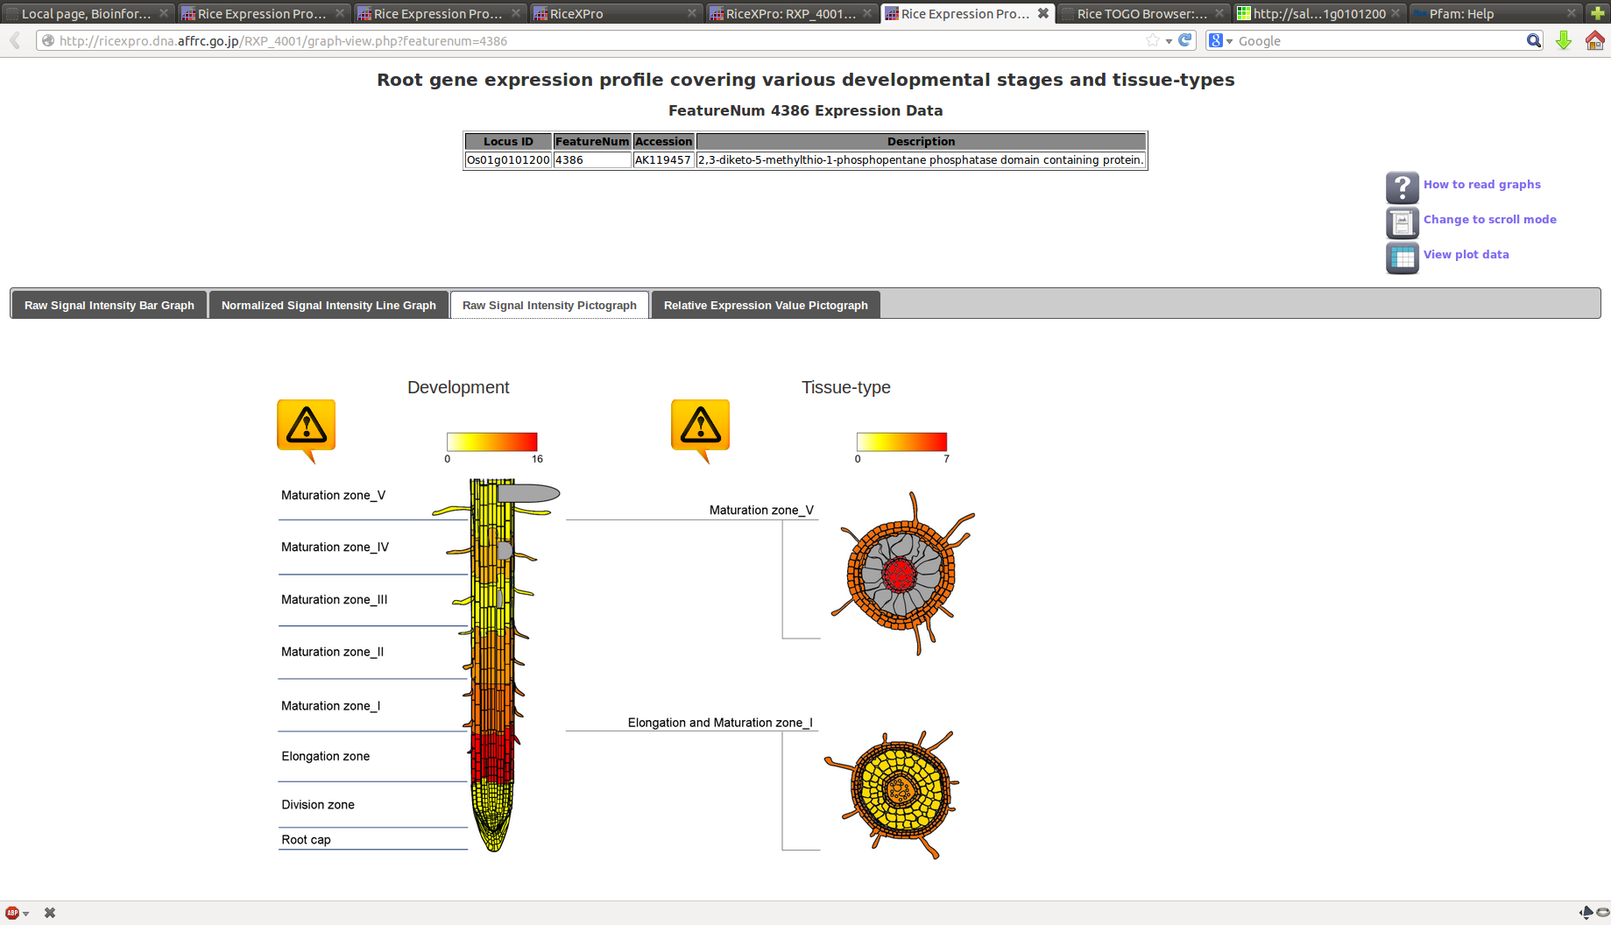
Raw Signal Intensity Pictograph

Slide 37
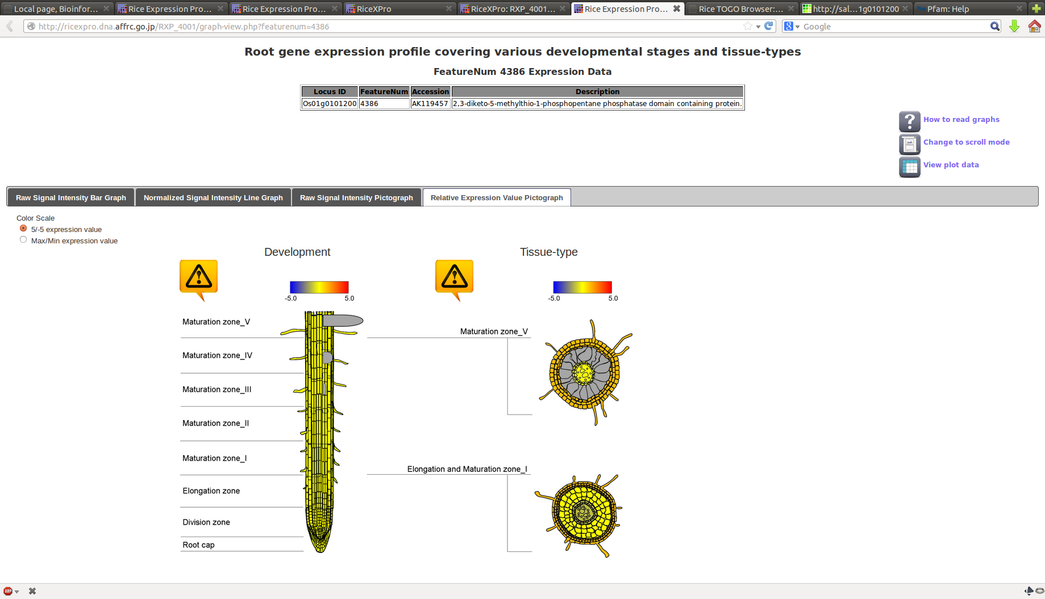
Relative Expression

Slide 38
ExProFlip
One of the neat features available is ExProFlip, which allow you to query several databases (or all databases) at once and then flip through the resulting data as a slide-show in the browser.
I found this feature to be useful when examining various aspects of a gene
Field/Development, Hormone response and Laser Dissection results could be viewed as a whole with a single search!

Slide 39
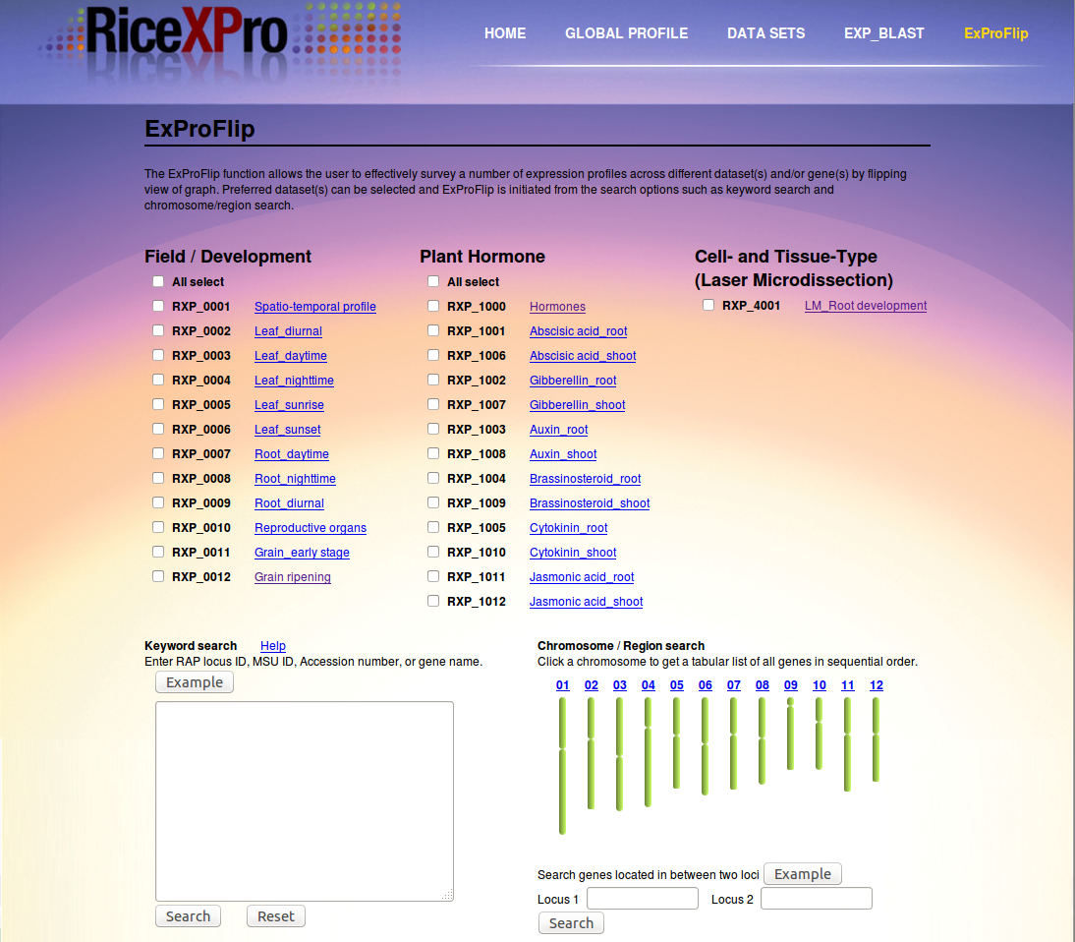
ExProFlip (continued)

Slide 40
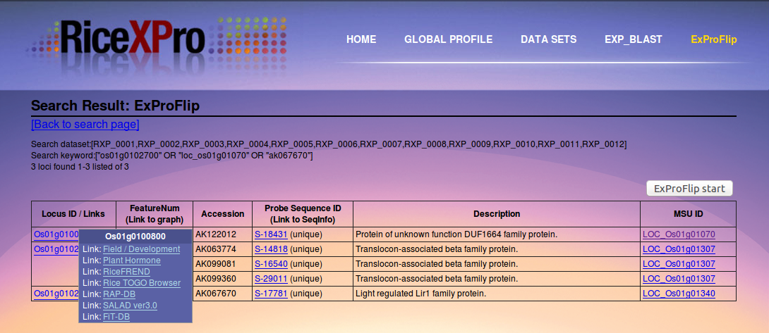
More ExProFlip

Slide 41
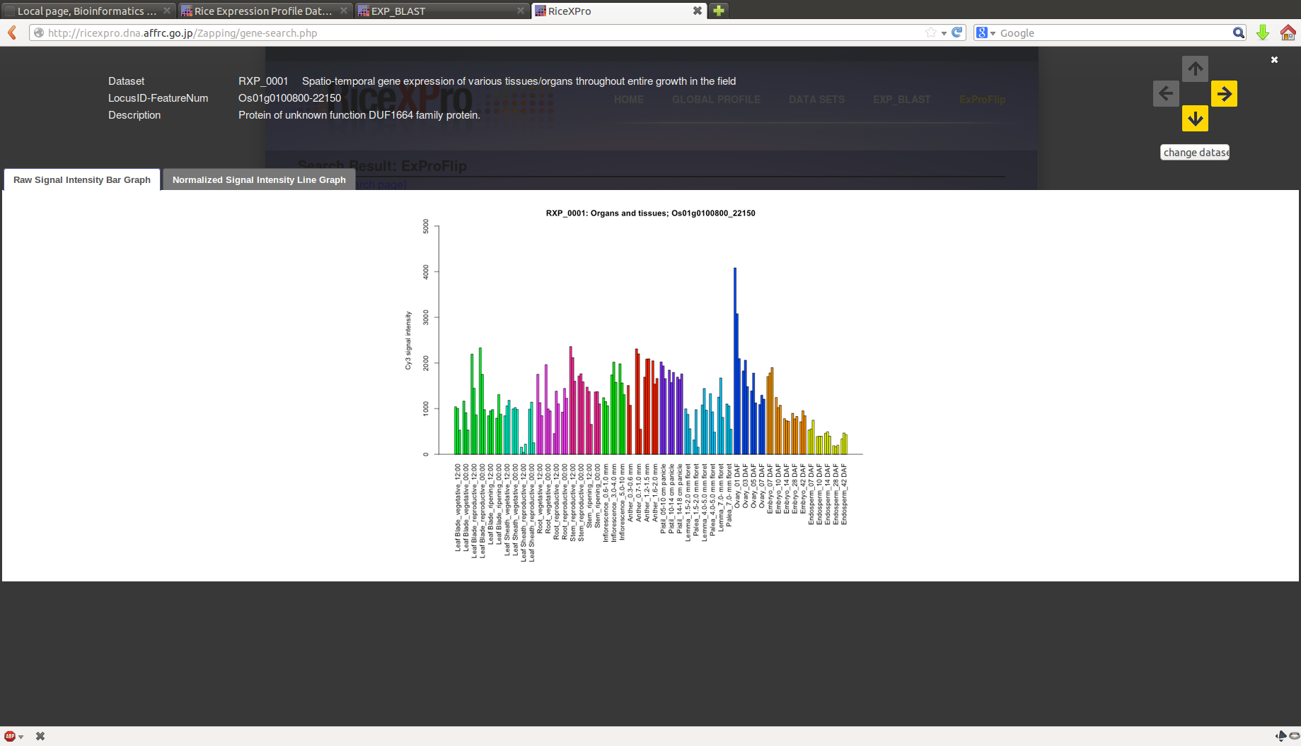
What clicking ExProFlip will do

Slide 42
Analysis Tools
RiceXPro provides information on co-expressed genes
Co-expression data based on calculation of Pearson’s correlation coefficients (r-values) of the normalized signal intensities (log₂) in each data set
T-test & fold change (FC) analysis
Heatmap toolkit

Slide 43

More on Pearson
The Pearson correlation
Not to be confused with:
+1 in the case of a perfect positive (increasing) linear relationship (correlation)
−1 in the case of a perfect decreasing (negative) linear relationship (anti-correlation)
some value between −1 and 1 in all other cases, indicating the degree of linear dependence between the variables.
As it approaches zero there is less of a relationship (closer to uncorrelated). The closer the coefficient is to either −1 or 1, the stronger the correlation between the variables.

Slide 44
Searching a specific dataset
Previously we utilized Global profile
We can also get more in depth information by querying a distinct dataset
Selecting datasets from the main page let's choose a particular dataset to query.

Slide 45
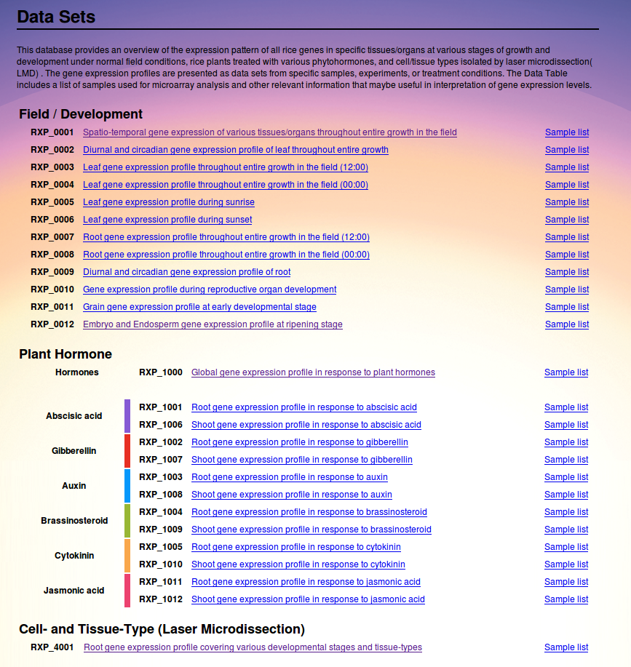

Slide 46
Co-expression Analysis
Choosing datasets and then selecting RXP_0001 we get taken to a similar search page as before
Clicking on analysis tools takes us to more options

Slide 47
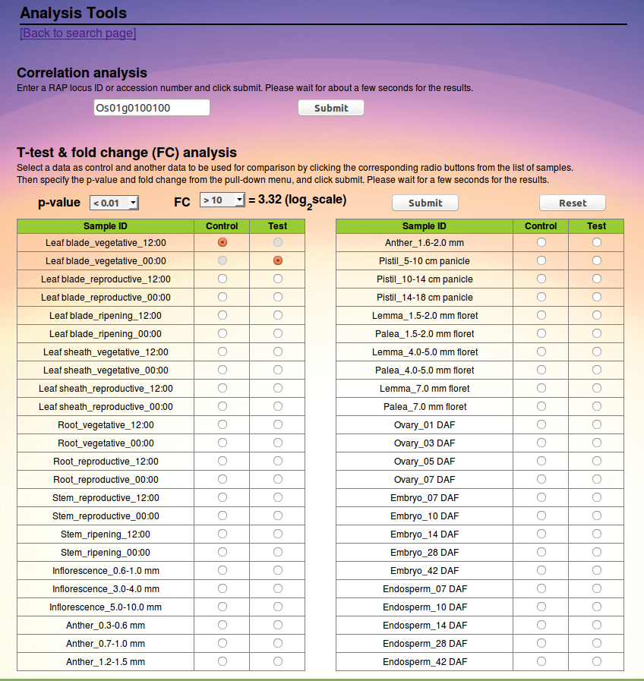

Slide 48
Searching data for significance
Entering the Locus of interest and selecting data sets as control and test
In statistical significance testing, the p-value is the probability of obtaining a test statistic at least as extreme as the one that was actually observed.
A researcher will often "reject the null hypothesis" when the p-value turns out to be less than a certain significance level, often 0.05 or 0.01. Such a result indicates that the observed result would be highly unlikely under the null hypothesis (that is, the observation is highly unlikely to be the result of random chance alone)
Fold change is a measure describing how much a quantity changes going from an initial to a final value. For example, an initial value of 30 and a final value of 60 corresponds to a fold change of 2, or in common terms, a two-fold increase. Fold change is calculated simply as the ratio of the final value to the initial value

Slide 49
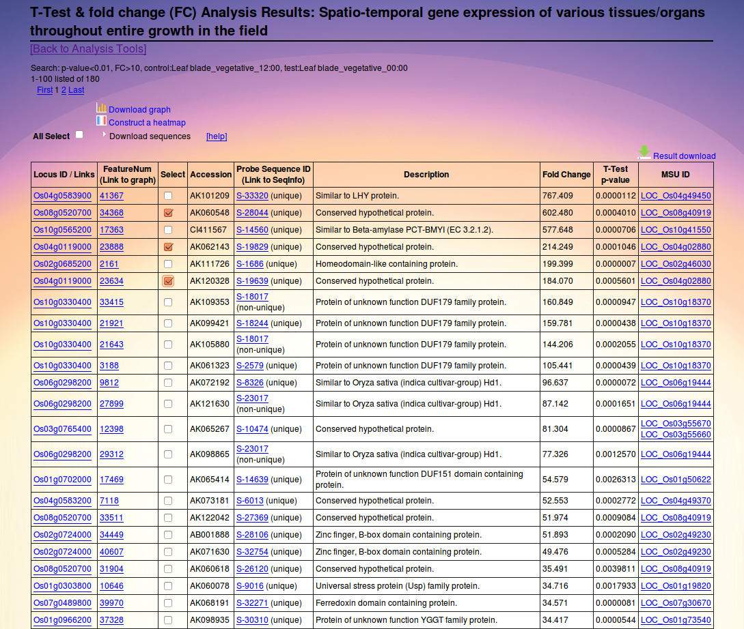

Slide 50
Examining multiple genes
Constructing a heatmap to view various predicted conserved hypothetical proteins
Download zip file of relevant graphs
Download heatmap as a pdf file

Slide 51
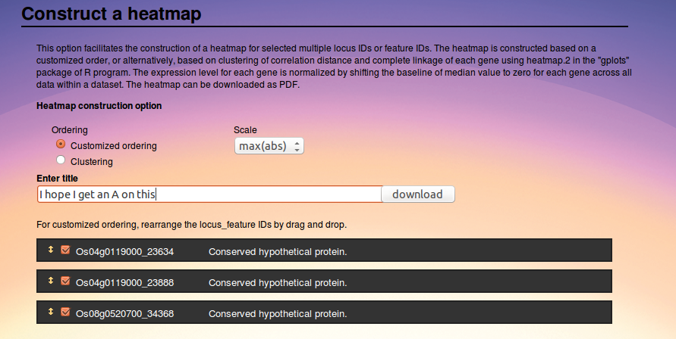

Slide 52
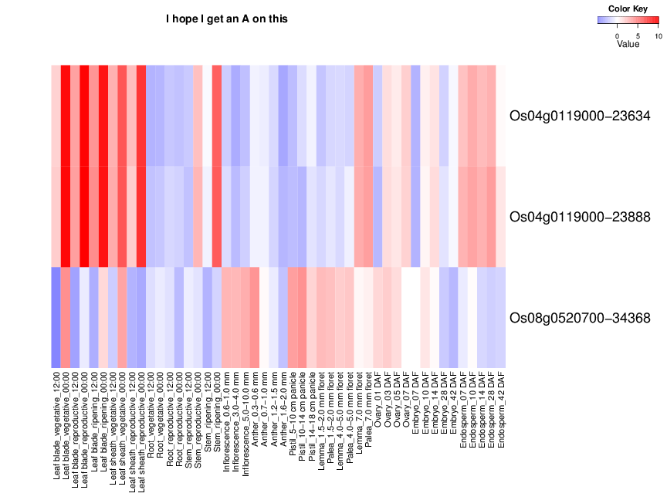

Slide 53
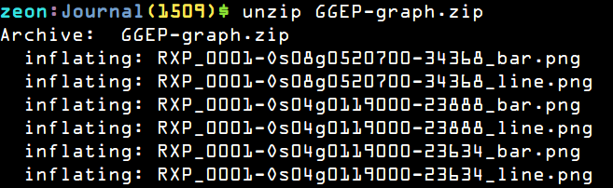
Downloading the graphs
Downloading the graphs we get a zip file containing the relevant data
Unzipping it gives us png formatted bar (Raw) and line (Normalized) graphs

Slide 54
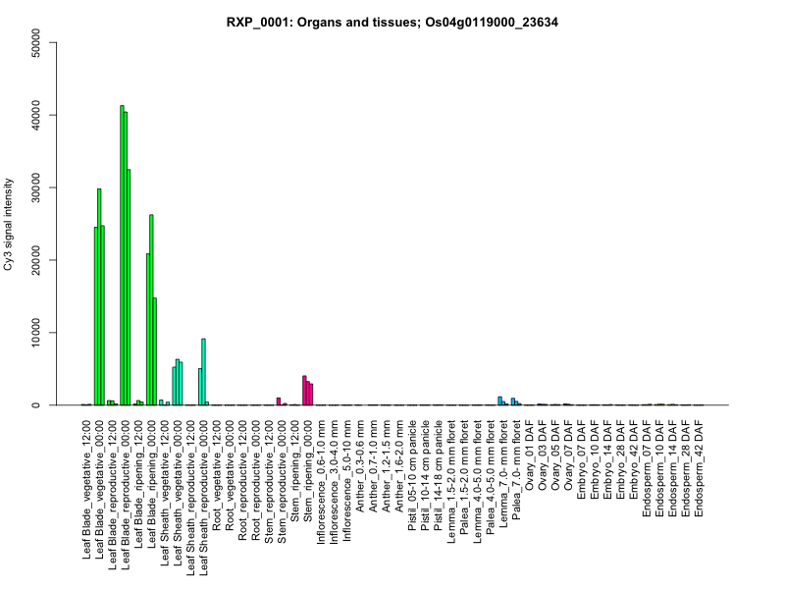
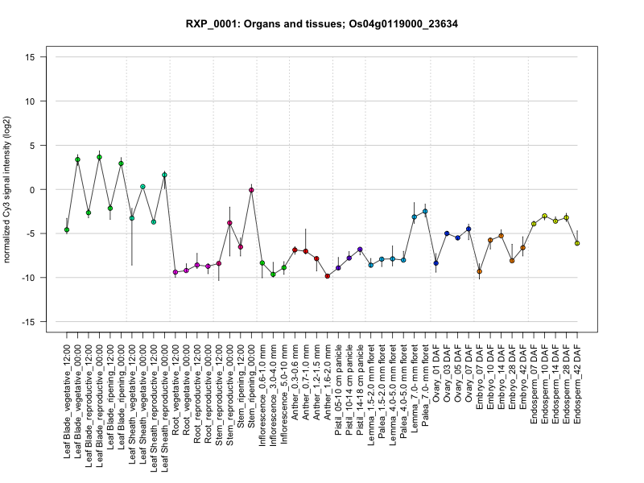

Slide 55
We can't have a Bioinformatics website without BLAST!
Similarity comparisons can be carried out via the EXP_BLAST link on the top menu bar
3 different types of similarity queries can be made:
    Blastn – Nucleotide vs. DB Nucleotide blast
    Tblastn – Protein vs. DB Translated Nucleotide
    Tblastx – Translated Nucleotide vs.DB Translated Nucleotide

Slide 56
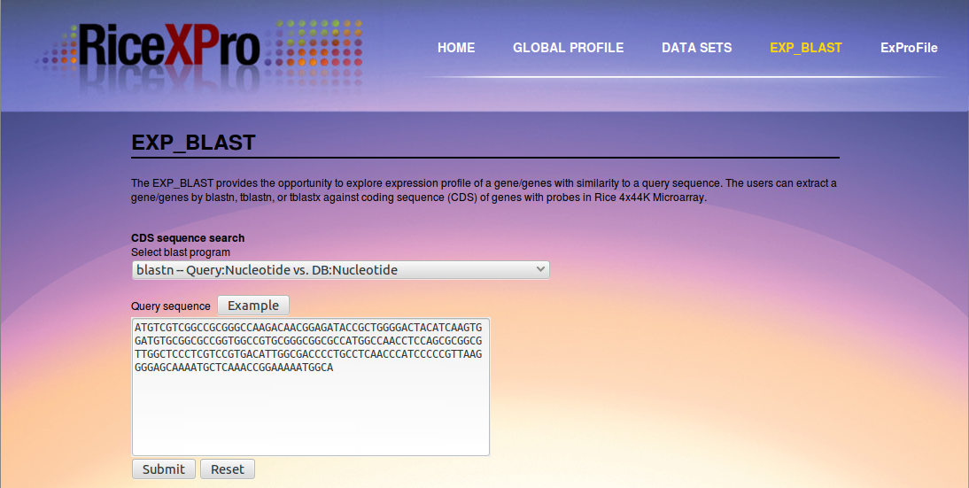
EXP_BLAST

Slide 57


Slide 58
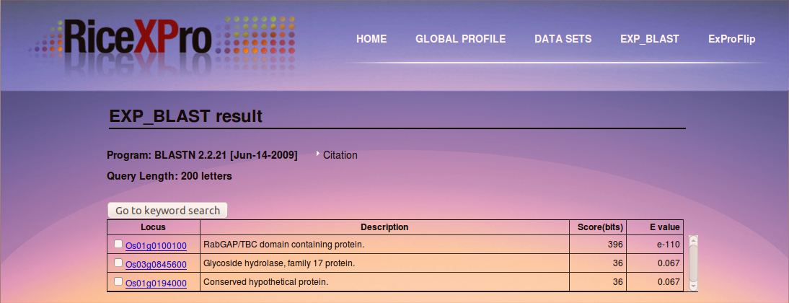
Blastn Results

Slide 59
What I like about RiceXPro
RiceXPro provides a wealth of genome expression data regarding Oryza Sativa Japponica Nipponbare.
Co-expression analysis can be conducted across this broad data set to find significant co-expressed genes.
  Heatmaps are useful for visualizing and interpreting the results of this analysis
The site is easily navigated and links to search various other rice genome databases are easily accessed.
The site contains a consistent and straight-forward user interface and design.
The ExProFlip feature is well thought out and provides a way to browse large amounts of graphical data quickly and easily.

Slide 60
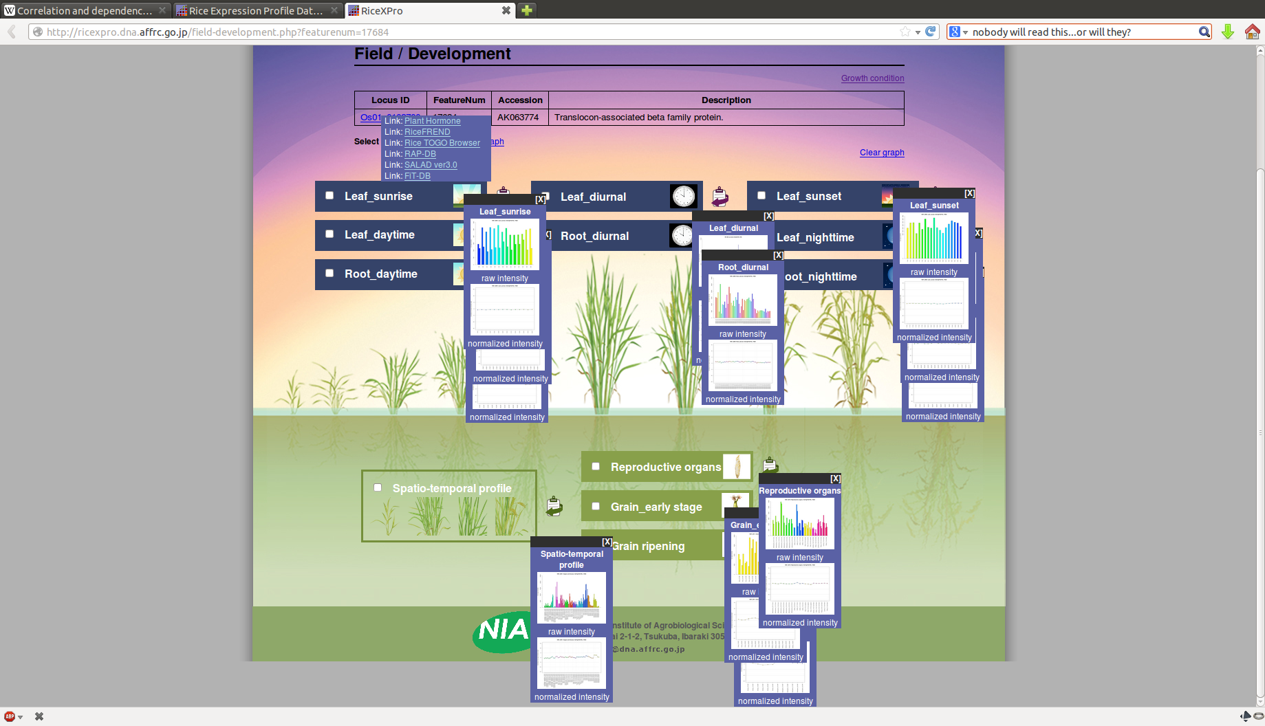
What I didn't like
“I've got a problem with the pop-ups.”
“The pop-ups?”
“Yeah, you know, the pop-ups.”

Slide 61
More on the Pop-ups
The mouse over function is a nice touch, however it would have been better implemented if the small preview windows disappeared after a short delay when the mouse moved off the target.
  The mouse over menus do this, so we have the technology!

Slide 62
References and other Rice Bioinformatics Websites
http://www.ncbi.nlm.nih.gov/pubmed/11935017
http://www.goldenrice.org/
http://www.ricediversity.org/
http://ricefrend.dna.affrc.go.jp/
http://agri-trait.dna.affrc.go.jp/
http://rice.plantbiology.msu.edu/index.shtml

Slide 63


Questions? Comments?

Slide 64

完了

