Slide 1
Team 2 NLP project Quora question pairs
Presenter: Tengbo Yang
Team member: Tengbo Yang
Shu Hong
Jianfeng Li

Slide 2




Introduction of the problem
The problem origins from a kaggle competition (https://www.kaggle.com/c/quora-question-pairs)
Target: Given a pair of Quora questions, determine if they are duplicated or not.
Background: The duplication could greatly reduce the searching efficiency because of the diversification of the information. Therefore, identifying duplication is very import!
Data: training data: 404291
test data: 2530000

Slide 3
Two kinds of “duplication”:
Exact duplicates and nearly exact duplicates
Semantically equivalent questions can be presented in different forms.
Difficulty:
The same question can be rephrased in many different ways
Two questions could be asking different things but look for the same solution
Case 1 (not duplicate):
Q1: What is the step by step guide to invest in share market in India?
Q2: What is the step by step guide to invest in share market?
Case 2 (duplicate):
Q1: What are some special cares for someone with a nose that gets stuffy during the night?
Q2: How can I keep my nose from getting stuffy at night?
Key: We really need to find ways to determine if two questions are semantically equivalent questions, or they can be answered by the same answer adequately

Slide 4
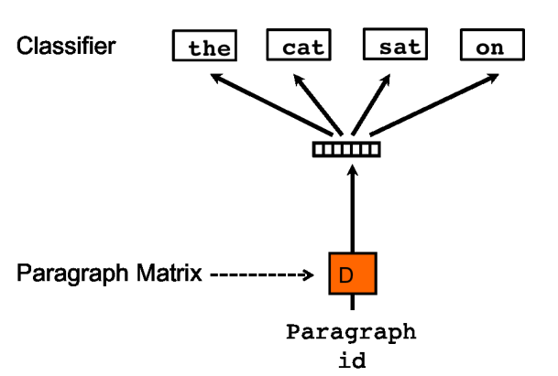
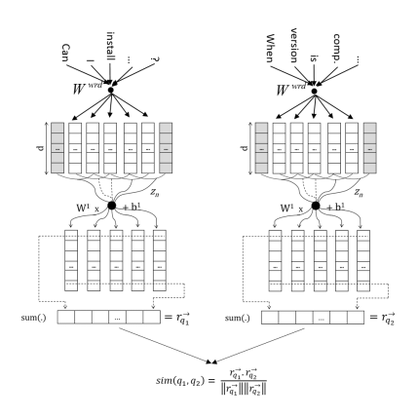
Sentence Embedding
Doc2vec (learn from unlabeled data)
CNN over word embedding (learn from labeled data)
Picture source: [2]
Picture source: [1]

Slide 5
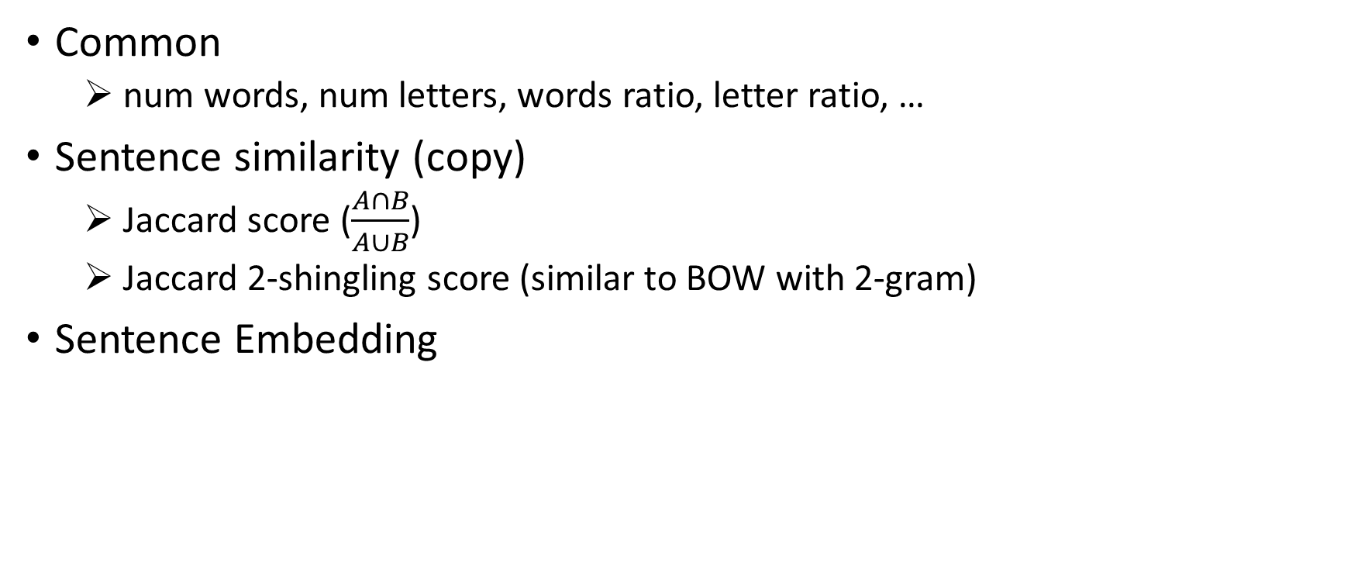
Feature engineering
Common
num words, num letters, words ratio, letter ratio, …
Sentence similarity (copy)
Jaccard score ($\frac{A∩B}{A∪B}$)
Jaccard 2-shingling score (similar to BOW with 2-gram)
Sentence Embedding

Slide 6

Model
Final data feature numbers: 615 (with word embedding and sentence embedding added)
lightGBM
Performance: logloss for dev: 0.15

Slide 7
Future work and conclusion
Future work:
Parameter tune and stacking
Find more in-domain data (entire documents in Quora community)
POS tagging
Conclusion:
Sentence embedding can capture the sentence relationship just like word embedding does for words.

Slide 8
Reference
[1] Bogdanova, Dasha, et al. "Detecting semantically equivalent questions in online user forums." Proceedings of the Nineteenth Conference on Computational Natural Language Learning. 2015.
[2] Le, Quoc, and Tomas Mikolov. "Distributed representations of sentences and documents." International conference on machine learning. 2014.

