Slide 1
15.2 Release Notes – Test Instructions

Slide 2
IP-2 TESTING
WHO? | All business team resources and selected developers.
WHAT? | Use and test new WTS functionality and provide feedback to Business Team on how it works.
WHERE? | At your desk
HOW? | Using CVT automated spread sheet tool – follow the test scripts to test out and use the system functionality.
WHEN? | Now through ???

Slide 3
Instructions for IP-2 Testing
Testing will be in WTS_Test https://dev.cafdex.com/WTS_Test/
Download CVT files, save the file locally
(Tip: Add your initials and date to the file name)
Follow step by step instructions
Submit Results to CVT.support@infintech.com
Questions to Consider as You Test
Do I get the results that I expect?
How is the system usability?
Is system performance acceptable?
Are labels consistent with process terminology?

Slide 4

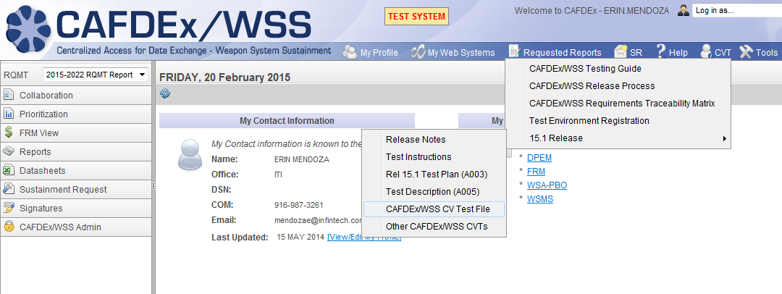
Accessing CVT Documents
The CVT Files may be updated nightly. Pull down a “new” CVT file when restarting testing to ensure that you have the most current version. Please retest any issues you note as they are corrected – see comments tab for updates.
PRE: | User is logged into WTS_Test.
1. | Click the CVT option from the menu bar.
2. | Click on “Release 15.2”
3. | Select WTS CV Test File.
4. | Follow instructions to download CVT file.
5. | Save Excel file with your initials and date 15_2_B_CVT_WTS _Appendix_ HSmith_9_15_2015.xls
Need to update screenshot.
Excel Tests: Save findings directly into Excel and Send to CVT.support@infintech.com
PDF Documents will automatically route to this mail box when the “Submit” button is checked
Notes:
Note: Data calls will be labeled “TEST FYDP” or “TEST EXECUTION”

Slide 5
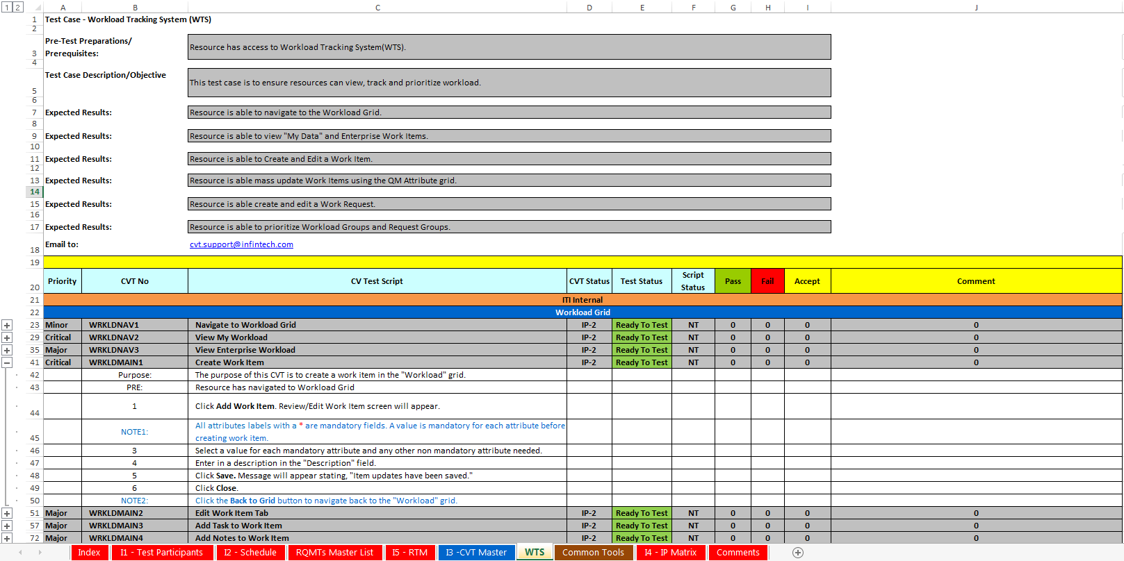
CVT Excel Files
Test Objectives
Record results in appropriate columns. Failure indicates inability to progress to next step. Please provide comments and examples for failures or where work-around is necessary.
Click [+] to expand test steps
Use tabs to navigate between tests
Tabs are color-coded to distinguish FUNCTIONAL TESTS versus REGRESSION TESTS
P - Test step works and passes.
F - Test step fails and you cannot proceed to next step.
A - Step does not work as expected but you can proceed to the next step.

Slide 6
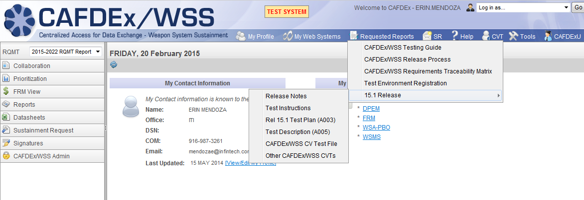
Other CVTs
“Other CVT” link contains an Adobe form for quick review of tests that are not captured in the Excel File (i.e. CAFDEx Facelift)

Slide 7
IP-2 Next Steps
Review test Instructions – if any questions please e-mail. CVT.support@infintech.com
Test your access to
https://dev.cafdex.com/WTS_Test/
UN: firstname.lastname from BugTracker
PW: iti_2015
Please notify Joe/Pete if there is any reason you cannot support the IP-2 testing.

Slide 8
THANK YOU FOR YOUR SUPPORT!!!

