Slide 1


Optimizing drone routing for post-disaster search and rescue
Optimization Days 2018, HEC Montréal
Sean Grogan, PhD Candidate
Michel Gamache, Robert Pellerin; Professors
Département de Mathématiques et de Génie Industriel
École Polytechnique de Montréal
Sean Grogan ©
May 8, 2018

Slide 2
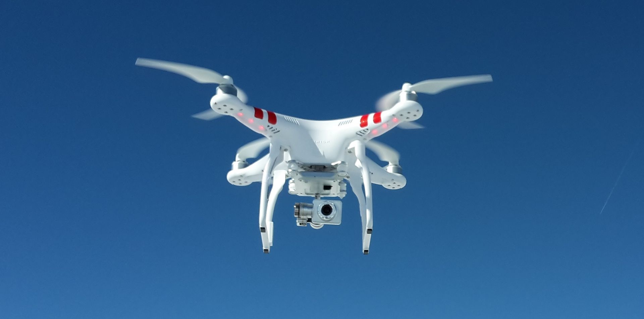
Contents
Context and Introduction
Problem Description
Problem Formulation
Model Demonstration
Proposed Heuristic
Conclusions and Future Work

Slide 3
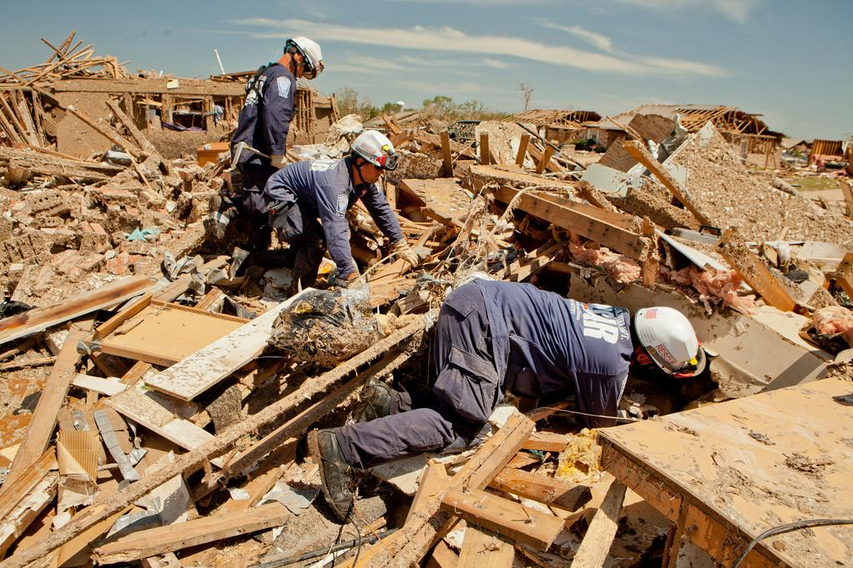
Context
In the aftermath of a disaster, often rescuers are tasked with locating victims trapped and in need of aid:
Most search and rescue procedures are incredibly manual with rescuers approaching collapsed structures;
After a disaster, human rescuers using tools such as dogs, acoustic sensors, and snake cameras to locate people;
Explosion of cell phone usage around the world:
Cellphones emit a host of signals by virtue of being on and active.
Research has begun to explore the ability to passively or actively detect in interact these signals.
FEMA Urban Search and Rescue team members search house to house for survivors in tornado devastated neighborhood in Moore, Oklahoma. Andrea Booher for FEMA

Slide 4
Introduction
Some organizations and research institutions have begun to look at the use of drones in the search and rescue operations;
Attaching a wireless sensor, a device to detect cell phones, to the done can allow the drone to locate cell phone users in a region;
Drones have an obvious utility with the ability to fly over a disaster area;
Drones have a hard endurance constraint (flight time) and cannot usually cover the entire search area alone.

Slide 5
Problem Formulation and Constraints (1/4)
Envision the search area discretized in into scanning areas,
A drone with a wireless sensor attached will fly to and scan a scanning area,
Drones have a hard endurance constraint, flight time,
Drones will consume flight time along the route and at each scanning site

Slide 6
Problem Formulation and Constraints (2/4)
Formulation envisioned as a distance-constrained capacity vehicle routing problem (DCVRP).
Began with formulation from Kek, et al (2008) and modified to suit the problem here,
Notable change: the DCVRP is usually outlined as having a different resource consumed at the nodes (customers) and on the arc (enroute).
In a post-disaster context: time windows less important than overall service time.
Kek, A. G., Cheu, R. L., & Meng, Q. (2008). Distance-constrained capacitated vehicle routing problems with flexible assignment of start and end depots. Mathematical and Computer Modelling, 47(1-2), 140-152. doi:10.1016/j.mcm.2007.02.007

Slide 7
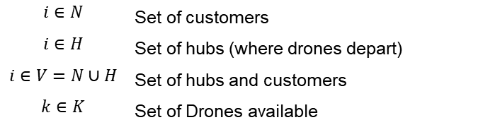
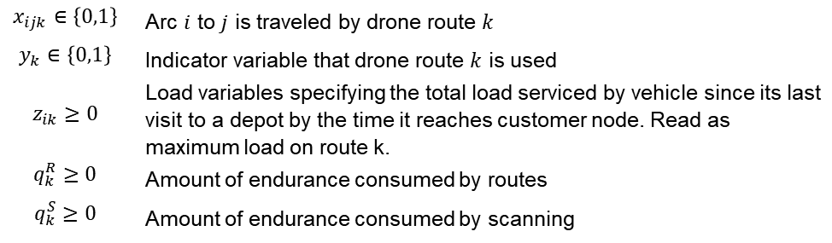
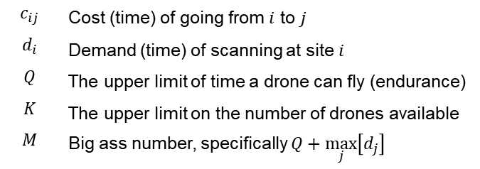
Problem Formulation and Constraints (3/4)
Sets:
Parameters:
$$i∈N$$ | Set of customers
$$i∈H$$ | Set of hubs (where drones depart)
$$i∈V=N∪H$$ | Set of hubs and customers
$$k∈K$$ | Set of Drones available
$$c_{ij}$$ | Cost (time) of going from $i$ to $j$
$$d_{i}$$ | Demand (time) of scanning at site $i$
$$Q$$ | The upper limit of time a drone can fly (endurance)
$$K$$ | The upper limit on the number of drones available
$$M$$ | Big ass number, specifically $Q+\max_{j}\left[d_{j}\right]$
Variables:
$$x_{ijk}∈\left\{0,1\right\}$$ | Arc $i$ to $j$ is traveled by drone route $k$
$$y_{k}∈\left\{0,1\right\}$$ | Indicator variable that drone route $k$ is used
$$z_{ik}≥0$$ | Load variables specifying the total load serviced by vehicle since its last visit to a depot by the time it reaches customer node. Read as maximum load on route k.
$$q_{k}^{R}≥0$$ | Amount of endurance consumed by routes
$$q_{k}^{S}≥0$$ | Amount of endurance consumed by scanning

Slide 8
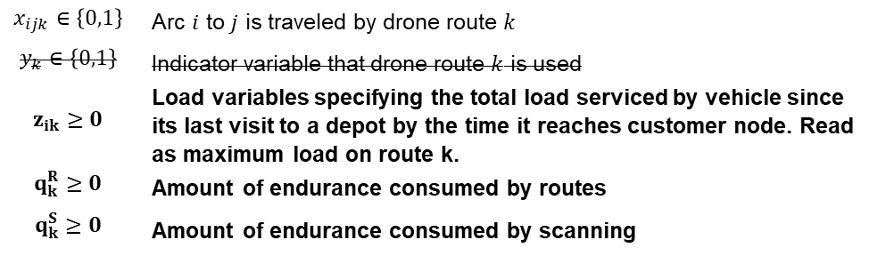
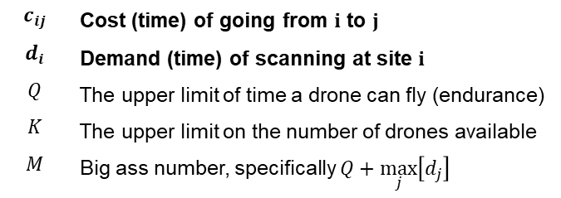
Problem Formulation and Constraints (3/4)
Sets:
Parameters:
$$i∈N$$ | Set of customers
$$i∈H$$ | Set of hubs (where drones depart)
$$i∈V=N∪H$$ | Set of hubs and customers
$$k∈K$$ | Set of Drones available
$$c_{ij}$$ | Cost (time) of going from $i$ to $j$
$$d_{i}$$ | Demand (time) of scanning at site $i$
$$Q$$ | The upper limit of time a drone can fly (endurance)
$$K$$ | The upper limit on the number of drones available
$$M$$ | Big ass number, specifically $Q+\max_{j}\left[d_{j}\right]$
Variables:
$$x_{ijk}∈\left\{0,1\right\}$$ | Arc $i$ to $j$ is traveled by drone route $k$
$$y_{k}∈\left\{0,1\right\}$$ | Indicator variable that drone route $k$ is used
$$z_{ik}≥0$$ | Load variables specifying the total load serviced by vehicle since its last visit to a depot by the time it reaches customer node. Read as maximum load on route k.
$$q_{k}^{R}≥0$$ | Amount of endurance consumed by routes
$$q_{k}^{S}≥0$$ | Amount of endurance consumed by scanning

Slide 9
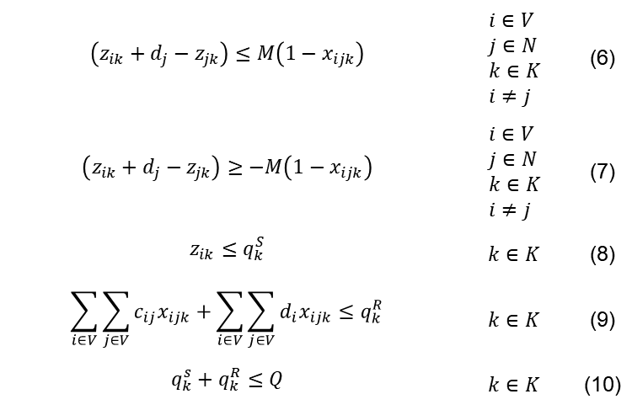
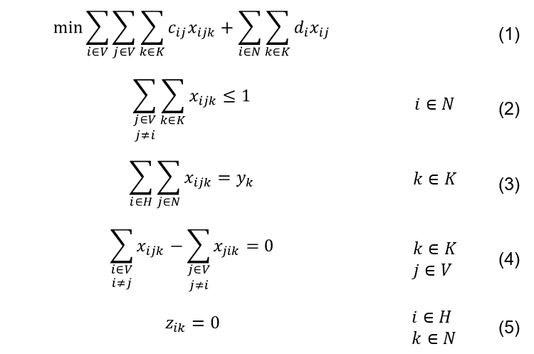
Problem Formulation and Constraints (4/4)
$$\min{\sum_{i∈V}{\sum_{j∈V}{\sum_{k∈K}{c_{ij}x_{ijk}}}}+\sum_{i∈N}{\sum_{k∈K}{d_{i}x_{ij}}}}$$ |  | (1)
$$\sum_{\begin{aligned}j∈V \\ j≠i\end{aligned}}{\sum_{k∈K}{x_{ijk}}}≤1$$ | $$i∈N$$ | (2)
$$\sum_{i∈H}{\sum_{j∈N}{x_{ijk}}}=y_{k}$$ | $$k∈K$$ | (3)
$$\sum_{\begin{aligned}i∈V \\ i≠j\end{aligned}}{x_{ijk}}−\sum_{\begin{aligned}j∈V \\ j≠i\end{aligned}}{x_{jik}}=0$$ | $$k∈K \\ j∈V$$ | (4)
$$z_{ik}=0$$ | $$i∈H \\ k∈N$$ | (5)
$$\left(z_{ik}+d_{j}−z_{jk}\right)≤M\left(1−x_{ijk}\right)$$ | $$i∈V \\ j∈N \\ k∈K \\ i≠j$$ | (6)
$$\left(z_{ik}+d_{j}−z_{jk}\right)≥−M\left(1−x_{ijk}\right)$$ | $$i∈V \\ j∈N \\ k∈K \\ i≠j$$ | (7)
$$z_{ik}≤q_{k}^{S}$$ | $$k∈K$$ | (8)
$$\sum_{i∈V}{\sum_{j∈V}{c_{ij}x_{ijk}}}+\sum_{i∈V}{\sum_{j∈V}{d_{i}x_{ijk}}}≤q_{k}^{R}$$ | $$k∈K$$ | (9)
$$q_{k}^{s}+q_{k}^{R}≤Q$$ | $$k∈K$$ | (10)

Slide 10
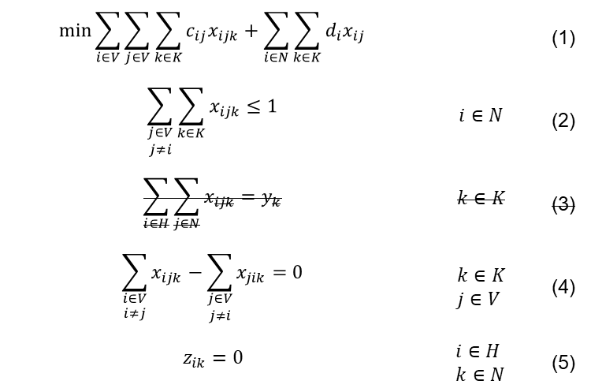
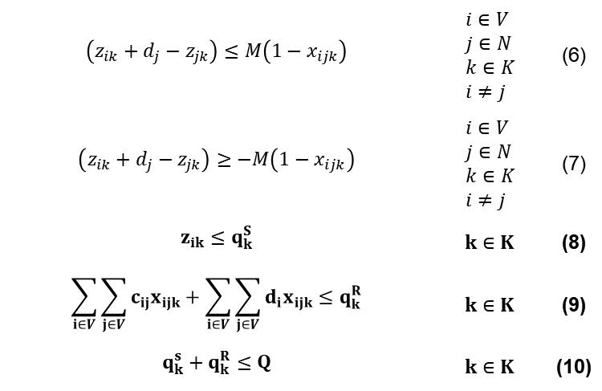
Problem Formulation and Constraints (4/4)
$$\min{\sum_{i∈V}{\sum_{j∈V}{\sum_{k∈K}{c_{ij}x_{ijk}}}}+\sum_{i∈N}{\sum_{k∈K}{d_{i}x_{ij}}}}$$ |  | (1)
$$\sum_{\begin{aligned}j∈V \\ j≠i\end{aligned}}{\sum_{k∈K}{x_{ijk}}}≤1$$ | $$i∈N$$ | (2)
$$\sum_{i∈H}{\sum_{j∈N}{x_{ijk}}}=y_{k}$$ | $$k∈K$$ | (3)
$$\sum_{\begin{aligned}i∈V \\ i≠j\end{aligned}}{x_{ijk}}−\sum_{\begin{aligned}j∈V \\ j≠i\end{aligned}}{x_{jik}}=0$$ | $$k∈K \\ j∈V$$ | (4)
$$z_{ik}=0$$ | $$i∈H \\ k∈N$$ | (5)
$$\left(z_{ik}+d_{j}−z_{jk}\right)≤M\left(1−x_{ijk}\right)$$ | $$i∈V \\ j∈N \\ k∈K \\ i≠j$$ | (6)
$$\left(z_{ik}+d_{j}−z_{jk}\right)≥−M\left(1−x_{ijk}\right)$$ | $$i∈V \\ j∈N \\ k∈K \\ i≠j$$ | (7)
$$z_{ik}≤q_{k}^{S}$$ | $$k∈K$$ | (8)
$$\sum_{i∈V}{\sum_{j∈V}{c_{ij}x_{ijk}}}+\sum_{i∈V}{\sum_{j∈V}{d_{i}x_{ijk}}}≤q_{k}^{R}$$ | $$k∈K$$ | (9)
$$q_{k}^{s}+q_{k}^{R}≤Q$$ | $$k∈K$$ | (10)
Notes:
I would like to draw your attention to the constraints bolded here. These are modified from the base formulation to combine the consumption in both the route and at sites. Recall that $z_{ik}$ is the amount of energy consumed in route k at customer i.

Slide 11
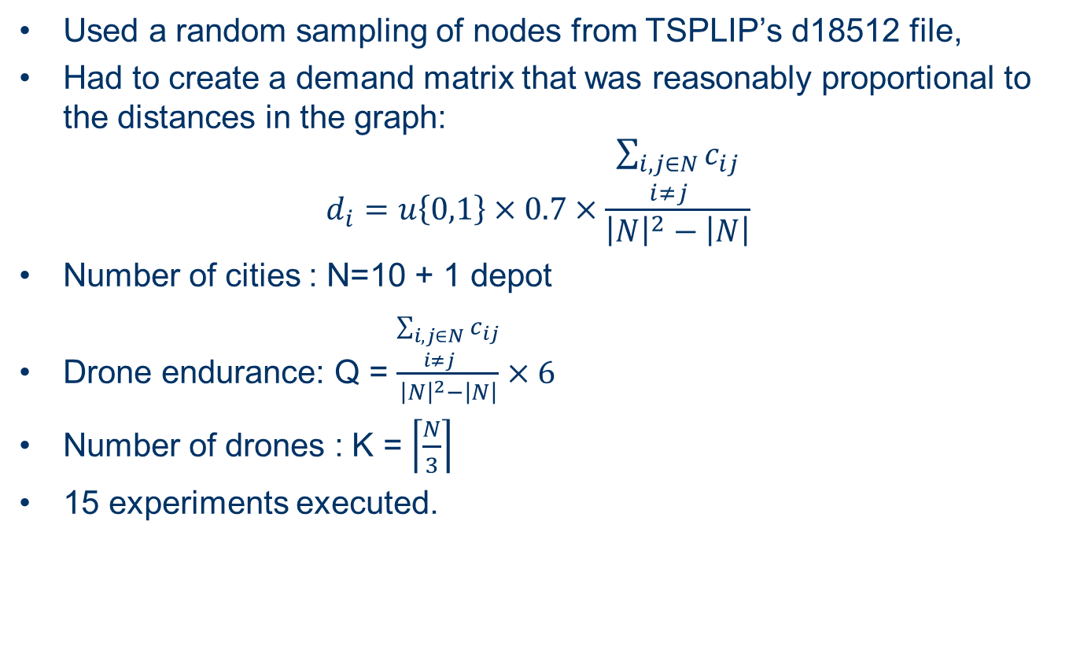
Model Demonstration (1/2)
Used a random sampling of nodes from TSPLIP’s d18512 file,
Had to create a demand matrix that was reasonably proportional to the distances in the graph:
$$d_{i}=u\left\{0,1\right\}×0.7×\frac{\sum_{\begin{aligned}i, j∈N \\ i≠j\end{aligned}}{c_{ij}}}{{\left|N\right|}^{2}−\left|N\right|}$$
Number of cities : N=10 + 1 depot
Drone endurance: Q = $\frac{\sum_{\begin{aligned}i, j∈N \\ i≠j\end{aligned}}{c_{ij}}}{{\left|N\right|}^{2}−\left|N\right|}×6$
Number of drones : K = $\left\lceil \frac{N}{3}\right\rceil$
15 experiments executed.

Slide 12
Model Demonstration (2/3)
Q = 19600
Tour 1 : 0->3->9->8->5->10->0
Transit : 5351
Service : 5311
Total : 10661
Tour 2 : 0->1->6->0
Transit : 11252
Service : 3475
Total : 14727
Tour 3 : 0->2->7->4->0
Transit : 11729
Service : 3698
Total : 15427
Notes:
blp_2018-05-04-11-46-17

Slide 13
Model Demonstration (3/3)
For N=11:
Average time to solve 70 seconds
Average tours was 3.2 tours

Slide 14
Proposed Heuristic – Elastic Net and Self Ordering Map
Began as a way of constructing a solution for TSPs,
Geometrically inspired, consider a rubber band that is slowly drawn to nodes of the graph,
Internal forces of the rubber band force the tour to remain small,
The force of the nodes on the rubber band draw the band to the nodes,
The algorithm terminates when the band arrives sufficiently close to all the cities in the tour.
Animation captured from https://larose.github.io/tsp/

Slide 15
Proposed Heuristic – Elastic Net and Self Ordering Map
There is a lack of research surrounding the use of neural networks in operations research:
Geometrically inspired heuristics don’t often work well for TSPs and VRPs in “real world cases”
However:
For a flying vehicle, routing is “as the crow flies”
Generally:
“The incremental development of neural networks [elastic nets and self ordering maps] may lead, over time, to more competitive approaches for the VRP.”
“SOM may become competitive in the future when massively parallel computer systems will become widely available.”
Créput, J.-C., & Koukam, A. (2008). The memetic self-organizing map approach to the vehicle routing problem. Soft Computing, 12(11), 1125–1141. http://doi.org/10.1007/s00500-008-0281-4

Slide 16
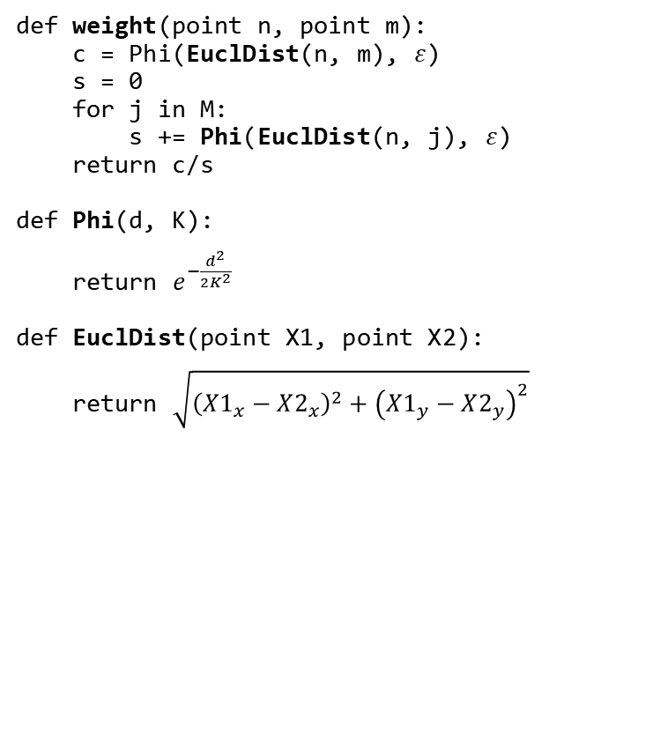
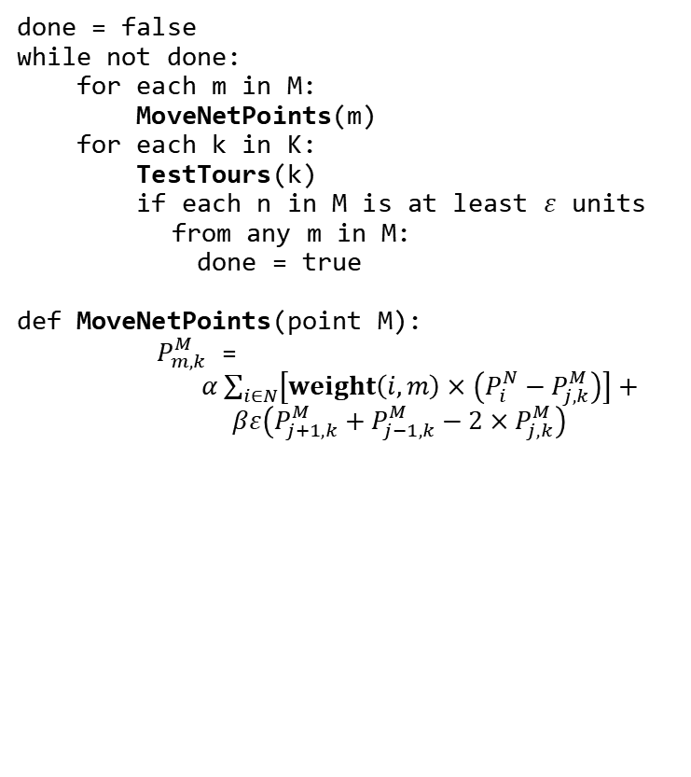
Pseudocode
done = false
while not done:
for each m in M:
MoveNetPoints(m)
for each k in K:
TestTours(k)
if each n in M is at least $ε$ units
from any m in M:
done = true
def MoveNetPoints(point M):
$P_{m,k}^{M}$ =
$α\sum_{i∈N}{\left[weight\left(i, m\right)×\left(P_{i}^{N}−P_{j, k}^{M}\right)\right]}+$
$βε\left(P_{j+1, k}^{M}+P_{j−1, k}^{M}−2×P_{j, k}^{M}\right)$
def weight(point n, point m):
c = Phi(EuclDist(n, m), $ε$)
s = 0
for j in M:
s += Phi(EuclDist(n, j), $ε$)
return c/s
def Phi(d, K):
return $e^{−\frac{d^{2}}{2K^{2}}}$
def EuclDist(point X1, point X2):
return $\sqrt{{\left(X1_{x}−X2_{x}\right)}^{2}+{\left(X1_{y}−X2_{y}\right)}^{2}}$

Slide 17
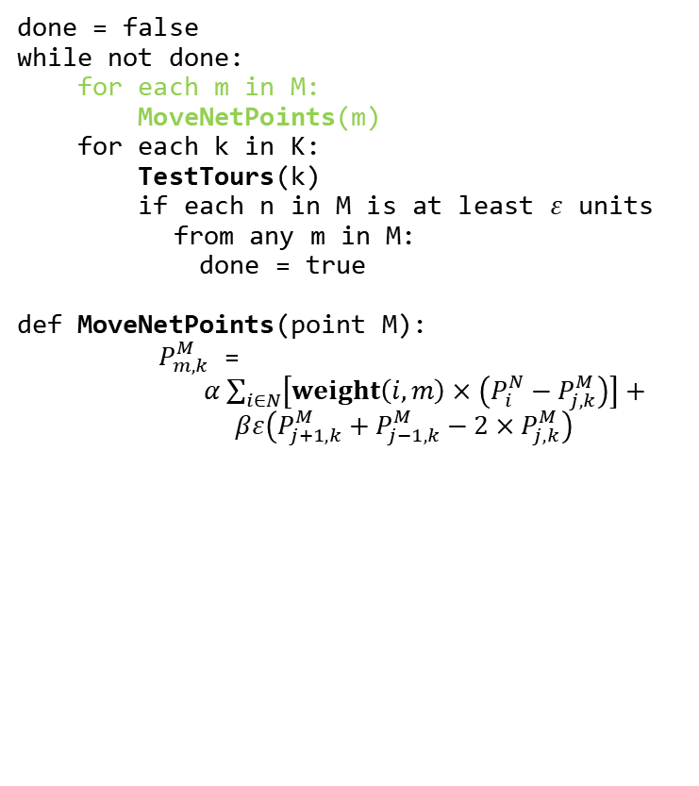
Pseudocode
done = false
while not done:
for each m in M:
MoveNetPoints(m)
for each k in K:
TestTours(k)
if each n in M is at least $ε$ units
from any m in M:
done = true
def MoveNetPoints(point M):
$P_{m,k}^{M}$ =
$α\sum_{i∈N}{\left[weight\left(i, m\right)×\left(P_{i}^{N}−P_{j, k}^{M}\right)\right]}+$
$βε\left(P_{j+1, k}^{M}+P_{j−1, k}^{M}−2×P_{j, k}^{M}\right)$
def weight(point n, point m):
c = Phi(EuclDist(n, m), $ε$)
s = 0
for j in M:
s += Phi(EuclDist(n, j), $ε$)
return c/s
def Phi(d, K):
return $e^{−\frac{d^{2}}{2K^{2}}}$
def EuclDist(point X1, point X2):
return $\sqrt{{\left(X1_{x}−X2_{x}\right)}^{2}+{\left(X1_{y}−X2_{y}\right)}^{2}}$

Slide 18

Questions

