Slide 1
§2.3-2.4: Problem Solving,
Documentation
devo
  15 Sep 2005
  CMPT14x
  Dr. Sean Ho
  Trinity Western University
Reminders:
journals in folder
http://cmpt14x.seanho.com/

Slide 2
Review of 2.2
Components of a baby Modula-2 program
Modules
Reserved words
Library tools (what are some we know already?)
Identifiers (what are some legit examples?)
Strings, quoting, newlines
Structure of a program module (railroad diagram)
  MODULE, IMPORT, BEGIN, END.

Slide 3
What's on for today (2.3-2.4)
Steps to problem solving: WADES in more detail
Analyze the problem: write, ask appropriate, rewrite
Plan and revise a solution
Data tables and I/O
Pseudocode
Implement in Modula-2 code
Compile, link, and run (several times)
Check output against specifications
Documentation

Slide 4

Steps to solving a problem
11 steps expanding upon WADES:
Analyze the problem
Plan a solution
Write down your data tables and I/O
Refine your solution (several times)
Execute your plan (code) and evaluate the results

Slide 5

Analyze the problem
Step 1: Write the problem out
  “Write a program that prints out a user-specified number of hash marks (#).”
Step 2: Ask whether a computer is appropriate
  Other ways to solve the problem?
Step 3: Rewrite the problem in your own words
  Given: number of hash marks to print
  To do: print hash marks
  Result: a string of hash marks, e.g., #######
  Formula: none needed

Slide 6

Plan and refine a solution
Step 4: Re-use previous work where possible
  Our program has input and output, so we will use the STextIO and SWholeIO libraries.
Step 5: Break the problem into smaller steps
  Input: read in desired number of hash marks
  Computation: none
  Output: print out hash marks

Slide 7

Further refinements
Second refinement:
  Input:
    Ask user for desired number of hash marks
    Input response and assign to a cardinal variable
  Computation:
    Initialize a cardinal counter to zero
  Output:
    While the counter is less than the desired number of hash marks:
      Print a hash mark
      Increment the counter

Slide 8
Data tables and I/O
Step 6: List all variables and imports (data table)
  Variables: NumberOfHashes, counter: cardinals
  Imports:
    From STextIO: WriteString, WriteLn
    From SWholeIO: ReadCard
Step 7: List required input (precondition) and expected output (postcondition)
  Input: A cardinal number ≥ 0, e.g. 6
  Output: A string of hashes, e.g. “######”

Slide 9
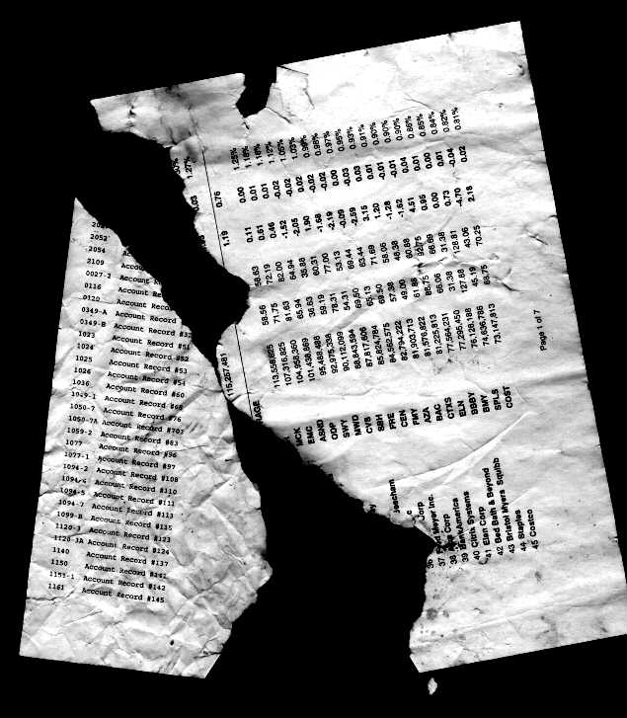
Refining the solution
Step 8: Pseudocode
  Print “How many hashes do you want printed?”
  Read user input into NumberOfHashes
  counter <---- 0
  While (counter < NumberOfHashes)
    Print “#”
    counter <----- counter + 1

Slide 10
Write the Modula-2 code
Step 9: Modula-2 code (syntax matters here)
  MODULE HashMarks;
  FROM STextIO IMPORT
    WriteString, WriteLn;
  FROM SWholeIO IMPORT
    ReadCard;
  VAR
    NumberOfHashes, counter: CARDINAL;
(continued next page)

Slide 11
Modula-2 code, cont.
  BEGIN
    WriteString (“How many hashes do you want? ”);
    ReadCard (NumberOfHashes);
    counter := 0;
    WHILE counter < NumberOfHashes
      DO
        WriteString (“#”);
        counter := counter + 1;
      END;
    WriteLn;
  END Hashmarks.

Slide 12

Execution and evaluation
Step 10: Compile, link, run
  First run:
    How many hashes do you want? 4
    ####
  Second run:
    How many hashes do you want? 7
    #######
Step 11: Check against specifications
  Does program print the right number of hashes? No one-off errors?
  What about weird input: 0, -1, 120, 5.3, abc?

Slide 13

Documentation
Document your thinking at every step,
even the ideas that didn't work!
  Programmer's diary: log of everything
External documentation: outside the program
  User manual:
    What user input is required
    What the user should expect the program to output
    No details about program internals
Internal documentation: within the program
  Descriptive variable/module names
  Comments in the code
  Online help for the user

Slide 14
Examples of internal documentation
Good variable name: NumberOfHashes
  Bad variable name: x, num, i
Comments: (* in Modula-2 *)
  (* loop NumberOfHashes times *)
  WHILE counter < NumberOfHashes
    DO
      WriteString (“#”); (* print just one # *)
      counter := counter + 1;
    END;
Online help:
  “Enter 'h' for online help.”

Slide 15
Review of today (2.3-2.4)
Analyze the problem: write, ask appropriate, rewrite
Plan and revise a solution:
  Reuse modules, break into smaller steps
Data tables and I/O:
  variables/imports, pre/postcondition
Pseudocode
Implement in Modula-2 code
Compile, link, and run (several times)
Check output against specifications
Documentation

Slide 16
TODO items
Homework due tomorrow (Fri):
  §1.11 # 35
Reading: through §2.5 for Fri
Quiz ch2 next Mon
Lab 1 due next MTW in lab section
  Short writeup ok

