Slide 1
§6.5-6.8: Writing Your Own Library
devo
  17 Oct 2005
  CMPT14x
  Dr. Sean Ho
  Trinity Western University
Reminders:
journals in folder
no quiz today
http://cmpt14x.seanho.com/

Slide 2
Library modules vs. programs
Library modules (e.g. STextIO) are different from program modules (e.g. HelloWorld):
  Linker needs to know what procedures / entities are available for import from a library
  Programs that use a library don't need to know the implementation of its procedures
Hence there are two parts to a library module:
  DEFINITION (a.k.a. header file)
  IMPLEMENTATION (a.k.a. code file)

Slide 3
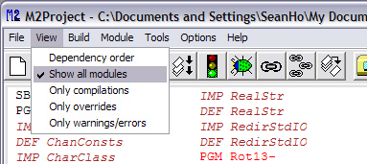
Viewing standard library modules
You can see the definition and implementation files for standard library modules in Stonybrook:
  View -> Show all modules
  Each library has a DEF and an IMP
Make sure not to modify the standard libraries!

Slide 4
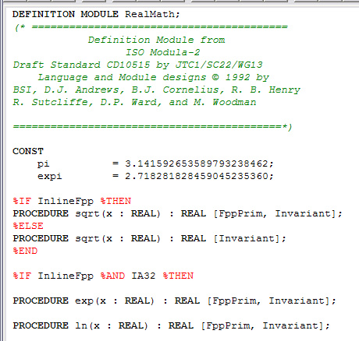
An example of a definition file
Let's peek at
RealMath's DEF:
Keyword DEFINITION
No bodies to the procedures
No body to the module
No BEGIN anywhere

Slide 5
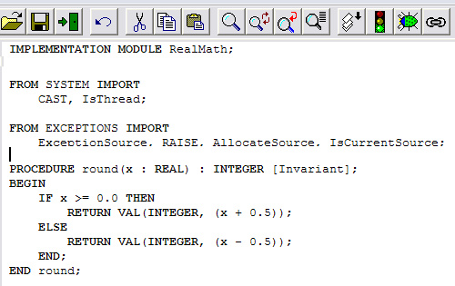
An example of an implementation
Here's part of RealMath's IMP:
Keyword IMPLEMENTATION
Parameter lists
must match
DEFINITION
IMPORTs
as needed
Body of module
optional
(initialization)

Slide 6
Module interface
The interface of a module is the way in which other modules use it: its publicly accessible
  Procedures, variables, types, constants, etc.
There may be other procedures, variables, etc. that are internal to the module and should be hidden from public view
When designing a module, think carefully about its public interface
  c.f. preconditions

Slide 7
Example: Fractions ADT
Often modules are used to define abstract data types: let's make a Fraction type:
    DEFINITION MODULE Fractions;
We can represent a fraction a/b internally as an ordered pair (array of length 2) of integers:
    TYPE Fraction = ARRAY [1 .. 2] OF INTEGER;
This Fractions module will contain the Fraction type as well as all the procedures we need to use variables of type Fraction

Slide 8
Creating a library function: Inv
Let's make a function that inverts a fraction:
  In the definition module:
    PROCEDURE Inv (x : Fraction) : Fraction;
  In the implementation module:
    PROCEDURE Inv (x : Fraction) : Fraction;
    VAR temp : INTEGER;
    BEGIN
      temp := x[1];
      x[1] := x[2];
      x[2] := temp;
    END Inv;

Slide 9
Using our Fractions library
Let's try to use our new Fractions library:
    MODULE FractionTest;
    FROM Fractions IMPORT
      Inv;
    VAR
      applesPerFriend, friendsPerApple : Fraction;
    BEGIN
      friendsPerApple := Inv (applesPerFriend);
    END FractionTest.
Oops, forgot to provide a way to initialize a Fraction!

Slide 10
Hiding implementation details
Since a Fraction is just an ARRAY [1..2] OF INTEGER, so FractionTest could initialize just by
    (* initialize with 1.5 apples per friend *)
    applesPerFriend[1] := 3;
    applesPerFriend[2] := 2;
But we want the Fractions library to hide the fact that a Fraction is really an array
  Array is just an implementation detail
  Future version could use some other way
  Public interface should stay the same
  A user could set denominator to zero

Slide 11
Accessor functions
We can provide an accessor function that allows the user to get at the numerator and denominator in a controlled manner
  Error checking (denominator ≠ 0)
  Consistent interface (if we switch from arrays)
Set function:
  Assign (num, denom : INTEGER) : Fraction
Get functions:
  Numerator (x : Fraction) : INTEGER
  Denominator (x : Fraction) : INTEGER

Slide 12
Set/Get functions
In the definition module:
    PROCEDURE Assign (num, denom:INTEGER): Fraction;
In the implementation module:
    PROCEDURE Assign (num,denom:INTEGER): Fraction;
    VAR x : Fraction;
    BEGIN
      x[1] := num;
      x[2] := denom;
      RETURN x;
    END Assign;
  Add error checking:

Slide 13
Design choices for error handling
No error checking:
  Make sure preconditions are clearly stated in documentation: writeup, comments, user manual, WriteString, etc.
  Not ideal – users can be very creatively bad!
Precondition checking:
  Use IF to check preconditions in code
  If bad input, take evasive action
Postcondition checking:
  ReadResult: if error, continue but set a flag

Slide 14
TODO items
Lab5 due today/tomorrow/Wed:
  §6.11 #( 25 / 33 ) (choose one)
Quiz ch6 on Wed
Homework due Fri: 6.11 #28
Quiz ch7 on Fri
Reading: through §7.5 for Wed

