Slide 1
§2.3-2.4: Problem Solving,
Documentation, Style
  14 Sep 2006
  CMPT14x
  Dr. Sean Ho
  Trinity Western University
devo

Slide 2
Review of §2.2, 2.5, 2.11
Components of a baby Python program
Modules
Library tools (what are some we know already?)
Literals, identifiers and reserved words (examples?)
Strings, quoting, newlines
Statically-typed vs. dynamically-typed
Declaring and initializing variables
  (what is needed in C? In Python?)
Keyboard input

Slide 3
Follow-up notes from yesterday
Static typing = strong typing
Dynamic typing = weak typing
print “hello”,
  No newline, but still a space after “hello”
  For more control, import sys and use sys.stdout.write()
Note the updated list of allowable Python constructs on the course website:
http://cmpt14x.seanho.com/python_constructs.html

Slide 4
What's on for today (§2.3-2.4)
Steps to problem solving: WADES in more detail
Documentation
  External documentation: design, manuals
  Internal documentation: comments, docstrings
Style guidelines

Slide 5
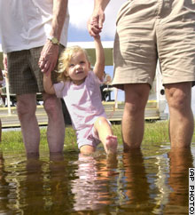
Steps to solving a problem
11 steps expanding upon WADES:
Analyze the problem
Plan a solution
Write down your data tables and I/O
Refine your solution (several times)
Execute your plan (code) and evaluate the results

Slide 6

Analyze the problem
Step 1: Write the problem out
  “Write a program that prints out a user-specified number of hash marks (#).”
Step 2: Ask whether a computer is appropriate
  Other ways to solve the problem?
Step 3: Rewrite the problem in your own words
  Given: number of hash marks to print
  To do: print hash marks
  Result: a string of hash marks, e.g., #######
  Formula: none needed

Slide 7

Plan and refine a solution
Step 4: Re-use previous work where possible
  Our program has input and output; in some languages (not Python), we need I/O libraries.
Step 5: Break the problem into smaller steps
  Input: read in desired number of hash marks
  Computation: none
  Output: print out hash marks

Slide 8

Further refinements
Second refinement:
  Input:
    Ask user for desired number of hash marks
    Input response and assign to a cardinal variable
  Computation:
    Initialize a cardinal counter to zero
  Output:
    While the counter is less than the desired number of hash marks:
      Print a hash mark
      Increment the counter

Slide 9
Data tables and I/O
Step 6: List all variables and imports (data table)
  Variables: numHashes, counter (int)
  Imports: none
Step 7: List required input (precondition) and expected output (postcondition)
  Input: An int ≥ 0, e.g. 6
  Output: A string of hashes, e.g. “######”

Slide 10
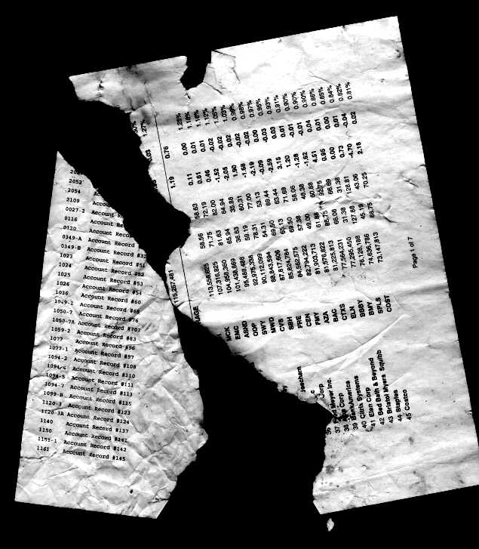
Refining the solution
Step 8: Pseudocode
  Print “How many hashes do you want printed?”
  Read user input into numHashes
  counter <---- 0
  While (counter < numHashes)
    Print “#”
    counter <----- counter + 1

Slide 11
Write the Python code
Step 9: Python code (syntax matters here)
  ” ” ” Print a bunch of hashes.
  Nellie Hacker, CMPT140
  ” ” ”
  numHashes = input(“How many hashes? ”)
  counter = 0
  while (counter < numHashes):
    print “#”, # no newline
    counter = counter + 1
  print

Slide 12

Execution and evaluation
Step 10: Compile, link, run
  First run:
    How many hashes do you want? 4
    ####
  Second run:
    How many hashes do you want? 7
    #######
Step 11: Check against specifications
  Does program print the right number of hashes? No one-off errors?
  What about weird input: 0, -1, 120, 5.3, abc?

Slide 13

Documentation
Document your thinking at every step,
even the ideas that didn't work!
  Programmer's diary: log of everything
External documentation: outside the program
  User manual:
    What user input is required
    What the user should expect the program to output
    No details about program internals
Internal documentation: within the program
  Descriptive variable/module names
  Comments in the code
  Online help for the user

Slide 14
Examples of internal documentation
Good variable names: numHashes
  Bad variable names: x, num, i
Comments: # in Python (to end of line)
  # loop numHashes times
  while (counter < numHashes):
    print “#”, # no newline
    counter = counter + 1
Online help:
  “Enter 'h' for online help.”

Slide 15
Comments
Explain the “why”, not the “what”:
  Bad: x = x + 1 # increment x
  Good: x = x + 1 # do next hashmark
Keep comments up-to-date!
  Incorrect comments are worse than no comments
Comments are no substitute for external documentation
  Still need a separate design doc, pseudocode, user manual, etc.

Slide 16
Docstrings
Python convention is to create a docstring at the top of every module, function, class, etc.:
  ” ” ” Print a bunch of hashes.
  Nellie Hacker, CMPT140
  ” ” ”
  numHashes = input(“How many hashes? ”)
  . . .
Triple-quotes: this is a string, not a comment
First line is a short summary
Second line is blank, then detailed description
Automated Python tools read docstrings to help you organize your code
  More info: http://www.python.org/dev/peps/pep-0257/

Slide 17
Style conventions
Not hard-and-fast rules, but flexible conventions that make code easier to read and understand
Variable names: numHashes
  Flexible, but I prefer no underscores, and capitalize each word (“CamelCase”)
  First letter is lowercase
File/module names: helloworld.py
  Short, all lowercase, no underscores
Function names: print_hashes()
  lowercase, command predicate, underscores
More details: http://www.python.org/dev/peps/pep-0008/

Slide 18
Review of today (§2.3-2.4)
Steps to problem solving: WADES in more detail
Documentation
  External documentation: design, manuals
  Internal documentation:
    Comments
    Docstrings
Style guidelines
(see bankinterest.py example)

Slide 19
TODO items
Homework due tomorrow (Fri):
  §1.11 # 35
Reading: through §2.10 for Fri
Quiz ch2 next Mon
Lab 1 due next MTW in lab section
  Short writeup ok

