Slide 1
Ch8: static
  19 February 2007
  CMPT167
  Dr. Sean Ho
  Trinity Western University

Slide 2

Science in the Valley is
looking for TAs for the month of May
Interested?
Thursday, Feb 22
1:10 - 2:30
NEU 41

Slide 3
Review last time
Packages
    package ca.twu.cmpt167.lab3.seanho.FractalTree;
Access modifiers
  private
  (no modifier)
  protected
  public
Jar

Slide 4
static keyword
    public static void main( String args[] ) {
static keyword: class attribute
  Shared by all instances of this class
    vs. instance attribute: separate for each object
  Exists before class is instantiated
    Invoke class methods as: ClassName.method()
Running a class vs. instantiating a class:
  Run a class from JRE: java MyClass
    No instances made, just MyClass.main() invoked
  Instantiating: new MyClass()
    Constructor is run, main() is not run

Slide 5
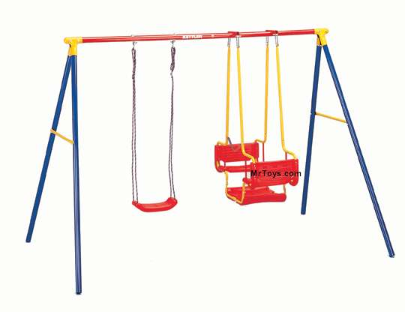
Idioms for Swing programs
    (see FractalTree.java)
main(): calls createAndShowGUI()
  In a thread-safe manner: invokeLater()
createAndShowGUI():
  Sets up window (JFrame)
  Instantiates panel (JPanel, FractalTree)
    This calls constructor
FractalTree() constructor:
  Creates widgets, layout
actionPerformed() callback

Slide 6

The “this” reference
this refers to the current instance
  Not always necessary in Java
  Use to distinguish between
  local variable/parameter and
  instance/class attribute
    public class Complex {
      double real, imag;
      public Complex() { real = 0.0; imag = 0.0; }
      public Complex( double real, double imag ) {
        this.real = real;
        this.imag = imag;
  Can't use in static methods (why?)

Slide 7
static import
    import static java.lang.Math.*;
Import all static members of a class
New feature in Java 1.5 (J2SE 5.0)
Brings static variables/methods into current namespace:
    sqrt( 36.0 ); instead of Math.sqrt( 36.0 );
    log( E ); instead of Math.log( Math.E );
Can also bring in one particular member:
    import static java.lang.Math.sqrt;

Slide 8
TODO
Midterm this Wed 21Feb
  Through lecture #11
Lab3 pushed to Fri 23Feb
  Recursion (fractal tree)

