Slide 1
CMPT370:
Advanced Programming Topics
  9 January 2007
  CMPT370
  Dr. Sean Ho
  Trinity Western University
cmpt370.seanho.com
Email sign-up sheet

Slide 2
Welcome to CMPT 370!
You are already proficient programmers
This course is to give you more experience as a programmer with some advanced topics and applications
  CMPT370 is different every time it's offered
This semester:
  Graphical user interfaces: FLTK (~2 wks)
  Parallel programming: OpenMP (~2.5 wks)
  Computer graphics: OpenGL (~8 wks)

Slide 3
What's on for today
Intro / Administration:
  What I assume of you
  How you'll be evaluated
  Principles and policy on group work
  Development / programming environments
Overview of this semester's 3 main topics
An excerpted history of GUIs

Slide 4
What I assume of you
You don't need hand-holding
  Lots of docs/tutorials on web: go at it!
You are proficient in programming
  At least one language (C, Java, M2, Python, ...)
  Can pick up C++ in the next two weeks
  Not required to be a wizard in OO / templates / generic programming
You are creative and excited to make cool and useful programs!
  Most labs ask you to design your own task

Slide 5
How you'll be evaluated
Programming projects (labs) (40%):
  5-6 total, about one every other week
  Usually due on Thursday midnight
  Lab write-up required (see template)
  Electronic submission via eCourses:
    Tarball of the project directory
    Include C++ sources, Fluid files, executables, data files, lab write-up
2 Midterms (15% each), final exam (30%)
  Midterms: Thu 15Feb, Thu 22Mar

Slide 6
Principles on group work
Teamwork is great! But it's more complicated.
  In the working world, you'll always be part of a team, but your role may often change
  Be flexible to fill all the roles:
  be able to do all the tasks for each lab
This course is not primarily about team software development (CMPT 386/387), but about advanced programming topics
Always give credit where credit is due
  Even just ideas from a conversation

Slide 7
Policy on group work
In this course, labs are generally individual work:
  You can talk about the assignment, but
  You may not copy a classmate's code
  You may copy snippets from the net, but you must cite where you got it from
  If you get a good idea from a classmate, give credit in your lab write-up
But: I'm flexible; if you really want to do a lab as a team, talk to me
  The scope of the project may need to expand

Slide 8
Development environments
See the IDE policy sheet for full details
Officially supported environment:
  gcc/g++, make, Cygwin on senior lab PCs
  gcc/g++4, make on carmel (Linux)
  Plain-text editors (Notepad, nano, vim)
You may use another environment (MSVC), but:
  Should use C/C++
  I need to run your program (Win32/Linux)
  Parallel lab must be done on carmel
I'm still flexible; ask me

Slide 9
Your first assignments
Lab0: FLTK orientation (due next Tues 16Jan)
  Login to senior lab PCs
  Get familiar with Cygwin, gcc, make, editors, etc.
  Follow along with FLTK tutorials
  Upload a tarball of CubeView to eCourses
Lab1: FLTK project (due next week Thu 18Jan)
  Design and implement a cool FLTK program of your own thinking
  Research and use an advanced FLTK feature
  Lab write-up required

Slide 10
Topics this semester
Graphical user interfaces
  Widgets, valuators, input and output, menus
  Events and callbacks (FLTK)
  Signals and slots (Qt)
Parallel programming
  Memory models: UMA vs. NUMA, etc.
  Shared-memory parallelism (OpenMP)
  Distributed/clusters (MPI)
  Hybrid models

Slide 11
Topics this semester, cont.
Lines, curves, Bezier, splines
Linear/bi/tri interpolation
Modeling:
trimeshes: vertex/face tbls, normal, parametric
Viewing: transforms, perspective projection, homogeneous coords, quaternions
Lighting:
shading, diffuse/ambient/specular, materials
Texture mapping: texcoords, mip-maps
(Raytracing, global illumination)

Slide 12
What's on for today
Intro / Administration:
  What I assume of you
  How you'll be evaluated
  Principles and policy on group work
  Development / programming environments
Overview of this semester's 3 main topics
An excerpted history of GUIs

Slide 13
History of graphical user interface
1940s-50s: big mainframes, punched cards,
mostly number-crunching: text interface
Some key developments in GUIs:
  Sutherland's SketchPad (1963)
  Engelbart's NLS (1968)
  Xerox PARC: Alto, Smalltalk (1974)
  Apple Lisa, Mac (1984)
  MS Windows 1.0 (1985)
ArsTechnica has an excellent article

Slide 14
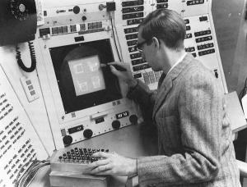
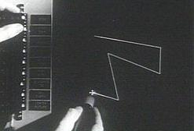
Sutherland's SketchPad (1963)
Ivan Sutherland
Ph.D. thesis at MIT
Used light pen to directly
manipulate graphical objects on screen
Pioneer of computer-aided drafting (CAD):
  Draw “master” diagram once
  Instantiate multiple copies, tweak
  (OO design)
  Constraint-based system
  (e.g., keep two lines at fixed angle)

Slide 15
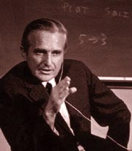

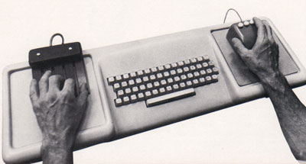
Engelbart's NLS demo (1968)
NLS (oNLine System) innovations:
  Mouse
  Windowing system
  Collaborative document editing with email, IM, and video conferencing
  Hyperlinks
  Chording keyboard
Douglas Englebart,
Stanford Research Inst.

Slide 16
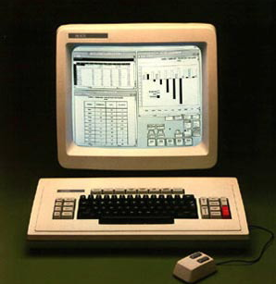
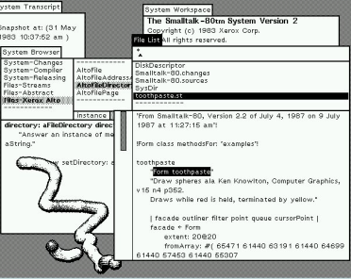
Xerox PARC in the 1970's
Smalltalk
on the Star
Xerox Palo Alto:
  Towards “paperless office”
  Microcomputers: Alto (1973), Star (1981)
  WIMP model: windows, icons, menus, pointer
  Desktop
  Smalltalk (1974):
    Pure OO language
    Integrated graphical
    development
    and runtime environment

Slide 17
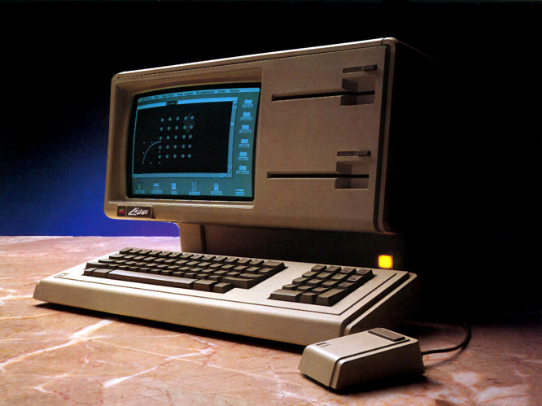
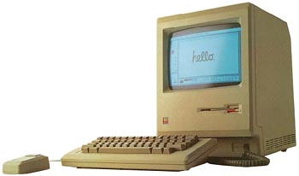
Apple in the 1980's
Lisa (1983):
  Drag-and-drop
  Double-click to open/run
Macintosh (1984):
  Much cheaper ($2,495 vs. >$10k)
  Accessible to the public
  Mass-marketing ad
  campaign during
  SuperBowl and
  1984 Olympics in L.A.

Slide 18
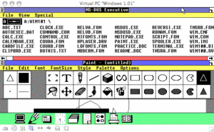
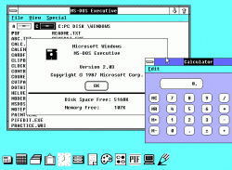
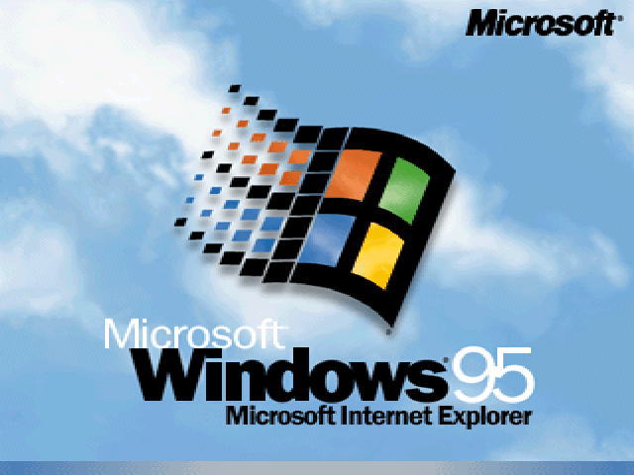
Microsoft Windows (1980's)
Windows 1.0 (1985):
  Mostly character-based graphics
  Tiled windows
  Popularity dwarfed by Mac
Windows 2.0 (1987):
  Overlapping windows
  Apple sues MS over “look and feel” (loses)
Windows 3.11 (1992), Win95:
  Looks pretty; wildly popular

Slide 19
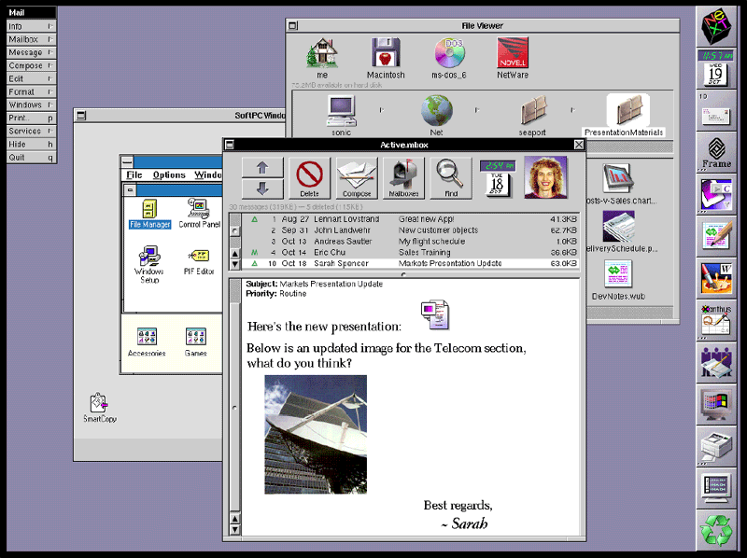
Other GUI environments
GEM (Digital Research) for Atari (1985)
Amiga Workbench (1985)
NeXTstep (Steve Jobs) (1988)
  Pretty, but CPU-intensive
OS/2 (IBM) (1988):
  competed with Windows
Unix X10 (1984), X11 (1987)
  Network transparency (Xwin32)
  Multiple libraries on top: Athena, Motif/CDE, OpenLook, KDE/Qt, Gnome/gtk, FLTK
NeXTstep

Slide 20
OS environment vs. toolkit
In the past, the only GUI was what was provided by the operating system
Now, we can write programs that link to various GUI toolkits:
  Libraries that provide a way to build a GUI program
  Menus/windows that look just like Windows:
    Link with MFC or Visual Basic or .NET
  Other options: FLTK, Qt, wxWindows, gtk, ...
    Cross-platform: can run on Linux, Mac, etc.

Slide 21
TODO
Email sign-up sheet
Brush up on your C++
  Links at bottom of our IDE policy sheet
Lab0 due next Tues 16Jan
  FLTK orientation, tutorials
  Upload tarball to eCourses by midnight
Lab1 due next week Thu 18Jan
  Design + implement your own FLTK program
  Should be somewhat “useful”

