Slide 1
History of GUIs, cont., and
FLTK: Fast Light ToolKit
  11 January 2007
  CMPT370
  Dr. Sean Ho
  Trinity Western University

Slide 2
What's on for today
An excerpted history of GUIs, cont.
  Sutherland, Engelbart, PARC, Apple, MS
GUI toolkits
Events and callbacks
FLTK and Fluid
  BankInterest example
  Template lab write-up
Next time: UI/HCI design issues

Slide 3
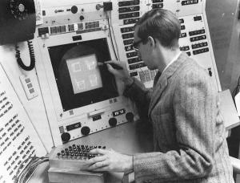
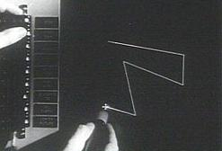
Sutherland's SketchPad (1963)
Ivan Sutherland
Ph.D. thesis at MIT
Used light pen to directly
manipulate graphical objects on screen
Pioneer of computer-aided drafting (CAD):
  Draw “master” diagram once
  Instantiate multiple copies, tweak
  (OO design)
  Constraint-based system
  (e.g., keep two lines at fixed angle)

Slide 4
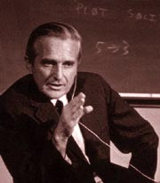

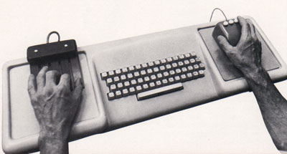
Engelbart's NLS demo (1968)
NLS (oNLine System) innovations:
  Mouse
  Windowing system
  Collaborative document editing with email, IM, and video conferencing
  Hyperlinks
  Chording keyboard
Douglas Englebart,
Stanford Research Inst.

Slide 5
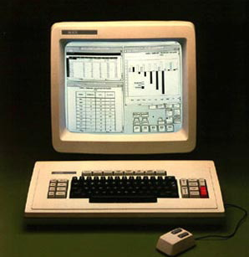
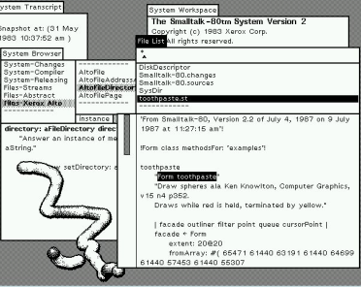
Xerox PARC in the 1970's
Smalltalk
on the Star
Xerox Palo Alto:
  Towards “paperless office”
  Microcomputers: Alto (1973), Star (1981)
  WIMP model: windows, icons, menus, pointer
  Desktop
  Smalltalk (1974):
    Pure OO language
    Integrated graphical
    development
    and runtime environment

Slide 6
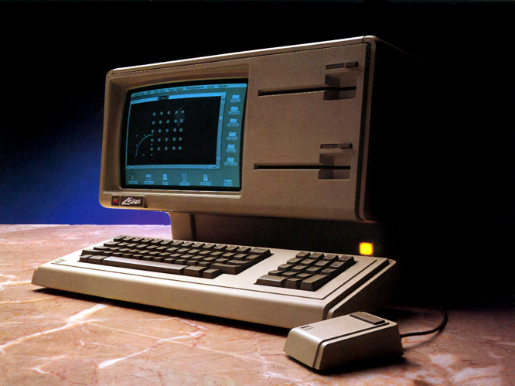
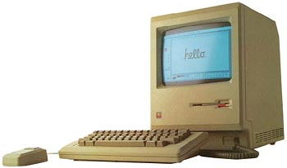
Apple in the 1980's
Lisa (1983):
  Drag-and-drop
  Double-click to open/run
Macintosh (1984):
  Much cheaper ($2,495 vs. >$10k)
  Accessible to the public
  Mass-marketing ad
  campaign during
  SuperBowl and
  1984 Olympics in L.A.

Slide 7
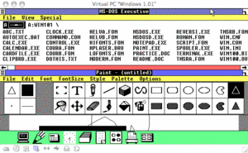
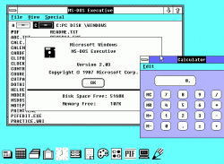
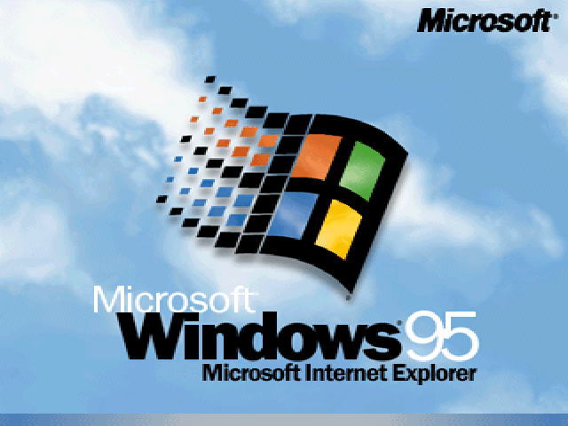
Microsoft Windows (1980's)
Windows 1.0 (1985):
  Mostly character-based graphics
  Tiled windows
  Popularity dwarfed by Mac
Windows 2.0 (1987):
  Overlapping windows
  Apple sues MS over “look and feel” (loses)
Windows 3.11 (1992), Win95:
  Looks pretty; wildly popular

Slide 8
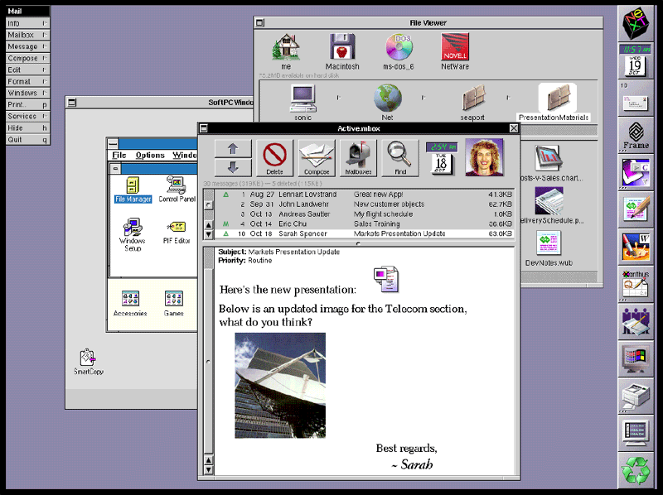
Other GUI environments
GEM (Digital Research) for Atari (1985)
Amiga Workbench (1985)
NeXTstep (Steve Jobs) (1988)
  Pretty, but CPU-intensive
OS/2 (IBM) (1988):
  competed with Windows
Unix X10 (1984), X11 (1987)
  Network transparency (Xwin32)
  Multiple libraries on top: Athena, Motif/CDE, OpenLook, KDE/Qt, Gnome/gtk, FLTK
NeXTstep

Slide 9
OS environment vs. toolkit
In the past, the only GUI was what was provided by the operating system
Now, we can write programs that link to various GUI toolkits:
  Libraries that provide a way to build a GUI program
  Menus/windows that look just like Windows:
    Link with MFC or Visual Basic or .NET
  Other options: FLTK, Qt, wxWidgets, gtk, ...
    Cross-platform: can run on Linux, Mac, etc.

Slide 10
Compiling with GUI toolkits
Libraries that provide GUI components as objects
  Windows (Fl_Window), menus, tabs, etc.
  Widgets: buttons, textboxes (Fl_Input), sliders, scrollbars, dials, etc.
Link your program with the toolkit library
  Static linking: libfltk.a
    Needed objects are bundled into the executable
  Dynamic linking: libfltk.dll.a / libfltk.so
    Need separate shared library
  FLTK-1 libraries: fltk, fltk_gl, fltk_images, fltk_forms

Slide 11
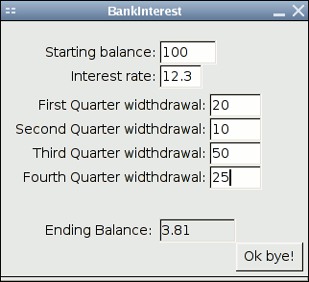
Events and callbacks
An event is a user action:
  Click a button
  Fill in a text box
  Press a key
  Move the mouse
A callback is a procedure invoked by an event:
  Close the window when user clicks “Ok bye!”
  Draw a circle where the user clicks the mouse

Slide 12
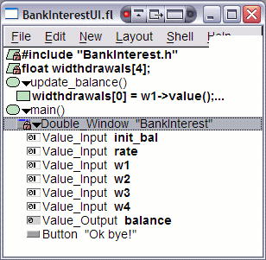
Using Fluid
Fluid is FLTK's interactive GUI
designer
  Drag and drop widgets
  Write code blocks / callbacks
Saves *.fl Fluid files; exports *.cxx/*.h code
Compile and link this code into your program
It is possible to write a whole program in Fluid
But better to separate GUI from main program logic: form vs. function
  Akin to HTML/CSS vs. PHP/ASP/JS

Slide 13
FLTK example: BankInterest
BankInterestUI:
  Just the user interface
  Get values from the widgets
  Minimal program logic
    But I did choose to put main() here
BankInterest:
  Main program functionality
  Provides functions invoked
  by UI callbacks
    calc_balance()

Slide 14
Lab write-ups: see BankInterest ex.
Purpose: a sentence or two
Suitability: do we even need a computer to do this? Or a GUI? Or carmel?
Restatement: given, todo, result
Libraries: libfltk, GL, etc. (incl versions if you can)
Program Design
User Manual
Test Cases
Bugs / Limitations / future work
Screenshots

Slide 15
Review of today
An excerpted history of GUIs, cont.
  Sutherland, Engelbart, PARC, Apple, MS
GUI toolkits
Events and callbacks
FLTK and Fluid
  BankInterest example
  Template lab write-up
Next time: UI/HCI design issues
Getting started on carmel

Slide 16
Carmel
Next topic (next Thu): parallel programming
We'll be using carmel's “8” processors
  OpenMP under gcc4
  Linux command-line (ssh/PuTTY); no GUI
If you don't have a carmel login yet, Dave Friesen is available in the senior lab right after class
We'll get to this next week, but you can get started early if you like:
  Download nbody and runtest to carmel
  './runtest' and watch the results

Slide 17
TODO
Brush up on your C++
  Links at bottom of our IDE policy sheet
Lab0 due next Tues 16Jan
  FLTK orientation, tutorials
  No write-up needed
  Upload ZIP/tarball to eCourses by midnight
Lab1 due next week Thu 18Jan
  Design + implement your own FLTK program
  Should be somewhat “useful”

