Slide 1
Parallel Computing
  18 January 2007
  CMPT370
  Dr. Sean Ho
  Trinity Western University
Lab1 extended
to next Tues 23Jan
Cygwin install notes
on ide_policy.html

Slide 2
Review of last time
UI design principles:
  Know your users
  Be consistent
  Use metaphors carefully
  Use multiple levels of complexity
  Always show the current state of the program

Slide 3
Some UNIX / Cygwin tips
Cygwin has command and filename completion:
  Type first few characters and press <Tab>
Job control:
  When a program (e.g., fluid) is running, press Ctrl-Z in the Cygwin window to suspend it
  Type “fg” to resume the suspended job
  Or “bg” to let it run in the background
  Use ampersand: “fluid &” to run in bg
  “jobs” to show all current jobs

Slide 4
What's on for today
Parallel computing concepts
  Why do parallel?
  vonNeumann abstraction: instructions, data
  Flynn's taxonomy: SISD, SIMD, MISD, MIMD
  Terms, measuring speedup
  Design issues
See tutorial from LLNL (Livermore) supercomputing centre

Slide 5
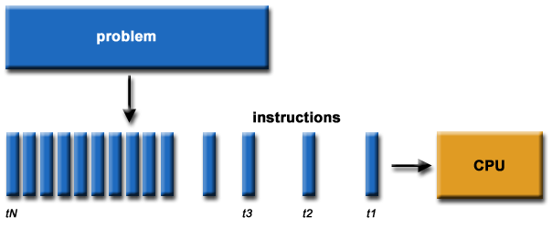

Parallel computing
Sequential computing:
  Divide task into instructions
  1 CPU executes serially
Parallel computing:
  Multiple tasks
  Multiple CPUs execute in parallel
Accomplish more in the same amount of time

Slide 6
Applications of parallel computing
Large, compute-intensive problems that can be divided up in some way
  Weather modelling
  Aircraft design / computational fluid dynamics
  Modelling nuclear reactions
  Protein folding, drug binding sites
  3D rendering
  Large-scale satellite / medical image analysis
  High-visibility website (Amazon, Google, etc.)
  Data mining

Slide 7
Instructions and data
Computers since the 1960s have used the (John) vonNeumann model of computing:
Instructions
Computer
/ CPU
Data
Result
CPU follows instructions to operate on data
vonNeumann's abstraction:
  Instructions and data both stored in memory
  Self-modifying code: rewrites own instructions

Slide 8
Flynn's taxonomy
SISD:
Single instr
Single data
SIMD:
Single instr
Multiple data
MISD:
Multiple instr
Single data
MIMD:
Multiple instr
Multiple data
Multiple data: divide up the problem by data
  Each processor operates on a chunk of data
Multiple instructions:
  Each processor does a different task

Slide 9
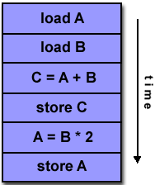
SISD: single instr, single data
SISD is the classical uniprocessor situation
  Serial execution
Processing can still be pipelined:
  Each instruction has multiple parts
  Each part is done by a different CPU component
fetch
decode
execute
memory
write-back
Instr 1
Instr 2
Instr 3

Slide 10
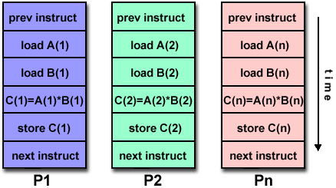
SIMD: single instr, multiple data
SIMD: same operations on multiple data in parallel
  Quite common on today's CPUs
  Intel MMX, SSE, Apple Altivec
  CM-2, Cray C90
Vector processing:
perform one operation on
a whole vector of numbers
  Add two RGBA values
  (128 bits each)

Slide 11
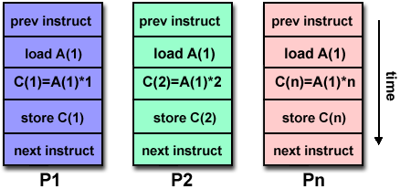
MISD: multiple instr, single data
MISD:
  Run the same data
  through different
  programs in parallel
  Not often seen in hardware
  Potential applications:
    One encrypted message to crack; try several algorithms in parallel
    One satellite image to process; run several image processing filters in parallel

Slide 12
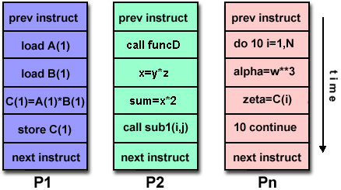
MIMD: multiple instr, multiple data
MIMD:
  Each processor is
  independent, runs its
  own task on its own data
“Parallel computer” usually means MIMD
  Most modern supercomputers
  Dual-core (e.g., carmel Xeon)
MIMD is most flexible, but also most complex:
  Synchronization between processors
  Shared memory access

Slide 13
Measuring speedup
A parallelizable task can be broken up into discrete tasks (SIMD/MIMD), one per processor
The parallel speedup is:
    (serial execution time) / (parallel execution time)
Ideal speedup is linear with # processors
Reality is not so sweet:
  Overhead in setting up parallel tasks
  Communication between processors
  Synchronization points mean waiting for slowest task

Slide 14
Design issues in parallel computing
Memory model
  Shared: all CPUs access same memory (SMP)
  Distributed: each CPU local memory (cluster)
Granularity: how often to communicate?
  Coarse: lots of computation between communication events
  Fine: processors frequently talk to each other
Scalability
  How many processors do you want to scale to?
  Communications network?

Slide 15
TODO
Lab1 due date extended to next Tues 23Jan
  Design + implement your own FLTK program
  Lab write-up
  Should be somewhat “useful”

