Slide 1
Parallel Programming:
Advanced Topics
  30 January 2007
  CMPT370
  Dr. Sean Ho
  Trinity Western University

Slide 2
Review last time
OpenMP
  #pragma omp parallel: begin parallel section
    #pragma omp for
    #pragma omp sections
  Shared vs. private variables
    private(), reduction()
  #pragma omp critical/single/barrier
  OMP_NUM_THREADS, omp_get_num_threads()
  Timing: omp_get_wtime()
  schedule(static/dynamic/guided/runtime)

Slide 3
Addendum: timing
<time.h> clock(): CPU time with tick resolution
  Usually 100 or 1000 ticks/sec
<time.h> time(): wall-clock time with second res
<sys/time.h> gettimeofday():
  Wall-clock time in seconds with tick resolution
double omp_get_wtime():
  Wall-clock time in seconds with tick resolution
  Platform independent
  Thread dependent

Slide 4
Communication Issues
I/O often the bottleneck: minimize communication
Latency vs. bandwidth
  Coarse-grain parallelism: e.g., FoldingAtHome
Unicast (point-to-point) vs. multicast
Synchronous (blocking) vs.
asynchronous (non-blocking)
Ease of programming
  OpenMP abstracts away from programmer
  MPI makes communication more explicit

Slide 5
Synchronization
Barrier
  Wait for all tasks to catch up
    Slowest task becomes weakest link
  Implicit barrier at end of each parallel section
Lock/semaphore/mutex
  Only one thread can hold the lock at a time
  Wait (block) for lock to free before moving on
  e.g., #pragma omp critical
Synchronous communications
  Both parties must synchronize

Slide 6
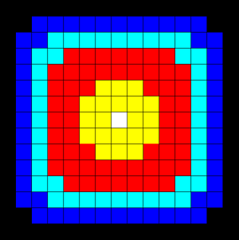
Data Parallelism
Some programs are not well parallelizable:
  e.g., Fibonacci(n): dependencies
Some can still be parallelized, but with some communication required:
  Heat equation on a 2D grid
  Each pixel U_{x,y} +=
    C_{x} (U_{x-1,y} + U_{x+1,y} – 2*U_{x,y}) +
    C_{y} (U_{x,y-1} + U_{x,y+1} – 2*U_{x,y})
  Used for blurring images

Slide 7
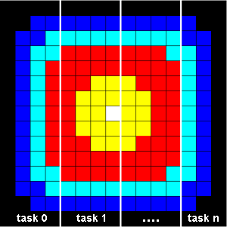
Heat equation: boundaries
Divide work by region of image:
  Data parallelism
Interior of region can be done
independently
Boundaries need information
from neighbouring threads
Use non-blocking communication to send/receive boundary pixels from neighbours while processing interior

Slide 8
TODO
Lab2 due next Tue 6Feb
  Design + implement your own OpenMP program
  Lab write-up

