Slide 1
Introduction to
Computer Graphics
  1 February 2007
  CMPT370
  Dr. Sean Ho
  Trinity Western University

Slide 2
Review last time
Communication issues
  Latency vs. bandwidth
  Synchronous vs. asynchronous communication
  Barriers, locking
  Data parallelism: heat equation example

Slide 3
What's on for today
Visual computing:
  Computer graphics and image analysis
Objectives of visual computing
  Capture and understand reality
  Emulate and enhance reality
  Parthenon video
Image formation
  Camera model
  Light and colour models
  Later: modelling objects

Slide 4
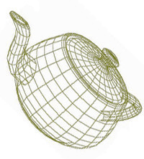
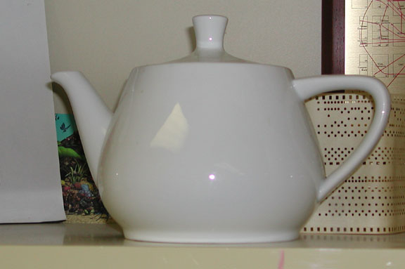
Graphics vs. Image analysis
Computer graphics is synthetic:
  From an internal data structure (representation),
    Triangle mesh, VRML, etc.
  Produce (render) an image
Image analysis is analytic:
  From an image of the real world
    Digicam, video, MRI/CT, satellite
  Produce an representation
  of the objects of interest
Graphics
Image
Analysis

Slide 5
Objectives of graphics/analysis
Image Analysis:
  Capture reality
    Image acquisition: camera, laser rangefinder, etc.
  Understand reality
    Object recognition: segmentation
Graphics:
  Emulate reality
    Photorealistic rendering, physically-based modelling
  “Enhance” reality
    Special effects, unrealistic physics

Slide 6
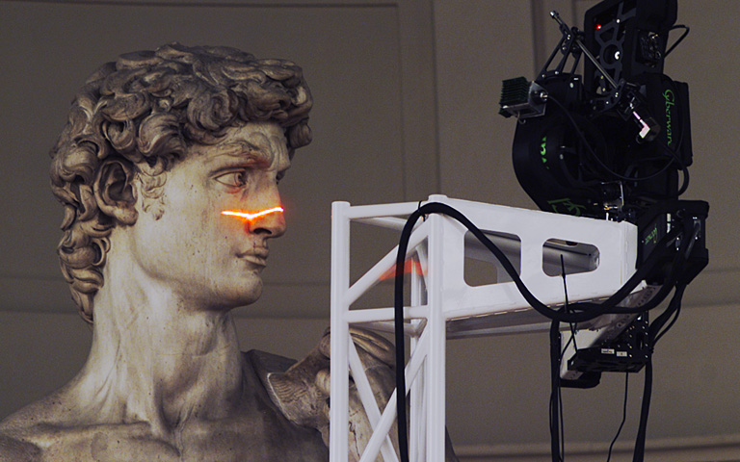
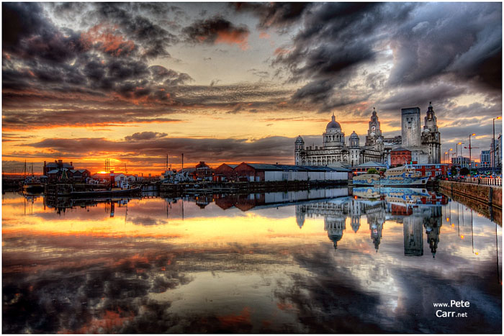
Objectives: Capture reality
Acquire a representation of the world
  Want it as faithful as possible to reality
  Higher resolution, broader dynamic range
  Optics/engineering/hardware
Digital Michelangelo
High Dynamic Range (HDR) image

Slide 7
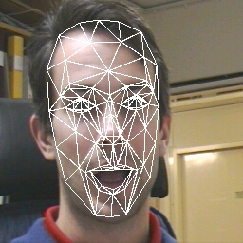
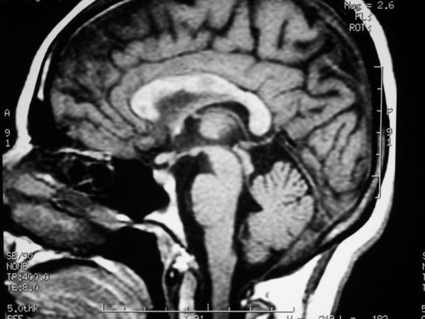
Objectives: Understand reality
Interpretation and segmentation:
  Finding objects of interest within an image
Object representation:
  Compact data structures suitable for, e.g.
    Population analysis and discrimination
Face recognition (AAM)
MS lesions in MRI

Slide 8
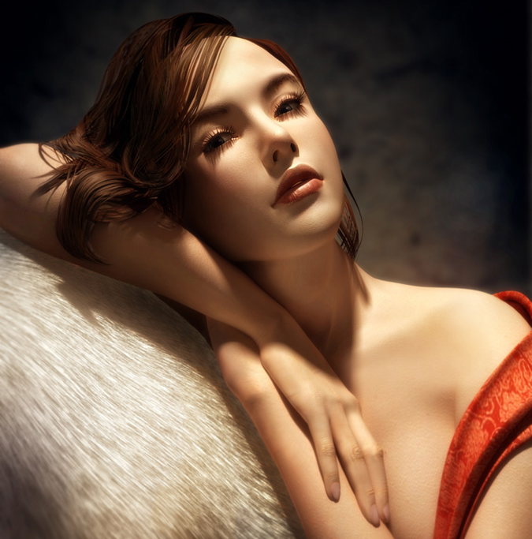
Objectives: Emulate reality
Try to get as close to reality as possible
  Modelling: geometry, texture, etc. of objects
  Lighting/shading: behaviour of light
  Animation: natural motion of objects
The “uncanny valley”:
not-quite-realistic
human characters are
very disconcerting
Soanala: 3DSMax
using sub-surface
scattering for skin

Slide 9
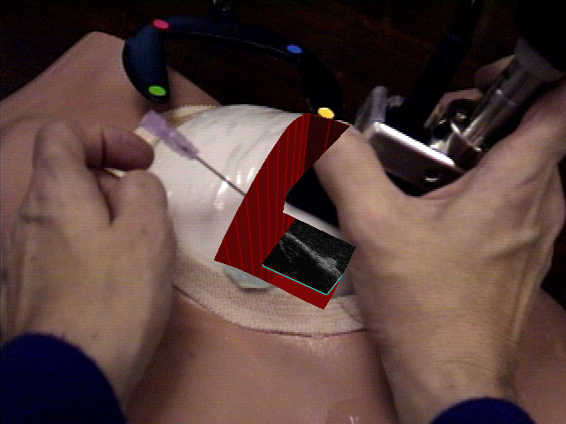
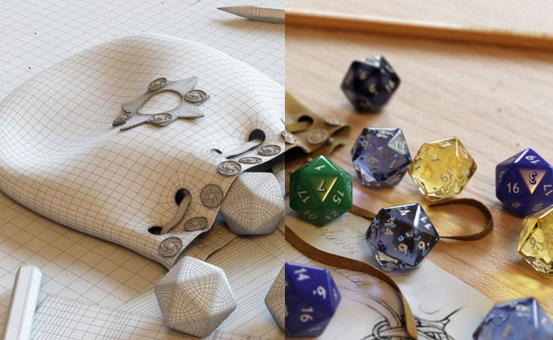
Objectives: “Enhance” reality
Combine real and generated elements
Movie special effects
Augmented reality HUD for telesurgery, manufacturing/design, etc.
Photorealistic rendering
UNC AR
ultrasound breast biopsy

Slide 10
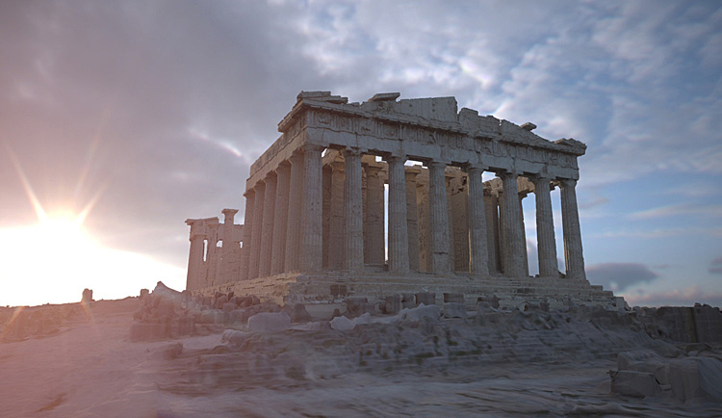
Parthenon example (SIGGRAPH 04)
The Debevec/USC Parthenon is just one example of combining image analysis and computer graphics
  53 pano laser scans
  90 million polygons
  Custom scanning rig for
  sculptures in London's
  Parthenon Museum
  Time-lapse daylight
  sequence uses HDR images taken in Marina Del Rey
  Total production time: 58 days (37-CPU render farm)

Slide 11
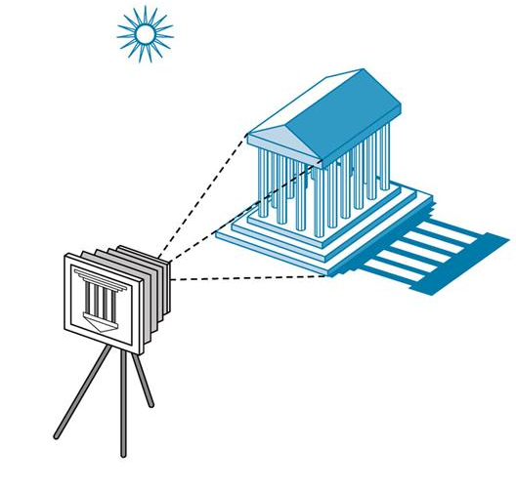
Image formation
Components to produce a static image:
  Objects
    Material properties: colour, shininess, bumpiness, etc.
  Light sources
    Colour spectrum, direction,
    area, etc.
  Viewer
    Camera model: lens,
    depth of field, etc.

Slide 12
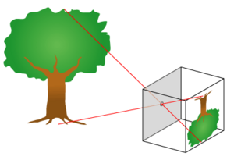
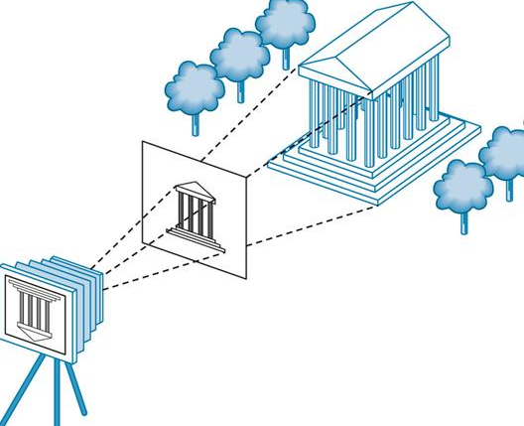
Camera model
The most basic is a pinhole camera:
  Image produced is upside down and flipped
  Larger hole yields smaller depth-of-field (more blurry)
Synthetic camera model:
  Image plane is in front of
  center of projection
  Cast rays from CoP through
  each pixel of image plane,
  into the scene
Control depth of field? Lens distortion?

Slide 13
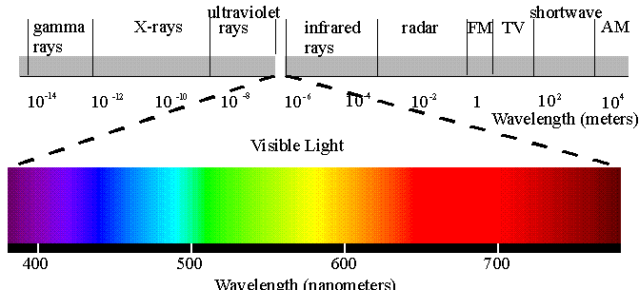
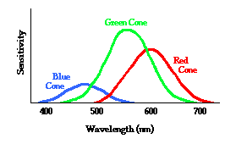
Light
Visible light
is electromagnetic radiation about 350-750nm in wavelength (~400 to 850 THz in frequency)
Light colour is a frequency distribution of energy
  Lasers: monochromatic
But our eyes only have four kinds of sensors:
  Rods: luminance (shades of grey)
  R,G,B cones: chrominance (colour)
  Each sensor has its own
  frequency response curve

Slide 14
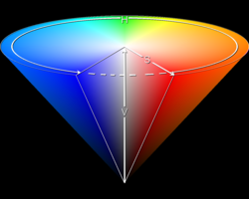
Colour models
“True” image: frequency distribution at each pixel
RGB: matches our cones
  Additive colour: CRTs use 3 electron guns
  Must still define chromaticities of R,G,B
CMYK: subtractive colour: C<->R, M<->G, Y<->B
  Inks/pigments: newspaper, paint
HSV: hue, saturation, value
CIELAB: lightness, a/b chrominance:
  Absolute colour space: only depends on whitepoint
  Convert to absolute via profile: AdobeRGB, sRGB

Slide 15
TODO
Lab2 due next Tue 6Feb
  Design + implement your own OpenMP program
  Lab write-up

