Slide 1
Architecture of a Graphics Pipeline
  6 February 2007
  CMPT370
  Dr. Sean Ho
  Trinity Western University

Slide 2
Review last time
Visual computing:
  Computer graphics and image analysis
Objectives of visual computing
  Capture and understand reality
  Emulate and enhance reality
  Parthenon video
Image formation
  Camera model

Slide 3
What's on for today
Light and colour models
Geometric representation: trimesh
Off-line rendering: raytracing, radiosity
Real-time interactive graphics pipeline:
  Vertex processing
  Clipping and culling
  Rasterizing
  Fragment processing
Graphics API overview (OpenGL)

Slide 4
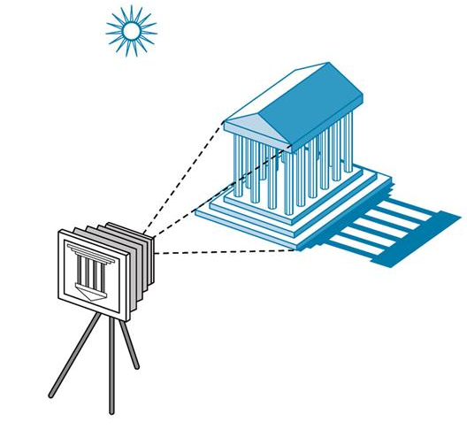
Image formation
Components to produce a static image:
  Objects
    Geometry (vertices, faces, etc.), material properties: colour, shininess, bumpiness, etc.
  Light sources
    Colour spectrum, direction,
    area, etc.
  Viewer
    Camera model: lens,
    depth of field, etc.

Slide 5
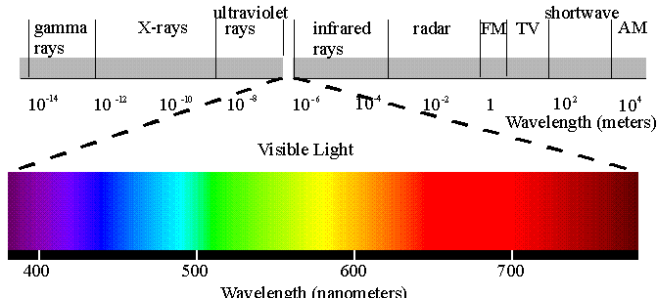
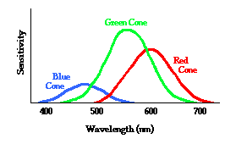
Light
Visible light
is electromagnetic radiation about 350-750nm in wavelength (~400 to 850 THz in frequency)
Light colour is a frequency distribution of energy
  Lasers: monochromatic
But our eyes only have four kinds of sensors:
  Rods: luminance (shades of grey)
  R,G,B cones: chrominance (colour)
  Each sensor has its own
  frequency response curve

Slide 6
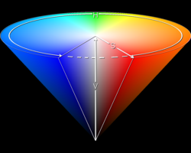
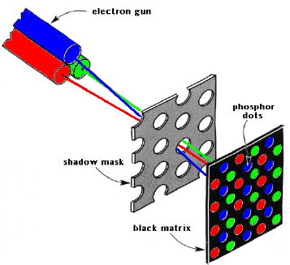
Colour models
“True” image: frequency distribution at each pixel
RGB: matches our cones
  Additive colour: CRTs use 3 electron guns
  Must still define chromaticities of R,G,B
CMYK: subtractive colour: C<->R, M<->G, Y<->B
  Inks/pigments: newspaper, paint
HSV: hue, saturation, value
CIELAB: lightness, a/b chrominance:
  Absolute colour space: only depends on whitepoint
  Convert to absolute via profile: AdobeRGB, sRGB

Slide 7
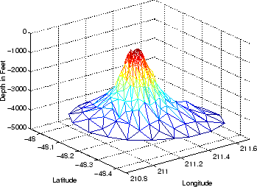
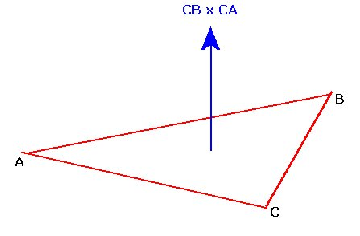
Geometric representation: trimesh
The most common representation for the geometry of 3D surfaces is a triangle mesh:
  Vertex list (point cloud): (x,y,z) coordinates
    {0.2, 0., 2.7}, {0.2, -0.112, 2.7}, {0.112, -0.2, 2.7},
  Face list: indexes into vertices
    {12, 13, 14}, {13, 14, 15}, ...
Can also use other polygons
  But triangle is a 2D simplex:
  Always flat
Faces have normal vectors

Slide 8
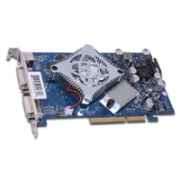
Off-line vs. real-time graphics
Off-line rendering
  Render time is not very important
    Use big parallel render farms
  Photo-realism is the priority
  Raytracing, radiosity, other rendering methods
Real-time (interactive) graphics
  Perfect photo-realism is not so important
  Frame rate is the priority: at least 60Hz
  3D modelling, CAD, scientific visualization
  Graphics pipeline in video card or software

Slide 9
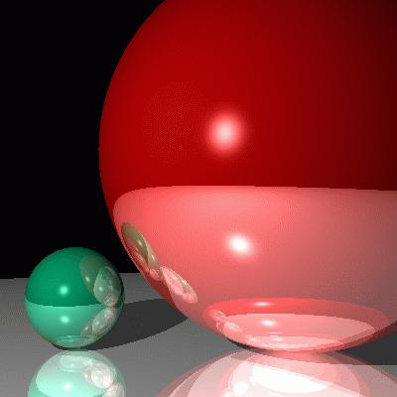
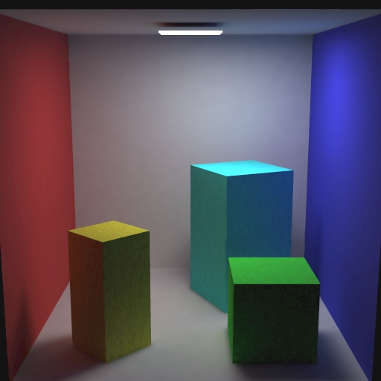
Off-line rendering
Raytracing:
  Cast rays from camera into scene
  until either absorbed or go to infinity
    Sky sphere handles infinity
  Reflections, translucency, refraction
  Only trace rays that are needed
Radiosity:
  Light sources emit energy
  Follow light energy as it bounces in scene
  Global illumination: not view-dependent

Slide 10
Real-time graphics pipeline
Process objects one at a time: local lighting
This is all done in hardware on the graphics card
Input: scene objects, lighting, camera
  Most of the data is the vertex list
Output: pixels stored in the framebuffer
  Raster graphics
Vertex
list
Vertex
processing
Clipping
Rasterize
Fragment
processing
Pixels

Slide 11
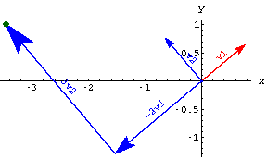
Vertex processing
Much of the work is in transforming vertices from one coordinate system to another:
  Object-based coords
  Camera-based coords
  Screen-based coords
Each transform is a matrix multiplication
Vertex processor also computes RGB colour at each vertex

Slide 12
Kinds of coordinate transforms
The transformations done on vertices include:
  Translation: shift in (x,y,z)
  Rotation: e.g., 3 Euler angles
  Scaling: uniform or along 3 axes
  (Perspective, affine)
3D points are projected onto 2D image plane:
  Perspective projection:
    Projection lines meet at center of projection
  Parallel projection:
    Projection lines are all parallel

Slide 13
Primitive assembly
The vertex processor is also responsible for assembling vertices into primitives:
  Lines/curves, triangles/polygons/surfaces
Uses the face list to index into the vertex list
Vertex
list
Vertex
processing
Clipping
Rasterize
Fragment
processing
Pixels

Slide 14
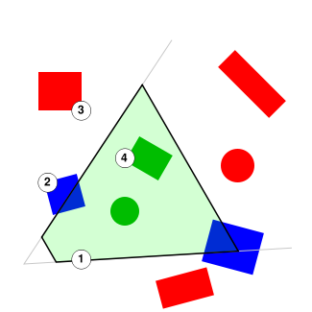

Clipping and culling
Don't render what we can't see
Clipping
  Remove primitives outside of
  the camera's view frustrum
Backface culling
  Remove triangles facing away from camera
  Usually cuts down # of triangles by about 50%!
Other optimizations also possible

Slide 15
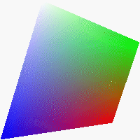
Rasterization
Convert a primitive into a fragment:
  Set of pixels just for that primitive
  Each pixel has RGB colour and depth
  Interpolate vertex colours over the fragment
Vertex
list
Vertex
processing
Clipping
Rasterize
Fragment
processing
Pixels

Slide 16
Fragment processing
Assemble the fragments into final framebuffer
Hidden-surface removal:
  Some fragments may occlude parts of others
  Handle transparency
Vertex
list
Vertex
processing
Clipping
Rasterize
Fragment
processing
Pixels

Slide 17



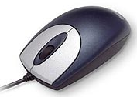
Programmer's interface
A graphics API allows a program to interact with the graphics pipeline
Library subroutines (see CubeView.cxx)
  Specify the scene (models)
  Specify the lighting
  Specify the camera
Application
program
API: OpenGL,
Direct3D
GPU: graphics card

Slide 18
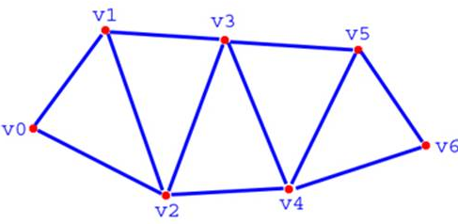
Graphics API: Model
Geometry: vertices (0D)
  Line segments, curves (1D)
  Polygons (2D), sometimes parametric surfaces
Material properties: colour, specularity, etc.
Example:
    glBegin(GL_TRIANGLE);
      glColor3f(0.0, 1.0, 0.0);
      glVertex3f(0.0, 0.0, 0.0);
      glVertex3f(1.0, 0.0, 0.0);
      glVertex3f(0.0, 1.0, 0.0);
    glEnd();
GL_TRIANGLE_STRIP

Slide 19




Graphics API: Lighting
Type of light:
  Ambient (uniform, everywhere)
  Directional (e.g., sunlight)
  Spotlight (cone with falloff)
  Point vs. area light
Material properties:
  Ambient colour
  Diffuse colour
  Specular colour
  Emissive colour

Slide 20
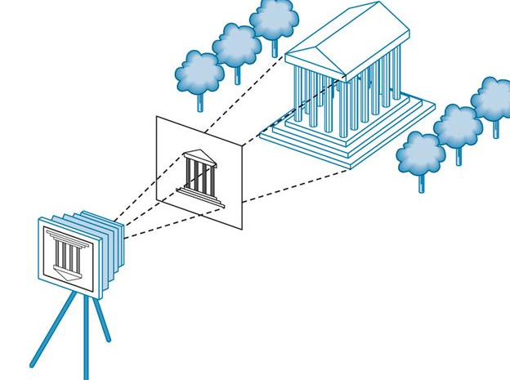
Graphics API: Camera
6DOF camera model:
  Position of center of projection (3DOF)
  Orientation (3DOF)
Also: location and size of image plane
Could also consider
modelling lens distortion

Slide 21
TODO
Lab2 due tonight
  Design + implement your own OpenMP program
  Lab write-up
Midterm 1 next week Thu 15Feb
  GUI, parallel
  Emphasis on lecture material
  Coding some snippets

