Slide 1
Introduction to OpenGL
  8 February 2007
  CMPT370
  Dr. Sean Ho
  Trinity Western University

Slide 2
Review last time
Light and colour models
Geometric representation: trimesh
Off-line rendering: raytracing, radiosity
Real-time interactive graphics pipeline:
  Vertex processing
  Clipping and culling
  Rasterizing
  Fragment processing

Slide 3
Real-time graphics pipeline
Process objects one at a time: local lighting
This is all done in hardware on the graphics card
Input: scene objects, lighting, camera
  Most of the data is the vertex list
Output: pixels stored in the framebuffer
  Raster graphics
Vertex
list
Vertex
processing
Clipping
Rasterize
Fragment
processing
Pixels

Slide 4
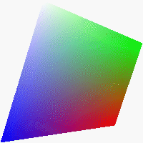
Rasterization
Convert a primitive into a fragment:
  Set of pixels just for that primitive
  Each pixel has RGB colour and depth
  Interpolate vertex colours over the fragment
Vertex
list
Vertex
processing
Clipping
Rasterize
Fragment
processing
Pixels

Slide 5
Fragment processing
Assemble the fragments into final framebuffer
Hidden-surface removal:
  Some fragments may occlude parts of others
  Handle transparency
Vertex
list
Vertex
processing
Clipping
Rasterize
Fragment
processing
Pixels

Slide 6



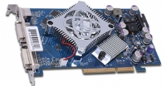
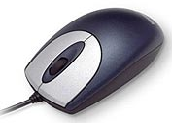
Programmer's interface
A graphics API allows a program to interact with the graphics pipeline
Library subroutines (see CubeView.cxx)
  Specify the scene (models)
  Specify the lighting
  Specify the camera
Application
program
API: OpenGL,
Direct3D
GPU: graphics card

Slide 7
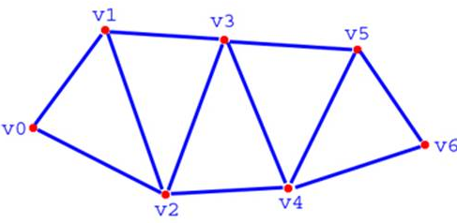
Graphics API: Model
Geometry: vertices (0D)
  Line segments, curves (1D)
  Polygons (2D), sometimes parametric surfaces
Material properties: colour, specularity, etc.
Example:
    glBegin(GL_TRIANGLE);
      glColor3f(0.0, 1.0, 0.0);
      glVertex3f(0.0, 0.0, 0.0);
      glVertex3f(1.0, 0.0, 0.0);
      glVertex3f(0.0, 1.0, 0.0);
    glEnd();
GL_TRIANGLE_STRIP

Slide 8


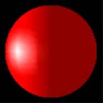
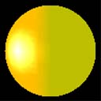
Graphics API: Lighting
Type of light:
  Ambient (uniform, everywhere)
  Directional (e.g., sunlight)
  Spotlight (cone with falloff)
  Point vs. area light
Material properties:
  Ambient colour
  Diffuse colour
  Specular colour
  Emissive colour

Slide 9
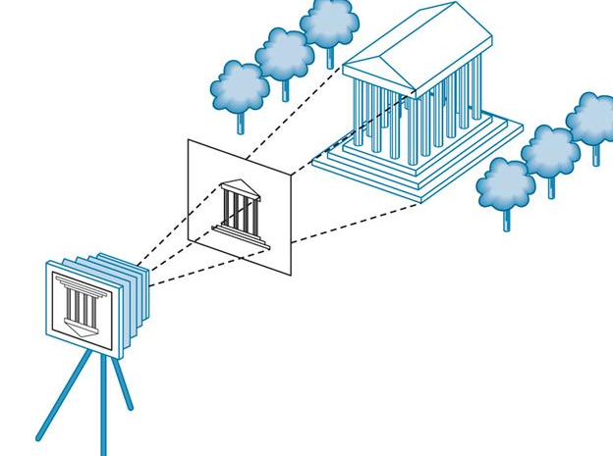
Graphics API: Camera
6DOF camera model:
  Position of center of projection (3DOF)
  Orientation (3DOF)
Also: location and size of image plane
Could also consider
modelling lens distortion

Slide 10
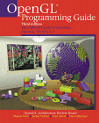
History of OpenGL
Silicon Graphics (SGI) was one of the first to implement graphics pipeline in hardware (1982)
  In-house library: GL
OpenGL (1992): platform-independent API
  Architectural Review Board / Working Group
    SGI, IBM, HP, MS, Nvidia, 3DLabs
  Stable, widely-accepted standard (now 2.1)
    New changes just for new hardware capabilities
  Lots of documentation and sample code
    “Red book” and “Blue book”

Slide 11
OpenGL libraries
OpenGL core library
  On Windows: opengl32.dll
  On Linux/Unix: libGL.a, libGL.so
OpenGL utility library: GLU
  Higher-level drawing routines that use OpenGL core primitives
OpenGL utility toolkit: GLUT
  Basic GUI toolkit, very small footprint
  FLTK is much more powerful
  Also freeglut, OpenGLUT, GLUI

Slide 12

Interface with window system
OpenGL links with the native window system
  Windows: WGL, GDI
  MacOS: AGL (for Carbon), NSOpenGL (Cocoa)
  Unix: GLX
This makes it possible to run an OpenGL program over the network:
  Run Xwin32 on local PC (has GLX)
  ssh -x carmel
  run program on carmel, primitives get sent to local PC, uses local hardware acceleration

Slide 13
Software architecture
Application program
X, Win32, MacOS
GL
FLTK, Qt,
MFC, .NET
Fl_Gl_Window,
GLUT
GLU
GLX, AGL, WGL
Rendering pipeline (usually hardware)

Slide 14
OpenGL pipeline architecture
CPU
Display
lists
Polynomial
evaluator
Vertex
processor
Pixel
operations
Rasterize
Fragment
proc.
Frame
buffer
Texture
memory

Slide 15
OpenGL state machine
Two kinds of OpenGL functions
  Generate primitives
    Vertex, line, triangle, polygon, etc.
  Change state
    Current colour
    Material properties (shininess, etc.)
    Transformations: view, model
Each primitive gets whatever state was current when it was drawn

Slide 16
OpenGL functions
Most core OpenGL functions look like this:
  glVertex3f( x, y, z )
    gl: belongs to core OpenGL library (glu for GLU)
    Vertex: name of function
    3f: argument type: 3 floats
Not overloaded, for efficiency
  glVertex3fv( vec )
    takes a pointer to an array of 3 floats
  glVertex3i( x, y, z ): ints
  glVertex3d( x, y, z ): doubles

Slide 17
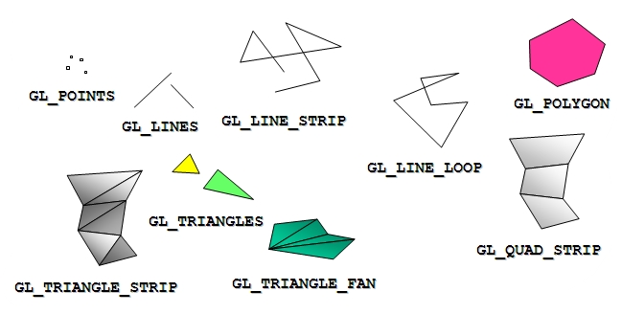
OpenGL primitives
glBegin(GL_*) starts a set of primitives
Polygons must be simple: edges cannot cross
Must be convex
Must be flat: all vertices in the same plane

Slide 18
Drawing in OpenGL (see CubeView)
Start the set of primitives:
    glBegin( GL_TRIANGLES );
Set the colour and other attributes:
    glColor3f( 0.0, 0.0, 1.0 );
Create the vertices:
    glVertex3f( 0.0, 0.1, 0.2 );
    glVertex3f( 0.1, 0.0, 0.2 );
    glVertex3f( 0.0, 0.0, 0.2 );
End the set of primitives:
    glEnd();

Slide 19
Projection matrix
The coordinates of glVertex are in world coords
  OpenGL converts to camera coords, then to screen coords
The projection matrix specifies the camera:
    glMatrixMode( GL_PROJECTION );
Specify the viewing volume:
    glLoadIdentity();
    glOrtho(left, right, bottom, top, near, far)
  Orthographic (parallel) projection

Slide 20
TODO
Midterm 1 next week Thu 15Feb
  GUI, parallel
  Emphasis on lecture material
  Practice exam on course schedule
Lab3 due in two weeks: Thu 22Feb
  OpenGL 3D model viewer
  Mouse interaction: transl, rot, scale
  Show rendering speed in polygons/sec
  You may use CubeView as a base

