Slide 1
Virtual Trackball: Quaternions
  6 March 2007
  CMPT370
  Dr. Sean Ho
  Trinity Western University

Slide 2
Review last time
Homogeneous coordinates
Changing frames via multiplying by 4x4 matrix
  Translation
  Scaling
  Rotation
    Euler angles

Slide 3
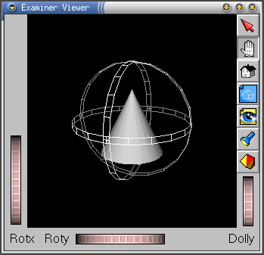
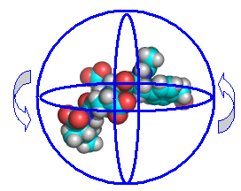
Rotations in 3D
We've learned about rotating in 3D via three Euler angles: angles to rotate around x, y, z axes
  Must pick an order: e.g., first x, then y, then z
  User interface to specify three angles clunky
A virtual trackball is like an upside-down mouse
  Motion in 2D determines rotation of trackball

Slide 4
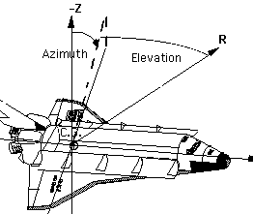
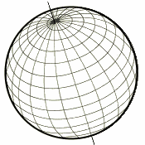
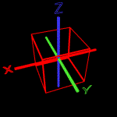
Gimbal lock
One naïve way to do get a rotation
from 2D mouse motion is:
  Vertical motion --> elevation (latitude)
  Horizontal --> azimuth (longitude)
Problem: gimbal lock!
  At the North/South poles,
  longitude has no meaning
  Lose a degree of freedom
  Apollo 11 landing on Moon nearly had an accident due to gimbal lock

Slide 5
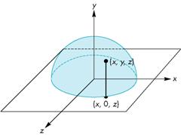
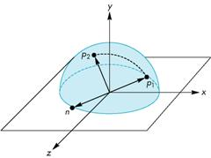
Virtual trackball
Let the mouse position be in x-z plane
Project up to the hemisphere of radius r:
    y = sqrt( r² – x² – z² )
Mouse motion corresponds to moving
from p₁ to p₂ on the hemisphere
Draw a “great circle” from p₁ to p₂
  This determines the rotation
Update in the event handler: every mouse motion yields a small rotation

Slide 6
Axis and angle of rotation
The axis of rotation is found by the
cross-product of p₁ and p₂
The angle between p₁ and p₂ is
found by: |sin θ| = |n| / (|p₁| * |p₂|)
  If the mouse is moved slowly enough and we sample frequently, sin θ ≈ θ
A quaternion is a compact way of representing the axis/angle of rotation

Slide 7
Quaternions
Extension of complex numbers from 2D to 4D
    (an example of a Clifford Algebra)
  One real, three imaginary components i, j, k:
    b = q₀ + q₁i + q₂j + q₃k = (q₀, q)
    Where q = q₁i + q₂j + q₃k is the pure quaternion part
Properties:
    a + b = (p₀ + q₀, p + q)
    i² = j² = k² = -1
    ij = k, ji = -k, jk = i, kj = -i, ki = j, ik = -j
    |b|² = q₀² + q₁² + q₂² + q₃² (magnitude)

Slide 8
Multiplying quaternions
a x b = (p₀q₀ – p*q), q₀p + p₀q + pxq)
  p*q: dot-product (treat p, q as 3D vectors)
  pxq: cross-product
Order matters: multiplication is not commutative!
  a x b ≠ b x a
We'll use multiplication to compose multiple rotations

Slide 9
Properties of quaternions
Conjugate: b(conj) = (q₀, -q)
Negative: -b = (-q₀, -q)
Multiplicative inverse: b⁻¹ = b(conj) / |b|²
Unit quaternions: |b|=1, so b⁻¹ = b(conj)
  We'll represent rotations with unit quaternions

Slide 10
Rotations with quaternions
From the vector-angle form:
  Rotate about the unit vector u by angle θ:
  b = ( cos(θ/2), u sin(θ/2) )
A point p in 3D space is represented by the quaternion P = ( 0, p )
The rotated point p' is represented by the quaternion
  P' = b * P * b⁻¹

Slide 11
Converting to 4x4 matrix
Rotate P by b: P' = b * P * b⁻¹
Left-multiplication of a point P = (x_{p}, y_{p}, z_{p})
by a rotation quaternion
q = (x, y, z, w):
  q * P:
Right-multiplication by q⁻¹:
  P * q⁻¹:

Slide 12
Putting it all together
Rotating a point P by a quaternion q = (x, y, z, w) is equivalent to multiplying by a 4x4 matrix:
(revised after lecture: I had this transposed before. This is the right way round for multiplying by a column vector on the right.)

Slide 13
TODO
Lab3 if you haven't finished it already
  OpenGL 3D model viewer
Lab4: due next week Thu 15Mar
  Add a virtual trackball using quaternions

