Slide 1
Modelling, Viewing, and Projection
  8 March 2007
  CMPT370
  Dr. Sean Ho
  Trinity Western University

Slide 2
Review last time
Rotations in 3D
  Euler angles, gimbal lock problem
  Virtual trackball
    2D mouse coords -> pt on hemisphere
  Axis-angle representation
Quaternions
  Converting from axis-angle to quaternion
  Using quaternions for rotations
  Constructing a 4x4 rotation matrix
    GameDev article on quaternions

Slide 3
Outline for today
Modelling: vertex lists, face lists, edge lists
  OpenGL vertex arrays
  OpenGL display lists (see RedBook ch7)
Viewing: (see RedBook ch3)
  Positioning the camera: model-view matrix
  Selecting a lens: projection matrix
  Clipping: setting the view volume
    See UC-Davis ECS175 graphics course

Slide 4
Modelling polygons
Simple representation (see CubeView):
    glBegin( GL_POLYGON );
      glVertex3f( 0.0, 0.0, 0.0 );
      glVertex3f( 1.0, 1.5, 2.2 );
      glVertex3f( -2.3, 1.5, 0.0 );
    glEnd();
Problems: inefficient, unstructured
  What if we want to move a vertex to a new location?
v₃
v₂
v₁

Slide 5
Inward/outward facing polygons
The normal vector for a polygon follows
the right-hand rule
Specifying vertices in order (v₁, v₂, v₃) is same as (v₂, v₃, v₁) but different from (v₁, v₃, v₂)
When constructing a closed surface, make sure all your polygons face outward
Backface culling may mean
inward-facing polygons
don't get rendered
v₃
v₁
v₂

Slide 6
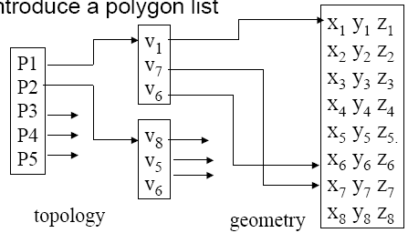
Vertex lists and face lists
v₃
P2
v₂
P1
v₁
Separate geometry from topology
  Vertex coords are geometry
  Connections between vertices (edges, polygons) are topology
Vertex list:
    v₁ = {x₁, y₁, z₁}
    v₂ = {x₂, y₂, z₂}
Polygon/face list:
    P₁ = {v₁, v₂, v₃}
    P₂ = {v₁, v₄, v₂}
v₄

Slide 7
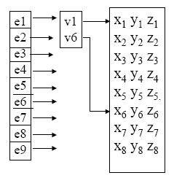
Edge lists
If only drawing edges (wireframe):
  Many shared edges may be duplicated
  Similar to face list but for edges:
    Does not represent the polygons!
Vertex list:
    v₁ = {x₁, y₁, z₁}
    v₂ = {x₂, y₂, z₂}
Edge list:
    e₁ = {v₁, v₂}
    e₂ = {v₁, v₄}
v₃
e₁
v₂
v₁
e₂
v₄

Slide 8
OpenGL vertex arrays
Stores a vertex list in the graphics hardware
    Six types of arrays: vertices, colours, colour indices, normals, texture coords, edge flags
Our vertex list in C:
    GLfloat verts[][3] = {{0.0, 0.0, 0.0}, {0.1, 0.0, 0.0}, ...}
Load into hardware:
    glEnableClientState( GL_VERTEX_ARRAY );
    glVertexPointer( 3, GL_FLOAT, 0, verts );
      3: 3D vertices
      GL_FLOAT: array is of GLfloat-s
      0: contiguous data
      verts: pointer to data

Slide 9
Using OpenGL vertex arrays
Use glDrawElements instead of glVertex
Polygon list references indices in the stored vertex array
    GLubyte cubeIndices[24] = {0,3,2,1, 2,3,7,6, 0,4,7,3, 1,2,6,5, 4,5,6,7, 0,1,5,4};
    Each group of four indices is one quad
Draw a whole object in one function call:
    glDrawElements( GL_QUADS, 24, GL_UNSIGNED_BYTE, cubeIndices );

Slide 10
OpenGL display lists
Take a group of OpenGL commands (e.g., defining an object) and store in hardware
Can change OpenGL state, camera view, other objects, etc. without redefining this stored object
Creating a display list:
    GLuint cubeDL = glGenLists(1);
    glNewList( cubeDL, GL_COMPILE );
      glBegin(); ....; glEnd();
    glEndList();
Using a stored display list:
    glCallList( cubeDL );
See RedBook ch7

Slide 11
Outline for today
Modelling: vertex lists, face lists, edge lists
  OpenGL vertex arrays
  OpenGL display lists
Viewing:
  Positioning the camera: model-view matrix
  Selecting a lens: projection matrix
  Clipping: setting the view volume

Slide 12
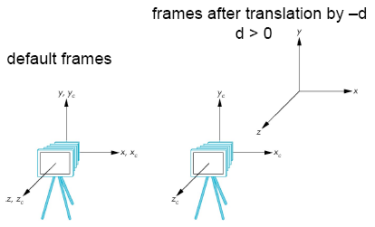
Positioning the camera: model-view
The model-view matrix describes where the world is relative to the camera
  Initially identity matrix: camera is at center of world, facing in negative z direction
Say we want to see an object placed at the origin:
  Move the camera in the +z direction, or
  Move the world frame
  in the -z direction
  Both are equivalent:
  glTranslatef( 0., 0., -d );

Slide 13
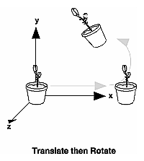
Order of transformations
    C: current model-view matrix
    M: new additional transformation,
    via glMultMatrix, glTranslate, glRotate, etc.
    v: vertex to be transformed
OpenGL applies transforms in the order: CMv
So the last transform is applied first!
    glMatrixMode( GL_MODELVIEW );
    glLoadIdentity();
    glRotatef( 60., 0., 0., 1. );
    glTranslatef( 10., 0., 0. );
    glBegin( GL_POINTS );
      glVertex3fv( vert );

Slide 14
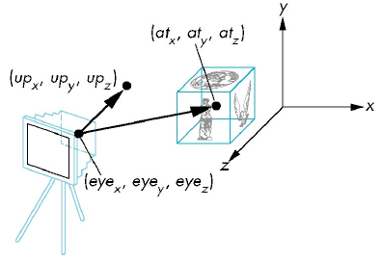
gluLookAt
Handy helper function for setting up model-view
    #include <GLU.h>
Specify eye coords, where you want to look at, and direction of “up” vector:
    glMatrixMode( GL_MODELVIEW );
    glLoadIdentity();
    gluLookAt( eye_{x}, eye_{y}, eye_{z},
    at_{x}, at_{y}, at_{z}, up_{x}, up_{y}, up_{z} );

Slide 15
Selecting a lens: Projection
The projection matrix maps 3D points in the camera's frame to 2D points on the image plane
  Input to projection matrix is homogeneous coords after model-view matrix is applied
  After multiplying by projection matrix,
    Divide to ensure homogeneous coords: [x y z 1]
    Take just the (x, y) coords as coords on image plane
  Default projection matrix is the identity
    Orthographic projection onto the xy plane

Slide 16
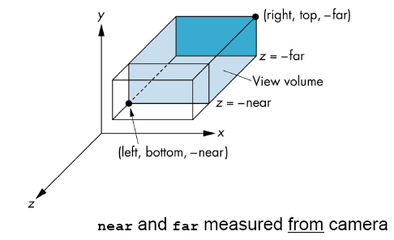
Orthographic projection
The manual way:
    glMatrixMode( GL_PROJECTION );
    glLoadIdentity();
    glMultMatrix(...);
The easier way with glOrtho():
    glMatrixMode( GL_PROJECTION );
    glLoadIdentity();
    glOrtho( left, right,
    bottom, top, near, far );

Slide 17
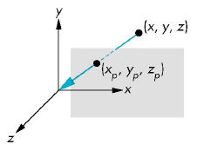
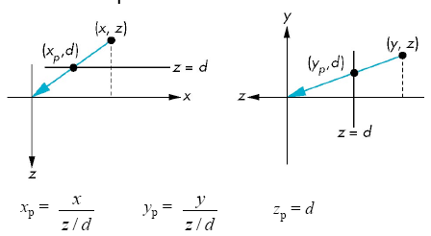
Perspective projection
Consider a perspective projection with center of projection (CoP) at origin, and image plane at z=d:
View from top:
View from side:
A point p = (x,y,z) projects to q = (x_{p}, y_{p}, z_{p}=d) via

Slide 18
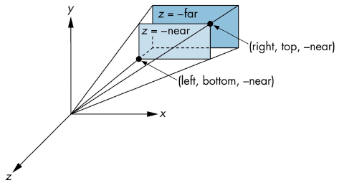
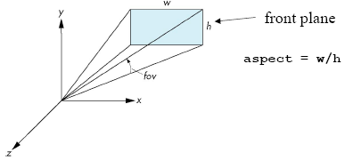
Specifying perspective projection
Can also do this manually with glMultMatrix()
Or use glFrustum():
    glFrustum( left, right,
    bottom, top, near, far)
Or use gluPerspective():
    gluPerspective(
    fov, aspect, near, far );
  Easier to use than glFrustum()

Slide 19
Outline for today
Modelling: vertex lists, face lists, edge lists
  OpenGL vertex arrays
  OpenGL display lists
Viewing:
  Positioning the camera: model-view matrix
  Selecting a lens: projection matrix
  Clipping: setting the view volume

Slide 20
TODO
Lab4: due next week Thu 15Mar
  Add a virtual trackball using quaternions

