Slide 1
Phong Shading and
Texture Mapping
  15 March 2007
  CMPT370
  Dr. Sean Ho
  Trinity Western University

Slide 2
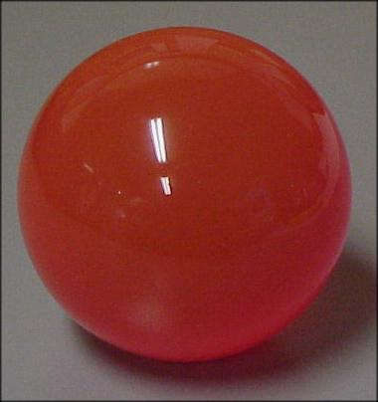
Review last time
Lighting and shading
  The global rendering equation
  Light-material interaction
  Kinds of light sources
The OpenGL local illumination model
  Ambient term
  Diffuse term
  Specular term
  Specifying in OpenGL
See RedBook ch5

Slide 3
What's on for today
Shading polygons
  Flat shading
  Gouraud shading
  Phong shading
Texture mapping
  Coordinate transforms
  Cylinder, sphere, cube maps
  Bump mapping
  Environment mapping

Slide 4
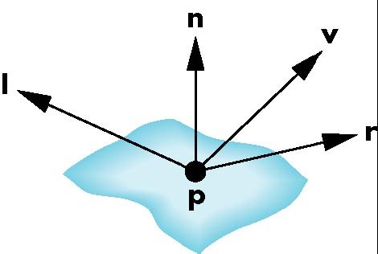
Computing the local illumination
The illumination model relies on four vectors:
  To light (l): specified by the model/scene
  To viewer (v): specified by model-view matrix
  Surface normal (n)
  Reflection (r): compute from l, n
Computing normals is not always easy
  Depends on how we represent
  the surface
  OpenGL leaves this up to us
  (in our application)

Slide 5
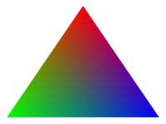
Shading polygons
We specify in our model for each vertex:
  Vertex coordinates
  Vertex colours
  Vertex normal
Use lighting model to calculate vertex shades
Smooth shading: vertex shades are interpolated across the polygon
    glShadeModel( GL_SMOOTH );
Flat-shading uses the colour of the first vertex:
    glShadeModel( GL_FLAT );

Slide 6
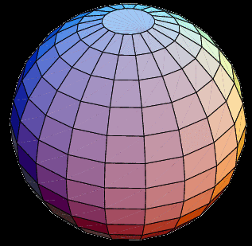
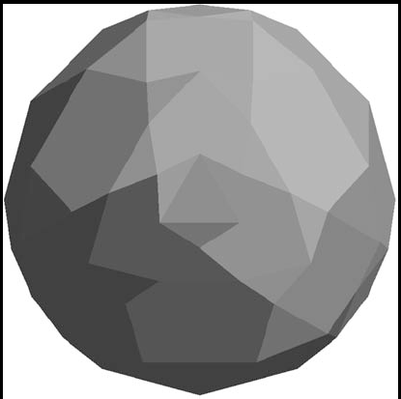
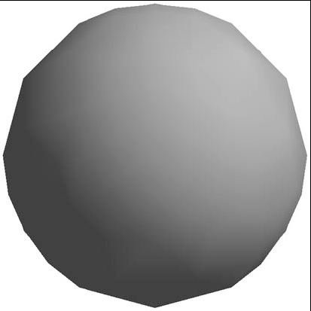
Calculating normals
OpenGL expects us to find the normals
Some shapes can be done analytically:
  Sphere: normal points from centre
  No vertex normals:
  flat-shaded
  With vertex normals:
  smooth-shaded
    Note silhouette edge
How to find normals for general surfaces?

Slide 7
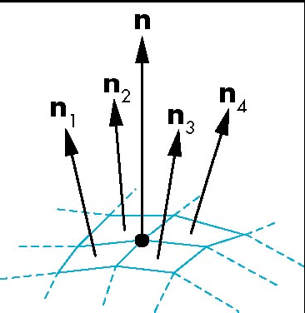
Mesh shading
Each polygon is flat and has a normal vector we can find
To calculate normal at a vertex, average the normals of the faces surrounding that vertex:

Slide 8
Gouraud shading
Find vertex normals (average polygon normals)
Apply lighting model to each vertex to get
vertex shades
Interpolate vertex shades across polygon
  Interpolate along edges first
  Then along each scan line (done in hardware)

Slide 9
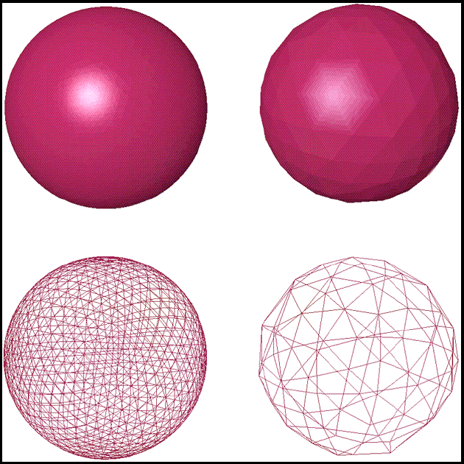
Gouraud shading: quality
Depends on how big each polygon appears on screen, compared to pixel size
  Fewer polygons => bigger on screen => worse

Slide 10
Phong shading
Find vertex normals (average polygon normals)
Interpolate vertex normals across polygon
    Interpolating vectors, not intensities!
Apply lighting model at each pixel to get shades
  Gouraud may miss small specular highlights
    OpenGL implements Gouraud but not Phong
  Calculate lighting model at each pixel: work
    Can use programmable shaders now

Slide 11
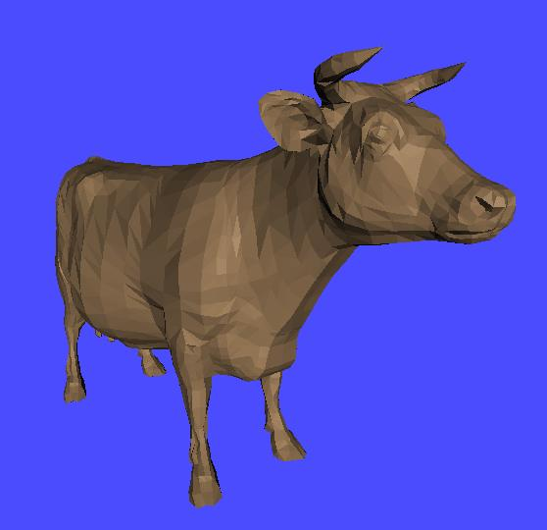
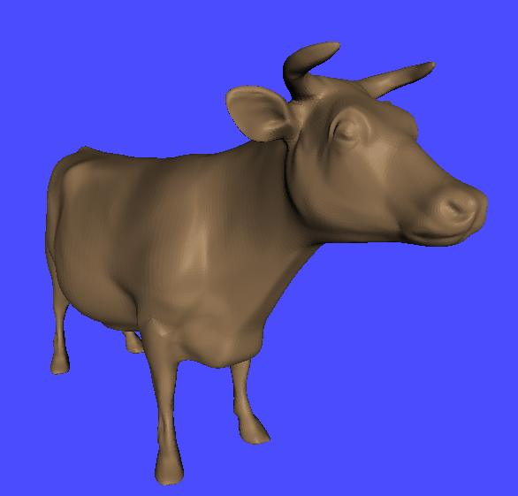
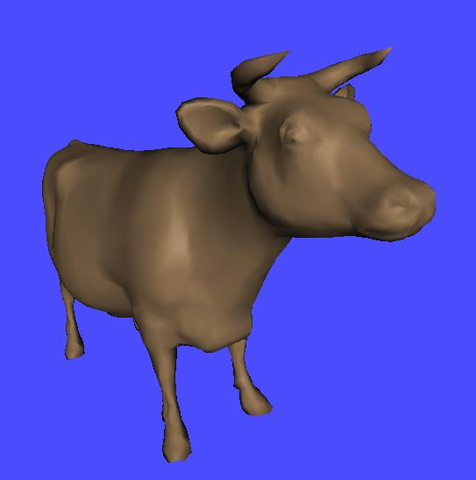
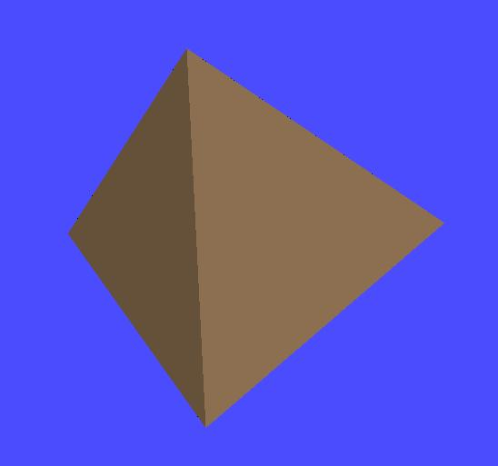
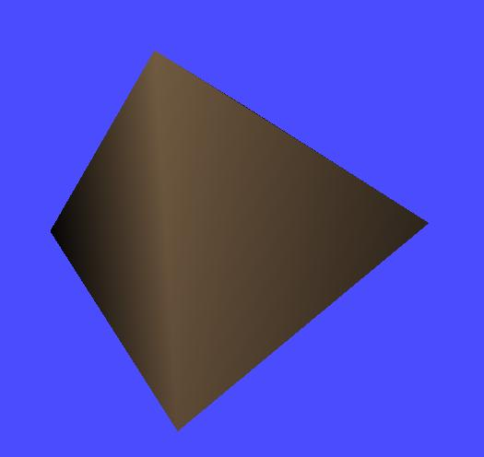
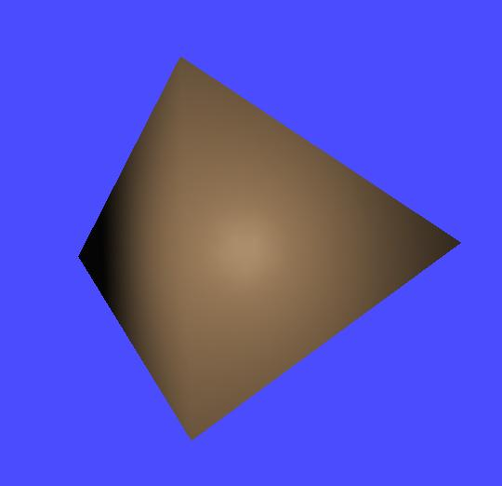
Flat vs. Gouraud vs. Phong

Slide 12
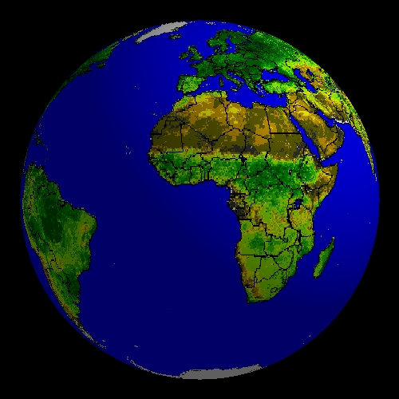
Texture mapping
Complex objects with many varying shades:
  Could use a new polygon for every shade
  Or use an image pasted on top of the surface
E.g., modeling the earth:
  Blue sphere is too simple
  Modeling every continent
  and mountain range with
  little polygons is too much
  Texture-map a picture
  onto the sphere

Slide 13
Bump mapping
e.g., modeling an orange:
  Geometry is just a simple sphere
  Texture map colours, striations, etc.
  But surface is still smooth: what about small dimples?
    Shading should change as light and view directions change
Bump mapping tweaks the normal vectors to simulate dimples or bumpiness
  Silhouette still reflects underlying geometry

Slide 14
Kinds of maps
Texture map:
  Paste an image onto a surface
Bump map:
  Perturbs normal vectors in lighting model to simulate small changes in surface orientation
Environment (reflection) map:
  Use a picture of the surrounding room/sky for a texture map
  Simulates reflections in highly specular surfaces
Only texture maps are built-in to OpenGL

Slide 15
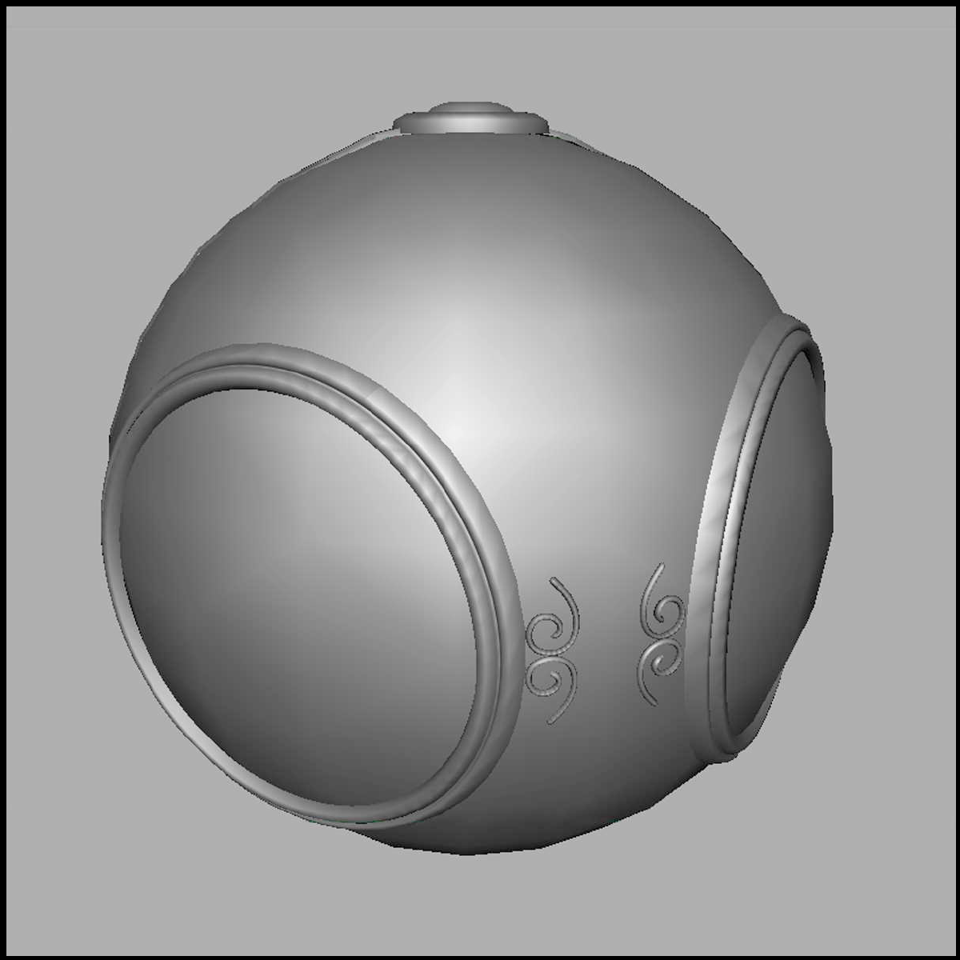
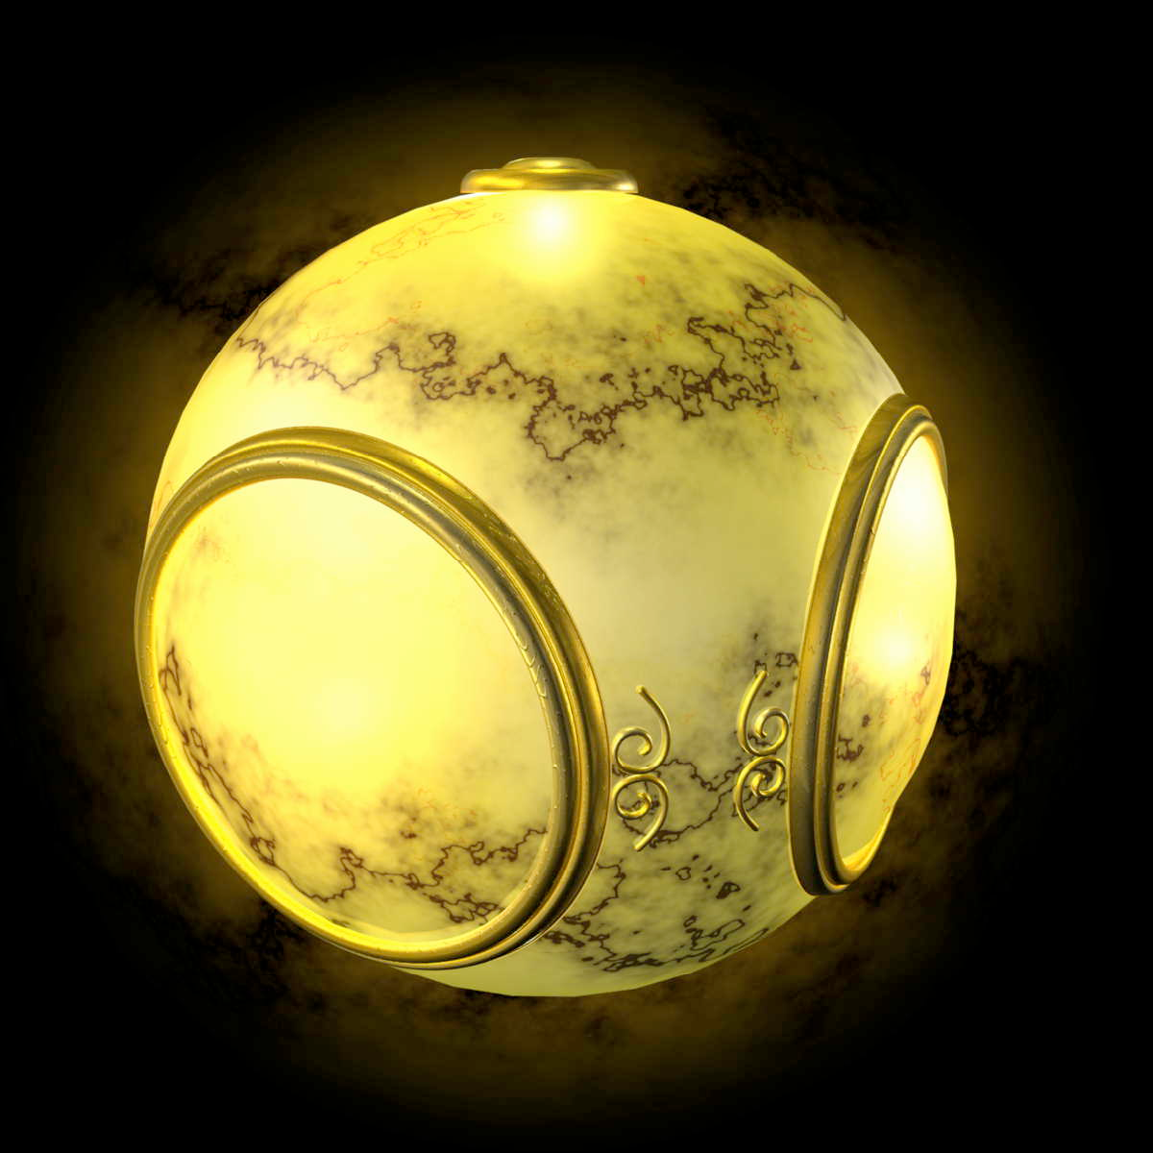
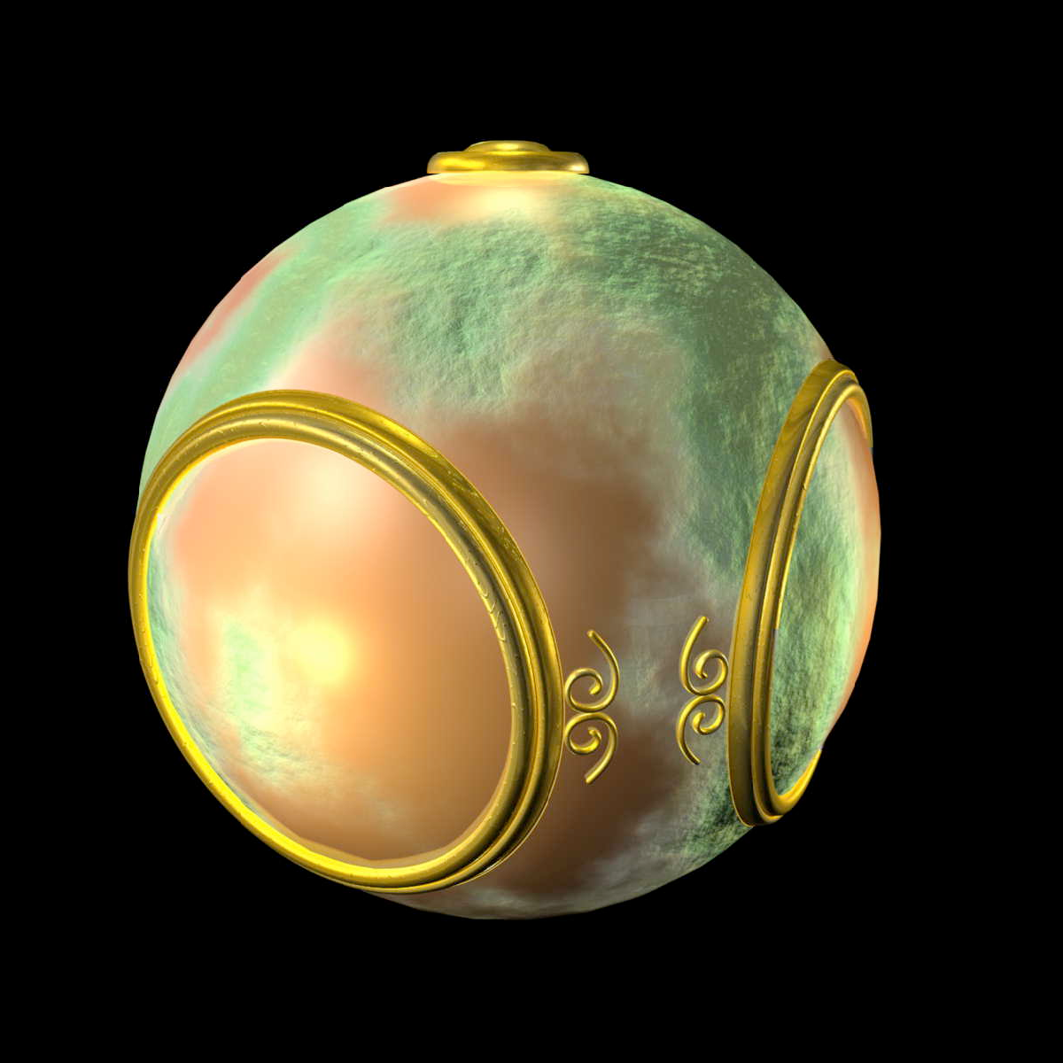
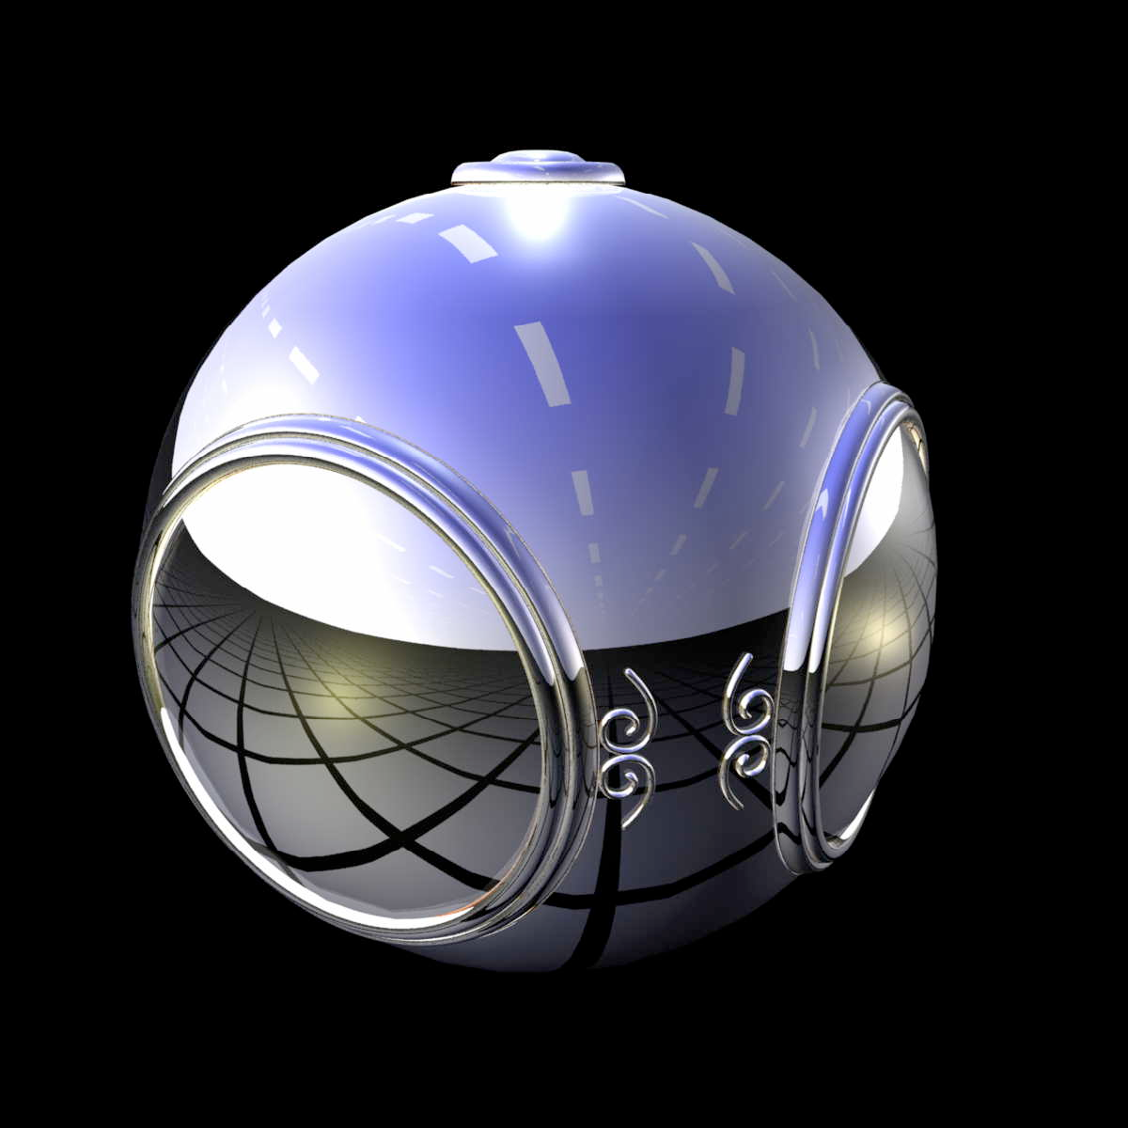
Texture/bump/environment maps
No map
Texture map
Bump map
Environment map

Slide 16
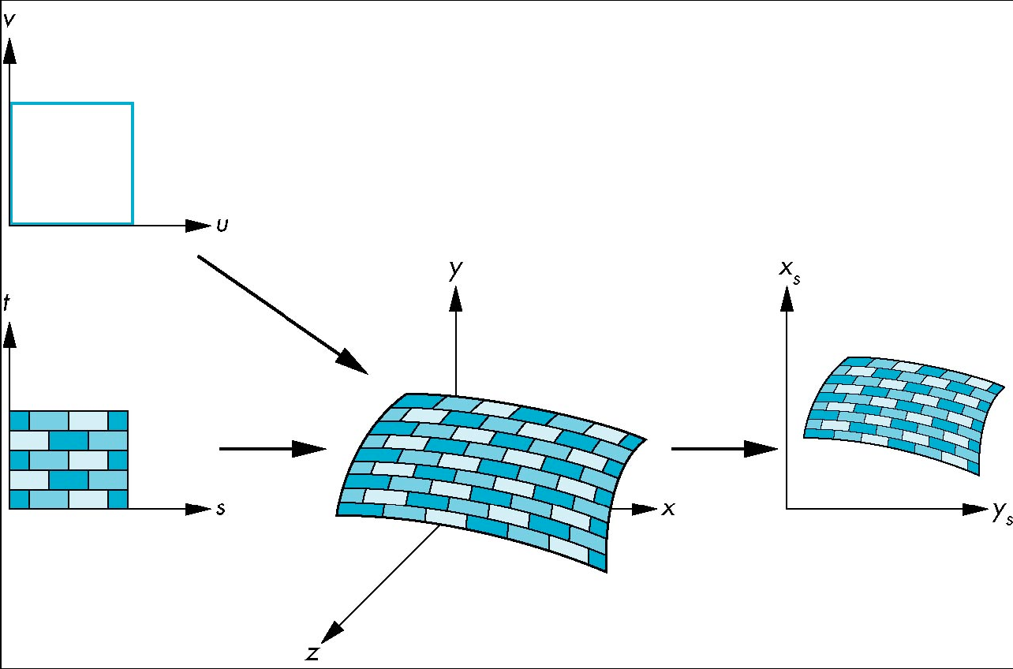
Mapping: coordinate systems
Essential question for maps: how to map coordinate systems?
  Parametric coords (u,v) describing the surface
  Texture coords
  (s,t)
  World coords
  (x,y,z)
  Window coords
  (x_{s}, y_{t})

Slide 17
Backward mapping
For each point (x,y,z) on the surface in world coords, we want to go backwards to find which pixel (s,t) in the texture we should paste:
    s = s(x,y,z);
    t = t(x,y,z);
Two-part mapping:
  First map texture onto a simple intermediate shape
    Cylinder
    Sphere
    Cube

Slide 18
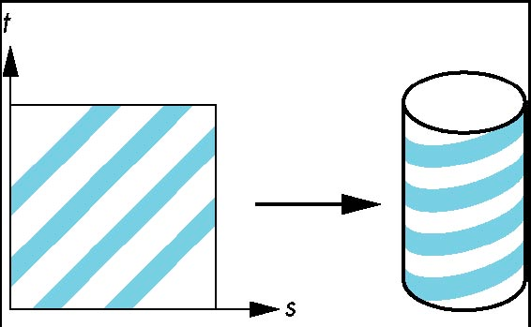
Cylindrical mapping
Parametric cylinder:
    x = r cos(2πs)
    y = r sin(2πs)
    z = t/h
Map from
  Square [0,1] x [0,1] in (s,t) texture space to
  Cylinder of radius r, height h
  in (x,y,z) world coordinates

Slide 19
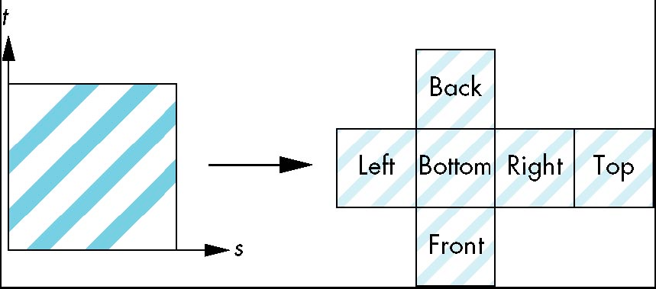
Spherical maps, cube maps
Parametric sphere:
    x = r cos(2πs)
    y = r sin(2πs) cos(2πt)
    z = r sin(2πs) sin(2πt)
  Bad distortions at the poles
Cube/box mapping:
  Easy with
  orthographic projection
Both are widely used for environment maps

Slide 20
Implementing bump mapping
Parameterized surface:
    p(u,v) = (x(u,v), y(u,v), z(u,v))
  Tangent vectors: p_{u} = ∂p/∂u, p_{v} = ∂p/∂v
  Normal vector: n = p_{u} x p_{v}
Perturbed surface: p'(u,v) = p(u,v) + d(u,v) n(u,v)
  d(u,v) is the displacement function/map
Perturbed normal: n' = p'_{u} x p'_{v}
  n' ≈ ( ∂d/∂u )( n x p_{v} ) + ( ∂d/∂v )( n x p_{u} )

Slide 21
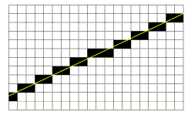
Rasterization
Our model is represented with mathematical precision, but
Ultimately we need to produce a framebuffer:
2D array of RGB values (pixels)
The rasterization process means that we lose some precision
  Vector graphics (e.g., Illustrator, EPS) vs.
  Raster graphics (e.g., PhotoShop, PNG)
“jaggies”

Slide 22
TODO
Lab4: due tonight
  Add a virtual trackball using quaternions

