Slide 1
Texture Mapping in OpenGL
  19 March 2007
  CMPT370
  Dr. Sean Ho
  Trinity Western University

Slide 2
Review last time
Shading polygons
  Flat shading
  Gouraud shading
  Phong shading
Texture mapping
  Coordinate transforms
  Cylinder, sphere, cube maps
  Bump mapping
  Environment mapping

Slide 3
What's on for today
  Bump mapping theory
Creating a texture in OpenGL
  Texture objects: glBindTexture()
  Loading image data: glTexImage2D()
    Using the framebuffer as a texture
Applying a texture in OpenGL
  Blending modes: glTexEnvf()
  Texture coordinates: glTexCoord2f()
    Auto-generated texcoords: glTexGen()
    Spherical environmental mapping
  Mip-maps

Slide 4
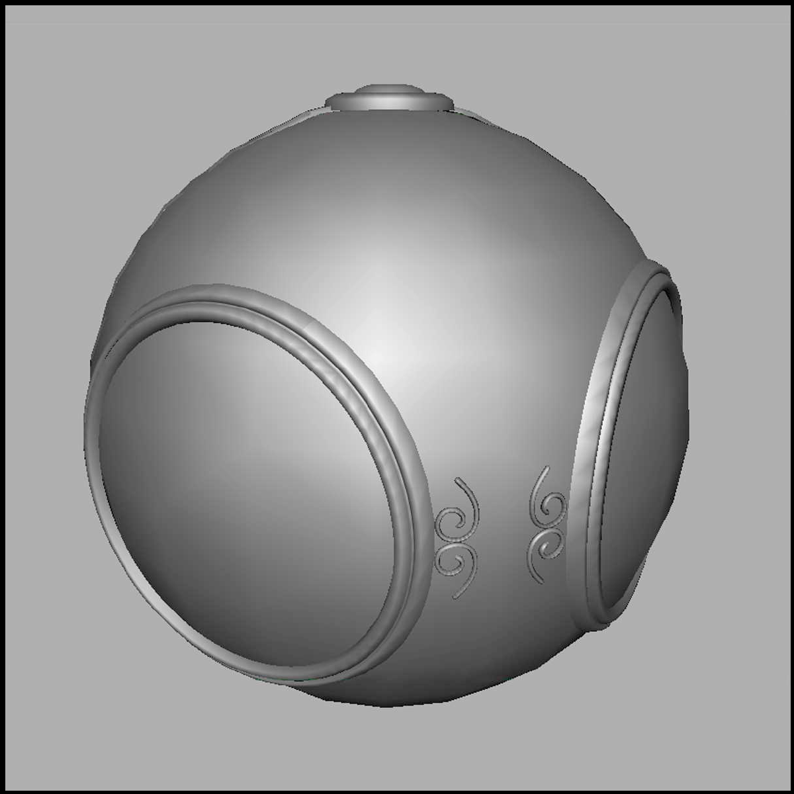
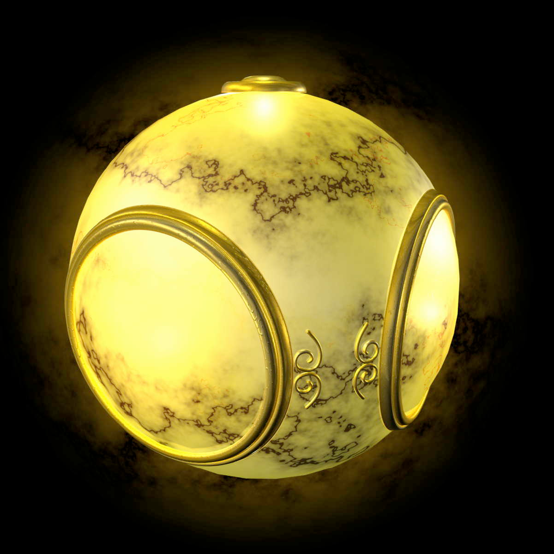
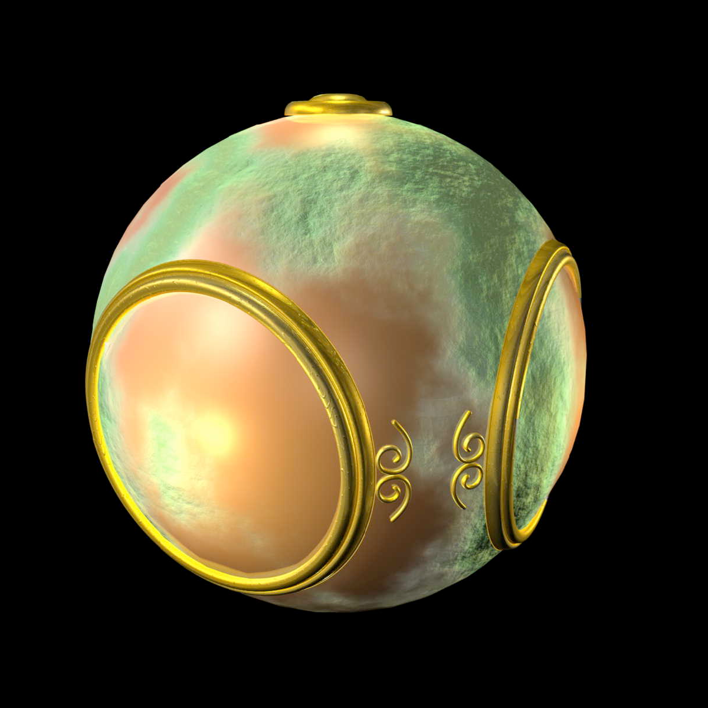
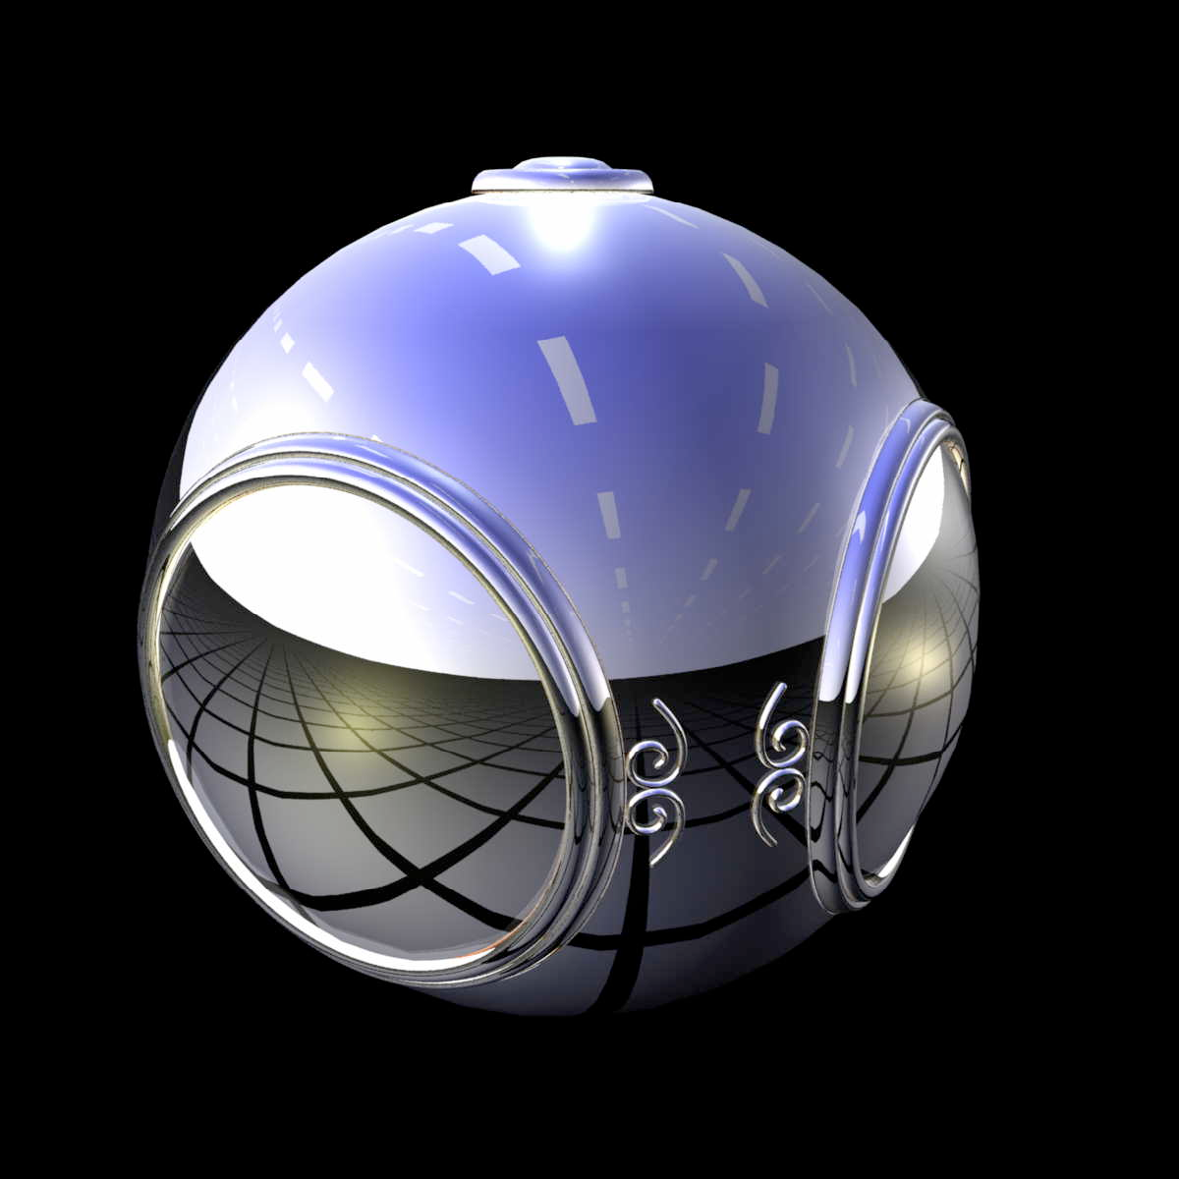
Texture/bump/environment maps
No map
Texture map
Bump map
Environment map

Slide 5
Bump mapping
Parameterized surface:
    p(u,v) = (x(u,v), y(u,v), z(u,v))
  Tangent vectors: p_{u} = ∂p/∂u, p_{v} = ∂p/∂v
  Normal vector: n = p_{u} x p_{v}
Perturbed surface: p'(u,v) = p(u,v) + d(u,v) n(u,v)
  d(u,v) is the displacement function/map
Perturbed normal: n' = p'_{u} x p'_{v}
  n' ≈ ( ∂d/∂u )( n x p_{v} ) + ( ∂d/∂v )( n x p_{u} )

Slide 6
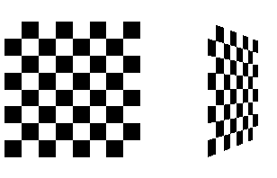
Texture mapping in OpenGL
Bump mapping / environment mapping are not provided in OpenGL
  Can be done with fragment programs (GLSL)
Using texture mapping in OpenGL:
  Create texture and bind to object
  Select how texture will affect each pixel
  Enable texture mapping
  Draw object, specifying
  texture coordinates
See Redbook examples, checker.c

Slide 7
Creating a texture
These steps should be done during initialization, not on every display refresh
Read in an image: 3D array (rows, cols, RGBA)
  Programmatically generate (checker.c), or
  Read from file (Fl_JPEG_Image->data())
Bind new texture object: glBindTexture()
Specify parameters: wrapping, filtering
Load image data to texture: glTexImage2D()

Slide 8
Texture objects (OpenGL 1.1)
Akin to display lists, but for textures
Allows us to reuse textures, bind to objects
  Request a new texture object id
    glGenTextures( 1, &texName );
  Can also request several texture object ids
  Bind this new texture object
    glBindTexture( GL_TEXTURE_2D, texName );
All subsequent texture commands are stored in this texture object
Use glBindTexture() to switch texture objects

Slide 9
Loading image data to a texture
glTexImage2D( GL_TEXTURE_2D, level, intFmt,
width, height, 0, format, type, pixels )
  level: mip-mapping level, usually 0
  intFmt: GL_RGB, GL_RGBA, etc.
  width, height: must be power of 2, ≥64
  format, type: describe incoming pixels:
    e.g., GL_RGB, GL_UNSIGNED_BYTE
    Affected by glPixelStore(), similar to glDrawPixels()
  pixels: pointer to the actual image data

Slide 10
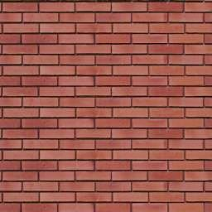
Texture size must be power of 2
OpenGL requires the width and height of textures to be powers of 2 (need not be square)
GLU provides a function to scale:
    gluScaleImage( fmtIn, wIn, hIn, typeIn, *pixelsIn,
    wOut, hOut, typeOut, *pixelsOut )
2ª
2^{b}

Slide 11
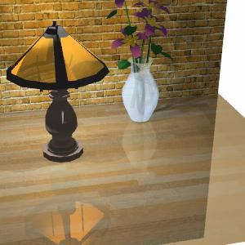
Using the framebuffer as a texture
Instead of loading a JPEG file for a texture, you can use the framebuffer itself:
    glCopyTexImage2D( GL_TEXTURE_2D, level,
    intFmt, x, y, w, h, border )
  Copies a rectangle from the framebuffer, starting at (x,y) with size (w,h)
  level, intFmt, border just
  as in glTexImage2D
Can use to do cheap reflections:
  Flip model-view matrix and render
  Texture-map framebuffer onto object

Slide 12
Applying the texture
These steps are done during display() refresh
Enable texture-mapping
    glEnable( GL_TEXTURE_2D );
Set blending mode
    glTexEnvf( GL_TEXTURE_ENV, GL_TEXTURE_ENV_MODE, GL_DECAL );
Bind the preloaded texture
    glBindTexture( GL_TEXTURE_2D, texName );
Specify texture coordinates with every vertex
    glTexCoord2f( 0.0, 0.0 ); glVertex3f( 1.0, 2.5, -1.0 );

Slide 13
Blending modes
    glTexEnvf( GL_TEXTURE_ENV, GL_TEXTURE_ENV_MODE, GL_DECAL );
Last param is the blending mode:
  How the texture colour is combined with the shaded colour of the fragment
  (e.g., Gouraud- or flat-shaded)
  GL_DECAL: pastes texture on top
  GL_MODULATE: multiplies colours
  GL_BLEND: uses texture to determine amount of blend between shaded colour and a fixed blend colour

Slide 14
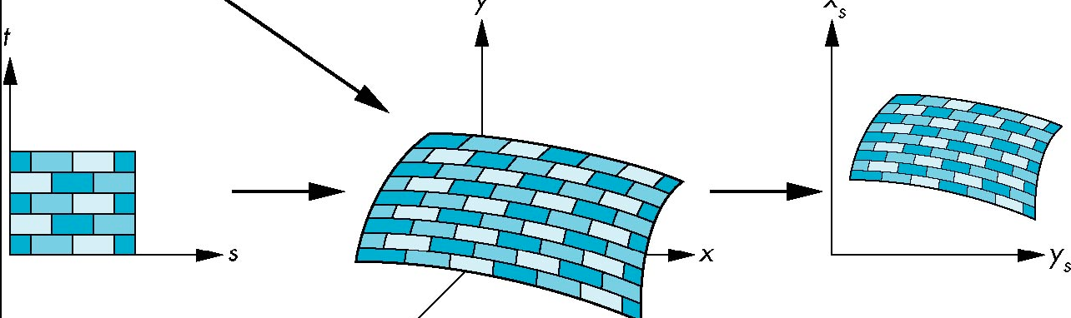
Texture coordinates
The rectangular texture is parameterized by (s,t) in the range (0,1)
Specify texture coordinates with each vertex
    glTexCoord2f( 0.5, 0.7 )
  Part of the OpenGL state for the vertex, just like colour / material properties
  Texcoords are interpolated just like shades

Slide 15
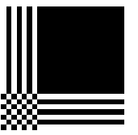
Parameters for texture mapping
Wrapping: texcoords outside (0,1)
  Repeat (tile) or clamp (only one copy)
  In either s or t directions in texture
    glTexParameteri( GL_TEXTURE_2D, GL_TEXTURE_WRAP_S, GL_REPEAT );
Filtering:
  Magnification (MAG) and minimization (MIN)
    glTexParameteri( GL_TEXTURE_2D,
    GL_TEXTURE_MAG_FILTER, GL_NEAREST );
  Nearest-neighbor or GL_LINEAR interpolation

Slide 16
Automatic texcoord generation
    glEnable( GL_TEXTURE_GEN_S );
    glTexGeni( coord, GL_TEXTURE_GEN_MODE, mode )
coord: GL_S or GL_T
If mode is GL_OBJECT_LINEAR:
  Texture is fixed to object and reference plane
  Specify reference plane with:
    glTexGenfv( coord, GL_OBJECT_PLANE,
    {p₁, p₂, p₃, p₄} )
  Generated texcoord is distance from vertex to plane: p₁x₀ + p₂y₀ + p₃z₀ + p₄w₀
Teapot example: slanted plane = {1., 1., 1., 0.}

Slide 17
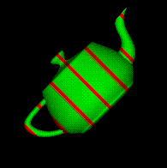
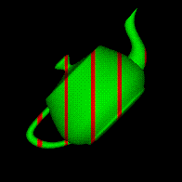
Object vs. eye coordinates
If mode is GL_OBJECT_LINEAR, generated texcoords are in the model coordinate system
If mode is GL_EYE_LINEAR, generated texcoords are in the eye (camera) coordinate system
  Object appears to “swim” in the texture
  Reference plane is specified with
    glTexGenfv( coord, GL_OBJECT_PLANE,
    {p₁, p₂, p₃, p₄} )
Obj coords
Eye coords

Slide 18
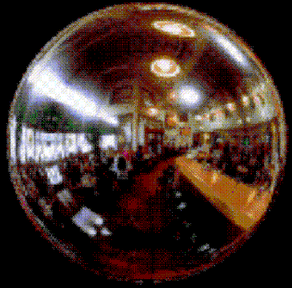
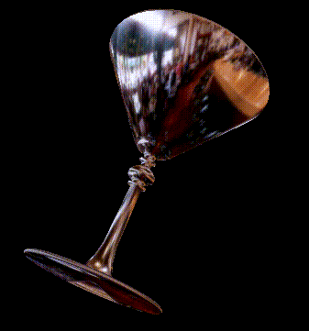
Spherical environment mapping
Photograph a large silvered ball, or
use a fisheye wide-angle lens
Use automatic spherical texcoords for both s and t:
    glTexGeni( GL_S, GL_TEXTURE_GEN_MODE, GL_SPHERE_MAP )
Assumes environment is far away (e.g., small object in large room)

Slide 19
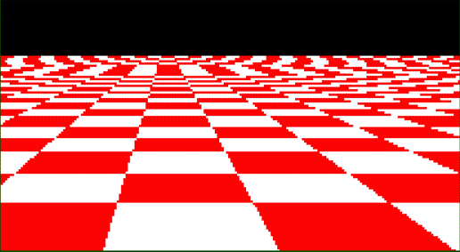
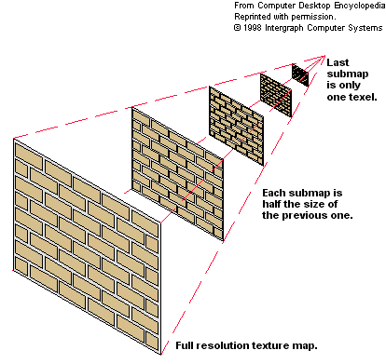
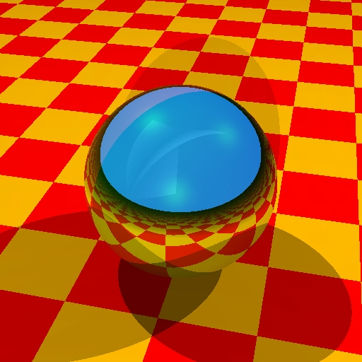

Mip-maps
Aliasing (jaggies) occurs when
textures become very small on-screen
Pre-calculate low-res versions of the
texture: levels of detail (LoD)
  Use gluBuild2DMipmaps()
  instead of glTexImage2D()

