Slide 1
Bezier Curves and Surfaces (Redbook ch12)
  27 March 2007
  CMPT370
  Dr. Sean Ho
  Trinity Western University

Slide 2
Review last time
  Bump mapping theory
Creating a texture in OpenGL
  Texture objects: glBindTexture()
  Loading image data: glTexImage2D()
    Using the framebuffer as a texture
Applying a texture in OpenGL
  Blending modes: glTexEnvf()
  Texture coordinates: glTexCoord2f()
    Auto-generated texcoords: glTexGen()
    Spherical environmental mapping
  Mip-maps

Slide 3
What's on for today
Polynomial curves and surfaces
Cubic polynomial curves:
  Interpolating (4 points)
  Hermite (2 points + 2 derivatives)
  Bezier (2 interpolating end points + 2 midpoints)
  Using Bezier evaluators in OpenGL

Slide 4
Parametric representation
Recall a 1D curve in 3D can be represented as:
p'(u) is the tangent (velocity) vector
  Usually limit u to interval [0,1] for simplicity
For surfaces we have two parameters (u, v):

Slide 5
Polynomial curves
Restrict the functions x(u), y(u), z(u) to be polynomial (of degree n) in u:
  Each coefficient c_{k} is a 3-vector
  u^{k} are the n+1 basis functions
  Often choose n=3: cubic polynomial
    k=0..3, (x,y,z): need 12 numbers
Similarly for surfaces:

Slide 6
Interpolating Cubic Polynomials
Simplest case, but rarely used in practice
Four control points p₀, ..., p₃
Fit a cubic polynomial through them
  Space u evenly: p₀ = p(0), p₁ = p(1/3), ...

Slide 7
Geometry matrix
Invert this matrix to get the geometry matrix
  Multiply the geometry matrix by the four control points to get the coefficients
The coefficients define the cubic polynomial that interpolates these control points
  Can render, e.g., by using many small line segments (GL_LINE_STRIP)

Slide 8
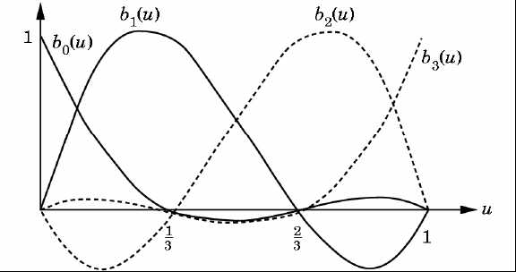
Blending functions
We can also look at the contribution each control point makes to the final curve
For interpolating cubics:
  p(u) = b₀(u) p₀ + b₁(u) p₁ + b₂(u) p₂ + b₃(u) p₃

Slide 9
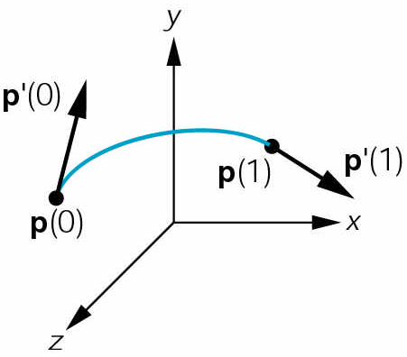
Hermite polynomial curves
Another way of defining cubic polynomials
Specify start+end position+velocity
  Also 12 numbers
In matrix form:
  Invert to get Hermite geometry matrix
  from which we get the coefficients

Slide 10
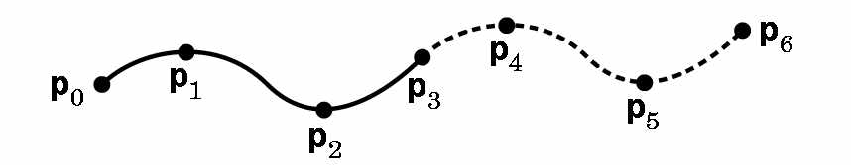
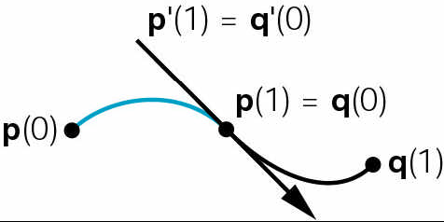
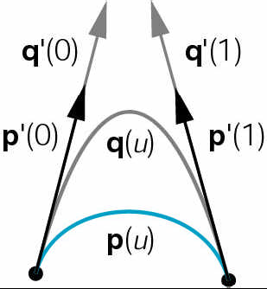
Joining polynomial curves
Each segment has 4 control points
  {p₀, p₁, p₂, p₃}, {p₃, p₄, p₅, p₆}, ...
Kinds of continuity: differential:
  C⁰: touching but may have corner
  C¹: derivatives match (Hermite)
  C²: curvatures match
Geometric continuity:
  G¹: velocity vectors in same
  direction but not necessarily
  same magnitude

Slide 11
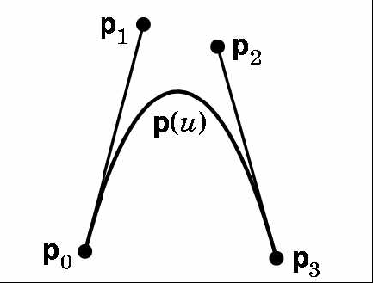
Bezier curves
Widely used, provided in OpenGL
Use control points to indicate tangent vectors
  Does not interpolate middle control points!
  p'(0) = 3(p₁–p₀), p'(1) = 3(p₃–p₂)
p₀, p₃ specify start+end position
start+end velocity derived from control points
Use Hermite form
C⁰ but not C¹

Slide 12
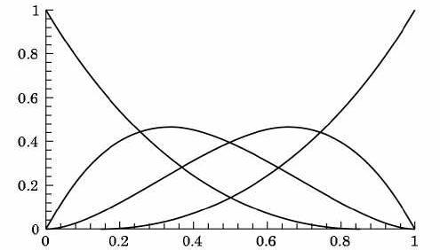
Bezier blending functions
Blending functions are smooth polynomials
    b₀(u) = (1-u)³
    b₁(u) = 3u(1-u)²
    b₂(u) = 3u²(1-u)
    b₃(u) = 3u³

Slide 13
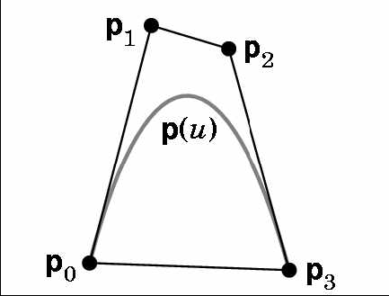
Convex hull property
Why the factor of 3 in the definition of Bezier curves?
  p'(0) = 3(p₁–p₀)
  p'(1) = 3(p₃–p₂)
Ensures that the curve is contained within the convex hull of the four control points

Slide 14
Bezier evaluators in OpenGL
Specify array (1D or 2D) of control points:
    GLfloat ctrlpoints[4][3] = { {-4.0, -4.0, 0.0}, ...
Create a Bezier evaluator: (type=GL_MAP1_VERTEX_3)
    glMap1f( type, u_{min}, u_{max}, stride, order, points );
Enable the evaluator:
    glEnable( type );
Evaluate the Bezier at a particular u/v:
    glEvalCoord1f( (GLfloat) u );
  Use this instead of glVertex(), e.g., within glBegin( GL_LINE_STRIP )

