Slide 1
NURBS (Redbook ch12)
  29 March 2007
  CMPT370
  Dr. Sean Ho
  Trinity Western University
IBiblio e-notes
Cambridge notes

Slide 2
Review last time
Polynomial curves and surfaces
Cubic polynomial curves:
  Interpolating
  Hermite
  Bezier
  Using Bezier evaluators in OpenGL

Slide 3
Bezier evaluators in OpenGL
Specify array (1D or 2D) of control points:
    GLfloat ctrlpoints[4][3] = { {-4.0, -4.0, 0.0}, ...
Create a Bezier evaluator: (type=GL_MAP1_VERTEX_3)
    glMap1f( type, u_{min}, u_{max}, stride, order, points );
Enable the evaluator:
    glEnable( type );
Evaluate the Bezier at a particular u/v:
    glEvalCoord1f( (GLfloat) u );
  Use this instead of glVertex(), e.g., within glBegin( GL_LINE_STRIP )

Slide 4
How OpenGL computes Beziers
de Casteljau's algorithm:
4 control points:
  Plot a point u of the way from p₀ to p₁
  Similarly between (p₁, p₂), and (p₂, p₃)
  Get 3 points (q₀, q₁, q₂)
Plot points u of the way between (q₀, q₁), (q₁, q₂)
  Get 2 points (r₀, r₁)
Plot a point u of the way between (r₀, r₁)
  This is our point on the Bezier curve

Slide 5
Splines
Draftsman's tool for drawing smooth curves:
  Flexible wood/plastic strip
  Bent to pass through knots (control points)
A spline is any sort of smooth curve that has a series of control points
  Interpolating splines
    Interpolating cubic spline
    Interpolating Catmull-Rom spline
  Cubic Bezier is a spline
  B-splines

Slide 6
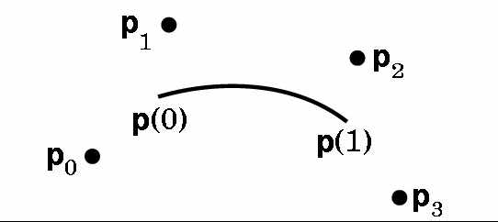
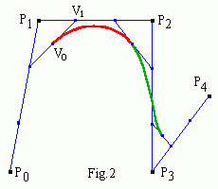
Cubic B-splines
n+1 deBoor control points p₀, ..., p_{n}.
Make n-2 Bezier curve segments
  Want C² at the joins; sacrifice interpolation
  Derive Bezier control points (v₀, v₁, v₂, v₃)
  from deBoor points (p₀, p₁, p₂, p₃):
  v₁ is (1/3)-way between p₁ and p₂
  v₀ is halfway between v₁ and
  (1/3)p₀ + (2/3)p₁
Cubic B-spline: order k=4

Slide 7
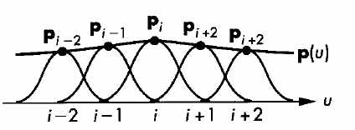
B-spline basis functions
Basis functions are simple polynomials
Region of influence for each deBoor control point is 4 Bezier segments
Each point on the curve is affected by 4 deBoor control points
Knots (u₀, ..., u_{n+4}) specify where the joins are in parameter space: e.g., {0.0, 0.25, 0.50, 0.75, 1.0}
Uniform B-spline: uniform spacing of knots
Open-spacing: duplicate end knots to get interpolation:
    {0.0, 0.0, 0.0, 0.0, 0.25, 0.50, 0.75, 1.0, 1.0, 1.0, 1.0}

Slide 8
NURBS
Spline:
  Smoothish curve defined by control points
B-spline:
  Joined Bezier curves with C² continuity
Non-uniform B-spline:
  Non-uniform spacing of knots (e.g., can use multiplicity to get interpolation of endpoints)
Rational B-spline:
  Add weights to each control point
  Takes advantage of perspective division hardware

Slide 9
Properties of NURBS
More computationally expensive than Bezier curves/patches
C² continuity makes shading look much better
Local control: moving a control point only affects 4 Bezier segments
Convex hull property: each point on the spline is within the convex hull of the four control points it's affected by
Affine-invariant (including perspective):
  Transforming control points = transforming curve

