Slide 1
Ray Tracing
  3 April 2007
  CMPT370
  Dr. Sean Ho
  Trinity Western University

Slide 2
Review last time
Using Bezier evaluators in OpenGL
deCasteljau algorithm to compute Beziers
B-splines
  C² continuity
  Knot spacing: uniform, open, non-uniform
  NURBS

Slide 3
What's on for today
Ray tracing
Object-space vs. image-space rendering
Backward ray tracing
  Shadow rays
  Reflection and refraction rays
  Ray-surface intersection
    Parametric surface
    Implicit surface
    Sphere / Quadric
    Polygon

Slide 4
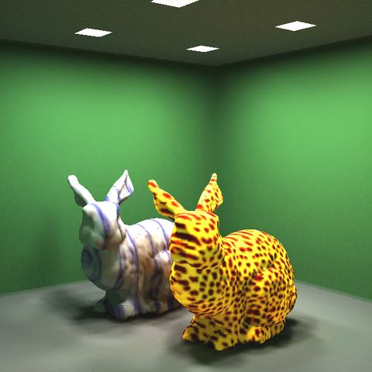
Local vs. global rendering
Local rendering:
  Each object is rendered
  independently
  Real-time OpenGL pipeline
Global rendering:
  Light scatters between objects
  Approximates more of the global rendering equation
  Usually computed off-line
    Ray tracing: highlights, reflection, refraction
    Radiosity: surface scattering

Slide 5
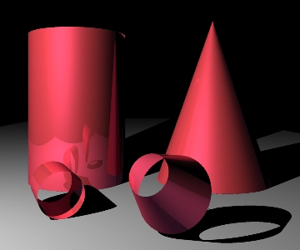
Object-space vs. image-space
OpenGL pipeline: object-space
  Render one object at a time
  Fast, easy, but doesn't model
  object-object interactions
Ray tracing: image-space
  Render one pixel at a time
  Pixel-level parallelism
Radiosity: surface patches
  Find diffuse inter-reflections between each pair of surface patches

Slide 6
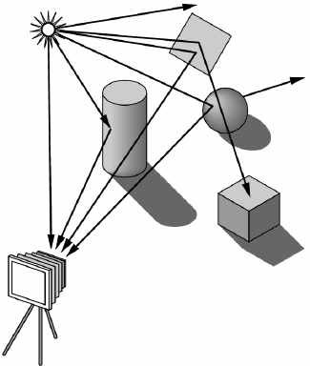
Forward ray tracing
Physically-based modelling
Each light source emits photons
Follow photons as they bounce around the scene and eventually to the camera
Problem: most photons won't contribute to the image!
  Waste of computation

Slide 7
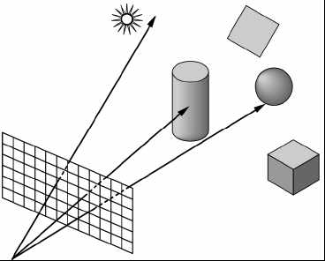
Backward ray tracing
First step is ray casting:
  Fire rays from center of projection
  through each pixel in image plane
When ray strikes an object, compute illumination:
  Local illumination model (as in OpenGL)
  Shadow rays
  Reflection rays
  Refraction rays
Reflection/refraction: use recursion
Critical operations: intersections, illumination

Slide 8
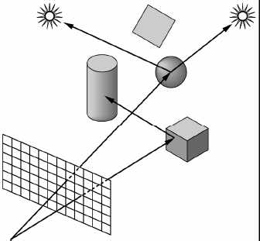
Shadow rays
An optimization to speed up local illumination
Trace a shadow ray from the surface to each light
If the shadow ray intersects any
opaque object, then
  That light does not contribute
  to the local illumination of
  this surface patch
  Don't need to compute the
  illumination from that light
Often over 90% of rays cast
are shadow rays!

Slide 9
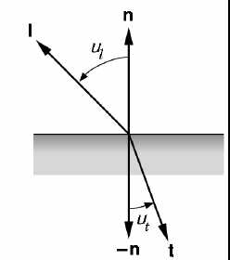
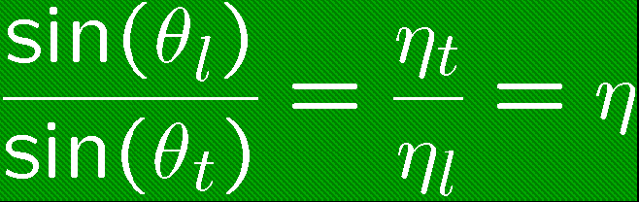
Reflection and refraction rays
Reflection ray
  Replaces specular part of local illumination model
  Compute backward reflection ray
Refraction (transmission) ray
  Models glass/water
  Refractive index
Recurse until either:
  Ray exits scene (no intersect)
  Contribution too dim
  Fixed recursion depth

Slide 10
Finding ray-surface intersections
Easier to work with specialized kinds of objects:
  Spheres
  Planes
  Polygons
  Generalized parametric surfaces
  Generalized implicit surfaces
  Constructive solid geometry (CSG)
We don't want to decompose a surface into lots of little triangles!

Slide 11
Intersect ray with parametric surface
Express the ray in parametric form:
  Origin: p₀ = [ x₀, y₀, z₀, 1]^{T}
  Direction: d = [ x_{d}, y_{d}, z_{d}, 0]^{T} (assume normalized)
  The ray is: p₀ + d t, for all t > 0.
Express surface in parametric form:
  p(u,v), for (u,v) in some bounds
Solve (not easy for general surfaces):
  p₀ + d t = p(u,v)
  3 equations, 3 unknowns (t,u,v)

Slide 12
Intersect ray with implicit surface
Express surface in implicit form:
  Let f:R³→R¹ be a function on 3D-space
  The surface is the set of points p where f(p) = 0
Solve:
  f(p₀ + d t) = 0
  Solve for t
  Check that t>0 (intersection in front of ray)
  Also hard for general surfaces, but numerical approximation algorithms exist for root-finding

Slide 13
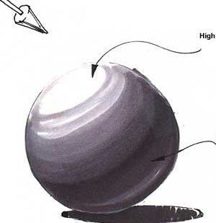
Intersect ray with sphere
Express the sphere in implicit form:
  Centre: c = [ x_{c}, y_{c}, z_{c}, 1]^{T}
  Radius: r
  The sphere is:
    f(x,y,z) = (x-x_{c})² + (y-y_{c})² + (z-z_{c})² – r² = 0
Solve: plug in ray equations for the point (x,y,z):
  (x₀ + x_{d} t - x_{c})² + (y₀ + y_{d} t - y_{c})² + (z₀ + z_{d} t - z_{c})² – r² = 0
  Quadratic in t: solve using quadratic formula
Also calculate normal vector on the sphere

Slide 14
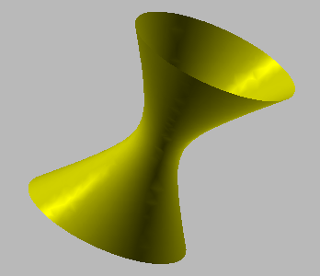
Intersect ray with quadric
A quadric is any surface with an implicit form
    f(x,y,z) = 0
  Where f is a polynomial of order 2 (quadratic)
  Examples: sphere, ellipsoid, cylinder, cone, etc.
Solving for ray-quadric intersection:
  Closed-form quadratic formula
  to solve for t
Intersecting with one quadric
faster than decomposing into
polygons and testing each polygon

Slide 15
Intersect ray with polygon
First intersect ray with the plane containing the polygon
  Implicit form of the plane:
    f(x,y,z) = ax + by + cz – h = 0
  Unit normal vector: n = [ a b c 0 ]^{T}
  Substitute ray equations and solve for t:
    t = - (n*p₀ + h) / n*d (use dot products)
Check if intersection point lies within polygon:
  Project onto 3 planes x=0, y=0, z=0
  Check point-in-polygon in 2D

