Slide 1
Spatial Data Structures
  5 April 2007
  CMPT370
  Dr. Sean Ho
  Trinity Western University

Slide 2
Review last time
Ray tracing
Object-space vs. image-space rendering
Backward ray tracing
  Shadow rays
  Reflection and refraction rays
  Ray-surface intersection
    Parametric surface
    Implicit surface
    Sphere / Quadric
    Polygon

Slide 3
Ray-object intersections
For every ray:
  Find all intersections with all objects
    Choose the closest intersection
  Cast shadow rays to every light
  Cast reflection and refraction rays and recurse
Significant computation work in ray-object intersections!
Speed up ray-object intersection tests:
  Cull away objects that won't be intersected

Slide 4
Spatial data structures
Storing the geometry in a smarter way
Applications:
  Rendering
  Collision detection
    Robotics
    Virtual world / gaming
    Chemical / drug simulation
Object-centred: bounding volumes
Space-subdivision: grid, octree, BSP
Speed-ups of 100x or more!

Slide 5
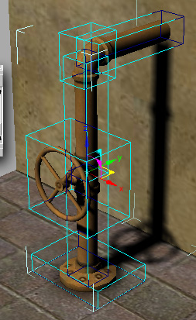
Object bounding volumes
Object-centred data structure
Wrap complex objects in simple ones
  Level of detail
If ray does not intersect bounding
volume, it won't intersect the object
Common types:
  Axis-aligned boxes
  Oriented boxes
  Spheres
  Convex hulls

Slide 6
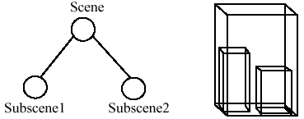
Hierarchical bounding volumes
Straightforward bounding volumes still store objects in a flat list: O(n) intersection tests
Use a tree structure: boxes within boxes
Recursively test for intersections:
  If ray misses large box,
  don't need to descend tree
  If ray hits large box,
  recurse into smaller boxes
Challenges:
  Constructing full balanced tree

Slide 7
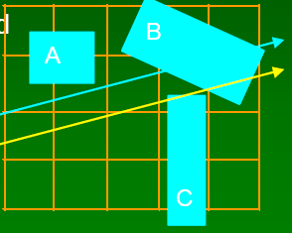
Spatial subdivision: grids
Instead of grouping objects together,
partition space (the view frustum)
Grids: 3D array of cells that tile the space: voxels
Each voxel keeps a list of all surfaces that intersect it
For each voxel intersected by the ray:
  Test intersection with each surface in the voxel
Only good if objects are uniformly spread in space
  Voxels too big => too many surfaces per cell
  Voxels too small => too many empty cells to walk
Try non-uniform cell spacing

Slide 8
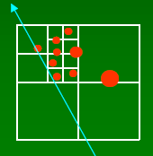
Octrees
In 1D: binary tree
In 2D: quadtree
Each cell (node of tree) is a cube
Recursively split into 8 equal sub-cubes
  Adaptive subdivision: stop dividing based on number of surfaces in the cell
Ray intersection: traverses tree
  Tradeoff: tough to step to next cell along ray

Slide 9
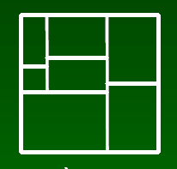
k-d trees and BSP trees
Relaxing the rules on octrees
k-d (k-dimensional) trees:
  Split each cell one dimension at a time
  at arbitrary point within cell
BSP (binary space partitioning) trees:
  Split with plane of any orientation
    In k-dims, split with hyperplane of dimension k-1
  Used for hidden-surface removal
    Painter's algorithm: planes oriented relative to camera

Slide 10
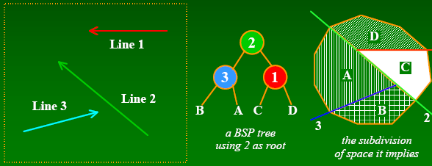
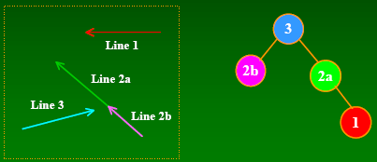
Building balanced trees
Use the objects to guide choice of splitting plane
Example with
simple line
segments
Using Line3 as root
requires splitting Line2
Splitting gives more surfaces but often a more balanced tree

Slide 11
TODO
Lab5 due next Thu 12Apr
  Virtual world
    Creative, interesting scene
    Lights and materials
    Texture map
    Bezier evaluator or NURBS
    Pick objects
  Final deadline for late labs: Thu 19Apr

