Slide 1
Radiosity I
  10 April 2007
  CMPT370
  Dr. Sean Ho
  Trinity Western University
reference:
(J.Stewart / Queen's U)

Slide 2
Review last time
Spatial data structures
  Applications
Object-centric
  Bounding volumes: axis-aligned, oriented, hull
  Hierarchical bounding volumes
Space-subdivision
  Grids
  Octrees
  k-d trees and BSP trees

Slide 3
What's on for today
Radiosity: terminology
  Assumptions
  Solid angles
  Radiometry
  BRDFs
  Albedo
  Radiosity equation
    Form factors

Slide 4
Local vs. global illumination
Local: OpenGL realtime pipeline
  Light/render each object individually
Global: ray tracing
  Image space: render one pixel at a time
  Reflection/refraction
Global: radiosity
  Object space: get colour for each surface patch
    View-independent
    Can then render using OpenGL
  Diffuse surface-to-surface interactions

Slide 5
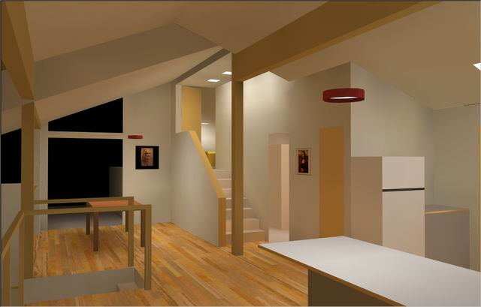
Assumptions for classical radiosity
Model light transfer from one element to another as system of linear equations
Reflection and emission are diffuse (Lambertian)
  Independent of direction
All surfaces opaque
No fog / atmospheric effects
Radiosity is constant across
each surface element
Can solve for R, G, B separately
http://gameprog.it/

Slide 6
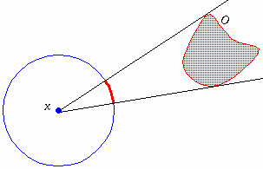
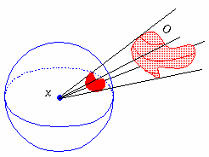
Solid angles (steradians)
In 2D: Angle subtended by an
object O as viewed from x:
  Project object onto unit circle
  Angle in radians, 0 to 2π
In 3D: Solid angle subtended by an
object O as viewed from x:
  Project object onto unit sphere
  Solid angle in steradians, 0 to 4π

Slide 7
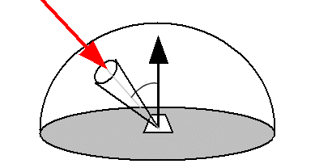
Radiometry terms
Light energy: Q (Joules)
Radiant power: P
  Power = energy / time (W = J/s)
  Rate at which light energy is transmitted
Flux density: Φ
  Radiant power per unit area of the surface (W/m²)
  Irradiance: E
    Flux density incident on surface
  Radiosity: B
    Flux density exitant from surface

Slide 8
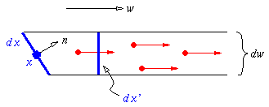
Power at a point in a direction
Flux density at a point x: Φ(x) = dP/dx
Radiant intensity: I
  Power radiated by a point source, per unit solid angle (W/sr)
Radiance L(x,ω):
  Flux density at a point x in a direction ω (W/m²sr)

Slide 9
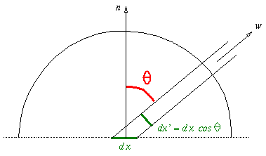
Radiosity vs. radiance
Radiance L(x,ω): in a direction ω
Radiosity B(x): integrate over all exit directions

Slide 10
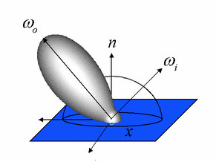
Bidirectional reflectance distribution
The bidirectional reflectance distribution (BRDF) at a point x gives the ratio of
  incoming radiance from one direction ω_{i}
  to outgoing flux density to another direction ω_{o}

Slide 11
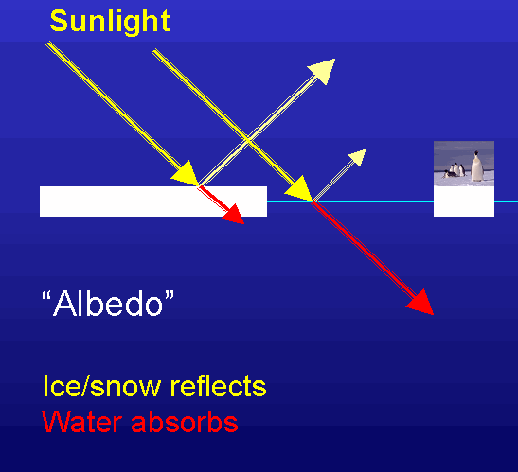
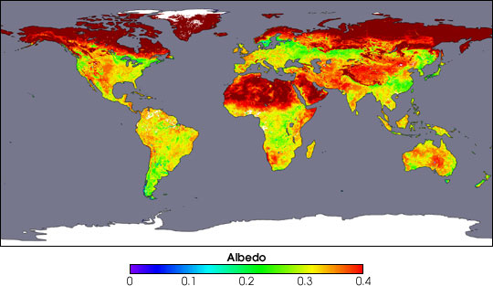
Lambertian BRDFs: albedo
We assume Lambertian surfaces
  Constant BRDFs (independent of direction):
Then the radiosity B(x) and irradiance E(x) (total incoming/outgoing flux density) are proportional:
The ratio ρ = πρ_{BD} is the albedo

Slide 12
Radiosity equation
Interaction between a surface element i and all other surface elements j:
  A_{i}: area of element i (known)
  B_{i}: radiosity of element i (unknown)
  E_{i}: irradiance (emission) of element i (given)
  ρ_{i}: reflectance of element i (given)
  F_{ji}: form factor from j to i (computable)

Slide 13
Form factors F_{ji}
The form factor F_{ji} is the fraction of light leaving element j that arrives at element i
Depends on:
  Shape of the elements i, j
  Relative orientation of the patches
  Distance between the patches
  Occlusion by other patches
Can be computed from the geometry of the scene

Slide 14
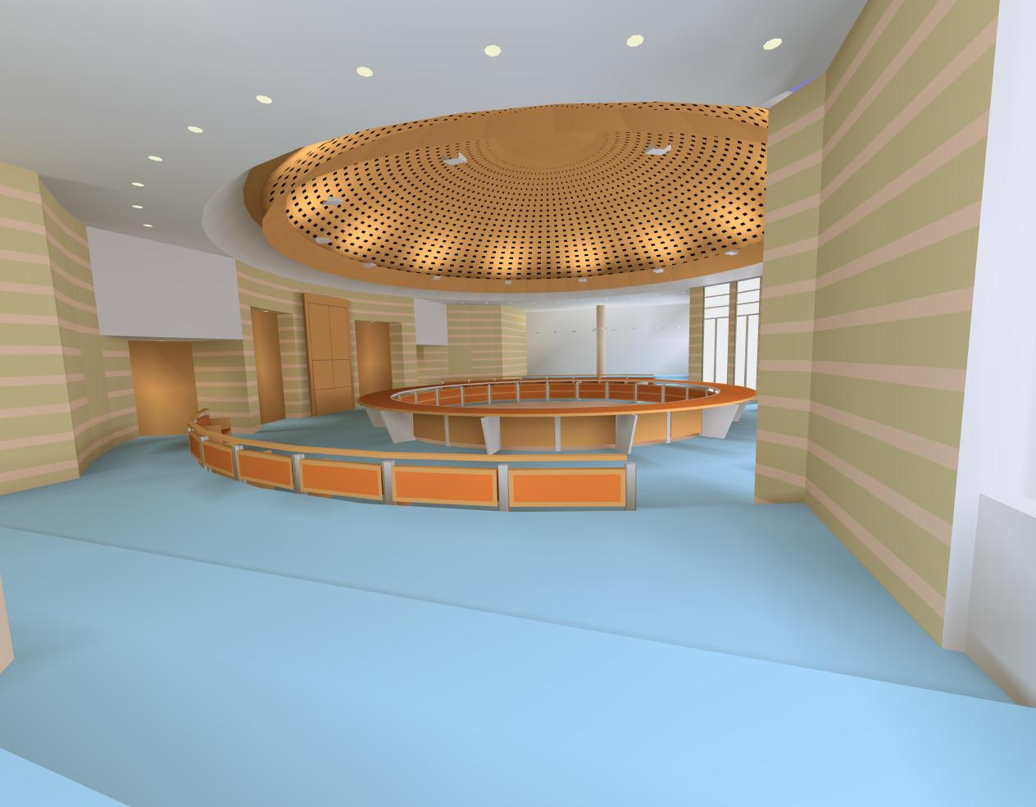
Radiosity pipeline
Compute form factors F_{ji} between all elements
Solve radiosity equation to calculate radiosity of each element
  Very large linear system: iterative solutions
  Radiosity is view-independent
Render final view using OpenGL
  Flat-shaded with colours
  coming from radiosity

Slide 15
TODO
Lab5 due this Thu 12Apr
  Virtual world
    Creative, interesting scene
    Lights and materials
    Texture map
    Bezier evaluator or NURBS
    Pick objects
  Final deadline for late labs: Thu 19Apr

