Slide 1
Radiosity II
  12 April 2007
  CMPT370
  Dr. Sean Ho
  Trinity Western University

Slide 2
Review last time
Radiosity: terminology
  Assumptions
  Solid angles
  Radiometry
  BRDFs
  Albedo
  Radiosity equation
    Form factors

Slide 3
Radiosity equation
Interaction between a surface element i and all other surface elements j:
  A_{i}: area of element i (known)
  B_{i}: radiosity of element i (unknown)
  E_{i}: emissivity of element i (given)
  ρ_{i}: reflectance of element i (given)
  F_{ji}: form factor from j to i (computable)

Slide 4
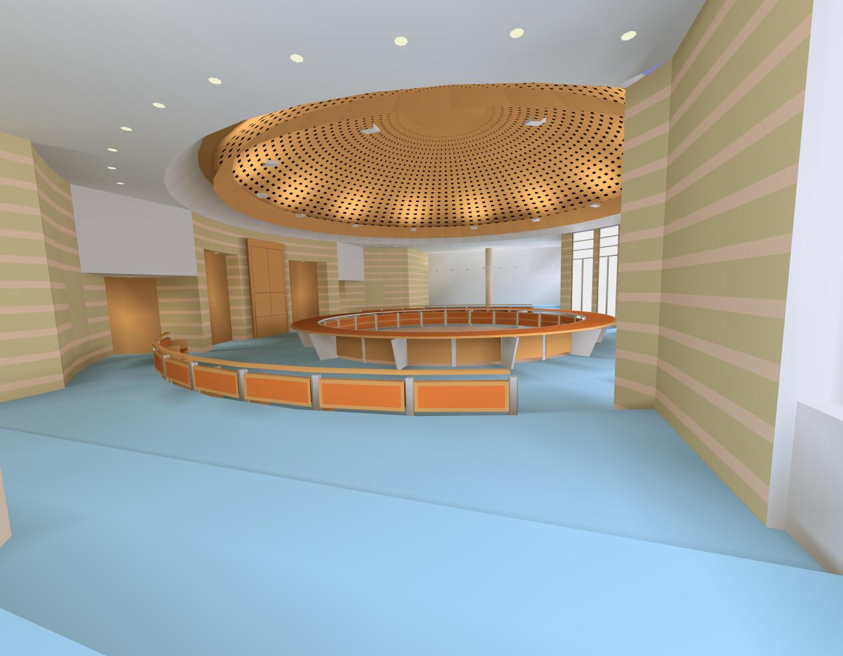
Radiosity pipeline
Split geometry into elements
Compute form factors F_{ji} between all elements
Solve radiosity equation to calculate radiosity of each element
  Very large linear system
  Radiosity view-independent
Render final view with OpenGL
  Flat-shaded using colours
  given by radiosity

Slide 5
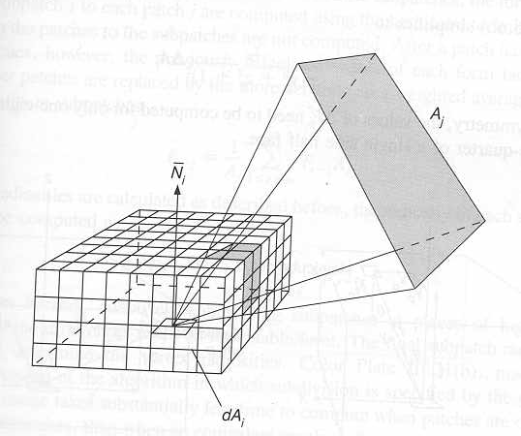
Computing form factors F_{ji}
Finding visiblity of elements j from element i
Hemicube algorithm:
  Render scene onto hemicube about i
  Instead of colour, use
  patch id# j
  Exploits hardware
  z-buffering to resolve
  occlusion

Slide 6
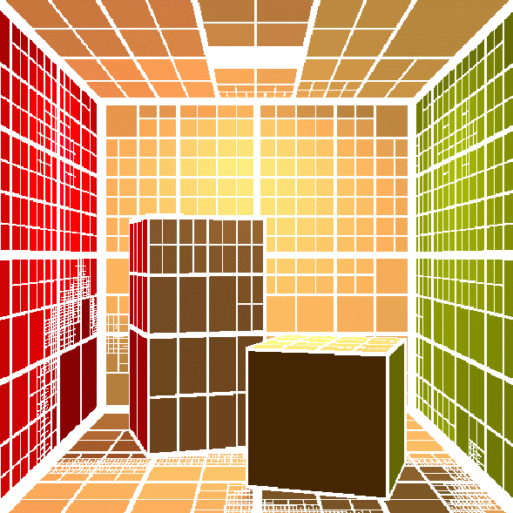
Substructuring
Make distinction between patches and elements:
  Subdivide patches into elements when needed
    Near lights, shadow boundaries
  Skip interaction of elements in same patch
  Compute F_{ji} from elements to other patches
  Other patches find a summary F_{ji}
  to this entire patch
  Complexity: O(m n), where
    m: # patches
    n: total # elements

Slide 7
Progressive solution to radiosity
Iterative solution to global radiosity equation:
Initialize with B_{i}=E_{i} for all emitting elements,
B_{i}=0 for all other elements
  Start with brightest element
  For all other elements, approx B_{j} = ρ_{j}B_{i}F_{ji}(A_{i}/A_{j})
    Shoot light from this source to scene
  Do next brightest elt; iterate to convergence
    Optimization: only iterate over emitting elements

Slide 8
Comparing radiosity + ray tracing
Kinds of light transport
    Diffuse to diffuse (done by radiosity)
    Specular to specular (done by ray tracing)
    Specular to diffuse
    Diffuse to specular
Ray tracing: view-dependent
  Specular to specular
  Light sources to diffuse
Radiosity: view-independent
  Diffuse to diffuse

Slide 9
Specular radiosity
Theoretical extension to include specularity
Diffuse radiosity
  Lambertian surfaces: light scatters isotropically
  Only need to know F_{ji} relationship btwn patches
Specular radiosity
  Full BRDF ρ(ω_{i}, ω_{o}) instead of just albedo
  Global radiosity equation no longer linear
Retains view independence
Generally computationally infeasible

Slide 10
Two-pass radiosity + ray tracing
Radiosity on first pass: view-independent
Enhancements to classical radiosity:
  Translucent surfaces: e.g., windows
    Transmission of both specular and diffuse light
    Include translucency in “window” form factor
  Reflective surfaces: e.g., mirrors
    Create a virtual (mirror-world) environment
    Mirror becomes a window into the reflected world
    Use transmission techniques
Accounts for only one level of reflection

Slide 11
Pass 2: enhanced ray tracing
Ray tracing on second pass: view-dependent
Classical ray tracing only specular-to-specular:
  Reflection ray
  Refraction ray
  Diffuse local illumination
Specular-to-diffuse light transport:
  Diffuse illumination should integrate all incoming light over a hemisphere
  Approximate using a cone about reflection ray
  If surface visible in cone is specular, recurse

Slide 12
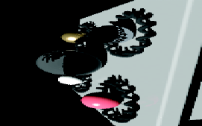
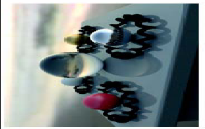
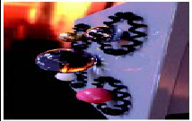
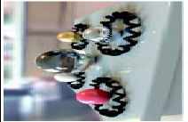
Ray tracing: image-based light
Rays that go to infinity map to sky sphere
Get colour
from
surrounding
image
Often used
with HDR
images

Slide 13
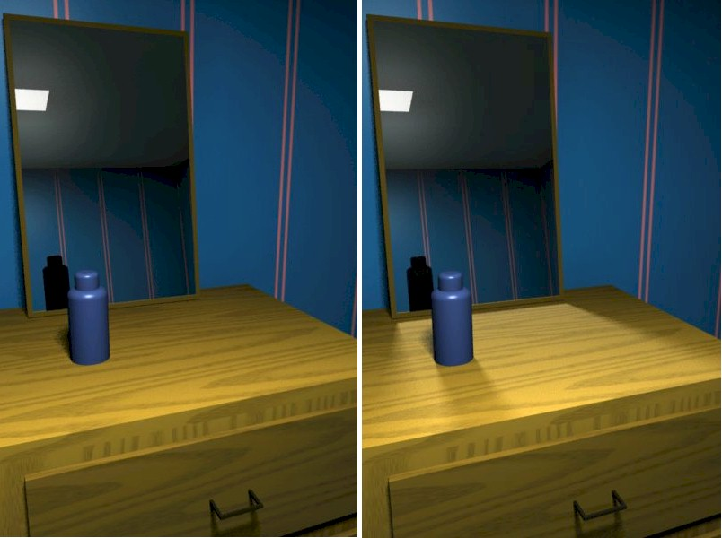
Classical radiosity vs. 2-pass

Slide 14
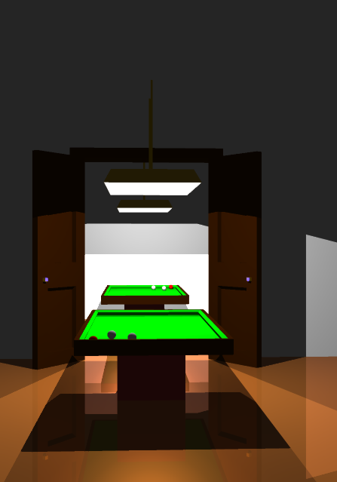
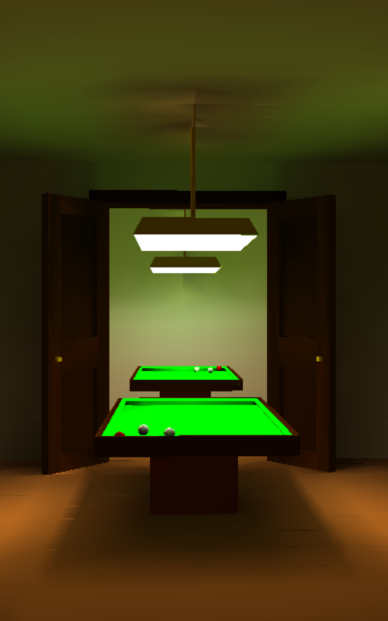
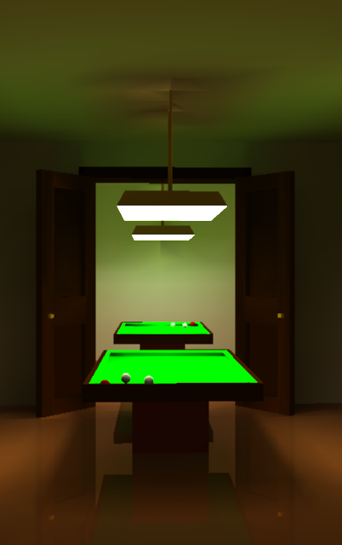
Raytrace vs. radiosity vs. 2-pass
tuwien Austria

Slide 15
TODO
Lab5 due tonight
  Virtual world
    Creative, interesting scene
    Lights and materials
    Texture map
    Bezier evaluator or NURBS
    Pick objects
  Final deadline for late labs: Thu 19Apr

